Slide 1

ProShop Billing Solution
PROJECT BY:
Rohini Jadhav
Deepali Ghumare

Slide 2
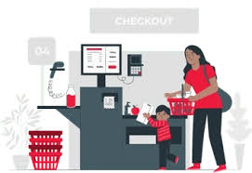
Overview Of the Project
Product Arrival & Database Entry: Upon product arrival, the administrator enters product info, prices into the database.
Customer Shopping Process: Customers select products, place them in their basket, and proceed to the counter.
Bill Calculation & Payment: At the counter, the operator enters product numbers to display info, prices, and calculate the bill. Total payment is shown for customer convenience.
Payment & Packaging: Customers pay for selected products, and all items are packed and delivered to them.

Slide 3



Introduction
Administrator
Billing Operator
Data Entry Operator
Product management and reporting.
Offline billing for customers
Database maintenance tasks.

Slide 4
Objectives
The application provides the user a quick response with very accurate information regarding the bill calculation and customer detail.
All the Billing details stored permanently in the database admin can see the data, whenever needed.

Slide 5
Header files included
#include <iostream>
#include <string>
#include <vector>
#include <fstream>
#include <mysql.h>
#include <mysqld_error.h>
#include <string>
#include <sstream>
#include <limits>

Slide 6
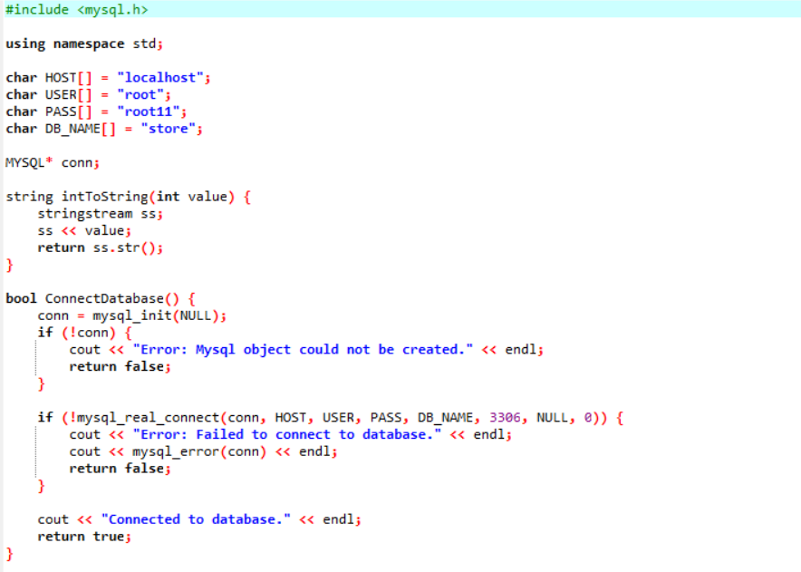
Connection with MySQL

Slide 7
Key Points
Inheritance: In the Program Bill Operator classes and other classes are inherits from the admin class.
class data : public admin{};
Abstraction: here abstraction concept that helps us manage complexity, improve code maintainability, and facilitate code reuse.
Encapsulation: Encapsulation is a programming concept that involves bundling data and the methods that operate on that data into a single unit, known as a class.

Slide 8
Vector: The program uses the vector container from the C++ Standard Library to store the selected items in the order. It provides functionality for adding and removing items from the order.
vector<Bill*> bills
File Handling: The program uses file handling to generate a receipt and save it as a text file. It creates an output file stream and writes the selected items and their prices to the file.

Slide 9
Conclusion:
The system helps manage supermarket transactions easily.
It lets users like administrators and billing operators handle tasks such as adding products, processing orders, and making bills.
The system is user-friendly, making it simple for anyone to use. By using basic programming concepts, like classes and databases, it shows how to solve real-life problems.
Its flexible design allows for easy changes to fit different needs in a supermarket.

Slide 10
Thank you

