Slide 1

PharmaGuard
Drug Safety Signal Detection & Regulatory Readiness Assistant
Turning complex pharmacovigilance data into actionable safety signals and submission-ready insights.
Team: Infinite Developers
Infinite Developers
01
Notes:
Welcome to PharmaGuard. We are InfiniteDevelopers, and today we're presenting a solution for one of the most critical challenges in the pharmaceutical industry: drug safety and regulatory readiness. PharmaGuard is designed to turn complex pharmacovigilance data into actionable safety signals and submission-ready insights.

Slide 2

The Pharmacovigilance Decision Bottleneck
Data Overload
Pharmaceutical safety data is massive and unstructured, making manual analysis slow and prone to oversight.
Massive Safety Data
Signal Identification
↓
Early safety signals are often buried in noise, delaying critical risk mitigation and regulatory reporting.
Manual Analysis Challenge
Regulatory Complexity
Readiness requires cross-referencing multiple CTD modules, leading to inconsistent and time-consuming checks.
↓
Delayed & Complex Decision Making
02
Notes:
The core problem we address is the pharmacovigilance decision bottleneck. Safety data is massive and unstructured, making manual analysis slow and prone to oversight. Early signals are often buried in noise, and regulatory readiness requires cross-referencing multiple complex modules, leading to inconsistency and delays.

Slide 3
One Workflow from Safety Data to Action
📥
🔍
📊
🤖
📋
📈
→
→
→
AI-Assisted Insights
→
Regulatory Readiness
→
Actionable Dashboard
Safety Data Input
Signal Detection
Risk Analysis
Automated Signal Identification
Regulatory Gap Analysis
PharmaGuard uses statistical PRR and Chi-square logic to instantly flag disproportionate reporting patterns in adverse event data.
The system maps submitted dossiers against CTD structures, identifying missing critical modules to ensure submission readiness.
03
Notes:
PharmaGuard provides a unified workflow. From safety data input, we automate signal detection and risk analysis. We've built an AI-assisted insight boundary that leads into regulatory readiness checks, all surfaced through an actionable dashboard for pharmacovigilance teams.

Slide 4
System Architecture: Transparent, Browser-Based Logic
User / Safety Data (CSV/Text)
FRONTEND & LOGIC
ANALYTICAL ENGINE
↓
JavaScript (ES6+)
PRR Calculation Logic
PharmaGuard Application (UI)
HTML5 / CSS3
Chi-Square Statistics
PapaParse (CSV Parsing)
Trend Analysis Engine
↓
Chart.js (Visualization)
CTD Readiness Mapper
Data Processing & Signal Detection
REPORTING
AI LAYER (PLANNED)
jsPDF (PDF Generation)
IBM watsonx.ai Integration
↓
CSV Export Engine
Natural Language Insights
Risk / Statistical Analysis
↓
Dashboard / Regulatory Output
04
Notes:
Our architecture is transparent and browser-based. We process CSV and text data directly in the application, applying PRR and Chi-square statistics for signal detection. The tech stack includes JavaScript, PapaParse for data handling, and Chart.js for visualization, with a planned integration layer for IBM watsonx.ai.

Slide 5
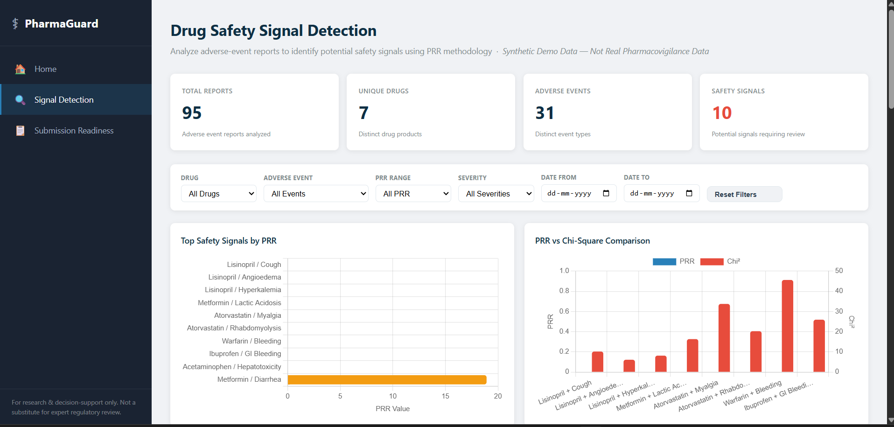
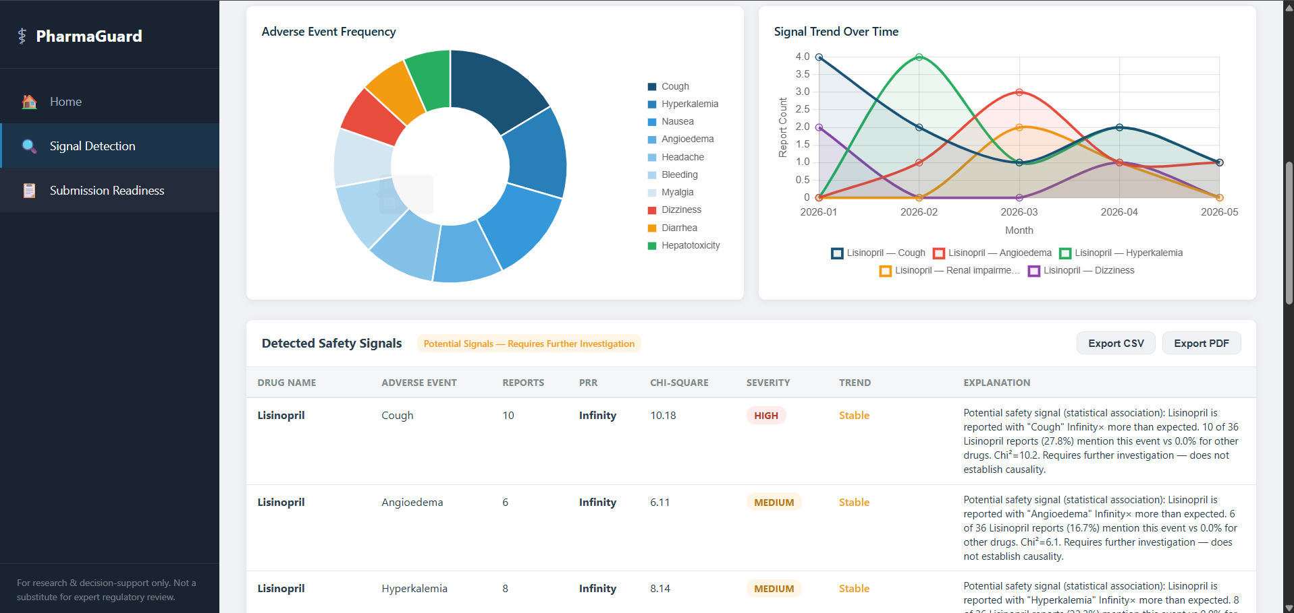
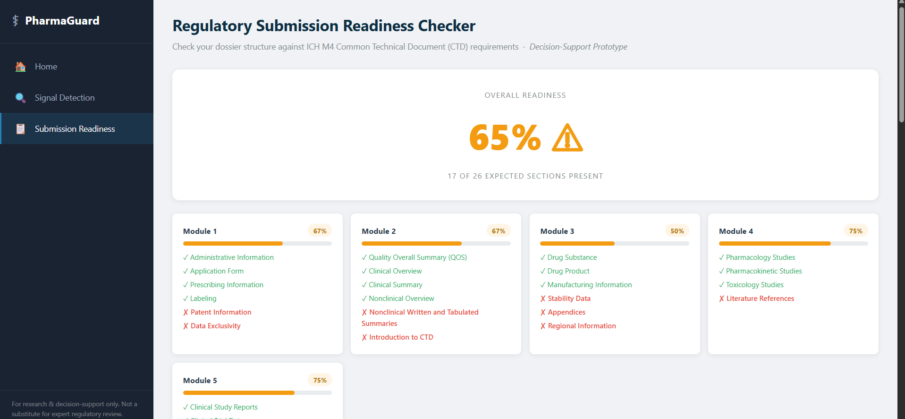
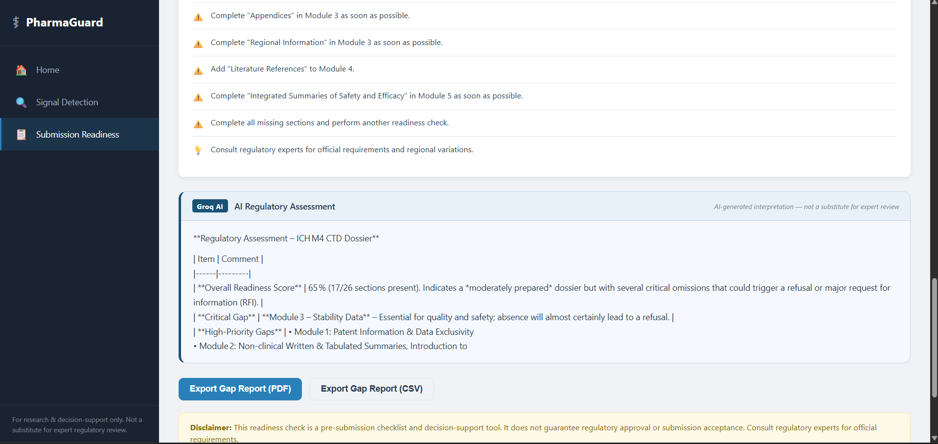
Demo / Key Feature
Drug
Event
PRR
Severity
MED
HIGH
05
Notes:
Here is the working prototype. On the left, you see our safety signal dashboard flagging disproportionate reporting patterns. On the right, our regulatory readiness mapper identifies critical gaps in CTD modules, such as missing stability data or clinical study reports, with an overall readiness score.

Slide 6
IBM Technologies
Current implementation boundary and planned IBM AI contribution
Implemented in the supplied prototype
Rule-based analytical engine
JavaScript (ES6+) application logic
PRR and Chi-square calculations
HTML5 / CSS3 interface
Threshold-based severity scoring
PapaParse for CSV parsing
Increasing / Decreasing / Stable trend logic
Chart.js for dashboard visualization
CTD completeness and gap analysis
jsPDF and CSV export utilities
IBM BOB AI / watsonx.ai
Transparency principle
Not evidenced as an active API integration in the supplied code.
Statistical results remain explainable and reviewable.
Planned layer for natural-language interpretation and dossier synthesis.
AI should support user decisions, not replace clinical or regulatory review.
Future scope, not a current implementation claim.
Important: The current prototype is primarily rule-based/statistical. IBM BOB AI / watsonx.ai is positioned as a future extension rather than claimed as an already-connected service.
06
Notes:
We want to be transparent about our AI integration. The current prototype uses robust statistical logic for signal detection, including PRR and trend analysis. We've identified IBM watsonx.ai as the strategic layer for the future, where it will interpret these statistical findings into natural language insights and automate dossier synthesis.

Slide 7
Impact, Feasibility & Future Scope
⚡
🛠️
🚀
IMPACT
FEASIBILITY
FUTURE SCOPE
Rapid identification of potential safety signals.
Lightweight, browser-based architecture.
Integration with real-world FDA/EMA datasets.
Enhanced decision support for PV teams.
Modular design for easy feature expansion.
Advanced IBM watsonx.ai insight generation.
Reduced manual effort in data normalization.
Integrates with standard CSV safety data.
Automated regulatory document drafting.
Improved visibility into safety trends.
Scalable AI layer for future insights.
Continuous real-time safety monitoring.
07
Notes:
PharmaGuard delivers immediate impact through rapid signal identification and reduced manual effort. It is highly feasible due to its lightweight, modular architecture. Looking ahead, we plan to integrate real-world FDA datasets and full IBM watsonx.ai insight generation.

Slide 8
Team
Infinite Developers
Team Leader: Preet Mali
TEAM MEMBER: Deep Lalwani
[ROLE / AREA]
[ROLE / AREA]
Built: Data and Backend
Built: AI/ML + PRR/Statistics
TEAM MEMBER: Mann Mahant
TEAM MEMBER: Hoshil Chovatiya
[ROLE / AREA]
[ROLE / AREA]
Built: Regulatory/CTD logic
Built: UI + Integration + Demo
PharmaGuard — Turning drug safety data into actionable intelligence.
Infinite Developers
08
Notes:
We've grounded our work in ICH M4 and FDA standards. PharmaGuard is about turning drug safety data into actionable intelligence. We are InfiniteDevelopers, and you can find our work at the link below. Thank you.

