Slide 1

Date-A-Scientist
Machine Learning Fundamentals
Julien AMAR
11/11/2018

Slide 2
Table of Contents
Exploration of the Dataset
Question(s) to Answer
Augmenting the Dataset
Regression Approaches
Classification Approaches
Conclusions/Next steps

Slide 3
Exploration of the Dataset
Raw dataset mix different type of data (numerical, enumeration, iterable, date & free text…)
Some features, mix several purposes
(by example: pets could be decomposed on : cat_preference & dog_preferences)
Some features lead to meta data extractions
(by exemple, a straight female, is looking for a man)

Slide 4
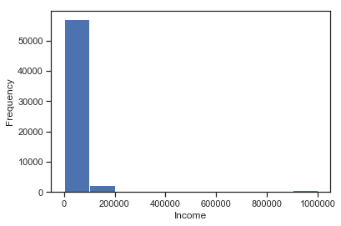
Question(s) to Answer
# Graph height repartition
plt.hist(df.income, bins=10)
plt.xlabel("Income")
plt.ylabel("Frequency")
plt.show()
# Load dataset
df = pd.read_csv("profiles.csv")
# Analyze numeric repartition
df.describe()
 | age | height | income
count | 59946 | 59943 | 59946
mean | 32.34 | 68.29 | 20033.22
std | 9.45 | 3.99 | 97346.19
min | 18 | 1 | -1
25% | 26 | 66 | -1
50% | 30 | 68 | -1
75% | 37 | 71 | -1
max | 110 | 95 | 1000000
QUESTION: As current income values are irrelevant, can we predict it ?

Slide 5
Augmenting the Dataset
There is 6 type of columns (for a total of 31 columns) in the dataset:
Columns that does not need augmentation
Columns that need to be mapped
Columns that need to be decomposed into several features
Some columns carry multiple traits and should be decomposed.
Columns that would represent a trait (described by the free text analysis)
Unusable columns (as there is no linear correlation between all the values available in this columns)
Combining columns could lead to data augmentation

Slide 6
Augmenting the Dataset
Columns that does not need augmentation
Age, Height, Income (usable as they are)
However, it is important to consider income column data quality.
More than 80% of the values are set to “-1” (unknown)

Slide 7
Augmenting the Dataset
# By example, mapping “Drinks” column
mapping_drinks = {
'not at all': 0.,
'rarely': 1.,
'socially': 2.,
'often': 3.,
'very often': 4.,
'desperately': 5.
}
# Map df.drinks values using mapping_drinks in drinks_code column
df["drinks_code"] = df.drinks.map(mapping_drinks)
Columns that need to be mapped
Body_type Can be map to values from 0 to 11
Drinks Can be map to values from 0 to 5
Drugs Can be map to values from 0 to 2
Education Can be mapped to the number of years spent that led to a diploma
Last_online Can be map to values representing the number of day since last connection
Orientation Can be map to values: 0 (straight), 0.5 (bisexual), 1 (gay)
Sex Can be map to values from 0 to 1
Smokes Can be map to values from 0 to 1
Status Can be map to values from -1 (married, seeing someone), 0 (unknown) , 1 (single, available)

Slide 8
Augmenting the Dataset
Columns that need to be decomposed into several features
Diet Can be split over 6 features, each of it having a value from 0 to 3: anything, vegetarian, other, vegan, kosher, halal
Ethnicity Can be split over 10 features, each of it being a Boolean (0 or 1): white, asian, hispanic, latin, black, other, indian, pacific islander, native american, middle eastern
Location Can be split over 41 features: Each feature representing a state
Offspring Can be split over 3 features, each of it being a Boolean (0 or 1): want kids, does not want kids & had kids
Pets Can be split over 2 features, each of it having values: -1 (dislike), 0 (no preference), 1 (like or has): cat_preference & dog_preference
Religion Can be split over 9 features, each of it having a value, representing how serious religion is important (from 0 to 5): Each feature represents a religion
Sign Can be split over 12 features, each of it having a value, representing how serious astrology is important (from 0 to 4): Each feature represents a zodiac sign
Speaks Can be split over 77 features, , each of it having a value, repsenting how fluent (from 0 (none), 0.5 (poorly), 1 (okey), 1.5 (fluent): Each feature represents a spoken language
# By example, mapping “speaks” column
def get_language_level(language):
def find_level(row):
speak = str(row.speaks)
for level in speak.split(','):
if language in level:
if "poorly" in speak:
return 0.5
if "okay" in speak:
return 1.
if "fluently" in speak:
return 1.5
return 1
return 0.
return find_level
# Map df.speaks values using get_language_level
languages = ['afrikaans’, …, 'vietnamese', 'welsh', 'yiddish’]
for language in languages:
df[language + '_code'] = df.apply(get_language_level(language), axis=1)

Slide 9
Augmenting the Dataset
Columns that would represent a trait
Essay 0..9 (each essay must be interpreted according to the question asked)
Unusable columns
Job (this feature is hard to map as there is no linear correlation between each job category)
Combining columns could lead to data augmentation
# By example, of combining columns to augment our dataset
def get_matching_gender(row):
if (row.sex == 'm') & (row.orientation == 'straight'): return 0.
elif (row.sex == 'm') & (row.orientation == 'bisexual'): return .5
elif (row.sex == 'm') & (row.orientation == 'gay'): return 1.
elif (row.sex == 'f') & (row.orientation == 'straight'): return 1.
elif (row.sex == 'f') & (row.orientation == 'bisexual'): return .5
elif (row.sex == 'f') & (row.orientation == 'gay'): return 0.
# Map df.sex & df.orientation into the type of gender they are looking to
df["gender_code"] = df.apply(get_matching_gender, axis=1)

Slide 10
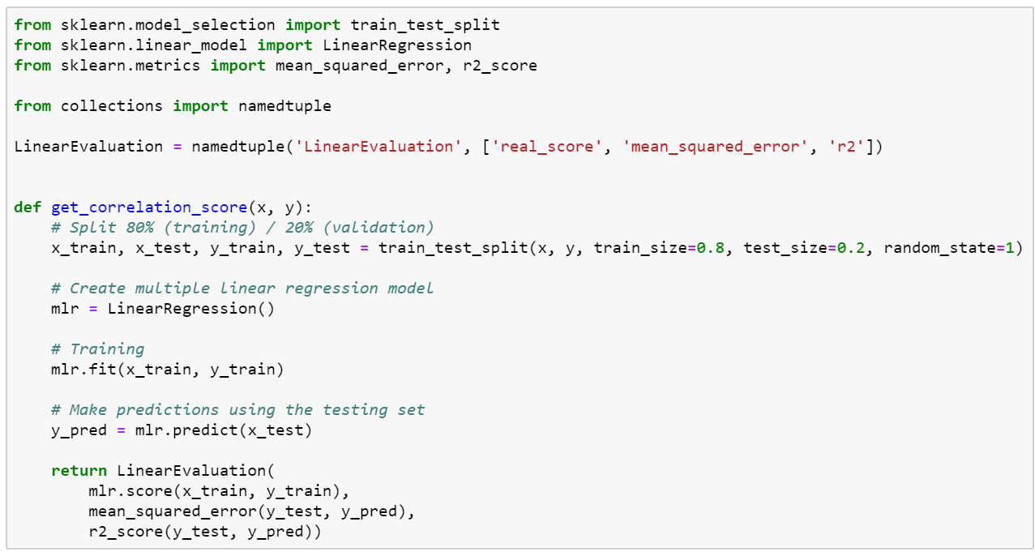
Regression Approaches (1/2)
We will use a Linear & MultiLinear Regression to check correlation between our 2 features (age & level of education) vs Income

Slide 11
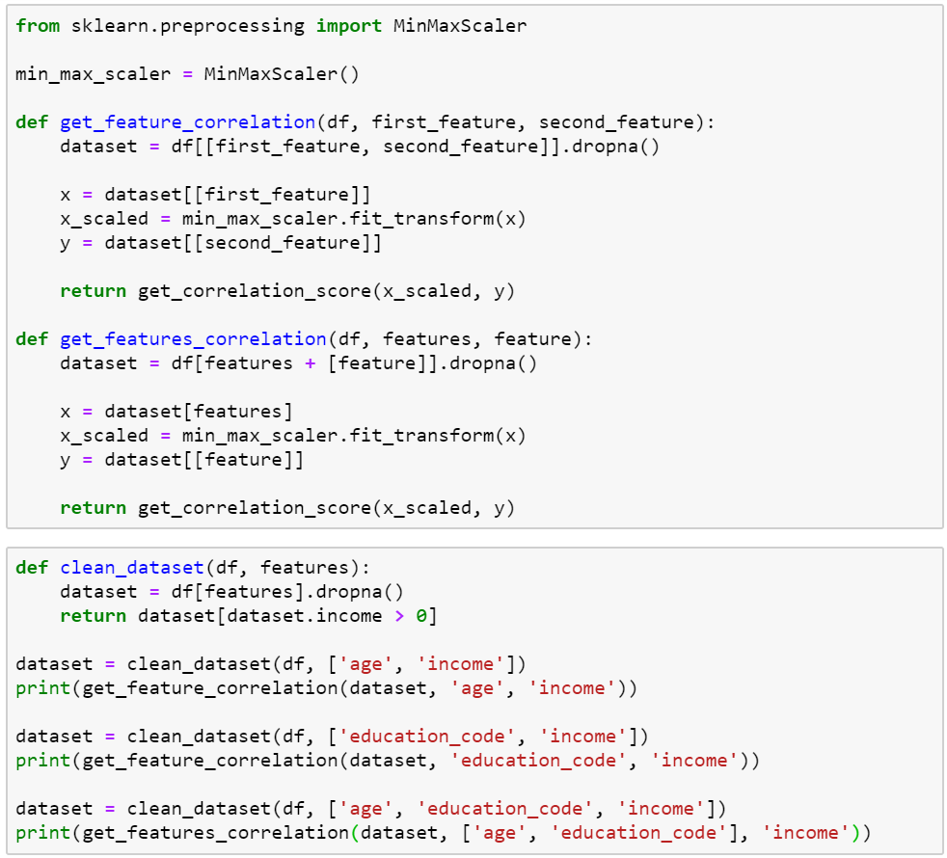
Regression Approaches (1/2)
Age vs Income
real_score=1.2893057174778731e-05
mean_squared_error=40551054875.32619
r2=0.0001940218951941297
Level of education vs Income
real_score=0.012194285283103068
mean_squared_error=39287104165.13057
r2=0.017308507450450317
Age & Level of education vs Income
real_score=0.015227149018885668
mean_squared_error=39266278536.23242
r2=0.01782942057907355

Slide 12
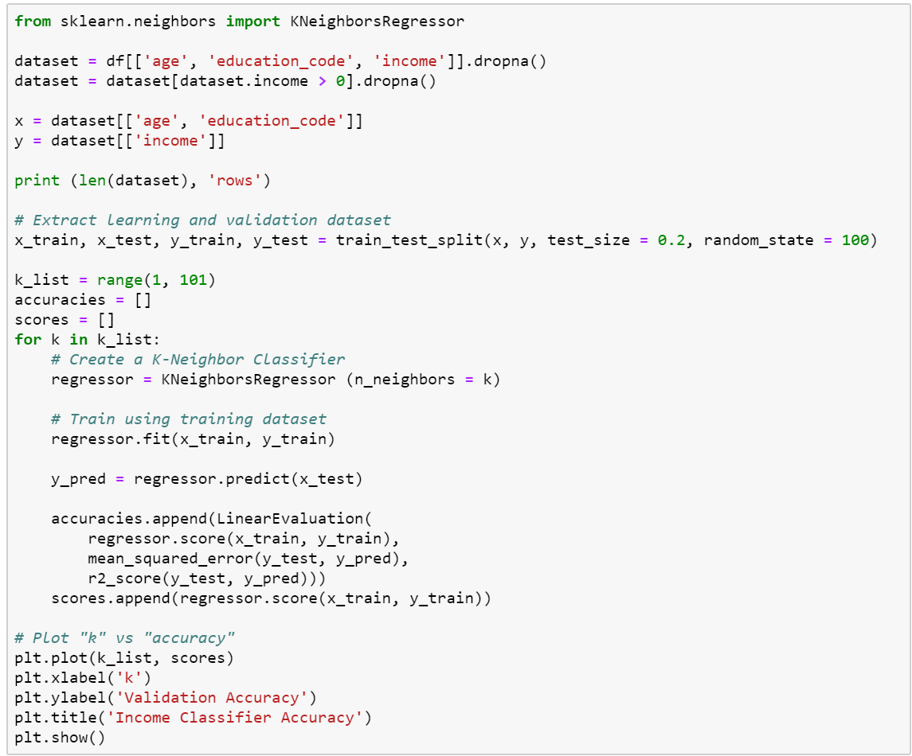
Regression Approaches (2/2)
We will use a K- neighbors Regression to check correlation between our 2 features (age & level of education) vs Income

Slide 13
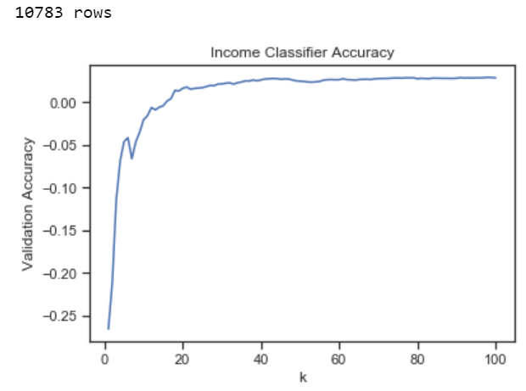
Regression Approaches (2/2)
Results seems a bit better (with 30 neighbors), but are still not good enough, we would need a accuracy at least 0.7

Slide 14
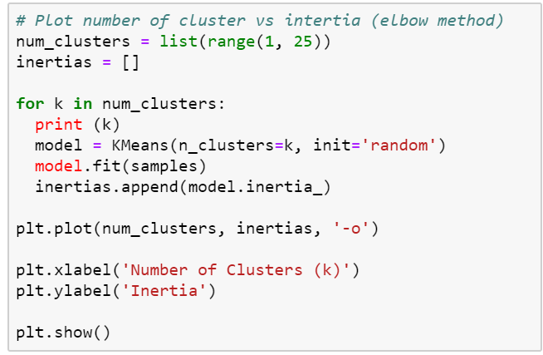
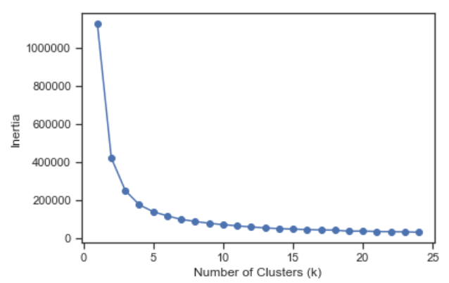
Classification Approaches
Applying K-Means enables to cluster our data in an unsupervised way.
Inertia is getting acceptable around 7 clusters

Slide 15
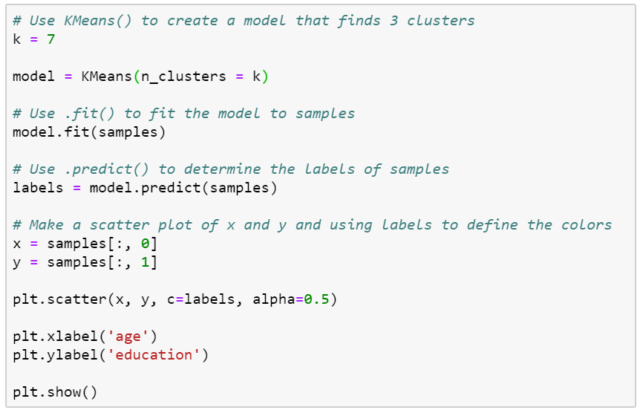
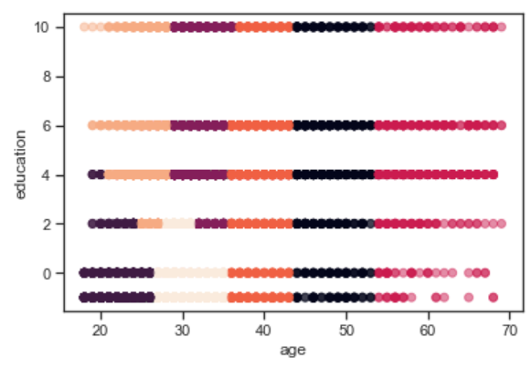
Classification Approaches
Let’s visualize repartition using 7 clusters

Slide 16
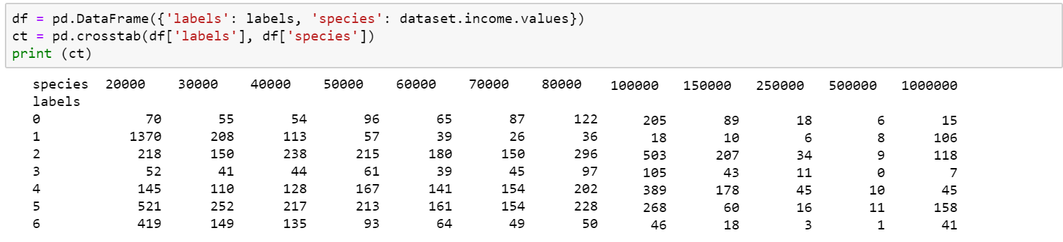
Classification Approaches
When analyzing repartition, we only notice that the second cluster had a high number of low income values(cluster #1)

Slide 17
Conclusions/Next steps
The score of both linear regression & K-Near Neighbor is pretty low, indicating that there is no correlation between age and/or level of education vs income.
The clusterization does not enable to identify income ranges correlated to age & level of education.
We can conclude that those features are not correlated.

