Slide 1
SQL

Slide 2
Objectives
SQL Sublanguages
DDL
DML
DQL
View
User

Slide 3
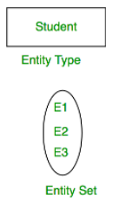
ER - Model
Introduction of ER Model
ER Model is used to model the logical view of the system from data perspective which consists of these components:
Entity,
Entity Type,
Entity Set
An Entity may be an object with a physical existence – a particular Student, person, car, house, or employee – or it may be an object with a conceptual existence – a company, a job, or a university course.
An Entity is an object of Entity Type and set of all entities is called as entity set.
e.g.; E1 is an entity having Entity Type Student and set of all students is called Entity Set. In ER diagram, Entity Type is represented as:

Slide 4

ER - Model
Attribute(s):
Attributes are the properties which define the entity type. For example, Roll_No, Name, DOB, Age, Address, Mobile_No are the attributes which defines entity type Student. In ER diagram, attribute is represented by an oval.
Types of Key Attribute
Key Attribute
Composite Attribute –
Multivalued Attribute –
Derived Attribute –
1. Key Attribute – The attribute which uniquely identifies each entity in the entity set is called key attribute.For example, Roll_No will be unique for each student. In ER diagram, key attribute is represented by an oval with underlying lines.

Slide 5
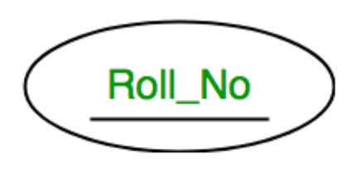
ER - Model
Key Attribute – The attribute which uniquely identifies each entity in the entity set is called key attribute. For example, Roll_No will be unique for each student. In ER diagram, key attribute is represented by an oval with underlying lines.

Slide 6
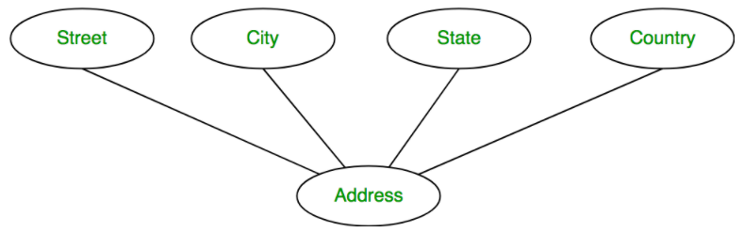
ER - Model
Composite Attribute – An attribute composed of many other attribute is called as composite attribute. For example, Address attribute of student Entity type consists of Street, City, State, and Country. In ER diagram, composite attribute is represented by an oval comprising of ovals.

Slide 7
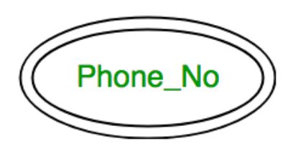
ER - Model
Multivalued Attribute – An attribute consisting more than one value for a given entity. For example, Phone_No (can be more than one for a given student). In ER diagram, multivalued attribute is represented by double oval.

Slide 8
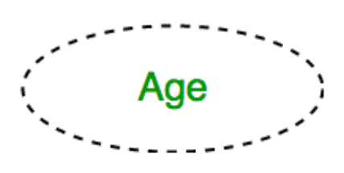
ER - Model
Derived Attribute – An attribute which can be derived from other attributes of the entity type is known as derived attribute. e.g.; Age (can be derived from DOB). In ER diagram, derived attribute is represented by dashed oval.

Slide 9
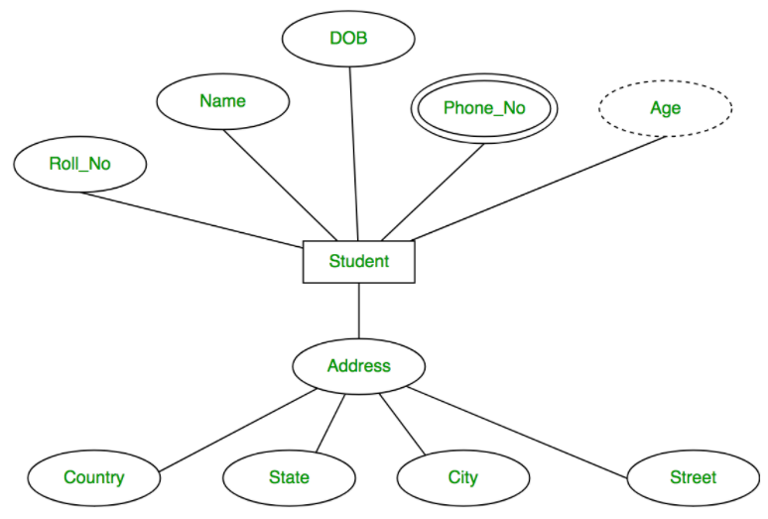
ER - Model
The complete entity type Student with its attributes can be represented as:

Slide 10
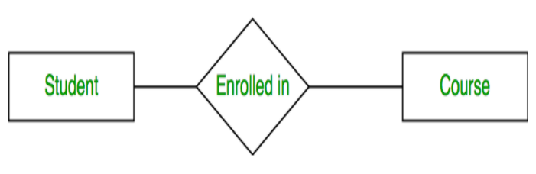
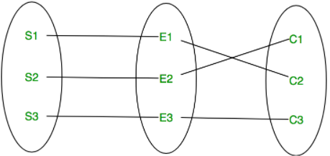
ER -Model
Relationship Type and Relationship Set:
A relationship type represents the association between entity types. For example, ‘Enrolled in’ is a relationship type that exists between entity type Student and Course. In ER diagram, relationship type is represented by a diamond and connecting the entities with lines.
A set of relationships of same type is known as relationship set. The following relationship set depicts S1 is enrolled in C2, S2 is enrolled in C1 and S3 is enrolled in C3.

Slide 11
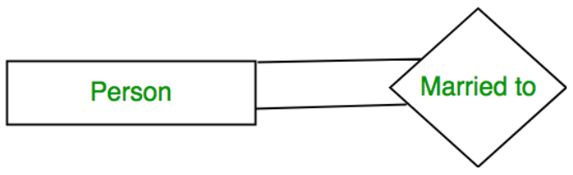
Degree of a relationship set:
The number of different entity sets participating in a relationship set is called as degree of a relationship set.
1. Unary Relationship – When there is only ONE entity set participating in a relation, the relationship is called as unary relationship.
For example, one person is married to only one person.

Slide 12
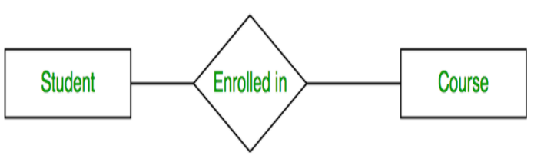
Degree of a relationship set:
2. Binary Relationship – When there are TWO entities set participating in a relation, the relationship is called as binary relationship.
For example, Student is enrolled in Course.
3. n-ary Relationship – When there are n entities set participating in a relation, the relationship is called as n-ary relationship.

Slide 13
Cardinality in ER-model
The number of times an entity of an entity set participates in a relationship set is known as cardinality. Cardinality can be of different types:
One to one
Many to one
Many to many

Slide 14
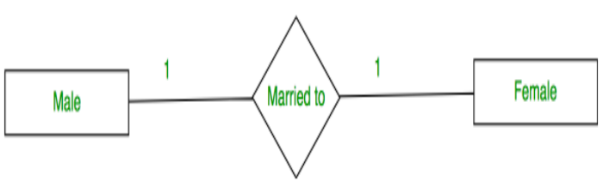
Cardinality in ER-model
One to one
When each entity in each entity set can take part only once in the relationship, the cardinality is one to one. Let us assume that a male can marry to one female and a female can marry to one male. So the relationship will be one to one.

Slide 15
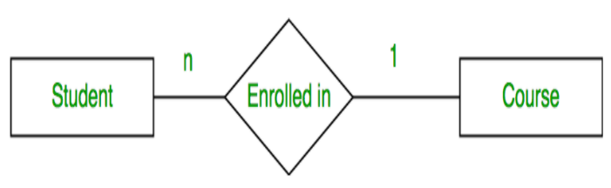
Cardinality in ER-model
Many to one –
When entities in one entity set can take part only once in the relationship set and entities in other entity set can take part more than once in the relationship set, cardinality is many to one. Let us assume that a student can take only one course but one course can be taken by many students. So the cardinality will be n to 1. It means that for one course there can be n students but for one student, there will be only one course.

Slide 16
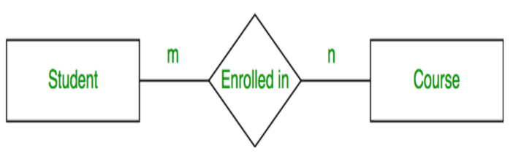
Cardinality in ER-model
Many to many –
When entities in all entity sets can take part more than once in the relationship cardinality is many to many. Let us assume that a student can take more than one course and one course can be taken by many students. So the relationship will be many to many.

Slide 17
ER-model - Activity
We have to consider an application that is amazon
Consider there is database of amazon which having Entities are as follows –
Customer →
custId – primary key
custName
custAddress – composite key
custPhone –
Products →
prod_Id – primary key
prod_Name
prod_price
prod_Category
Order
order_id –primary key
order_Date
order_Price.
cust_id – foreign key
Consider following point
One Customer can buy many products
One product purchase can have one orderDetails
One Product can be buy by many customer

Slide 18
SQL

Slide 19
What is SQL?
SQL is a standard language for accessing and manipulating databases.
What Can SQL do?
SQL can execute queries against a database
SQL can retrieve data from a database
SQL can insert records in a database
SQL can update records in a database
SQL can delete records from a database
SQL can create new databases
SQL can create new tables in a database
SQL can create stored procedures in a database
SQL can create views in a database
SQL can set permissions on tables, procedures, and views

Slide 20
Sub language in sql
SQL (Structured Query Language) statements are classified in various ways, which can be grouped into sublanguages, commonly:
data query language(DQL)
data definition language (DDL)
data control language(DCL)
data manipulation language(DML)

Slide 21
Data types in sql
String Data Types
Data type | Description
CHAR | A FIXED length string (can contain letters, numbers, and special characters). The size parameter specifies the column length in characters - can be from 0 to 255. Default is 1
VARCHAR(size) | A VARIABLE length string (can contain letters, numbers, and special characters). The size parameter specifies the maximum column length in characters - can be from 0 to 65535
LONGTEXT | Holds a string with a maximum length of 4,294,967,295 characters
NVARCHAR(MAX) | n in nvarchar stands for Unicode characters, ex. Characters apart from English.

Slide 22
Data types in sql
Numeric Data Types
Data type | Description
INT(size) | A medium integer. Signed range is from -2147483648 to 2147483647. Unsigned range is from 0 to 4294967295. The size parameter specifies the maximum display width (which is 255)
BIGINT(size) | A large integer. Signed range is from -9223372036854775808 to 9223372036854775807. Unsigned range is from 0 to 18446744073709551615. The size parameter specifies the maximum display width (which is 255)
FLOAT(size) | A floating point number. The total number of digits is specified in size.
DOUBLE(size) | A normal-size floating point number. The total number of digits is specified in size.

Slide 23
Data types in sql
Date and Time Data Types
Data type | Description
DATE | A date. Format: YYYY-MM-DD. The supported range is from '1000-01-01' to '9999-12-31'
DATETIME(fsp) | A date and time combination. Format: YYYY-MM-DD hh:mm:ss. The supported range is from '1000-01-01 00:00:00' to '9999-12-31 23:59:59'. Adding DEFAULT and ON UPDATE in the column definition to get automatic initialization and updating to the current date and time
TIME(fsp) | A time. Format: hh:mm:ss. The supported range is from '-838:59:59' to '838:59:59'
YEAR | A year in four-digit format. Values allowed in four-digit format: 1901 to 2155, and 0000.

Slide 24
Data sub language
SQL Queries Categories -
Data Definition Lang. (DDL) | Data Manipulation (DML) | Data Control (DCL) | Data Query Language (DQL)
Deals with Database, How data will resides | Deals with data manipulation, very common operations | Deals with control system of database like grant, revoke | Deals with querying database
Create Alter Drop | Insert Update Delete | Grant Invoke | select

Slide 25
DDL (Data definition language)
There are three keywords use for data definition language.
Create
Alter
Drop
Create →
It is use to create database and table into database.
Syntax
Create database database_Name;
Create table table_Name{
Attributes……..
}

Slide 26
Ddl (Data definition language)
Alter →
Add Column- alter table Customer add custAddress varchar(50); this will add a column custAddress in Customer table.
Drop Column- alter table Customer drop custAddress; this command will delete column custAddress in Customer table.
Alter Column- alter table Customer modify custName nvarchar(50); this command will modify data type of custName from varchar(50) to nvarchar(50).

Slide 27
Ddl (Data definition language)
Drop- Drop table is command use to drop specific table from given database.
drop table Customer; → It will delete table
TRUNCATE TABLE
The TRUNCATE TABLE command deletes the data inside a table, but not the table itself.
TRUNCATE TABLE tableName; -> delete all data in table.

Slide 28
Constraints
These are set of rule applied on table in order to perform insert, update ,delete commands.
Define constraint at column or table level.
Constraint can be defined at the time of creation or can be created using alter.
There are three types of constraints
Primary Key
Foreign Key
Unique

Slide 29
Constraints
Primary Key → A primary key, also called a primary keyword, is a key in a relational database that is unique for each record. It is a unique identifier
we can simply add primary key constraints using three ways

Slide 30
Constraints
Primary Key →
we can simply add primary key constraints using three ways
----------way 1-------------------
create table emp(
empId int primary key, (at the time of creation )
empName varchar(50)
);
----------way 2-------------------
create table emp2(
empId int not null,
empName varchar(50),
primary key(empId) (at the time of creation)
);

Slide 31
Constraints
Primary Key →
----------way 3-------------------
create table emp3(
empId int not null,
empName varchar(50)
);
alter table emp3 add constraint emp_pri primary key (empId); alter

Slide 32
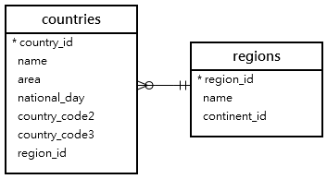
Constraints
Foreign Key →
A foreign key is a column or group of columns in a relational database table that provides a link between data in two tables. It acts as a cross-reference between tables because it references the primary key of another table

Slide 33
Constraints
Foreign Key →
create table Customer(
custId int primary key,
custName nvarchar(50)
);
create table orderDetails
(
orderId int primary key,
orderPrice double,
custId int,
constraint fk_key foreign key(custId)references Customer(custId));
);
alter table orderDetails
add constraint my_fKey foreign key(custId)references Customer(custId));

Slide 34
Constraints
Unique constraint→
Difference between unique and primary key is that primary key doesn't allow null but unique key allows null once.
We can create any column as unique key column just by simply adding unique keyword.
create table cust(
cId int primary key,
cName varchar(50) not null unique
);
alter table cust add constraint myUn unique (cName );

Slide 35
Creating Views :
View in simple words we can say it’s a virtual table; you can take output of query and treat it as table.
If there will be multiple columns in our table but we want to view only few of them then we create a view in which we explicitly mention those columns then it will create customized view this is what view.
Syntax for Creating view
“Create a view ViewName as Select Column1, Column2, Column3 from table name;”

Slide 36
Creating Views :
Ex- Let’s consider this is our table and we will create a view for two columns empId and empaddress->
create table emp5(
empId int not null,
empfname varchar(50) not null,
emplname varchar(50) not null,
empaddress varchar(50)
);
Creating view →
create view myView as select empId, empaddress from emp5;
Command To execute view we can fire command select * from myView;

Slide 37
DML Commands
There are three types of commonly use DML commands
Insert
Update
Delete

Slide 38
DML Commands
Insert →
Insert command is use to insert data into table using simple command.
Syntax →
Insert into TableName ( col1 , col2 ) values (val1,val2)
Insert into TableName values (val1,val2);

Slide 39
DML Commands
Update →
Update – Update statement is use to modify data in database, we can update values of single or multiple columns. We have to provide specific condition in order to update information of specific row.
Syntax – update table_Name set column_Name= value where condition
(Note- We have to apply where clause otherwise Update will update multiple row data, We can update data of multiple rows at same time using where clause.)

Slide 40
DML Commands
Delete →
Delete command is use to delete record or data from row using or without using where clause. Execution of Delete without where clause may delete all records
Syntax – delete from Table_Name
Delete from table_Name where condition
(Note- We have to apply where clause otherwise delete will delete multiple row data, )

Slide 41
DQL
Select – Select statement is important command to fetch data from database with or without where clause with mentioned or all columns.
Syntax – select * from table_NAME
Select column_Name from table_Name
Select Column_Name from table_Name where condition.
Select with distinct →It is use to fetch unique values from column
Select distinct empfname from emp5
Order is use to display the specified column in ascending order or descending order, default is ascending order.
select empfname from emp5 order by empId asc; -ascending
select empfname from emp5 order by empId desc; -descending

Slide 42
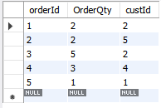
Min, MaxCount, Avg and Sum Function
select max(OrderQty)
from corder;
output 5
select min(OrderQty)
from corder;
output 1
select avg(OrderQty)
from corder;
output 2.6000
select sum(OrderQty)
from corder;
output 13

Slide 43
Subquery in sql
A Subquery or Inner query or a Nested query is a query within another SQL query and embedded within the WHERE clause.
A subquery is used to return data that will be used in the main query as a condition to further restrict the data to be retrieved.
Subqueries can be used with the SELECT, INSERT, UPDATE, and DELETE statements along with the operators like =, <, >, >=, <=, IN, BETWEEN, etc.

Slide 44
Subquery in sql
A Subquery or Inner query or a Nested query is a query within another SQL query and embedded within the WHERE clause.
A subquery is used to return data that will be used in the main query as a condition to further restrict the data to be retrieved.
Subqueries can be used with the SELECT, INSERT, UPDATE, and DELETE statements along with the operators like =, <, >, >=, <=, IN, BETWEEN, etc.

