Slide 1
Implications of Decentralized Q-learning Resource Allocation in Wireless Networks

Slide 2
Outline
Motivation
Reinforcement Learning in Wireless Networks
Scenario & System Model
Simulation Results
Conclusions

Slide 3
Motivation

Slide 4
Main Goal
Study the feasibility of achieving fair configurations that enhance the overall throughput in a decentralized way
What?
In which context?
Uncoordinated Wireless Networks (WNs) that compete for the same resources
With which tools?
Reinforcement Learning (RL),
more precisely a stateless variation of Q-learning

Slide 5
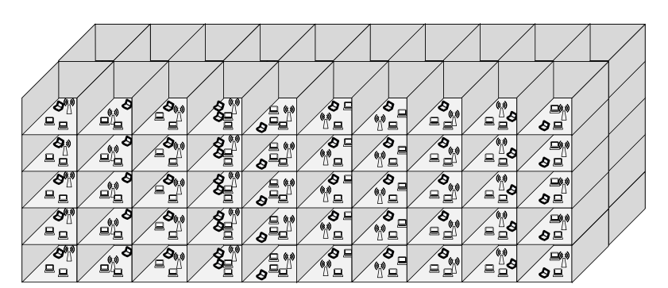
Next-generation WNs
Dense scenarios
Decentralization
Potential Solutions
Future WNs will be characterized by high-density and chaotic deployments
High amount of devices that coexist (e.g., 1 user/m²)
Coexistence derives into performance issues
Limited resources
Weaknesses in protocols
Centralization is often unfeasible
Only local information
No extra overhead
“Survive in the crowd” vs being fair
Time
Scheduling
CW adaptation
Frequency
DSA
DCB
Space
TPC and CST adjustment
Directional transmissions
Interference cancellation
[1]
Coordinated
Uncoordinated

Slide 6
Stateless Q-learning

Slide 7
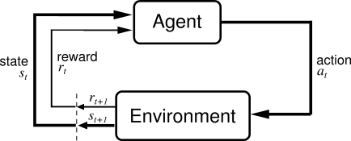
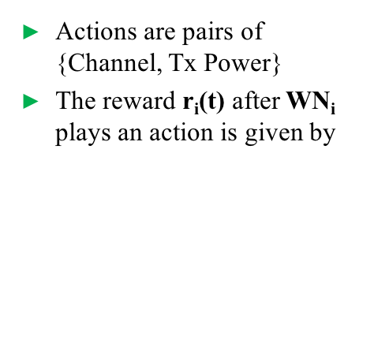
Stateless Q-learning
Reinforcement Learning
Stateless Q-learning
Mapping to WNs
States in WNs are very complex to be defined. Each WN implements Stateless Q-learning by only considering actions.
RL is a ML technique that aims at optimizing action selection
Feedback received by the system is a scalar reward signal*
Q(s,a) is updated through the reward and the tuning parameters:
𝛼: learning rate
𝛾: discount factor
The 𝜀-greedy policy is used to frame the exploration-explotaition trade-off
𝜀₀: initial exploration coefficient
Actions are pairs of {Channel, Tx Power}
The reward r_{i}(t) after WN_{i} plays an action is given by
Notes:
Focus on a completely decentralized scenario: Described by the set of actions and rewards
(as opposed to supervised learning where the system is told which the correct action was).
Choose action with maximum “Q” with probability 1 – 𝜀. Otherwise, choose a random action
𝜀0 decreases quadratically with the time

Slide 8
Scenario and System Model

Slide 9
Scenario and System Model
We consider a symmetric grid scenario containing 4 WNs. STAs are located to the most conservative position regarding the overlapping interference.
Dense deployment: 0.008 AP/m³
Limited resources:
Allows studying the adversarial setting on equal terms
Channels: 1 and 2
TX power levels: 5, 10, 15 and 20 dBm

Slide 10
Simulation Results

Slide 11
Analysis of the Input Parameters
Some combinations of {𝛼, 𝛾, 𝜀₀} show results close to the throughput resulting from the optimal proportional fairness.
There is a strong relationship between the discount factor (𝛾) and the learning rate (𝛼). For good performance, 𝛼 > 𝛾
100 repetitions of 10,000 iterations*
* The last 5000 iterations are considered for plotting results (avoid the instability during the transitory regime)
Notes:
Mention optimal configurations briefly
Mention that optimal solution (agg. Tpt) requires centralization
Mention that some configurations allow reaching the optimal fairness, and exploring not enough lead to variable results (from good to bad performacne)

Slide 12
Actions Probability in each WN
Single simulation of 10,000 iterations
𝜀₀ = 1, 𝛼 = 1, 𝛾 = 0.95
𝜀₀ = 0.1, 𝛼 = 1, 𝛾 = 0.95
𝜀₀ = 1, 𝛼 = 0.1, 𝛾 = 0.05
𝜀₀ = 0.1, 𝛼 = 0.1, 𝛾 = 0.05
More actions are explored as 𝜀₀ increases
High {𝛼, 𝛾} also entails more exploration
Notes:
Mention that we now look into individual performance, and that we use different values of epsilon, alpha and gamma to see the networks behavior
In figure 1, mention that maximum exploration leads to channel swapping, as well as the individual reward is greedy
Previous phenomena is soften in Figure 2, where alpha and gamma are lower
Remark fast convergence in Figures 3 and 4, which does not lead to fair configurations

Slide 13
Average Throughput experienced per WN
𝜀₀ = 1, 𝛼 = 1, 𝛾 = 0.95
𝜀₀ = 0.1, 𝛼 = 1, 𝛾 = 0.95
Single simulation of 10,000 iterations
A higher fairness is noticed as 𝜀₀ increases
A high {𝛼, 𝛾} pair entails a higher aggregate throughput
𝜀₀ = 1, 𝛼 = 0.1, 𝛾 = 0.05
𝜀₀ = 0.1, 𝛼 = 0.1, 𝛾 = 0.05
Notes:
* Fairness is achieved when enough exploration is provided

Slide 14
Temporal Throughput experienced per WN
𝜀₀ = 1, 𝛼 = 1, 𝛾 = 0.95
𝜀₀ = 0.1, 𝛼 = 1, 𝛾 = 0.95
Single simulation of 10,000 iterations
A higher variability is noticed as 𝜀₀ increases
A high {𝛼, 𝛾} pair entails more variability
𝜀₀ = 1, 𝛼 = 0.1, 𝛾 = 0.05
𝜀₀ = 0.1, 𝛼 = 0.1, 𝛾 = 0.05
Notes:
Only mention that a higher exploration incurs into a higher temporal throughput variability, which may have side effects on the networks performance, as it may affect to higher protocols levels

Slide 15
Conclusions

Slide 16
Conclusions
1
Decentralized learning
Spatial Reuse can be improved in dense WNs
Entails competitiveness, becomes worse if a NE does not exist
2
Q-learning
Allows finding close-to-optimal configurations in terms of fairness
Trade-off between the individual throughput and the variability
Notes:
The decentralized problem with limited resourced might not have a *pure strategy* equilibrium

Slide 17
Implications of Decentralized Q-learning Resource Allocation in Wireless Networks

Slide 18
Moving towards Artificial Intelligence
Challenges in WNs vs ML features
Previous Work
AI may satisfy the high-demanding requirements in next-generation scenarios. There is an upward trend in combining AI with Wireless Communications.
WNs strongly interact with the environment
Q-learning
Packet routing [2]
Energy harvesting [3]
Adversarial setting
High variability (channel, users, traffic…)
Observations-based learning process
MABs
Rate sampling [4]
Training a system may be infeasible and not practical
Optimal solution or an approximation
ANNs
AP selection [5, 6]

Slide 19

Reinforcement Learning
An agent attempts to learn a policy given the observations it does. The goal is to maximize the expected future cumulative reward.
S: set of states
A: set of actions
R_{a,s}: reward
T(s, a, s’): transition probability
MDP formulation:
No supervisor (only reward signal)
Delayed feedback & sequentiality
Actions affect the environment
Examples:
Q-learning, SARSA, TD-learning

Slide 20
Q-learning [7]
Agents maintain an estimate of the expected long-term discounted reward for each state-action pair. The goal is to maximize the long-term reward.
Update rule:
r_{t} = obtained reward
𝛼_{t} = learning rate
𝛾 = discount factor
𝜀-greedy policy (select the most rewarding action with probability 1 - 𝜀)
Previous work:
Real-time Q-learning for DCA [8]
Q-learning for channel selection in mobile communications [9, 10]

Slide 21
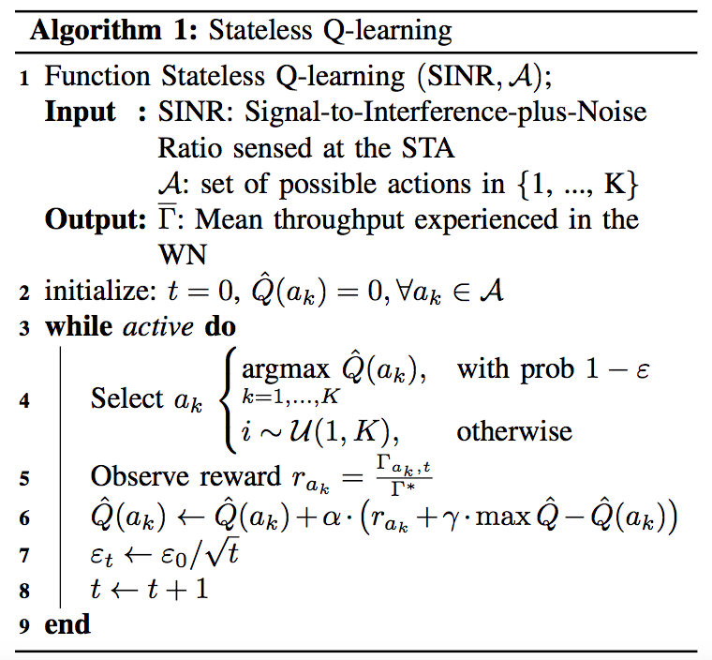
Stateless Q-learning Algorithm

Slide 22
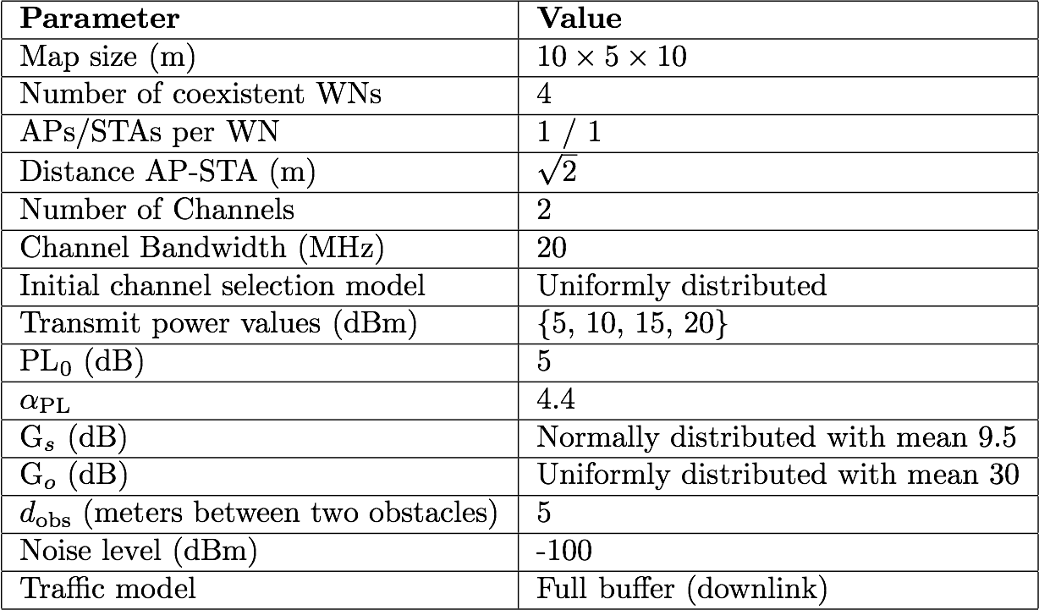
System Model
Throughput calculation is done through interference, so that performance enhancement can be achieved through interference minimization.
Throughput computed according to the Shannon’s capacity
Indoor path-loss model
Possible actions:
Channels: 1 and 2 (with co-channel interference)
TX power levels: 5, 10, 15 and 20 dBm

Slide 23
Optimal Configuration
For comparison purposes, we compute the optimal configurations that maximize the aggregate throughput and the proportional fairness, respectively.
Aggregate throughput
One combination is {a₁, a₁, a₇, a₈}*
Two WNs sacrifice their individual performance for the “common good”
Proportional fairness
One combination is {a₇, a₈, a₇, a₈}
Aggressive configurations
*Actions indexes are mapped to {channel number, tx power (dBm)}:
a₁={1,5}, a₂={2,5}, a₃={1,10}, a₄={2,10},
a₅={1,15}, a₆={2,15}, a₇={1,20}, a₈ ={2,20}

Slide 24
References
[1] Afaqui, M. S., Garcia-Villegas, E., Lopez-Aguilera, E., & Camps-Mur, D. (2016, May). Dynamic sensitivity control of access points for IEEE 802.11 ax. In Communications (ICC), 2016 IEEE International Conference on (pp. 1-7). IEEE.
[2] Littman, M., & Boyan, J. (1993, July). A distributed reinforcement learning scheme for network routing. In Proceedings of the international workshop on applications of neural networks to telecommunications (pp. 45-51). Psychology Press.
[3] Miozzo, M., Giupponi, L., Rossi, M., & Dini, P. (2015, June). Distributed Q-learning for energy harvesting Heterogeneous Networks. In Communication Workshop (ICCW), 2015 IEEE International Conference on (pp. 2006-2011). IEEE.
[4] Combes, R., Proutiere, A., Yun, D., Ok, J., & Yi, Y. (2014, April). Optimal rate sampling in 802.11 systems. In INFOCOM, 2014 Proceedings IEEE (pp. 2760-2767). IEEE.
[5] Bojovic, B., Baldo, N., Nin-Guerrero, J., & Dini, P. (2011, December). A supervised learning approach to cognitive access point selection. In GLOBECOM Workshops (GC Wkshps), 2011 IEEE (pp. 1100-1105). IEEE.
[6] Bojovic, B., Baldo, N., & Dini, P. (2012, January). A neural network based cognitive engine for IEEE 802.11 WLAN access point selection. In Consumer Communications and Networking Conference (CCNC), 2012 IEEE (pp. 864-868). IEEE.
[7] Sutton, Richard S. "Learning to predict by the methods of temporal differences." Machine learning 3.1 (1988): 9-44.
[8] Nie, J., & Haykin, S. (1999). A Q-learning-based dynamic channel assignment technique for mobile communication systems. IEEE Transactions on Vehicular Technology, 48(5), 1676-1687.
[9] Li, H. (2009, October). Multi-agent Q-learning of channel selection in multi-user cognitive radio systems: A two by two case. In Systems, Man and Cybernetics, 2009. SMC 2009. IEEE International Conference on (pp. 1893-1898). IEEE.
[10] Bennis, M., & Niyato, D. (2010, December). A Q-learning based approach to interference avoidance in self-organized femtocell networks. In GLOBECOM Workshops (GC Wkshps), 2010 IEEE (pp. 706-710). IEEE.

