Slide 1
Automating PHP E - Commerce Application
DevOps Integration

Slide 2
Agenda
SDLC PROCESS
IMPLEMENTATION OF SDLC
AUTOMATION OF SDLC WITH JENKINS
HOSTING SOLUTION
AWS INFRASTRUCTURE
LIVE DEMO
CONCLUSION

Slide 3
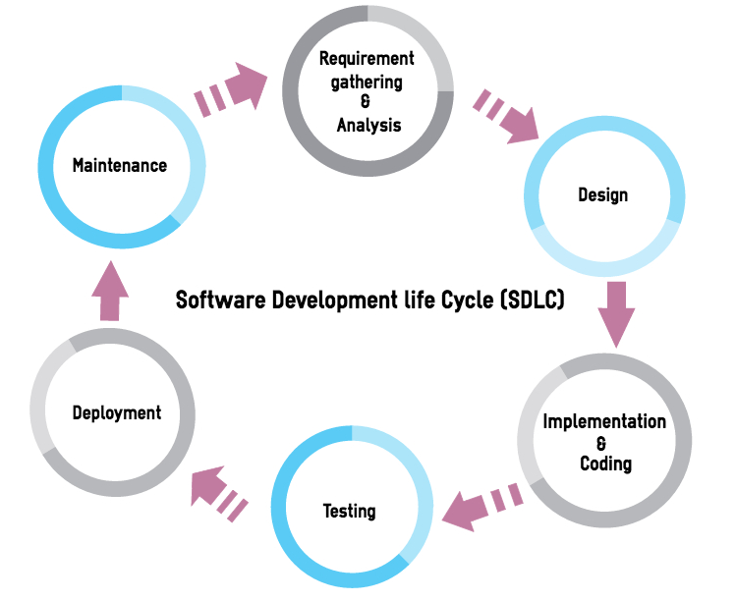
SDLC PROCESS
Notes:
K

Slide 4
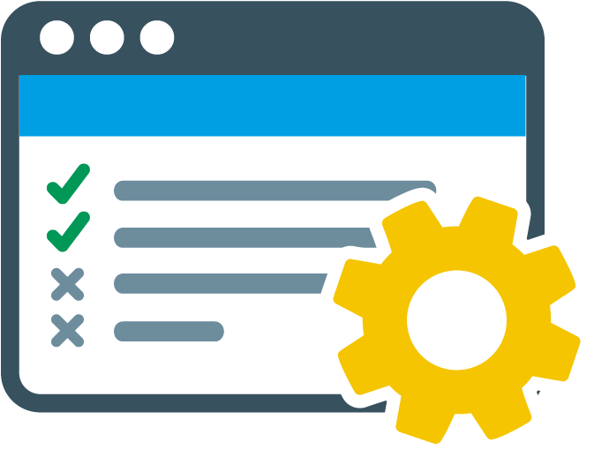

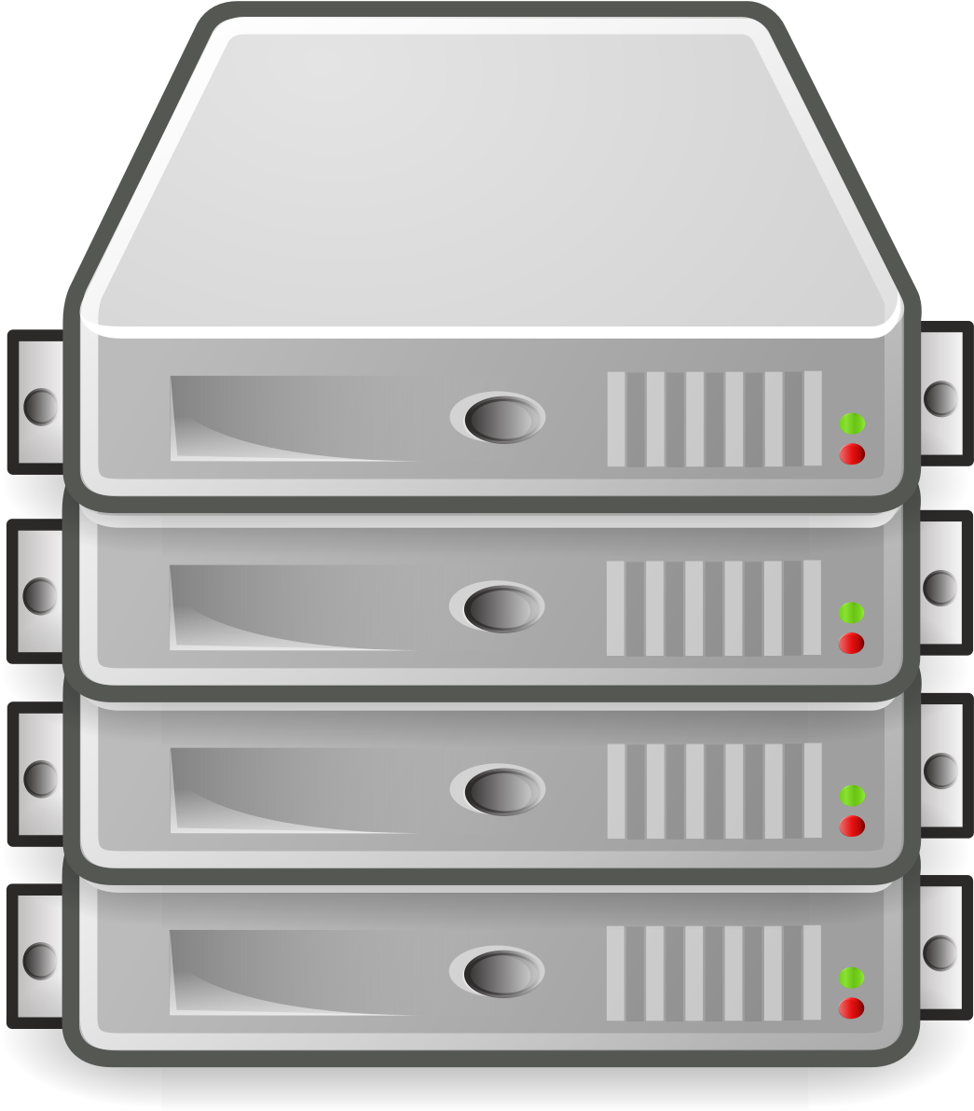
Develop Code
Testing Code
Deploy Code

Slide 5
        IMPLEMENTATION OF SDLC

Slide 6
Developer Team

Slide 7

Developer Team
Build Code

Slide 8
Developer Team
QA Team
Testing Code
Build Code

Slide 9
Operation /Deployment Team
Developer Team
QA Team
Testing Code
Deploy Code
Build Code

Slide 10
AUTOMATION OF SDLC WITH JENKINS

Slide 11



Testing Code
Deploy Code
Build Code

Slide 12
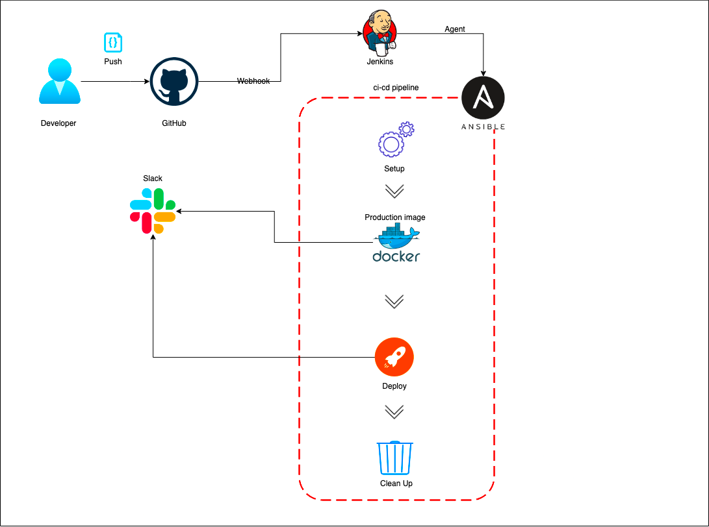

Slide 13
HOSTING SOLUTION

Slide 14




Slide 15





1
2
3
10,000
25,000

Slide 16
1
2
3
10,000
25,000
25,000

Slide 17



Google Cloud Plateform
Cloud Hosting Solution

Slide 18
AWS INFRASTRUCTURE

Slide 19

Cloud Hosting Solution

Slide 20
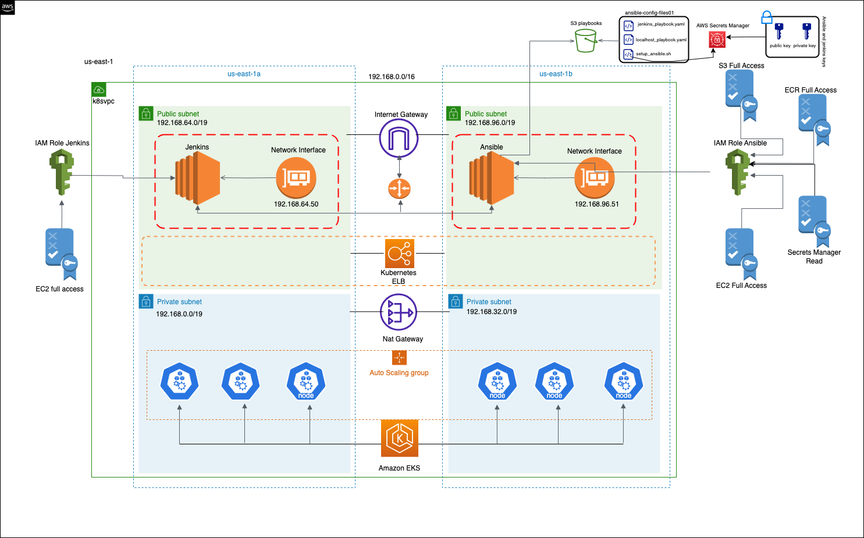

Slide 21


Slide 22
LIVE DEMO

Slide 23
CONCLUSION

