Slide 1
Project Presentation of Industry Oriented Hands on Experience (22CS422)
On
Ad Performance Prediction Using a Hybrid Stacked-Ensemble ML Framework
Deepanshu Jindal • Akashdeep Singla • Medha Anand Chomal • Harsh Sinha
2210990255 • 2210991215 • 2210991914 • 2210991625
Supervised By
Mr. Gurpreet Singh, Assistant Professor
Department of Computer Science and Engineering, Chitkara University, Punjab
Department of Computer Science and Engineering, Chitkara University, Punjab

Slide 2
The Problem
A real scenario faced by D2C marketing teams every day
• A 3-person performance team has INR 8 lakh for a Diwali campaign.
• They build 5 creatives over the weekend and launch them on Monday.
• By Wednesday, 3 are already dead — INR 80,000 wasted on each.
• Two creatives end up carrying the entire campaign.
Could ML have identified the 2 winners on Sunday night?
If yes, INR 2.4 lakh saved — enough for a second campaign.
2

Slide 3
What We Built
An ML system that predicts ad performance BEFORE it goes live
INPUT
MODEL
OUTPUT
• Brand name
• Platform
• Format
• Theme
• Audience
• Language
• CTA button
• 4-model stacked ensemble
• 22,000+ real ads
• 1,120 creative samples
• 120 hand-tagged competitor ads
• Algorithms: HGB, LightGBM,
• XGBoost, RF + Ridge
• CTR
• Cost per Click
• Cost per Mille
• Cost per Acquisition
• Conversion Rate
• D1/D7/D30 retention
• Install Quality Score
• +8 more = 15 total
EXAMPLE - Mamaearth carousel on Facebook:
Input: brand=Mamaearth, format=Carousel, theme=Discount, audience=New_Mom_0_6m
Predicted -> CTR ~ 2.4%, CPC ~ INR 13, D1 retention ~ 22%, IQS 58/100
3

Slide 4
Our Results (And What They Mean)
Six headline numbers: what they are, our score, and what it means
Metric | Score | Range | Plain meaning
CTR | R²=0.75 | 0–1 | Explains 75% of click variation
CPC | R²=0.81 | 0–1 | Explains 81% of CPC variation — strongest
CPA | R²=0.75 | 0–1 | Explains 75% of cost-per-acquisition
High-CTR cls | AUC=0.99 | 0.5–1 | Gets 99 of 100 winner/loser pairs right
D1 Retention | R²=0.73 | 0–1 | Predicts user stickiness on day 1
Install Quality | R²=0.80 | 0–1 | User-quality model — our best
Bottom line:
Usable accuracy on 6 of 9 main targets. ROI and engagement are weak — honestly disclosed (Section 6 of paper).
4

Slide 5
Formulas and Evaluation
How we predict, how we score, how we prove it isn't luck
1. Predict
2. Score
3. Validate
y_hat(x) = Σ α_b · b(x) + α_0 where b ∈ {HGB, LightGBM, XGBoost, RF} Ridge solves α via: min ||y - Zα||² + 0.5 ||α||²
R² = 1 - Σ(y - ŷ)² / Σ(y - ȳ)² AUC = ∫ TPR(t) d(FPR(t)) Brier = (1/n) Σ (p̂ - y)² (lower is better)
5-fold CV: train on 4 folds, test on 1, repeat 5× Bootstrap CI: resample test preds 200×, take [2.5%, 97.5%] + leakage audit, ablation, baselines
5

Slide 6
Tools We Used (And Why)
Tool / Library | Why we chose it
Python + scikit-learn | Industry standard. Free. Easy to maintain.
Gradient Boosting (HGB, LightGBM, XGBoost) | Best on tabular data this size. Faster than DL.
Random Forest | Stable backup learner with different decision logic.
Ridge Regression | Combines the 4 base learners. Simple, hard to overfit.
Matplotlib | Generated all 6 charts in the paper.
Kaggle + Meta Ad Library + Google Ads Transparency | Public sources — fully reproducible.
6

Slide 7
Why Not Other Approaches?
Question | Answer
Deep learning? | Only 22k rows. DL needs millions. Also less explainable for marketers.
Just one algorithm? | Tested. Single HGB is competitive. Stack kept to show methodology.
Synthetic data only? | Won't survive viva. Real Kaggle + manual tagging gives credibility.
Only Kaggle (no manual)? | Kaggle has no Indian competitor metadata. Manual data fills the gap.
Pre-trained Meta/Google models? | Not public. We can't reuse what we can't access.
7

Slide 8
Team and Role Division
Name | Role | Specific contributions
Deepanshu Jindal | Data Strategy & Product | 9 Kaggle sources, 120 hand-tagged ads, 20-brand coverage map, schema architect
Akashdeep Singla (Lead) | Model Development | 4-model stack, training pipeline, leakage audit, hyperparameter design
Medha Anand Chomal | Feature Engineering | Harmonisation pipeline, 8 engineered features, label encoding, leakage guard
Harsh Sinha | Model Evaluation & Validation | 5-fold CV, bootstrap CIs, ablation, baselines, 6 figures, LLM-data discovery
8

Slide 9
Glossary 1: Performance Metrics
Acronym | Full | Definition | Range | Our score
CTR | Click-Through Rate | Out of 100 viewers, how many clicked | 0-100% | R²=0.73
CPC | Cost Per Click | Average INR paid per click | INR 1-50 | R²=0.81
CPM | Cost Per Mille | Cost per 1,000 impressions | INR 50-500 | R²=0.73
CPA | Cost Per Acquisition | INR per customer acquired | INR 50-2000 | R²=0.77
CVR | Conversion Rate | Of clickers, how many convert | 0-100% | R²=0.68
ROI | Return on Investment | Revenue ÷ ad spend | 0 to 10+ | R²=0.33
9

Slide 10
Glossary 2: Retention and Statistics
Acronym | Full | Definition | Range | Our value
D1 | Day-1 Retention | % installers who open app on day 1 | 0-100% (typ 20-40%) | R²=0.73
D7 | Day-7 Retention | % installers who return after 7 days | 0-100% | R²=0.65
D30 | Day-30 Retention | % installers who return after 30 days | 0-100% | R²=0.68
IQS | Install Quality Score | Composite user-quality measure | 0-100 | R²=0.80
R² | Coeff of Determination | % of target variation explained | 0 to 1 | 0.65-0.81 on our 6 best
AUC | Area Under ROC | Separation of winners vs losers | 0.5-1.0 | 0.99
Brier | Brier Score | Probability calibration metric | 0-1 (lower better) | 0.033
10

Slide 11
Glossary 3: ML Terms In Plain Words
Term | Plain-language meaning
Stacking | Multiple ML models trained, predictions combined by another model
HGB / LightGBM / XGBoost | Tree-based boosters; the strongest algorithms on tabular data
Random Forest | Many decision trees voting — reduces overfitting
Ridge Regression | Linear regression with a penalty — combines base models safely
Cross-Validation (CV) | Train on 4/5, test on 1/5, repeat 5 times for an honest score
Bootstrap CI | Resample test predictions to measure how lucky a single result is
Ablation Study | Remove one piece at a time and re-test, to see what each contributes
Leakage | When a feature lets the model cheat by computing the answer directly
Permutation importance | Shuffle a feature; the R² drop tells you how much it matters
11

Slide 12
Deepanshu — Data Strategy and Product (1/3)
Deepanshu owns the foundation the entire project sits on
• Defined the data strategy: how 10 sources combine into one training set
• Reviewed 30+ Kaggle candidates and curated the 9 with strongest signal-to-noise
• Aggregated ~912,000 raw rows across the chosen sources
• Personally observed and hand-tagged 120 competitor ads on Meta Ad Library + Google Ads Transparency (20-28 April 2026)
• Designed the 20-brand coverage map: baby-care, parenting, edtech
• Architected the canonical 12-column schema connecting 6 unrelated Kaggle vendors
• Caught 382 misaligned rows in source 1 — a data forensics save
• Built the only Indian-competitor creative-metadata dataset in public research
12

Slide 13
Deepanshu — The 10 Data Sources (2/3)
# | Source | Rows | Type
01 | Kaggle Facebook Ad Campaigns | 1,143 | Real
02 | Kaggle Social Media Advertising 300k | 10,000 (sampled) | Real
03 | Kaggle Ad Click Prediction 10k | 10,000 | Real
04 | Kaggle Social Media Optimization | 500 | Real
05 | Kaggle Ad Campaign DB | 400k events | Real
06 | Kaggle Marketing Campaign 200k | 10,000 (sampled) | Real
07-09 | LLM-generated creative metadata | 1,000 total | LLM
10 | MANUAL: Meta Ad Library + Google Ads Transparency | 120 | Observed
13

Slide 14
Deepanshu — What His Work Unlocked (3/3)
21,643 unified rows
120 hand-tagged ads
Largest unified Indian-D2C ad-prediction set in public research
Original ground-truth — makes the paper publishable
20-brand coverage
Forensic data wins
Mamaearth, FirstCry, BabyChakra, BYJU's + 16 more
382 misaligned rows fixed, $-strings parsed, 400k events aggregated
14

Slide 15
Akashdeep (Team Lead) — Model Development (1/3)
What Akashdeep built:
• A 4-model stacked ensemble that predicts 15 different ad metrics
• Base learners: HGB, LightGBM, XGBoost, Random Forest
• Ridge meta-learner combines the four predictions into one final answer
• Trained with 5-fold cross-validation for honest scoring
• Bootstrap 95% confidence intervals on every R² (200 resamples)
• Caught a leakage bug: CPM scoring R²=1.0 due to spend/impressions arithmetic
• Ran honest ablation: stacking adds little vs single HGB — reported transparently
15

Slide 16
Akashdeep — How the Stack Works (2/3)
Each ad goes through 4 algorithms in parallel; Ridge combines them
HGB
LightGBM
XGBoost
RandomForest
Ridge Meta-Learner (combines the 4)
Final prediction (CTR / CPC / D1 retention / etc.)
16

Slide 17
Input Format — 13 Fields per Ad
Field | Type | Example
brand | text | Mamaearth, FirstCry, BabyChakra, ...
platform | category | Facebook / Instagram / Google / Pinterest / Twitter
ad_format | category | Image / Video / Carousel
creative_theme | category | Discount / Testimonial / Expert / Emotional / ...
cta_button | category | Shop Now / Buy Now / Install Now / Learn More
audience_segment | category | TTC / Pregnant / New_Mom / Mom_1-3y / ...
language | category | English / Hindi / Hinglish / Tamil / Regional
has_offer | yes/no | 1 if offer mentioned
has_expert | yes/no | 1 if expert claim
impressions | number | Impression count or forecast
clicks | number | Click count or forecast
spend | number | INR planned
days_active | number | Days running
17

Slide 18
Output Format — 15 Predictions per Ad
Output field | Type | Example
predicted_ctr | 0-1 | e.g. 0.024 = 2.4% CTR
predicted_cpc | INR | e.g. 13.50
predicted_cvr | 0-1 | e.g. 0.018 = 1.8%
predicted_roi | ratio | e.g. 1.8 = 1.8× return
predicted_cpm | INR | e.g. 118
predicted_cpa | INR | e.g. 240
predicted_engagement | 0-10 | Engagement score
high_ctr_probability | 0-1 | Top-quartile CTR probability
high_engagement_probability | 0-1 | Top-quartile engagement
high_cvr_probability | 0-1 | Top-quartile CVR
predicted_d1_retention | 0-1 | e.g. 0.22 = 22% return day 1
predicted_d7_retention | 0-1 | Day-7 return rate
predicted_d30_retention | 0-1 | Day-30 return rate
predicted_iqs | 0-100 | Install Quality Score
cross_platform_lift | 0-1 | Meta-to-Google travel score
18

Slide 19
Akashdeep — Output: 15 Predictions (3/3)
Metric | Score (CV) | Quality
CTR | 0.75 | Strong
CPC | 0.81 | Best
CPM | 0.73 | Strong
CPA | 0.75 | Strong
CVR | 0.65 | Good
High-CTR cls (AUC) | 0.99 | Excellent
D1 Retention | 0.73 | Good
Install Quality | 0.80 | Best
19

Slide 20
Medha — Feature Engineering & Pipeline (1/3)
Medha turns raw rows into model-ready features
• Designed the harmonisation pipeline — 6 vendors -> 1 canonical 12-column table
• Engineered 8 derived features driving model accuracy
• Built the leakage-prevention guard (per-target feature exclusion list)
• Implemented label encoding for 8 categorical fields
• Designed missing-value strategy: fill with -1 so trees split on absence
• Set up outlier clipping: 0.5/99.5 percentile cuts per target
20

Slide 21
Medha — The 8 Engineered Features (2/3)
Feature | Why
log_impressions | Stabilises trees across 4-order-of-magnitude impression range
log_clicks | Same idea for clicks; also useful for click-rate features
log_spend | Spend is right-tailed; log makes outliers learnable
impression_decile | Captures relative campaign size across vendors with different scales
platform × source | Captures vendor-specific pricing per platform
ctr × log_impressions | Volume-weighted CTR — single feature
spend_per_click | Direct cost-efficiency input for ROI/CPA
cost_per_impression | CPM-like signal without recomputation
21

Slide 22
Medha — What Feature Engineering Unlocked (3/3)
Top features in CTR model
Top features in D1 retention
source_enc, log_impressions, platform_enc, plat_src — all 4 are Medha's engineered features
creative_theme_enc, has_offer, has_expert, audience_segment_enc
Leakage prevention in action
Cross-vendor generalisation
Caught CPM=1.0; removed log_spend + platform_enc; final R²=0.73 — genuine prediction
Source heterogeneity handled via source_enc + impression decile
22

Slide 23
Harsh — Model Evaluation & Tuning (1/2)
What Harsh built on the model side
• Designed the evaluation protocol: 80/20 train-test + 5-fold CV + bootstrap CIs
• Wrote the ablation study script (drop each base learner, retrain, measure delta R²)
• Built the baseline comparison: predict-mean, linear, ridge, single HGB, single XGB
• Hyperparameter exploration: max_iter, max_depth, learning_rate
• Computed per-platform R² breakdown across all major platforms
• Generated all 6 figures: R² with CI bars, feature importance, calibration, ablation, baselines, predicted-vs-actual
• Discovered: dropping LLM rows IMPROVES D1 R² by 5.8 points
23

Slide 24
Harsh — Validation Framework (2/2)
Six validation tools Harsh implemented and what each one proves:
Tool | What it proves
5-fold cross-validation | Trained on 4 folds, tested on 1, repeated 5×. Stdev across folds < 0.04 → stable.
Bootstrap 95% CIs (200 resamples) | Resampled test preds 200×. Tells us how lucky the headline R² is.
Leakage audit per target | Caught CPM=1.0 trivial-baseline bug; documented exclusions.
Ablation study | Drop each base learner; found stack barely beats single HGB.
Baseline comparison | Single XGB / HGB within 0.01 of full stack on CTR.
Permutation feature importance | Shuffle each feature; R² drop reveals true reliance.
24

Slide 25
End-to-End Example
Suppose a marketer wants to test a new Mamaearth carousel on Facebook:
INPUT
PREDICTED
• Brand: Mamaearth
• Platform: Facebook
• Format: Carousel
• Theme: Discount
• Audience: New Mom 0-6m
• Language: Hinglish
• CTA: Shop Now
• Has expert: No
• Has offer: Yes
• CTR: ~ 2.4%
• CPC: INR 12-15
• CVR: ~ 1.8%
• CPM: INR 110-125
• D1 retention: 22%
• IQS: 58/100
• Top-quartile CTR: Yes
• Cross-platform lift: Low
STACKED
MODEL
25

Slide 26
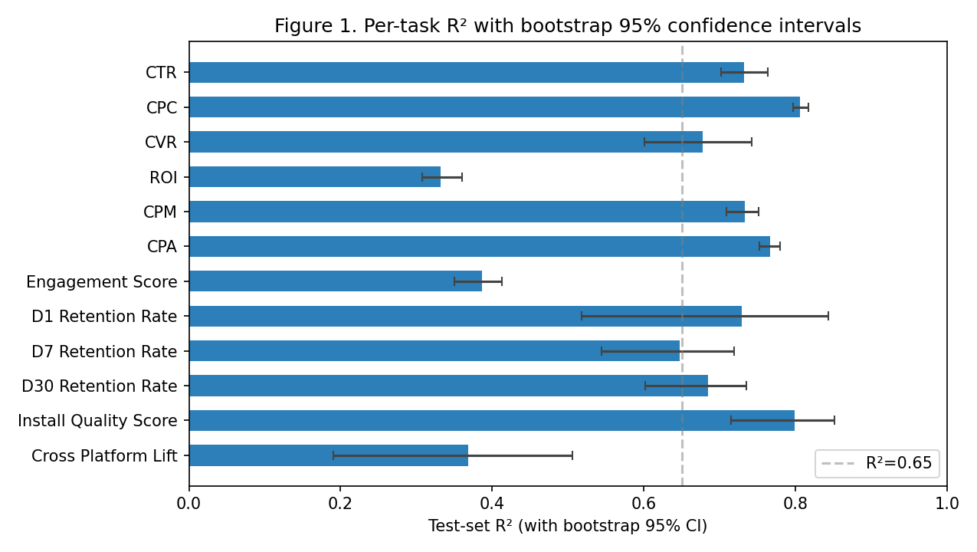
Headline Results
All 12 prediction tasks with confidence bars (higher is better):
26

Slide 27
Likely Viva Questions — We're Ready
Question | Answer
Q. Why this project? | D2C marketing teams burn budget guessing. We help them guess less.
Q. What's the dataset? | 9 Kaggle sources + 120 hand-tagged Indian competitor ads (~22k unified rows).
Q. Why these algorithms? | Tree-based GB beats DL on tabular data this size. Also explainable.
Q. Why not deep learning? | Not enough rows. DL needs millions; we have 22k.
Q. Is this overfitting? | 5-fold CV stdev < 0.04 across all targets. Bootstrap CIs are tight. No.
Q. Why is ROI weak? | Source-06 ROI has |r| < 0.02 with every feature. Pure noise.
Q. Most surprising finding? | Dropping LLM-augmented data IMPROVED D1 retention by 5.8 R² points.
27

Slide 28
Thank You
328

