Slide 1





Introduction & Background Model Description Data Overview Forward Problem Parameter Selection OLS Results Model Diagnostics Optimal Experimental Design
Predictive Modeling of Salmonella enteritidis Growth Under
Sinusoidal Temperature
Modified Gompertz Model & OLS Parameter Estimation
Team Members
生物系统工程与食品科学学院
浙江大学
2026 年 4 月 14 日
· · G , ·
Team 2026 年 4 月 14 日 Salmonella Gompertz Model 1 / 18

Slide 2

Introduction & Background Model Description Data Overview Forward Problem Parameter Selection OLS Results Model Diagnostics Optimal Experimental Design Bootstrapping Conc lusions
目录
1 Introduction & Background
2 Model Description
3 Data Overview
4 Forward Problem
5 Parameter Selection
6 OLS Results
7 Model Diagnostics
8 Optimal Experimental Design
9 Bootstrapping
10 Conclusions
11 References
Team 2026 年 4 月 14 日 Salmonella Gompertz Model 2 / 18

Slide 3

Introduction & Background Model Description Data Overview Forward Problem Parameter Selection OLS Results Model Diagnostics Optimal Experimental Design Bootstrapping Conc lusions
Introduction & Background
• Salmonella enteritidis is a major foodborne pathogen in egg products
• Temperature fluctuations during storage/transport affect microbial growth
• Reference: Gumudavelli et al. (2007), J. Food Sci. 72:M254–62 [1]
Objective
Use a modified Gompertz model to predict Salmonella growth under sinusoidal heating, estimate model parameters via OLS, and evaluate model adequacy.
Team 2026 年 4 月 14 日 Salmonella Gompertz Model 3 / 18

Slide 4



Introduction & Background Model Description Data Overview Forward Problem Parameter Selection OLS Results Model Diagnostics Optimal Experimental Design Bootstrapping Conc lusions
Model Description
Primary Model (differential form)
· K · C · exp(−K), K = exp^{(−μ(t} ⁻ ^{M))} (1)
Secondary Model (growth rate vs. temperature)
μ = a(T − T_{min} )² ⁽¹ ⁻ exp[b(T − T_{max} ^{)])} (2)
• Dependent variable: log10 N(t) —log microbial concentration (log cfu/mL)
• Independent variable: t —time (hr)
· · G , ·
Team 2026 年 4 月 14 日 Salmonella Gompertz Model 4 / 18

Slide 5
Introduction & Background Model Description Data Overview Forward Problem Parameter Selection OLS Results Model Diagnostics Optimal Experimental Design Bootstrapping Conc lusions
Model Description —7 Candidate Parameters
Parameter | Symbol | Description | Units | Initial Guess
A | A | Initial log microbial number | log cfu/mL | log 10(400) ≈ 2.60
C | C | Upper一lower asymptote difference | log cfu/mL | 11
M | M | Inflection point time | hr | 7.5
a | a | Secondary model coeﬀicient | ◦ C⁻² hr⁻¹ | 0.000338
b | b | Secondary model coeﬀicient | ◦ _{C}⁻¹ | 0.275
Tmin | Tmin | Minimum growth temperature | ◦ C | 6
Tmax | Tmax | Maximum growth temperature | ◦ C | 46.3
Team 2026 年 4 月 14 日 Salmonella Gompertz Model 5 / 18

Slide 6
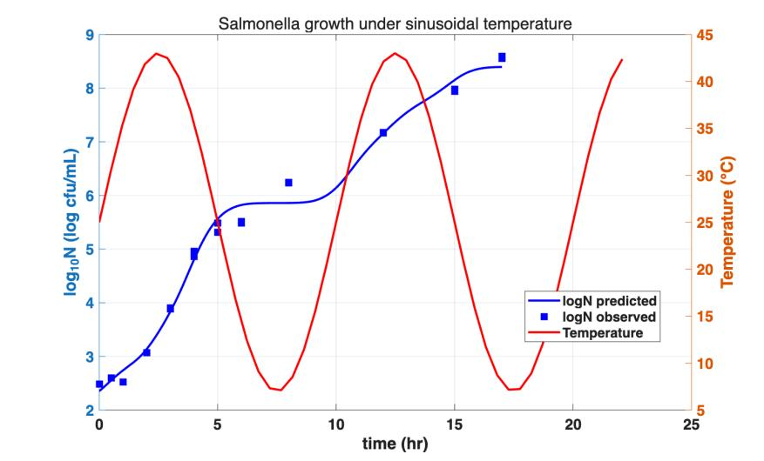
Introduction & Background Model Description Data Overview Forward Problem Parameter Selection OLS Results Model Diagnostics Optimal Experimental Design Bootstrapping Conc lusions
Data Overview
• Growth data: log₁₀ (CFU/mL) at multiple time points, n = 20
• Temperature: sinusoidal T(t) recorded every minute
• Two independent time vectors
Fig 1 . Dual-axis: log10 N and T vs . time
Team 2026 年 4 月 14 日 Salmonella Gompertz Model 6 / 18

Slide 7
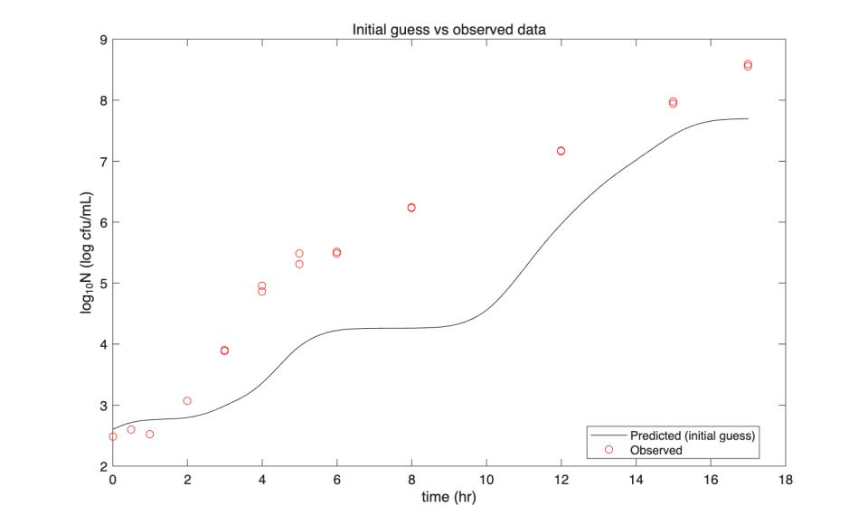

Introduction & Background Model Description Data Overview Forward Problem Parameter Selection OLS Results Model Diagnostics Optimal Experimental Design Bootstrapping Conc lusions
Forward Problem —Initial Guess
• All 7 parameter guesses from literature (Gumudavelli et al. , 2007)
• ODE solved with ode45
• Temperature interpolated via interp1
Fig 2 . Initial guess vs . observed data
· · G , ·
Team 2026 年 4 月 14 日 7 / 18
Salmonella Gompertz Model

Slide 8
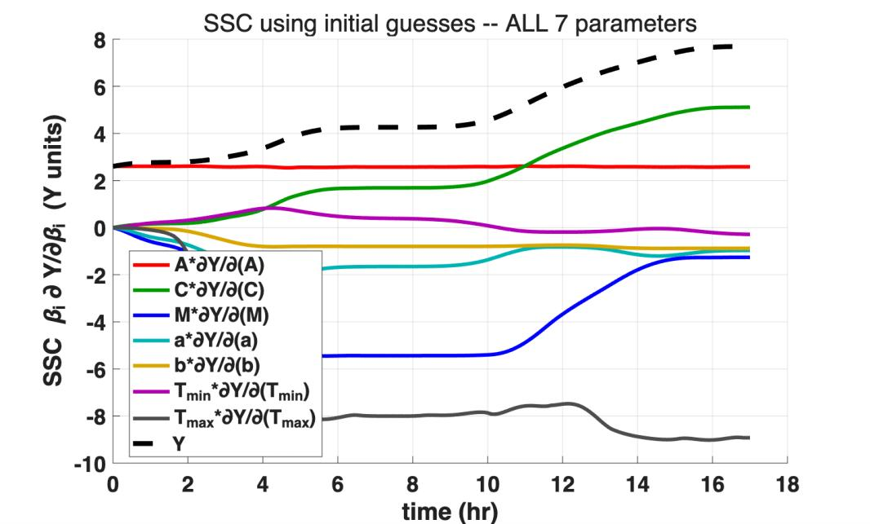

Introduction & Background Model Description Data Overview Forward Problem Parameter Selection OLS Results Model Diagnostics Optimal Experimental Design Bootstrapping Conc lusions
SSC Analysis —All 7 Parameters (Step 1)
Max|SSC| :
Param | Max|SSC|
A | 2.61
C | 5.11
M | 5.45
a | 2.20
b | 0.88
Tmin | 0.83
Tmax | 9.02
Decision
T_{min} (0.83) and b (0.88): lowest SSC ⇒ fix: T_{min} = 6 。C, b = 0 .275.
Fig 3 . SSC for all 7 parameters
Team 2026 年 4 月 14 日 Salmonella Gompertz Model 8 / 18

Slide 9
Introduction & Background Model Description Data Overview Forward Problem Parameter Selection OLS Results Model Diagnostics Optimal Experimental Design Bootstrapping Conc lusions
Parameter Selection Summary
Parameter | Max|SSC| | Identifiable? | Action | Value Used
A | 2.61 | ✓Yes | Estimate | OLS result
C | 5.11 | ✓Yes | Estimate | OLS result
M | 5.45 | ✓Yes | Estimate | OLS result
a | 2.20 | ✓Yes | Estimate | OLS result
b | 0.88 | × Low SSC | Fix (literature) | 0.275 ◦ C⁻¹
Tmin | 0.83 | × Lowest SSC | Fix (literature) | 6 ◦ C
Tmax | 9.02 | △ C一Tmax collinear | Fix (literature) | 46.3 ◦ C
• Direct elimination: 7 → 4 —fix T_{min} , b (low SSC), T_{max} (C一T_{max} collinearity R = −0.991, fix at literature value 46.3 。C)
• Final estimable parameters: [A, C, M, a]
• After estimation: all |R_{ij} | < 0.60, cond(J) = 1.19 × 10⁴ ≪ 10⁶
Team 2026 年 4 月 14 日 Salmonella Gompertz Model 9 / 18

Slide 10
Introduction & Background Model Description Data Overview Forward Problem Parameter Selection OLS Results Model Diagnostics Optimal Experimental Design Bootstrapping Conc lusions
OLS Inverse Problem —Final Results ([A, C, M, a])
Param | Estimate | σ | Rel Err | 95% CI
A | 2.352 | 0.138 | 5.9% | [2.059, 2.645]
C | 11.197 | 0.370 | 3.3% | [10.41, 11.98]
M | 5.559 | 0.183 | 3.3% | [5.172, 5.946]
a | 0.000300 | 0.0000357 | 11.9% | [0.0002, 0.0004]
• Fixed: T_{min} = 6 。C, b = 0.275 , T_{max} = 46.3 。C (literature)
• cond(J) = 1.19 × 10⁴ RMSE = 0.225 relRMSE = 3.72% R² = 0.989
• All |R_{ij} | < 0.60: no collinearity issues
· · G , ·
Team 2026 年 4 月 14 日 Salmonella Gompertz Model 10 / 18

Slide 11
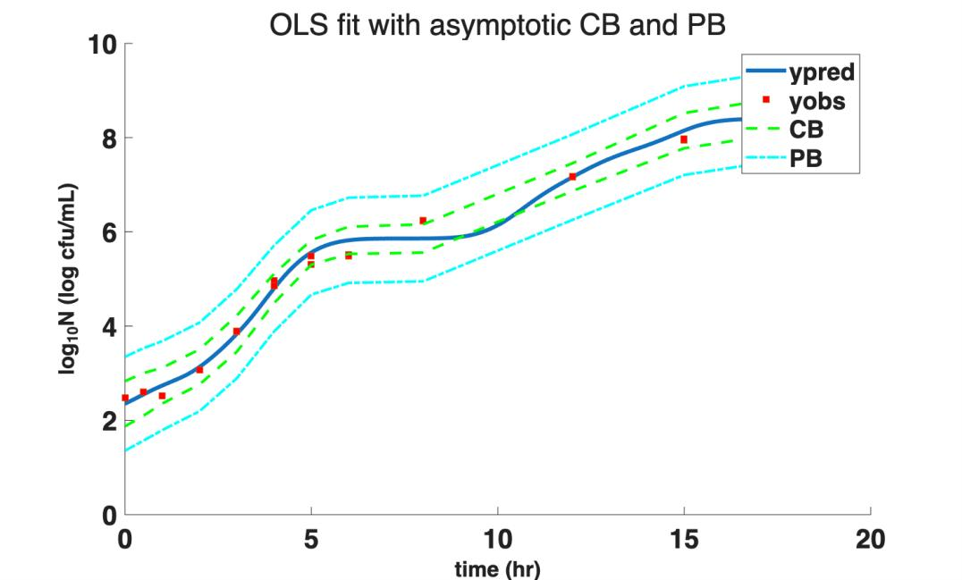
Introduction & Background Model Description Data Overview Forward Problem Parameter Selection OLS Results Model Diagnostics Optimal Experimental Design Bootstrapping Conc lusions
Fitted Curve with Asymptotic CB and PB
Fig 6 . OLS fit with 95% simultaneous confidence bands (CB) and prediction bands (PB)
Team 2026 年 4 月 14 日 Salmonella Gompertz Model 11 / 18

Slide 12
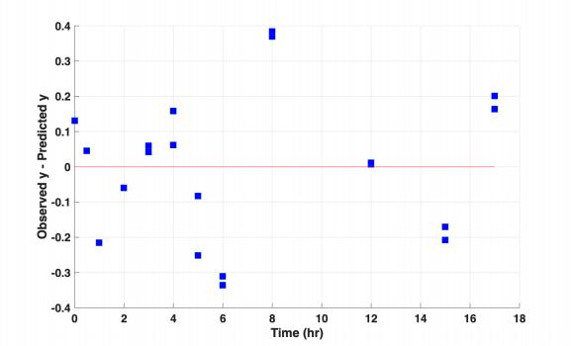
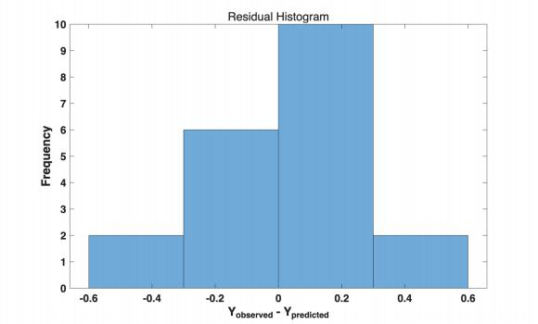
Introduction & Background Model Description Data Overview Forward Problem Parameter Selection OLS Results Model Diagnostics Optimal Experimental Design Bootstrapping Conc lusions
Residual Analysis
5 Assumptions:
✓ Zero mean (≈ 0.064)
△ Constant variance
△ Uncorrelated (runs = 6 < 10.5)
✓ Normality
✓ Correct model
Fig 7 . Residual scatter
Fig 8 . Residual histogram
Team 2026 年 4 月 14 日 Salmonella Gompertz Model 12 / 18

Slide 13
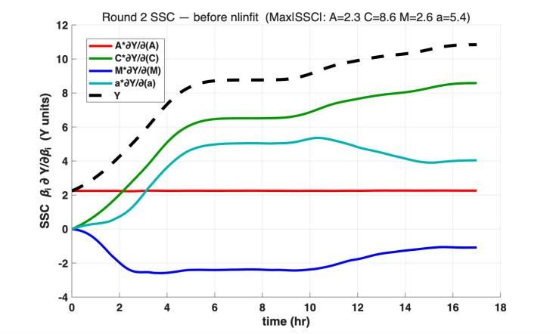
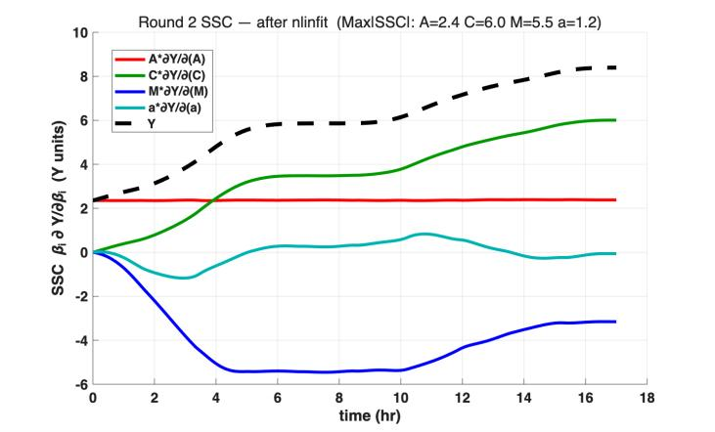
Introduction & Background Model Description Data Overview Forward Problem Parameter Selection OLS Results Model Diagnostics Optimal Experimental Design Bootstrapping Conc lusions
SSC Convergence —Before & After Estimation
Fig 9a. SSC (initial guess)
Fig 9b. SSC (after OLS)
SSC Convergence
Consistent SSC shapes before & after estimation → parameters stable and identifiable.
· · G , ·
Team 2026 年 4 月 14 日 Salmonella Gompertz Model 13 / 18

Slide 14
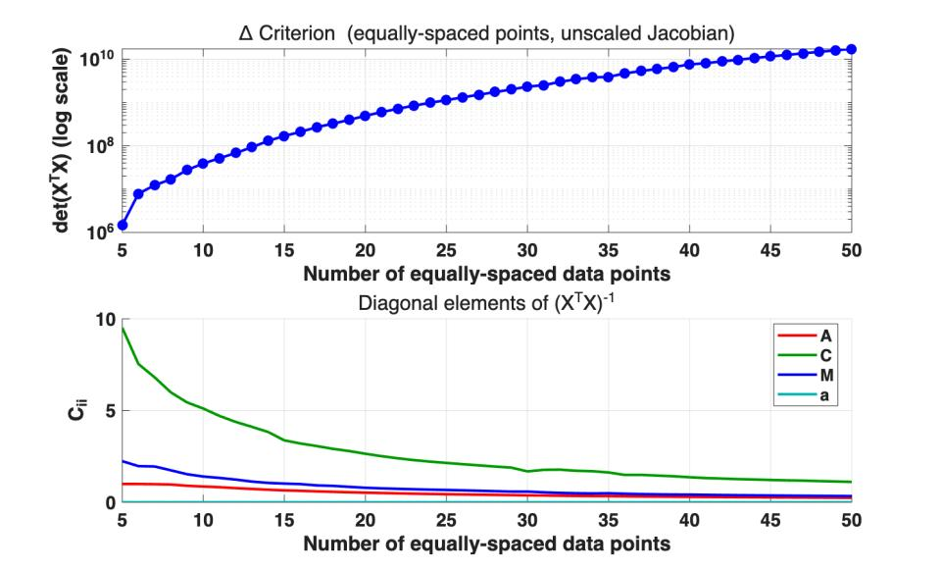
Introduction & Background Model Description Data Overview Forward Problem Parameter Selection OLS Results Model Diagnostics Optimal Experimental Design Bootstrapping Conc lusions
Optimal Experimental Design
• Equally-spaced linspace points (consistent with inv_soln5.m); unscaled Jacobian J = ∂Y/∂β
• ∆ criterion increases
monotonically ⇒ more data always helps
• C_{ii} (parameter variance)
decreases with more data points for all 4 parameters
Fig 10 . ∆ criterion and Cii vs . data points
Team 2026 年 4 月 14 日 Salmonella Gompertz Model 14 / 18

Slide 15
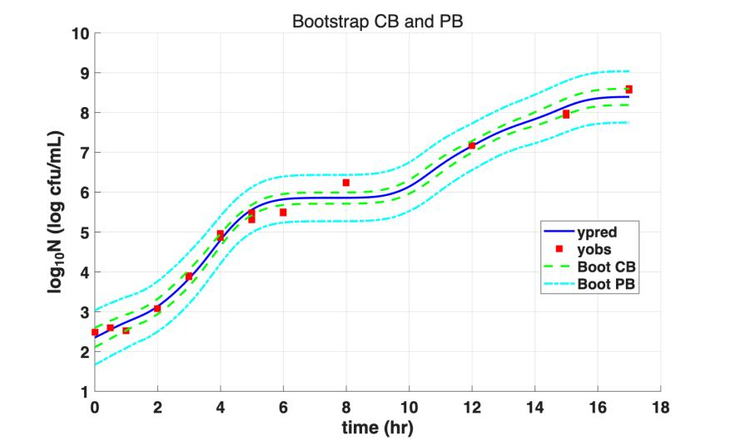
Introduction & Background Model Description Data Overview Forward Problem Parameter Selection OLS Results Model Diagnostics Optimal Experimental Design Bootstrapping Conc lusions
Bootstrapping of Residuals
600 bootstrap iterations (residual resampling), 600/600 valid.
Param | Bootstrap 95% CI | Asymptotic 95% CI
A | [2.113, 2.596] | [2.059, 2.645]
C | [10.63, 12.02] | [10.41, 11.98]
M | [5.174, 5.850] | [5.172, 5.946]
a | [2.57e-4, 3.88e-4] | [2.0e-4, 4.0e-4]
Fig 11 . Bootstrap CB and PB
Team 2026 年 4 月 14 日 Salmonella Gompertz Model 15 / 18

Slide 16
Introduction & Background Model Description Data Overview Forward Problem Parameter Selection OLS Results Model Diagnostics Optimal Experimental Design Bootstrapping Conc lusions
Asymptotic vs Bootstrap Comparison
Metric | Asymptotic | Bootstrap
CB width (avg) | 0.687 | 0.340
PB width (avg) | 1.858 | 1.220
• Bootstrap CB is 2 × narrower; Bootstrap PB is 1.5 × narrower
• Asymptotic method overestimates uncertainty for this nonlinear model
• Bootstrap provides more realistic uncertainty quantification
· · G , ·
Team 2026 年 4 月 14 日 Salmonella Gompertz Model 16 / 18

Slide 17




Introduction & Background Model Description Data Overview Forward Problem Parameter Selection OLS Results Model Diagnostics Optimal Experimental Design Bootstrapping Conc lusions
Conclusions
1 Modified Gompertz model successfully predicts Salmonella growth under sinusoidal temperature
2 Parameter selection: SSC analysis ⇒ fix T_{min} , b (low SSC) and T_{max} (C–T_{max} collinearity R = −0.991); estimate [A, C, M, a] (7 → 4 direct elimination)
3 Robust OLS fit: cond(J) = 1.19 × 10⁴ , relRMSE = 3.72% , R² = 0.989; all |R_{ij} | < 0.60 ; residual autocorrelation (runs = 6 < 10.5) suggests model improvement potential
4 Bootstrap CI narrower than asymptotic CI (2× for CB, 1.5 × for PB) ⇒ asymptotic method overestimates uncertainty
Team 2026 年 4 月 14 日 Salmonella Gompertz Model 17 / 18

Slide 18
Introduction & Background Model Description Data Overview Forward Problem Parameter Selection OLS Results Model Diagnostics Optimal Experimental Design Bootstrapping Conc lusions
References I
[1] Lavanya Gumudavelli, Prem Rishi Velugoti, Ramaswamy C Anantheswaran, John D Floros, and Stephen J Knabel.
Dynamic predictive model for growth of Salmonella Enteritidis in egg yolk.
Journal of Food Science, 72(7):M254–M262, 2007 .
Team 2026 年 4 月 14 日 Salmonella Gompertz Model 18 / 18

