Slide 1
AI-Driven Transformation in Banking GRC:
Implications for Workforce Management in UK and EU Banks
Narentheran S | Roll No. 2406OBA0034 | Reg. No. 69124100089
Online MBA, Centre for Distance and Online Education, Anna University, Chennai
Guide: Dr. RAMYA J, Associate Professor & Head, Department of Management Studies
Viva voce | October 2026
AI-Driven Transformation in Banking GRC | Narentheran S | Viva voce
1
Notes:
Good morning. My project is titled "AI-Driven Transformation in Banking GRC: Implications for Workforce Management in UK and EU Banks", carried out under the guidance of Dr. Ramya J. In one line: I studied what happens to the people in banks' governance, risk and compliance functions when AI comes in, and what management should do about it.

Slide 2
AI is entering bank risk and compliance faster than people can govern it
75%
46%
57%
of UK financial firms
already use AI
have only a partial understanding
of the AI they use
say talent and skills
are a constraint
Adoption is not the problem. Understanding and skills are.
Source: Bank of England & FCA (2024), Artificial intelligence in UK financial services
AI-Driven Transformation in Banking GRC | Narentheran S | Viva voce
2
Notes:
Let me start with why this matters. The Bank of England and FCA survey of 2024 found that 75% of UK financial firms already use AI. But look at the number in red: 46% of firms say they only partly understand the AI they use, and 57% say talent and skills are a constraint. So adoption is not the problem. The problem is that the technology is moving faster than the people who have to govern it. In risk and compliance that gap is dangerous, because these are the people who answer to regulators.

Slide 3
This is a management problem, and regulation makes it urgent
Four decisions managers now face
Regulation
Which GRC roles to redesign, reduce or create
Whether to build, buy or borrow skills
DORA
board & staff ICT competence
EU AI Act
AI literacy, human oversight
PRA SS1/23
skilled model validators
How to shape the team
How to get staff to trust AI appropriately
SM&CR
named personal accountability
Competence and human oversight are now legal obligations
AI-Driven Transformation in Banking GRC | Narentheran S | Viva voce
3
Notes:
When AI takes over routine monitoring and reporting, managers face four decisions: which roles to redesign, reduce or create; whether to build, buy or borrow skills; how to shape the team; and how to get staff to trust AI appropriately, neither blindly nor not at all. On the right are four regulations. DORA requires board and staff ICT competence. The EU AI Act requires AI literacy and human oversight. The PRA's SS1/23 requires skilled model validators, and SM&CR makes named senior managers personally accountable. Together they make competence and human oversight a legal obligation, not just an HR preference. A bank that automates a control without people who can challenge it hasn't removed the risk; it has moved it.

Slide 4
Objectives: build the evidence, then turn it into a framework
Primary: examine how AI in GRC is reshaping workforce decisions (role structure, skills, staffing, employee adaptation) and develop a practical framework for management.
i
Which GRC activities are automated or augmented, and the effect on role demand
ii
How DORA, the AI Act, SS1/23 and SM&CR shape oversight and competence
iii
Emerging skill gaps and reskilling strategies
iv
Employee responses: usefulness, trust, replaceability
v
An integrated workforce transformation framework and recommendations
AI-Driven Transformation in Banking GRC | Narentheran S | Viva voce
4
Notes:
My primary objective was to examine how AI is reshaping workforce decisions in GRC (roles, skills, staffing and employee adaptation) and to build a practical framework for management. The five secondary objectives follow from it: which activities are automated or augmented, how regulation shapes oversight and competence, where the skill gaps are, how employees respond, and finally, in red, the framework. The first four build the evidence; the fifth turns it into something a bank can use.

Slide 5
Three bodies of research, and none of them looks at the GRC workforce
Technology acceptance & trust
Davis (1989)
Glikson & Woolley (2020)
Automation & work
Autor (2015)
Frey & Osborne (2017)
Cascio & Montealegre (2016)
Brougham & Haar (2018)
Research gap
Workforce management inside regulated banking GRC: roles, skills, staffing and adaptation
GAP
RegTech
Arner et al. (2017)
Buckley et al. (2020)
AI-Driven Transformation in Banking GRC | Narentheran S | Viva voce
5
Notes:
I reviewed eight core sources in three streams. First, technology acceptance and trust: Davis's Technology Acceptance Model says people use technology they find useful and easy to use, and Glikson and Woolley show that trust in AI depends on transparency and reliability. Second, automation and work: Autor argues that automation replaces routine tasks but complements judgement, so jobs are recomposed rather than eliminated; Frey and Osborne show routine work is most exposed; Cascio and Montealegre frame technology change as an HR and organisation-design problem; and Brougham and Haar show that employees who feel replaceable become less committed and more likely to leave. Third, RegTech: Arner and colleagues, and Buckley and colleagues, show that technology and regulation are reshaping compliance work itself. The gap, in red, is the overlap: none of them studies workforce management inside regulated banking GRC.

Slide 6
The literature gave four propositions to test
 | Proposition | Grounded in
P1 | Routine GRC tasks are automated first; judgement work is augmented | Autor (2015); Frey & Osborne (2017)
P2 | Regulation turns competence and oversight into obligations | Buckley et al. (2020); DORA, AI Act, SS1/23, SM&CR
P3 | AI needs a hybrid technical + regulatory skill profile | Cascio & Montealegre (2016)
P4 | Losing expert knowledge is a hidden restructuring risk EMERGENT | Interviews (extends Autor, 2015)
AI-Driven Transformation in Banking GRC | Narentheran S | Viva voce
6
Notes:
From that review I set four propositions. P1, from Autor and Frey and Osborne: routine GRC tasks are automated first and judgement work is augmented. P2, from Buckley and colleagues and the regulations: regulation turns competence and oversight into obligations. P3, from Cascio and Montealegre: AI needs a hybrid profile of technical and regulatory skills. P4 is marked "emergent" because it was not in my original plan. It came out of the interviews: losing experienced people's knowledge is a hidden risk of restructuring.

Slide 7
A sequential exploratory mixed-methods design
1 LISTEN
Interviews + questionnaire
Themes T1–T10
2 TEST
Hypotheses H5–H10
on public data D1–D4
3 COMPARE
Triangulation
P1–P4 verdicts + framework
The interviews decided what to test. The public data showed whether it holds across the industry.
The public datasets are independent sources; they were not produced from the interviews.
AI-Driven Transformation in Banking GRC | Narentheran S | Viva voce
7
Notes:
My design has three steps. Step one, listen: written interviews with GRC practitioners and senior professionals gave ten themes, and a questionnaire measured how strongly practitioners agree with them. Step two, test: I turned each testable theme into a hypothesis and tested it on public industry data. Step three, compare: I triangulated everything against the four propositions and built the framework. The key point is this. The interviews decided *what* to test; the public data showed *whether it holds* across the industry. The public datasets are independent sources and were not produced from my interviews. This is a recognised design called sequential exploratory mixed methods: qualitative first, quantitative second.

Slide 8
Two kinds of evidence: practitioners, and four public datasets
Primary
Secondary (public)
Written semi-structured interviews: 11 questions, 5 sections
Questionnaire: 25 Likert items, 7 constructs adapted from Davis; Glikson & Woolley; Brougham & Haar
Sampling: purposive + snowball; GRC professionals exposed to AI
D1
Eurostat
AI adoption, 27 EU countries, 2021–2025
D2
Bank annual reports
Large UK/EU banks, FY2022 vs FY2025; 19 paired
D3
Reed job adverts
163 UK financial-services GRC adverts
D4
Published surveys
BoE/FCA 2022 & 2024, IIA, Thomson Reuters
AI-Driven Transformation in Banking GRC | Narentheran S | Viva voce
8
Notes:
On the primary side, the interview form had eleven open questions in five sections, done in writing because the respondents were senior and busy. The questionnaire had 25 Likert items in seven constructs, adapted from Davis, Glikson and Woolley, and Brougham and Haar. Sampling was purposive with snowball referral, because I needed people with real exposure to AI in GRC. On the secondary side, four public datasets each answer a different question. D1, Eurostat, covers the economy: AI adoption in 27 EU countries. D2 covers the banks: annual reports of large UK and EU banks for FY2022 and FY2025, with 19 banks having both years. D3 covers the job market: 163 UK GRC job adverts. D4 covers the profession: published surveys from the Bank of England and FCA, the IIA and Thomson Reuters.

Slide 9
Every hypothesis traces back to something practitioners said
Interview theme | Questionnaire signal | Public-data hypothesis
T1 AI spreading, still pilot-heavy | Role will change: 4.33 | H5a, H8: adoption is rising
T2/T3 Routine work absorbed | Usefulness: 3.58 | H10a AI mentions; H6 skill mix in adverts
T4/T5 Humans must challenge AI | Can defend AI decision: 4.33 | H10b: AI governance bodies
T6 Regulation felt unevenly | Oversight clear: 3.67 | H10a regulation mentions; H10d UK vs EU
T7 Hybrid skills | Data skills more important: 4.00 | H5b, H6, H7: skills and pay
T8/T9 Training lags, knowledge at risk | Training adequate: 3.33 | H9 skills constraint; H10c reskilling vs AI
T10 Anxiety, weak change management | Replaceability concern: 3.89 | Not testable on public data
AI-Driven Transformation in Banking GRC | Narentheran S | Viva voce
9
Notes:
This slide is the bridge in my design. Take the first row. Practitioners said AI is spreading but still pilot-heavy, and the questionnaire showed strong agreement that roles will change, at 4.33. That became H5a and H8: is AI adoption actually rising? Row two: routine work is being absorbed, which became H10a on AI mentions in bank reports and H6 on the skill mix in job adverts. Practitioners said humans must be able to challenge AI, which became H10b: are banks setting up AI governance bodies? Regulation is felt unevenly, which became H10d: do UK and EU banks differ? Hybrid skills became H5b, H6 and H7. And the row in red: practitioners rated training adequacy lowest, at 3.33, which became H9 and H10c: is reskilling keeping up with AI? Every test exists because a theme pointed to it.

Slide 10
Each test was chosen by the shape of the data
Same countries/banks measured twice
Paired t-test + Wilcoxon; Friedman (4 yrs)
H5a, H10a
Yes/no for the same banks, two years
Exact McNemar
H10b
Two independent, skewed groups
Mann–Whitney U
H7, H10d
Yes/no skill flags across two groups
Chi-square / Fisher + Holm
H6
Only published percentages
Two-proportion & one-sample z
H8, H9
Strength of a link
Pearson / Spearman / OLS
H5b, H10c
Questionnaire: descriptive only (means/SD vs neutral 3); significance tests are not meaningful on a small purposive sample
AI-Driven Transformation in Banking GRC | Narentheran S | Viva voce
10
Notes:
I chose each test by asking what the data looks like. Where the same countries or banks are measured twice, I used a paired t-test, with a Wilcoxon signed-rank test as a check that doesn't assume normality, because bank data is small and skewed. Friedman covers all four Eurostat years. Where the outcome is yes or no for the same banks in two years, does the bank name an AI governance body, I used the exact McNemar test. For two independent, skewed groups, UK versus EU banks or salaries, I used Mann–Whitney U. For yes/no skill flags across two groups of adverts, I used chi-square, or Fisher where counts are small, with a Holm correction because I tested six skills at once. Where I only have published percentages, I used z-tests. For the strength of a link, I used Pearson, Spearman and a simple regression. Finally, in red: the questionnaire is descriptive only. On a small purposive sample, significance tests are not meaningful, so I compare means with the neutral point of 3 and let the public data carry the statistics.

Slide 11
Practitioners: routine work goes; judgement and knowledge matter more
"GRC testing roles have disappeared."
"C-level execs really do not understand what the AI is, and thus are likely to simply trust it."
"Too much business knowledge exists in people's heads… I would prioritise knowledge capture and transfer before any significant workforce reductions."
Ten themes by objective: (i) automation precedes AI · routine absorbed · roles recomposed (ii) expert review · accountability gap · regulation uneven (iii) hybrid skills · knowledge loss · build-buy-borrow (iv) ease welcomed, anxiety, weak change management
AI-Driven Transformation in Banking GRC | Narentheran S | Viva voce
11
Notes:
Now the findings, starting with what practitioners told me. Three quotes capture it. "GRC testing roles have disappeared": routine execution work goes first. "C-level execs really do not understand what the AI is, and thus are likely to simply trust it": the people formally accountable may understand AI least, which is a real risk under SM&CR. And "too much business knowledge exists in people's heads… prioritise knowledge capture before any significant workforce reductions". That last quote became proposition P4. Underneath are the ten themes grouped by objective.

Slide 12
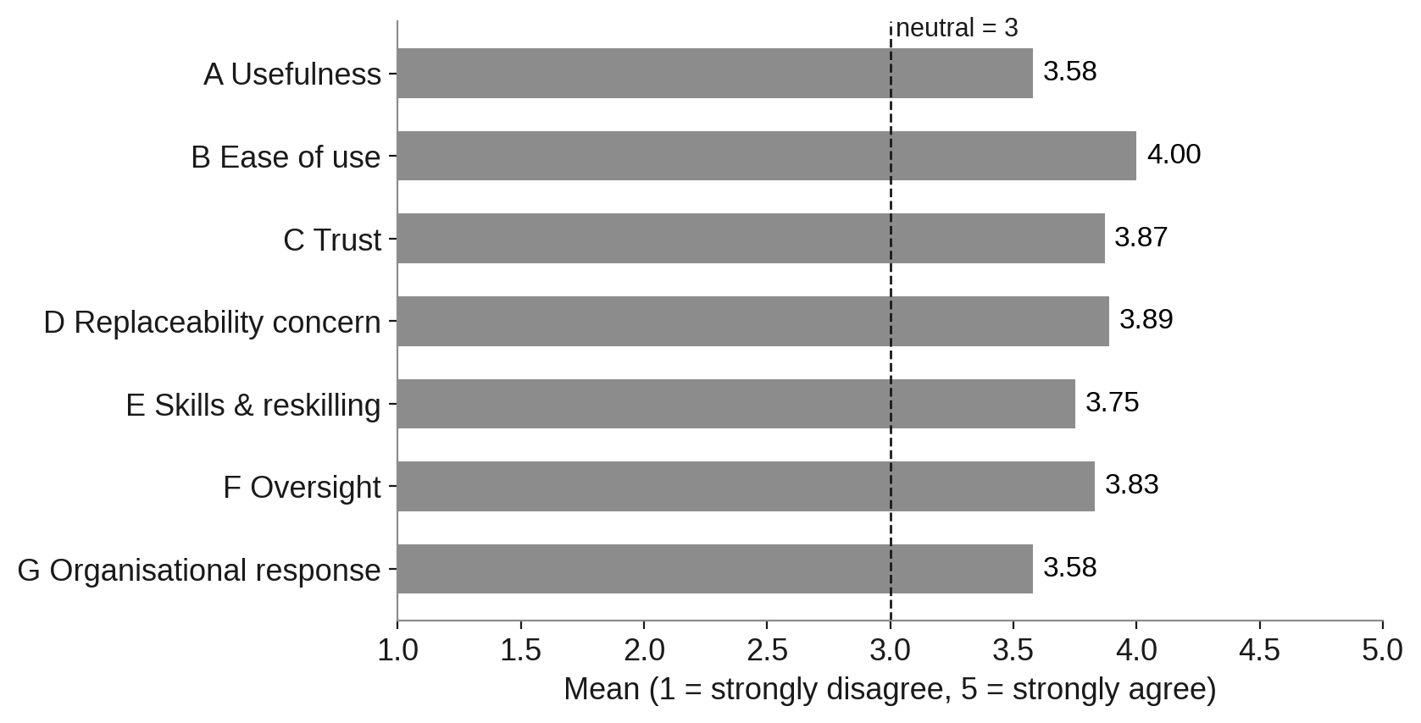
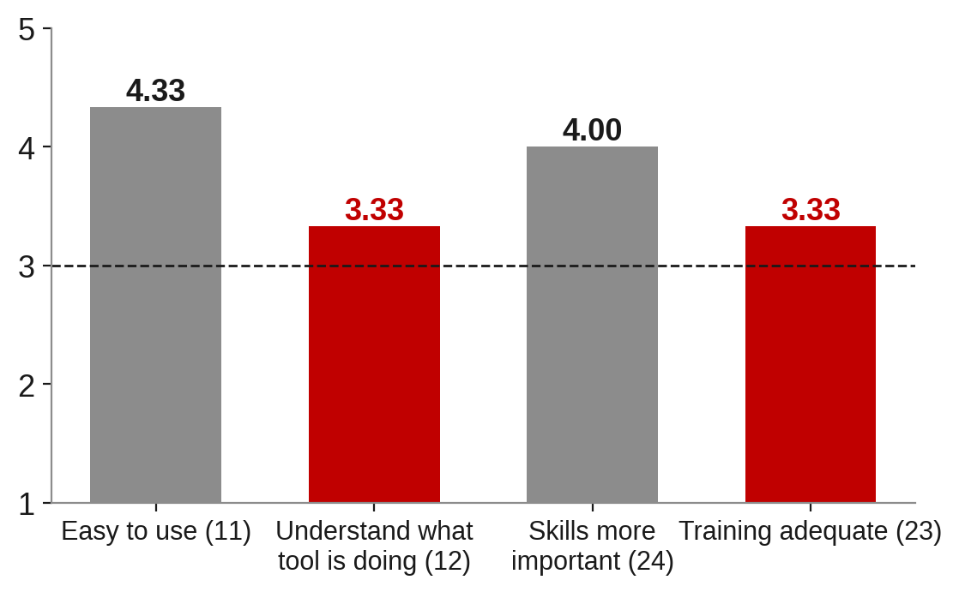
Questionnaire: easy to use but hard to see into, and training lags
Usability–transparency gap: 4.33 vs 3.33
Training gap: skills matter more (4.00), training adequate 3.33
Descriptive means only; not generalised
AI-Driven Transformation in Banking GRC | Narentheran S | Viva voce
12
Notes:
All seven constructs sit above the neutral point of 3. Ease of use is highest, at 4.00. But the gaps tell the real story. On the right: the tools are easy to use, 4.33, but understanding what the tool is doing is only 3.33. That is a usability–transparency gap, exactly the transparency dimension of trust in Glikson and Woolley. And while practitioners say data skills are more important, at 4.00, training adequacy is the lowest skills item, at 3.33. I report these as means and standard deviations only, descriptive and not generalised.

Slide 13
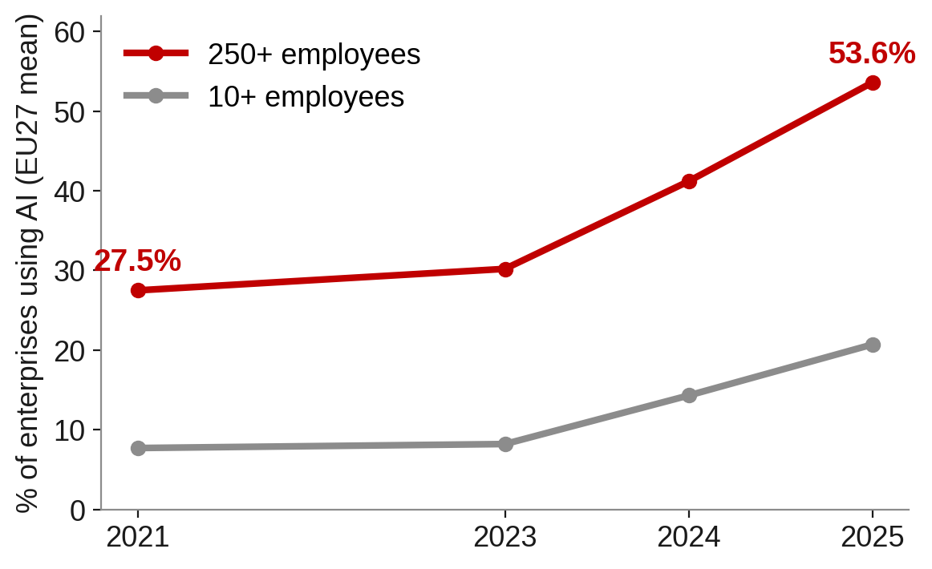
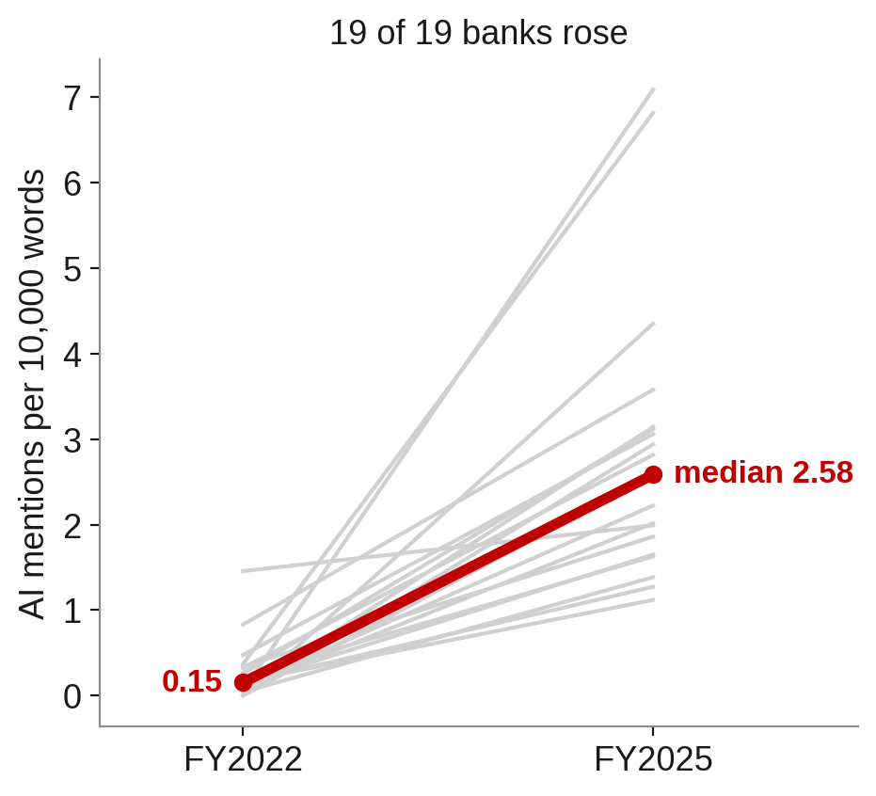
AI adoption is surging everywhere (H5a, H8, H10a supported)
EU large firms 27.5% → 53.6%, up in 27/27 countries (p < 0.0001) | UK FS firms 58% → 75% (p = 0.008) | Bank AI mentions ≈10×, up in 19 of 19 banks (p < 0.0001)
AI-Driven Transformation in Banking GRC | Narentheran S | Viva voce
13
Notes:
The public data confirm the first theme from three independent directions. On the left, Eurostat: AI adoption among large EU firms nearly doubled, from 27.5% in 2021 to 53.6% in 2025, and it rose in all 27 countries, p below 0.0001. UK financial firms using AI rose from 58% to 75%, p = 0.008. On the right, each grey line is one bank. AI mentions per 10,000 words rose about tenfold between FY2022 and FY2025, and in every one of the 19 paired banks. That is why the Wilcoxon statistic is at its maximum possible value of 190. Three sources, one direction.

Slide 14
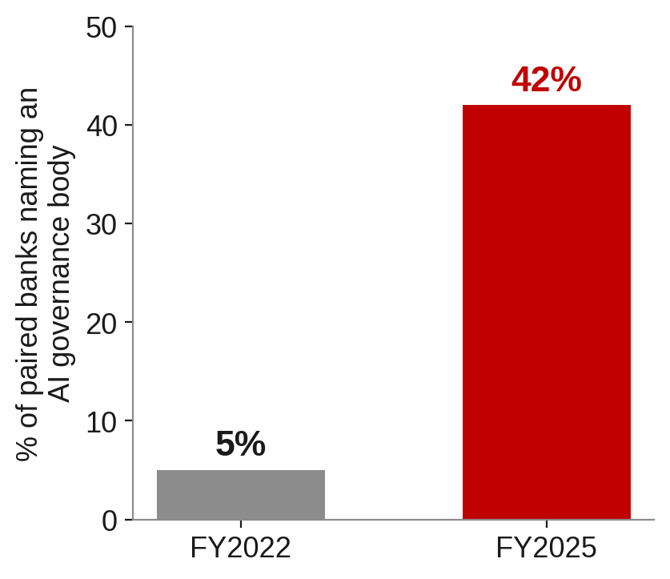
Governance structures are growing faster than governance practice
Banks naming an AI governance body: 5% → 42% (7 added, 0 dropped; exact McNemar p = 0.016)
AI Act / DORA / SS1/23 mentions: near zero → routine; 18 of 19 banks up (p < 0.0001)
Broader AI-governance wording flat (p ≈ 0.07)
UK > EU on AI and AI-governance mentions (Holm p = 0.007 and 0.0004)
AI-Driven Transformation in Banking GRC | Narentheran S | Viva voce
14
Notes:
On regulation and governance, banks are clearly building structures. The share of paired banks naming a dedicated AI governance body (an AI committee, a chief data or AI officer, a responsible-AI office) went from 5% to 42%. Seven banks added one and none dropped one; the exact McNemar test gives p = 0.016. Mentions of the AI Act, DORA and SS1/23 went from almost zero to routine. But in red: broader AI-governance wording, such as human oversight, explainability and model risk, did not rise significantly, p about 0.07. And UK banks talk about AI and AI governance more than EU banks, consistent with the UK's accountability regime. So structures are ahead of practice, which matches the practitioner view that oversight exists on paper but is not yet embedded.

Slide 15
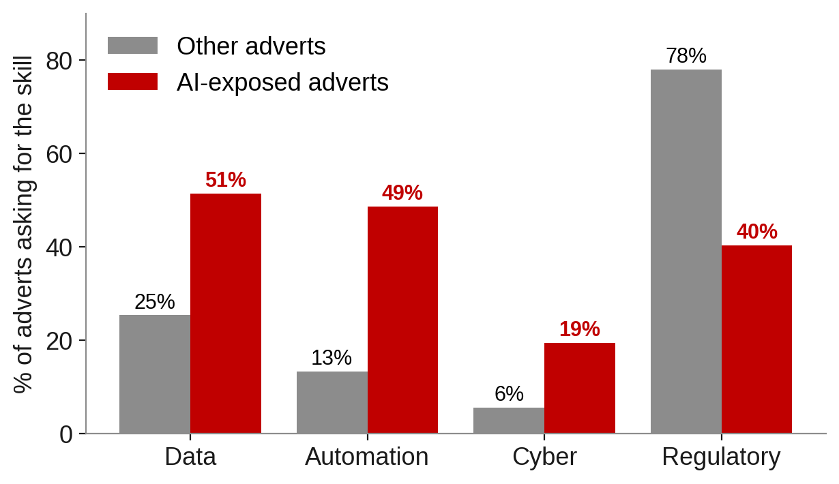
Skills are shifting, but reskilling is not keeping up
AI-exposed adverts want more data, automation and cyber skills but fewer regulatory skills (all Holm p < 0.05): the hybrid gap
AI-titled roles: median £90k vs £60k (p = 0.009; small group)
Reskilling mentions not linked to AI intensity (ρ = −0.16, p = 0.49)
AI-Driven Transformation in Banking GRC | Narentheran S | Viva voce
15
Notes:
In the job adverts, AI-exposed roles ask for data skills about twice as often, 51% versus 25%; automation nearly four times as often; and cyber skills more often. But they ask for regulatory skills far less often, 40% versus 78%. All of these are significant after Holm correction. That is the hybrid gap: employers hire technical profiles for AI work, while practitioners and regulators say regulatory judgement still matters. Roles with AI in the title pay a median of £90,000 against £60,000, but that group is small, so I treat it as indicative. And in red: bank reports' reskilling mentions are not linked to AI intensity, with a Spearman rho of minus 0.16, not significant. AI talk has grown far faster than reskilling talk.

Slide 16
Hypothesis scorecard
Hypothesis | Verdict
H1–H3 Useful, easy to use, roles will change (questionnaire) | ● Supported (descriptive)
H4 Trust is conditional | ◐ Partly
H5a, H5b EU adoption rising; ICT skills linked | ● Supported
H6 Skill mix differs in AI adverts | ● Supported
H7 AI roles pay more | ◐ Partly (AI-titled only)
H8 UK FS adoption rose | ● Supported
H9 Skills a majority constraint | ◐ Partly
H10a AI, reskilling, regulation mentions rose | ● Supported
H10a AI-governance wording rose | ○ Not supported
H10b More AI governance bodies | ● Supported
H10c AI and reskilling linked | ○ Not supported
H10d UK and EU differ | ◐ Partly (AI, AI governance)
AI-Driven Transformation in Banking GRC | Narentheran S | Viva voce
16
Notes:
Here is the full scorecard. Most hypotheses are supported: adoption, the ICT-skills link, the skill mix, the governance bodies and the rise in AI, reskilling and regulation disclosure. Four are partly supported: conditional trust, the pay premium, the skills constraint and the UK–EU difference. Two are not supported, in red: AI-governance wording did not rise, and reskilling is not linked to AI intensity. I want to stress that the unsupported results are findings too. They show exactly where banks are lagging.

Slide 17
Triangulation: all four propositions hold
 | Interviews | Questionnaire | Public data | Verdict
P1 Routine automated first | T1–T3 | Role change 4.33 | H5a, H8, H10a | Supported
P2 Regulation → obligations | T4–T6 | Items 26–27 | H10a reg, H10b, H10d | Texts & structures; partly in practice
P3 Hybrid skills | T7, T9 | Items 24–25 | H6, H5b, H9 | Supported
P4 Knowledge-loss risk | T8 | – | Indirect (H10c) | Qualitative; emergent contribution
AI-Driven Transformation in Banking GRC | Narentheran S | Viva voce
17
Notes:
Bringing the three streams together: P1, routine work automated first, is supported by the interviews, the job descriptions and the adoption tests. P2, regulation creating obligations, is supported in regulatory texts and governance structures, but only partly in day-to-day practice. P3, the hybrid skill profile, is supported by the interviews, the adverts and the surveys. P4, knowledge loss, is supported qualitatively, because public data cannot measure tacit knowledge directly, so I present it as an emergent contribution. Where practitioners and public data agree, I'm confident; where only practitioners speak, I say so.

Slide 18
AI changes the composition of GRC work, not just its volume
AUTOMATED
Data consolidation · reconciliation · MI · first-level alert triage · periodic KYC refresh
AUGMENTED
Alert investigation · KYC/CDD judgement · model validation · audit fieldwork · regulatory change
NEWLY CREATED
AI governance lead · AI model-risk validator · AI audit lead · human-in-the-loop supervisor of AI agents
HUMAN-RETAINED
Interpreting regulatory intent · challenging decisions · assurance to boards · final accountability (SM&CR, DORA)
AI-Driven Transformation in Banking GRC | Narentheran S | Viva voce
18
Notes:
This is the first output: the GRC role-impact map. Automated: data consolidation, reconciliation and first-level alert triage. Augmented: investigation, KYC judgement and model validation. Newly created: AI governance leads, AI model-risk validators and supervisors of AI agents. And in red, human-retained: interpreting regulatory intent, challenging decisions and final accountability. Jobs are recomposed, not simply removed, which is Autor's argument, now observed inside a regulated bank.

Slide 19
A seven-stage framework: protect knowledge before restructuring
1
Diagnose
2
Protect knowledge
3
Redesign roles
4
Build oversight competence
5
Reskill & source
6
Secure trust
7
Lead change & retain
Why this order? The experts whose routine work is automated are the same people needed to validate the AI.
Enablers: data quality & lineage · clear accountability map · workforce indicators tracked alongside AI indicators
AI-Driven Transformation in Banking GRC | Narentheran S | Viva voce
19
Notes:
The second output, and the answer to objective five, is a seven-stage framework: diagnose which activities are exposed; protect knowledge; redesign roles; build oversight competence; reskill and source through build, buy or borrow; secure trust and adoption; and lead change and retain talent. The most important design choice is the order, shown in red. Knowledge protection comes before any restructuring, because the experts whose routine work is automated are the same people needed to validate the AI. Three enablers run across all stages: data quality, a clear accountability map, and tracking workforce indicators alongside AI indicators.

Slide 20
Recommendations, conclusion and limits
GRC leaders
HR
Boards & senior managers
Map activities, not job titles
Capture knowledge before cutting roles
Make oversight operational
Close the training gap: role-tiered AI literacy
Build, buy, borrow deliberately
Career paths for junior staff
Close the AI-understanding gap at the top
Pair every AI plan with a people plan
Track workforce indicators
Conclusion: AI in GRC succeeds only if the people who answer for it can understand and challenge it.
Limits: small purposive primary sample (analytical generalisation) · disclosure ≠ action · 19 paired banks · one UK job board
Next: larger surveys · annual tracking of reports and adverts · EU job data · in-bank case studies
AI-Driven Transformation in Banking GRC | Narentheran S | Viva voce
20
Notes:
My recommendations go to three audiences. GRC leaders should map exposure at the level of activities, not job titles, and capture knowledge before cutting roles. HR should close the training gap with role-tiered AI literacy and create visible career paths for junior staff. Boards and senior managers should close the AI-understanding gap at the top and pair every AI plan with a people plan. On limits: the primary sample is small and purposive, so it supports analytical rather than statistical generalisation; disclosure counts measure words, not actions; I have 19 paired banks and one UK job board. Future work should use larger surveys, track banks over time and add EU job data. My conclusion: AI in GRC succeeds only if the people who answer for it can understand and challenge it.

Slide 21
Thank you
Questions welcome
AI in GRC succeeds only if the people who answer for it can understand and challenge it.
AI-Driven Transformation in Banking GRC | Narentheran S | Viva voce
21
Notes:
Thank you. I'm happy to take your questions.

Slide 22
Backup: D2 bank sample and coding
Both years (19): ABN AMRO, BBVA, Banco Santander, Bank of Ireland, Barclays, Danske Bank, Deutsche Bank, Erste Group, Groupe BPCE, HSBC, Intesa Sanpaolo, KBC, NatWest, Nationwide, Nordea, Santander UK, Société Générale, Standard Chartered, UniCredit
FY2025 only: Handelsbanken, ING, SEB | FY2022 only: Rabobank
Not coded: AIB, BNP Paribas, CaixaBank, Commerzbank, Crédit Agricole, Lloyds (no full English report / access blocked)
Coding: fixed keyword lists for AI, reskilling, AI governance and regulation; count ÷ total words × 10,000; binary flag for a named AI governance body. Each file checked against its title page.
AI-Driven Transformation in Banking GRC | Narentheran S | Viva voce
B1
Notes:
Use this if asked which banks were included or how mentions were counted. Nineteen banks have both years, three have FY2025 only and one has FY2022 only; six were not coded because no full English report was available or the site blocked automated access. Counting used fixed keyword lists, divided by report length and multiplied by 10,000.

Slide 23
Backup: full H10 results
Test | Statistic | p | Effect | n
AI density, paired t / Wilcoxon | t = 6.61 / W = 190 | <0.0001 | +2.61; 19/19 up | 19
Reskilling density | t = 2.09 / W = 142 | 0.026 / 0.030 | +0.16; 13/19 up | 19
AI-governance density | t = 1.56 / W = 132 | 0.068 / 0.072 | +0.15; 13/19 up | 19
Regulation density | t = 5.42 / W = 171 | <0.0001 | +0.20; 18/19 up | 19
AI governance body, exact McNemar | – | 0.016 | 7 up, 0 down | 19
AI vs reskilling, Spearman (FY2025) | ρ = −0.16 | 0.487 |  | 22
UK vs EU AI density, Mann–Whitney | U = 87 | Holm 0.007 | 3.96 vs 2.00 | 6+16
UK vs EU reskilling | U = 23 | Holm 0.140 | 0.22 vs 0.42 | 6+16
UK vs EU AI governance | U = 94 | Holm 0.0004 | 2.01 vs 0.50 | 6+16
UK vs EU regulation | U = 45 | Holm 0.858 | 0.21 vs 0.15 | 6+16
AI-Driven Transformation in Banking GRC | Narentheran S | Viva voce
B2
Notes:
Use this if asked for exact statistics. Point out that the t-test and Wilcoxon agree on every measure, and that the Holm correction was applied to the four UK–EU comparisons.

Slide 24
Backup: questionnaire item means (1–5)
Item | Mean
7 Improves performance | 4.00
8 Increases volume | 3.33
9 Improves quality | 3.33
10 Useful overall | 3.67
11 Easy to use | 4.33
12 Understand what it does | 3.33
13 Easy to learn | 4.33
14 Understand outputs | 3.67
15 Outputs reliable | 3.67
16 Could defend decision | 4.33
17 Rely without re-performing | 3.67
18 Can override | 4.00
19 Role could be done by AI | 3.33
Item | Mean
20 Role will change | 4.33
21 Career concern | 4.00
22 Skills sufficient | 3.67
23 Training adequate | 3.33
24 Data skills more important | 4.00
25 Judgement more important | 4.00
26 Accountable people knowledgeable | 4.00
27 Oversight clear in practice | 3.67
28 Management communicated | 4.00
29 Positive about AI | 4.00
30 Would consider leaving | 3.67
31 Committed to organisation | 4.00
AI-Driven Transformation in Banking GRC | Narentheran S | Viva voce
B3
Notes:
Use this if asked about individual items. Point to items 11 vs 12 (usability vs transparency), 15 vs 17 (H4) and 23 (training).

Slide 25
Backup: regulation mapped to workforce obligations
Instrument | Workforce requirement | Implication
DORA (2022/2554) | Board ICT knowledge (Art. 5); training for all staff (Art. 13) | Capability becomes auditable; training records = evidence
EU AI Act (2024/1689) + Omnibus | AI literacy (Art. 4); effective human oversight (Art. 14) | Role-based AI literacy; trained overseers
PRA SS1/23 | Accountable SMF; documented lifecycle roles and validator skills | AI-capable model validation roles
SM&CR | Existing senior managers accountable for AI use | AI understanding gap = personal exposure
AMLR / AMLA (2024) | Compliance manager + AML compliance officer | Senior AML roles own AI-enabled monitoring
AI-Driven Transformation in Banking GRC | Narentheran S | Viva voce
B4
Notes:
Use this if asked about P2 or the regulatory analysis. Each regulation is linked to who must know what, and what evidence the bank must hold.

Slide 26
Backup: why the questionnaire is descriptive and public data carry the tests
Questionnaire: small purposive sample of senior practitioners, used to validate interview themes. Significance tests and Cronbach's alpha are not meaningful at this size, so means/SD are compared with the neutral point 3.
Interviews: free-text data, so thematic analysis is the right method.
Public data: large, independent samples (27 countries, 19 paired banks, 163 adverts, surveys of 71–6,506) allow proper inferential tests.
The interviews decided what to test; the public data tested whether it holds.
AI-Driven Transformation in Banking GRC | Narentheran S | Viva voce
B5
Notes:
Use this if asked about sample size or the absence of Cronbach's alpha. A small purposive sample cannot support significance tests or reliability coefficients, so the design uses it to validate themes. The public datasets provide large, independent samples for the statistics.

