Slide 1
Distributed Training
02457 Machine Learning Operations
Nicki Skafte Detlefsen,
Postdoc
DTU Compute

Slide 2
What is distributed computations?
Computing on multiple threads/devices/nodes in parallel
We focus on training as it is the most computationally expensive part but doing testing or inference can also be done in distributed manner
Distributed computing is not always beneficial:
Communication cost
Device utility

Slide 3
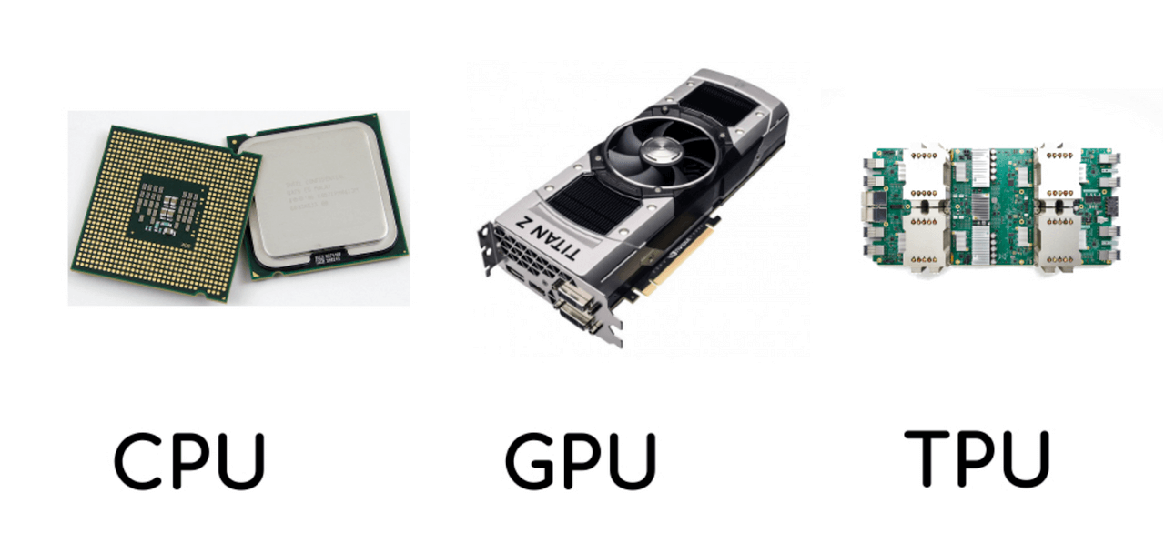
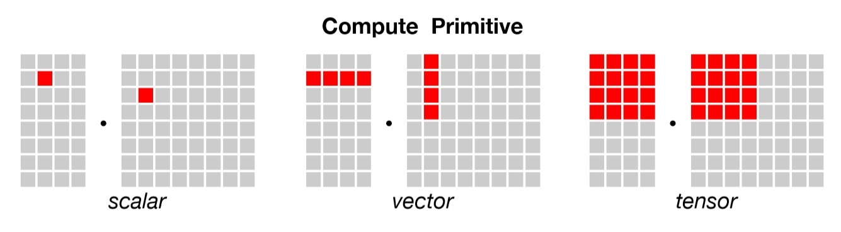
Devices
Three types of devices
CPU
General compute unit
2-128 threads
GPU
Rendering unit
1000-10000 threads
TPU
Specialized unit
8-2048 threads
Note that we are comparing apples to bananas!

Slide 4
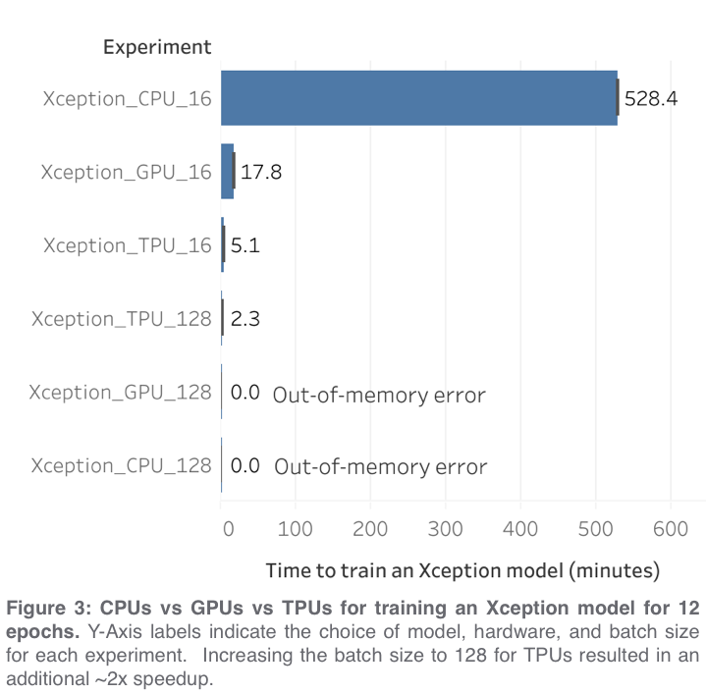
Memory
Equally important to what device you are using, is the amount of memory that you have available
With more memory
Faster data transfer
Higher data modality
Larger models
 | CPU | GPU | TPU
Standard | 32-64 GiB | 12 GiB | 64 GiB
Maximum | 256 GiB | 24 GiB | 32 TiB
https://towardsdatascience.com/when-to-use-cpus-vs-gpus-vs-tpus-in-a-kaggle-competition-9af708a8c3eb

Slide 5
Many layers of distributed computations
Data
Model
Experiment
Load data in paralle
Inference on data in parallel
Stack models in parallel
You may use multiple of these at the same time
Launch multiple experiments at once

Slide 6
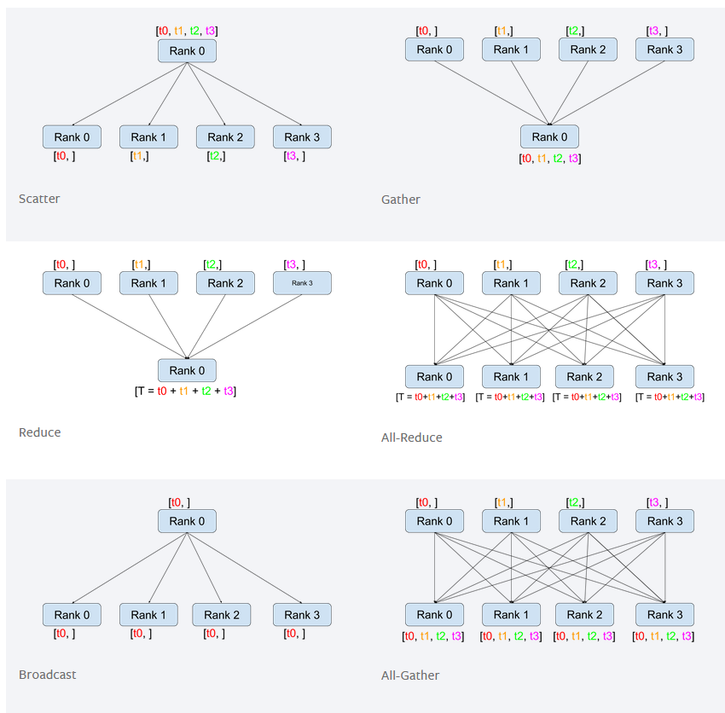
The six imporatnt communication types

Slide 7
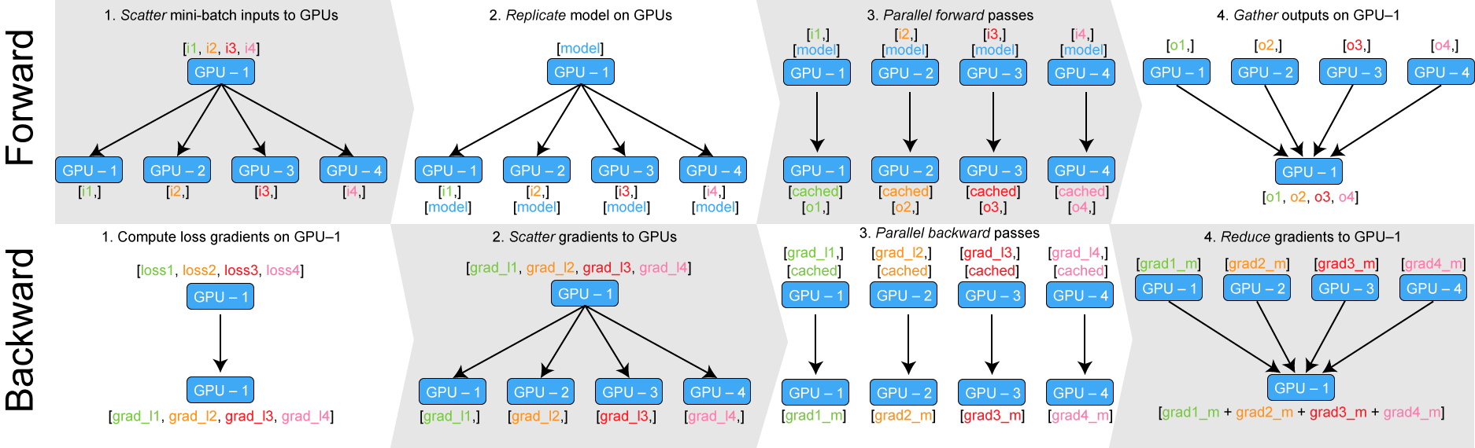
Data Parallel: one process controls all
Simple as parallel_model = torch.nn.DataParallel(model)
Note that only GPU-1 parameters are updated, the replicas are destroyed after backward

Slide 8
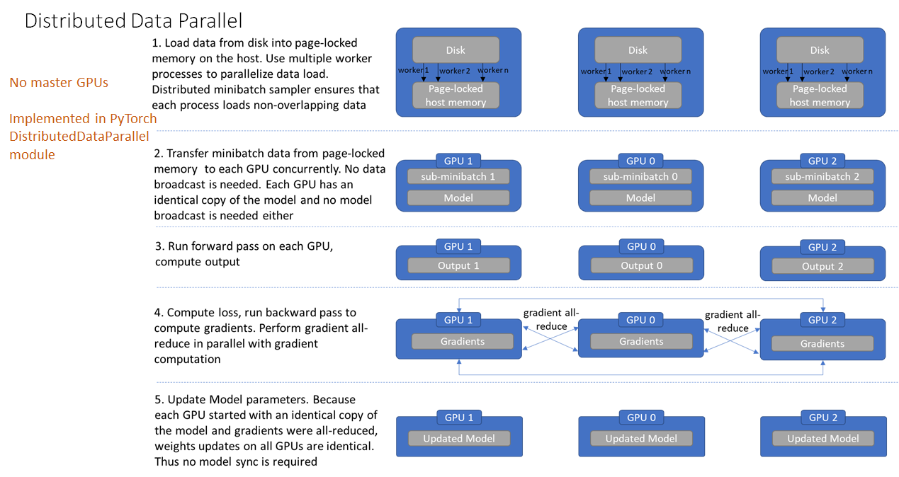
Distributed Data Parallel
In Distributed Data Parallel (DDP) all processes gets equal workload

Slide 9
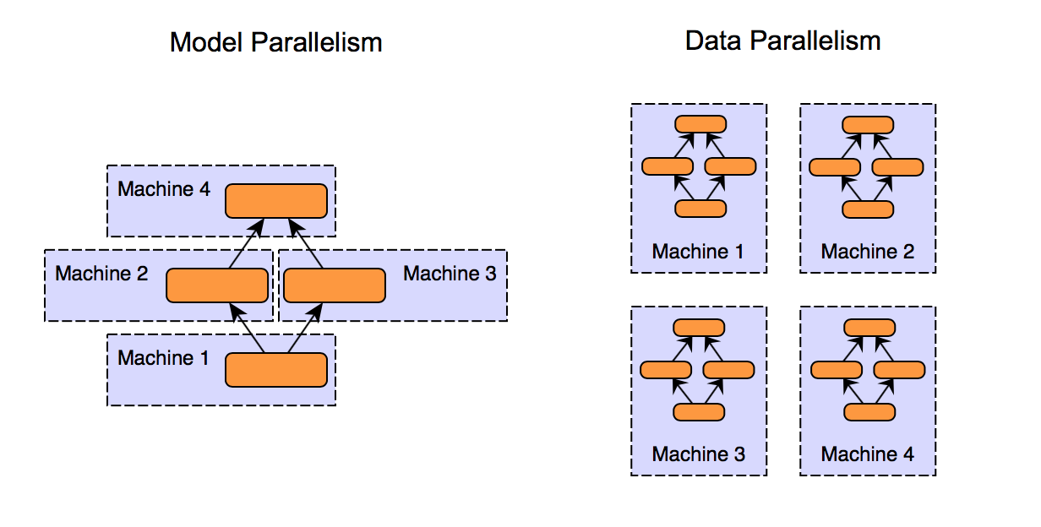
Model paralliseme
When your model is too big for one device

Slide 10
How to do this in practise
DataParallel
parallel_model = torch.nn.DataParallel(model)
Distributed Data Parallel
Set a enviroment MASTER_ADDR and MASTER_PORT
Init a process group
parallel_model = nn.parallel.DistributedDataParallel(model, device_ids=[gpu]
Use mp.spawn to spawn multiple processes
...
Model parallizeme
A shit ton of tensor.to(‘cuda:x’) calls

Slide 11
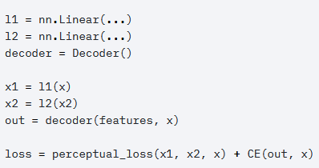
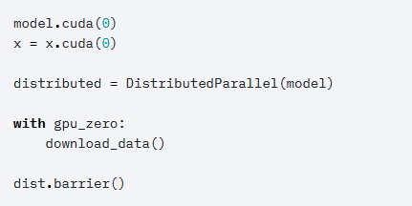
Seperating engineering and research code
Getting code to run in parallel has somewhat become a research task!
However maybe it should not be like that?
Research Code Engineering code
Spend time on research code and not engineering code!

Slide 12
Why using a training framework
Spend time on research code and not engineering code
-> Why training frameworks exist!
Reduce boilerplate = increase turn-around time
Focus on what is important
Reproduceability
Shareability
Consistency
Scaleability

Slide 13







Training Fremworks
Many fremeworks exist for reducing boilerplate
Many frameworks for accelerating training

