Slide 1
The pytorch ecosystem
02457 Machine Learning Operations
Nicki Skafte Detlefsen,
Postdoc
DTU Compute

Slide 2
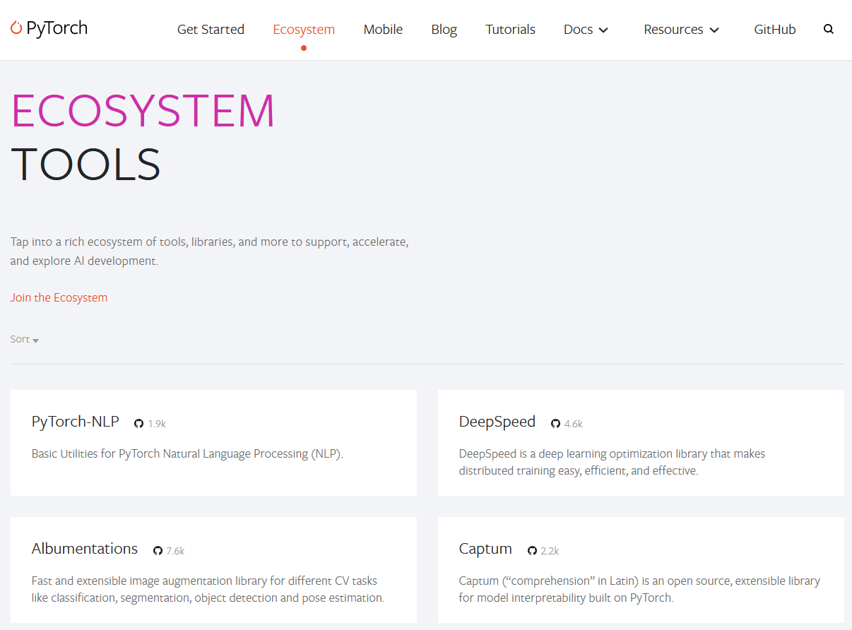
The ecosystem
Collection of frameworks build to be used in combination with Pytorch

Slide 3
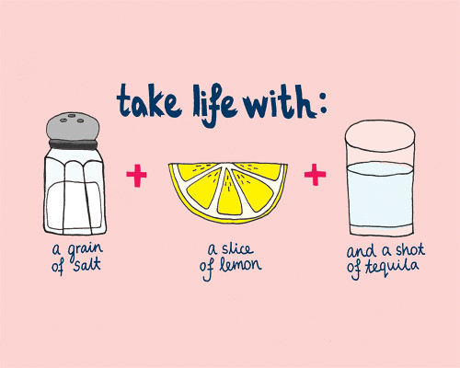
Fremwork categorising
Data specific frameworks | Training frameworks | Utility fremeworks
Transformers | fastai | Albumentations
Detectron2 | Ray | PySyft
Pytorch geometric | Pytorch Lightning | Pyro
Flair | Horovod | Optuna
AllenNLP | DeepSpeed | Hydra
ParlAI | ONNX Runtime | Pytorch Metric Learning
DGL | skorch | Einops
PyTorch3D | Ignite
MMF | Polyaxon
Kornia

Slide 4
Project work
Organise, plan and execute an MLOps project
What you will be evaluated on
Done in groups
You will be asked to implement what is showcased in the exercises in your project work
Each Thursday afternoon you will be asked to upload you current progress to github
Monday after will be given small feedback
Final day of the course you will be presenting your project work

Slide 5
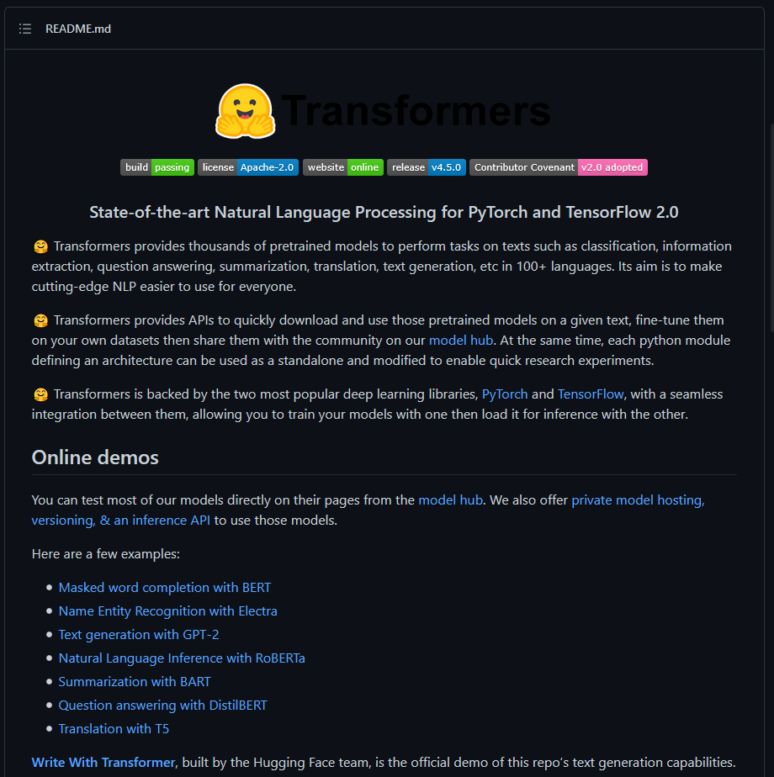
Project 1: NLP
Fremework: Transformers (Huggingface)
https://github.com/huggingface/transformers
State-of-the-art NLP models
Most starred framework in the ecosystem

Slide 6
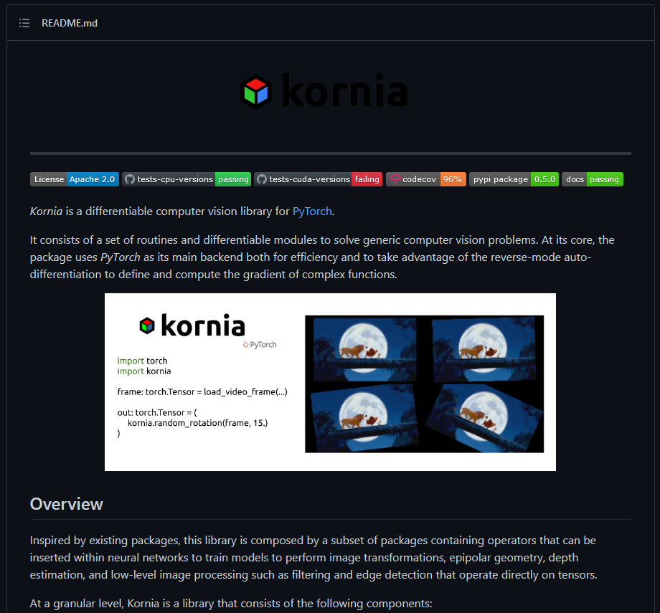
Project 2: CV
Framework: Kornia
https://github.com/kornia/kornia
Differentiable computer vision algoritms

Slide 7
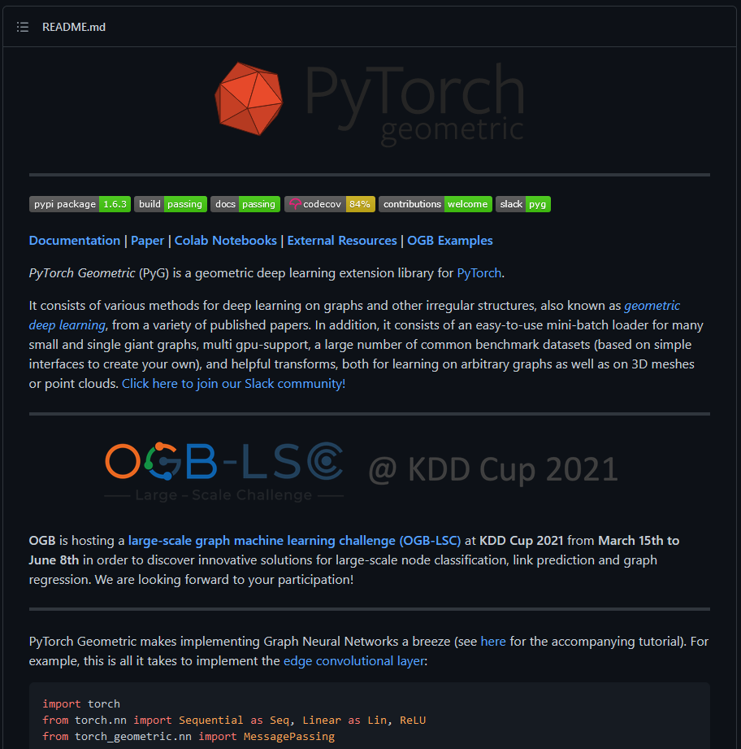
Project 3: Graphs and points
Framework: Pytorch Geometric
https://github.com/rusty1s/pytorch_geometric
Neural networks on graphs and pointclouds

Slide 8
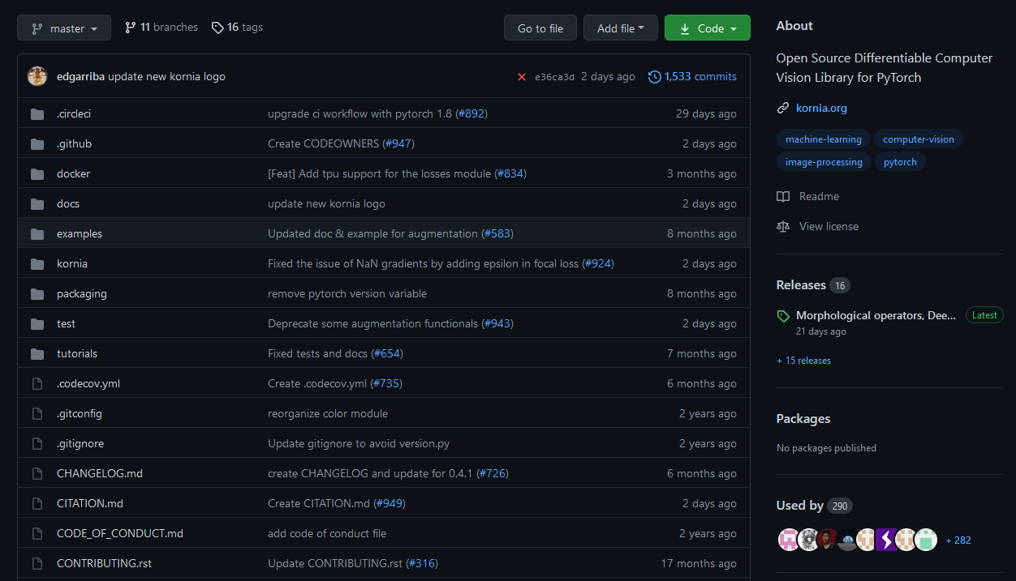
Getting a good idea

Slide 9
Summary
Pick a framework (try running their notebooks/examples!):
Project 1: NLP
Project 2: CV
Project 3: Graphs and points
Brainstorm a project. It does not have to be particular big as you only have 4 full days for working on it
Write a small (max 1 page) project description including:
What model do intent to implement
What data are you going to use
How you think the chosen framework can be incorporated

