Slide 1
Continues Integration (CI)
02457 Machine Learning Operations
Nicki Skafte Detlefsen,
Postdoc
DTU Compute

Slide 2
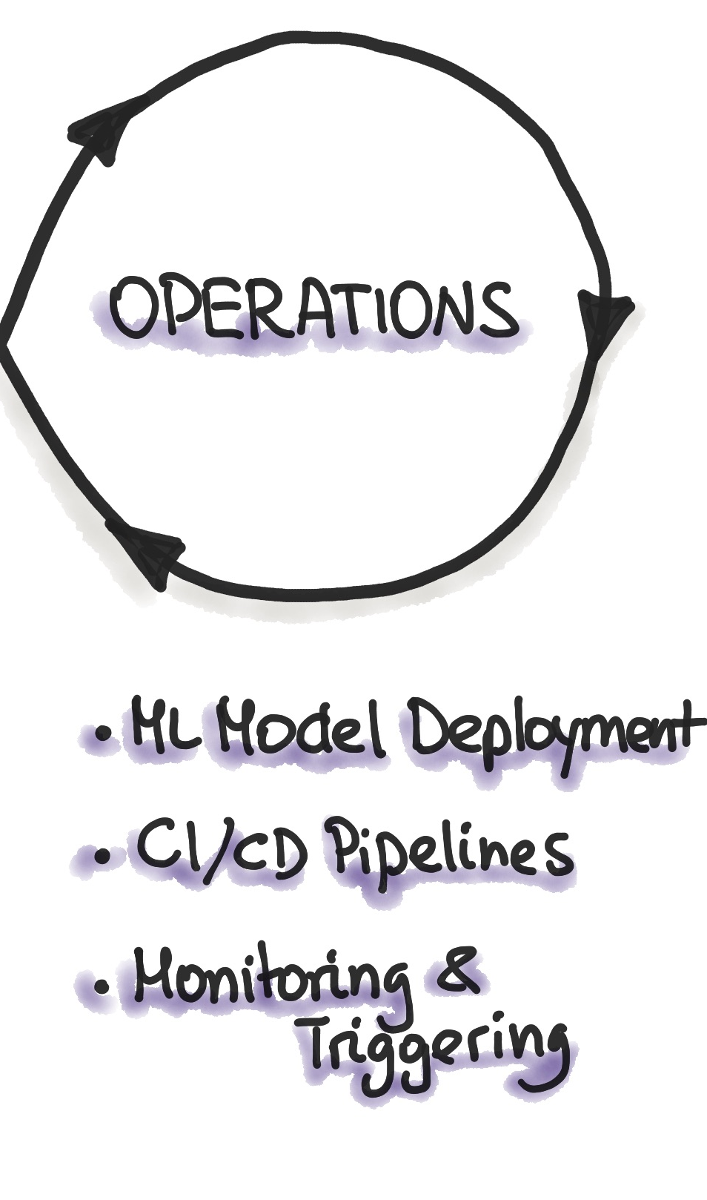
What is continues integration?
Software practise
Frequitly commit code to shared reposatory
By commit sooner than later, errors are captured early
Make merging easier
Automate build + test
App independent

Slide 3
What is continues deployment?
How to get your code to the user
3 phases: Testing, staging and deploying
App dependent
Note: Not covered in this course

Slide 4
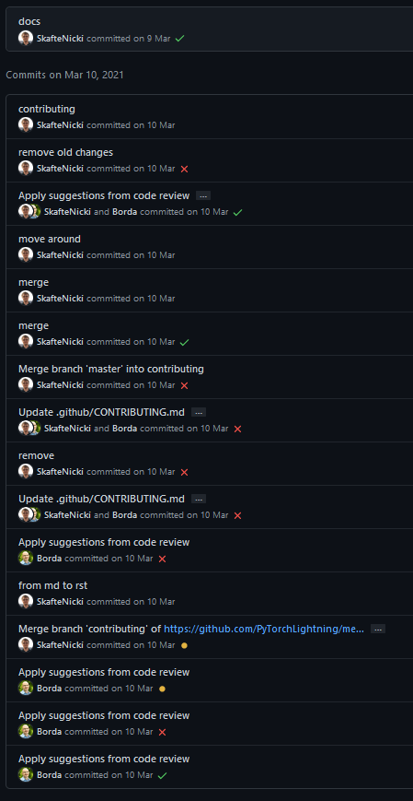
CI step 1: Commiting code
Create someting
Break it
Fix it
Commit frequently
Use branches
Make PRs

Slide 5
CI step 2: Automating stuff
What can be automated: EVERYTHING
Functional tests
Documentation creation
Linters (which check style formatting)
Security checks
Code coverage
Custom checks…

Slide 6
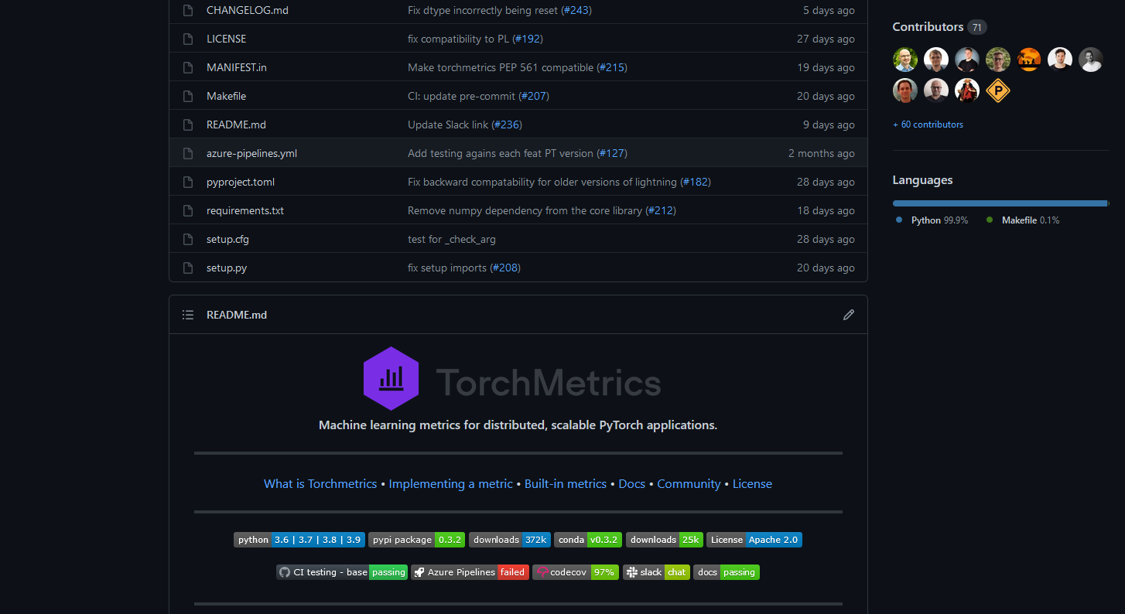
A small case study
All the metric in the world – now in pytorch
Have I seen that guy before?

Slide 7
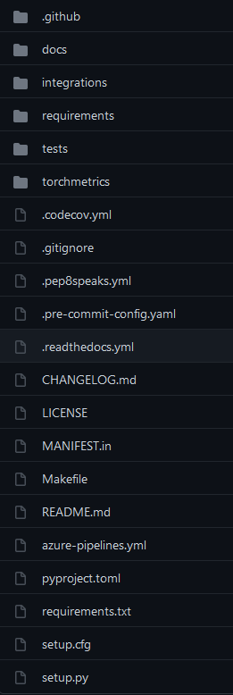
A small case study
Ranked by importance (biased)
Source code
Tests
Setup
CI workflows
Documentation

Slide 8
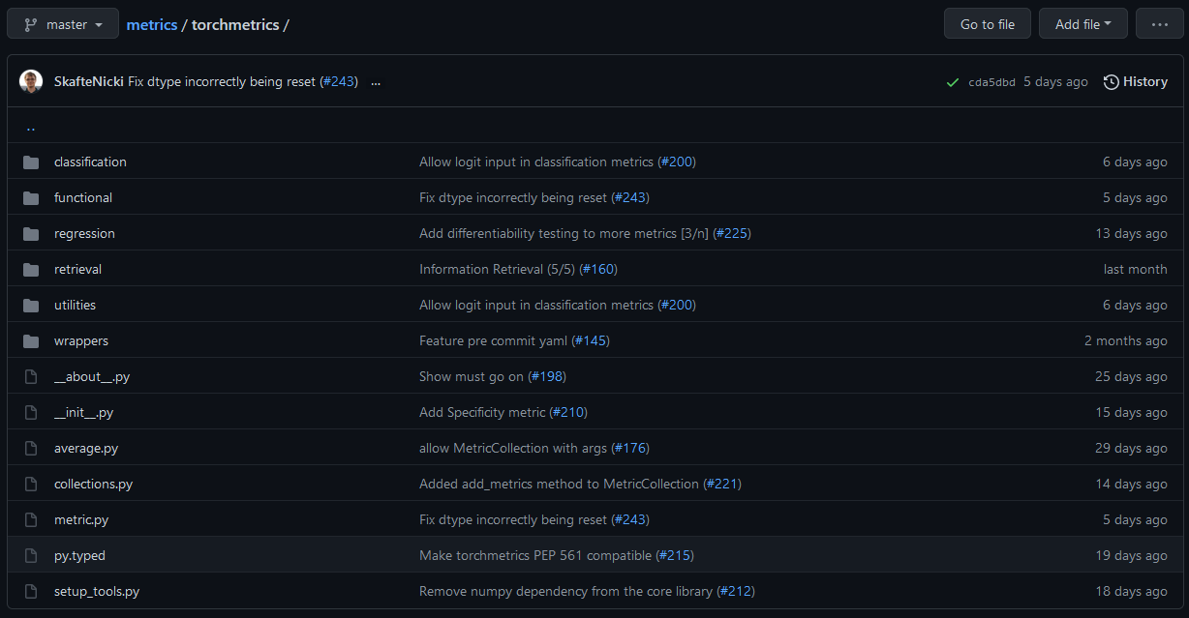
Source code

Slide 9
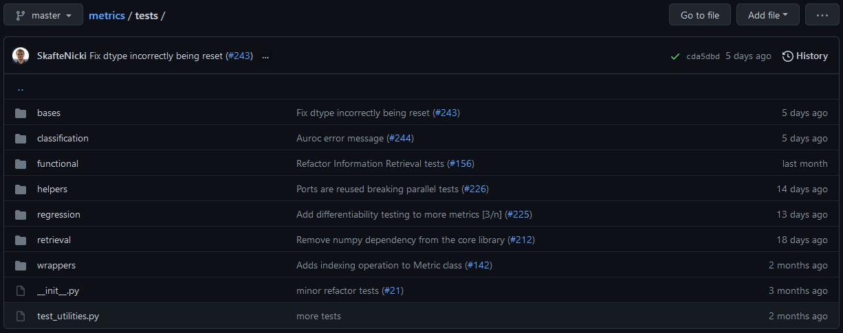
Test code

Slide 10
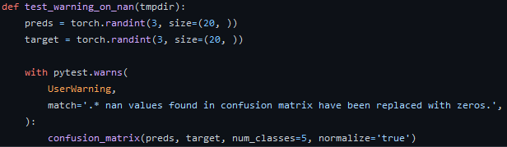
Test example 2
Can be simple

Slide 11
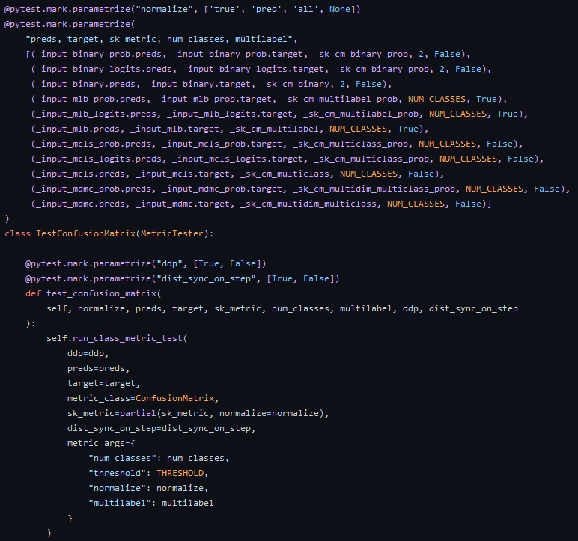
Test example 1
Can be very complex

Slide 14
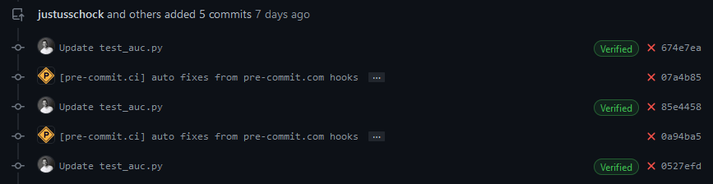
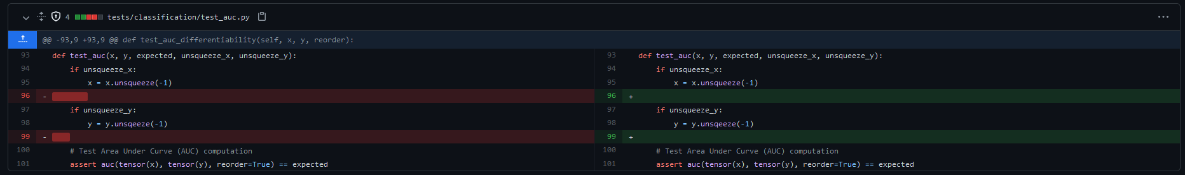
Advanced: Use bots
Bots can take care of tidious task for you (like linting)

Slide 15
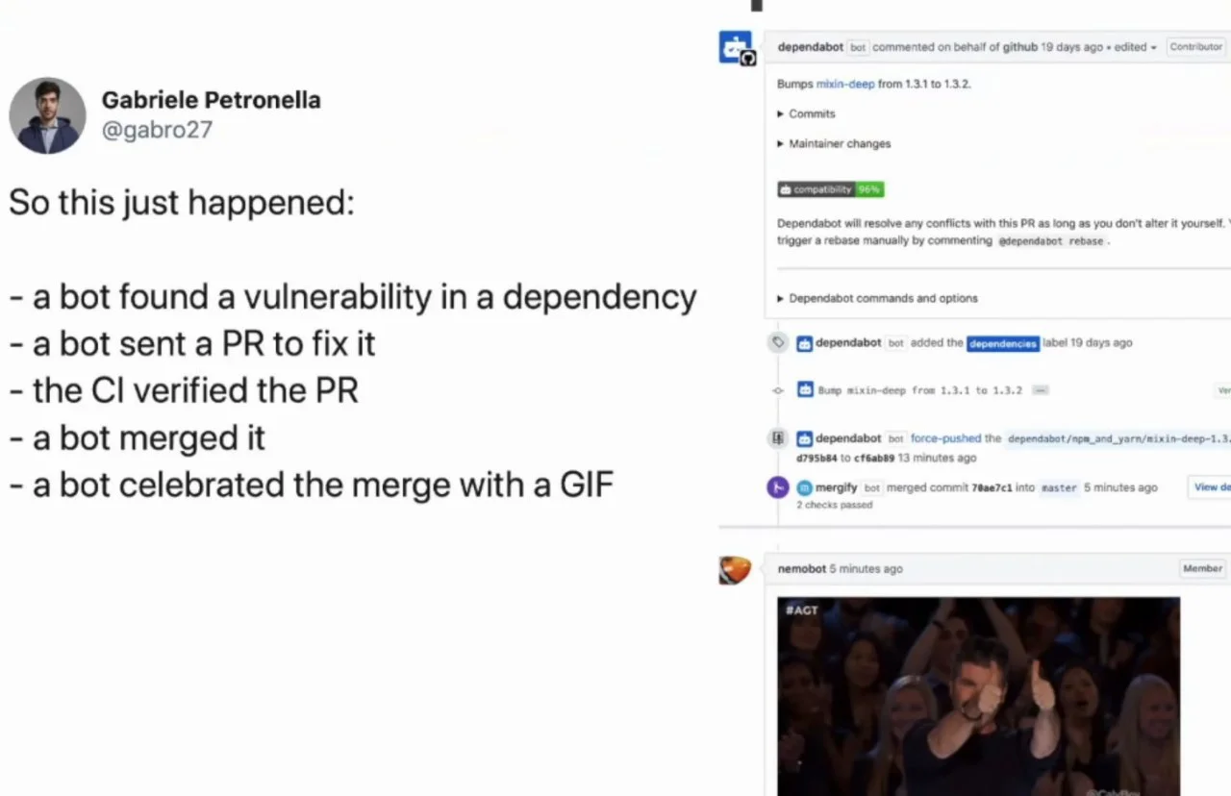
The future is here

