Slide 1
Hyperparameters
02457 Machine Learning Operations
Nicki Skafte Detlefsen,
Postdoc
DTU Compute

Slide 2

Why do we optimize hyperparameters
https://paperswithcode.com/
Many reasons
Get a working model
Get a more robust model
Get better performance
Something else...
”We are all SOTA suckers”
- Ole Winther

Slide 3
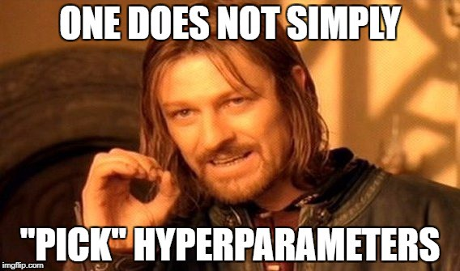
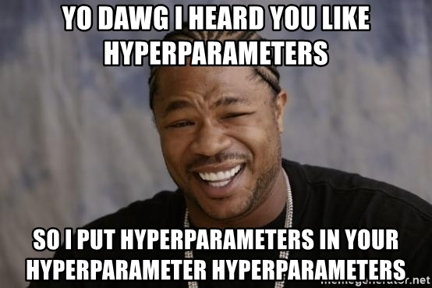
What is considered a hyperparameter?
Everything that effects training:
Model architechture
Optimizer structure
Question: Is the following a hyperparameter?
Dataset
Seed

Slide 4
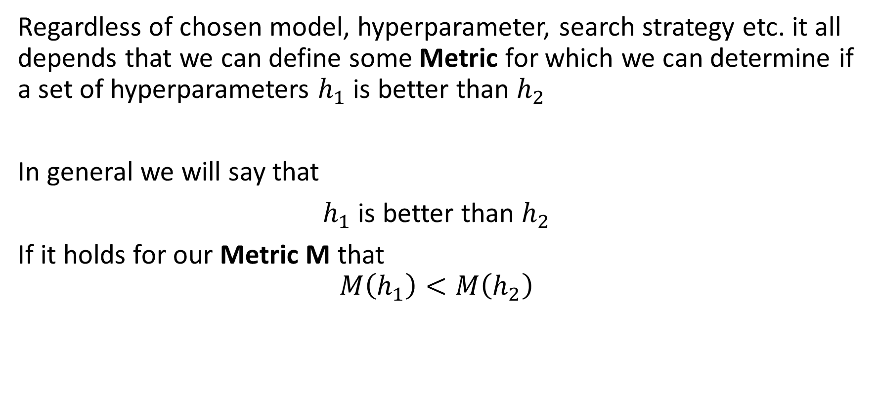
Detour: What should we optimize?
Regardless of chosen model, hyperparameter, search strategy etc. it all depends that we can define some Metric for which we can determine if a set of hyperparameters $h_{1}$is better than $h_{2}$
In general we will say that
$h_{1}$ is better than $h_{2}$
If it holds for our Metric M that
$$M\left(h_{1}\right)<M\left(h_{2}\right)$$

Slide 5
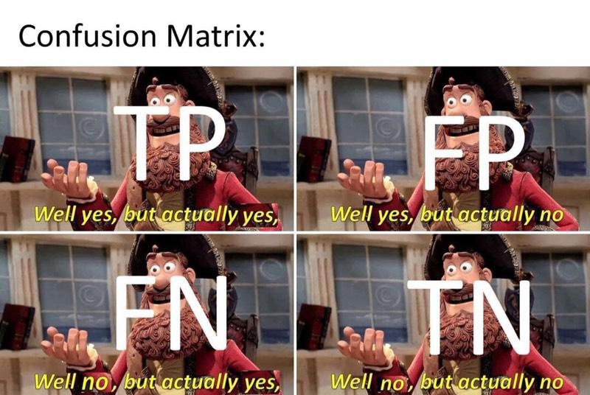
What is a metric?
Any quantity that measures ”goodness of fit”
Metric
Scalar-metrics
Loss functions
(differentiable)

Slide 6
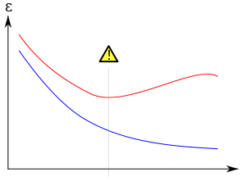
What should M be evaluated on?
Do you recognize this figure?
M
Validation
Training
Step

Slide 7
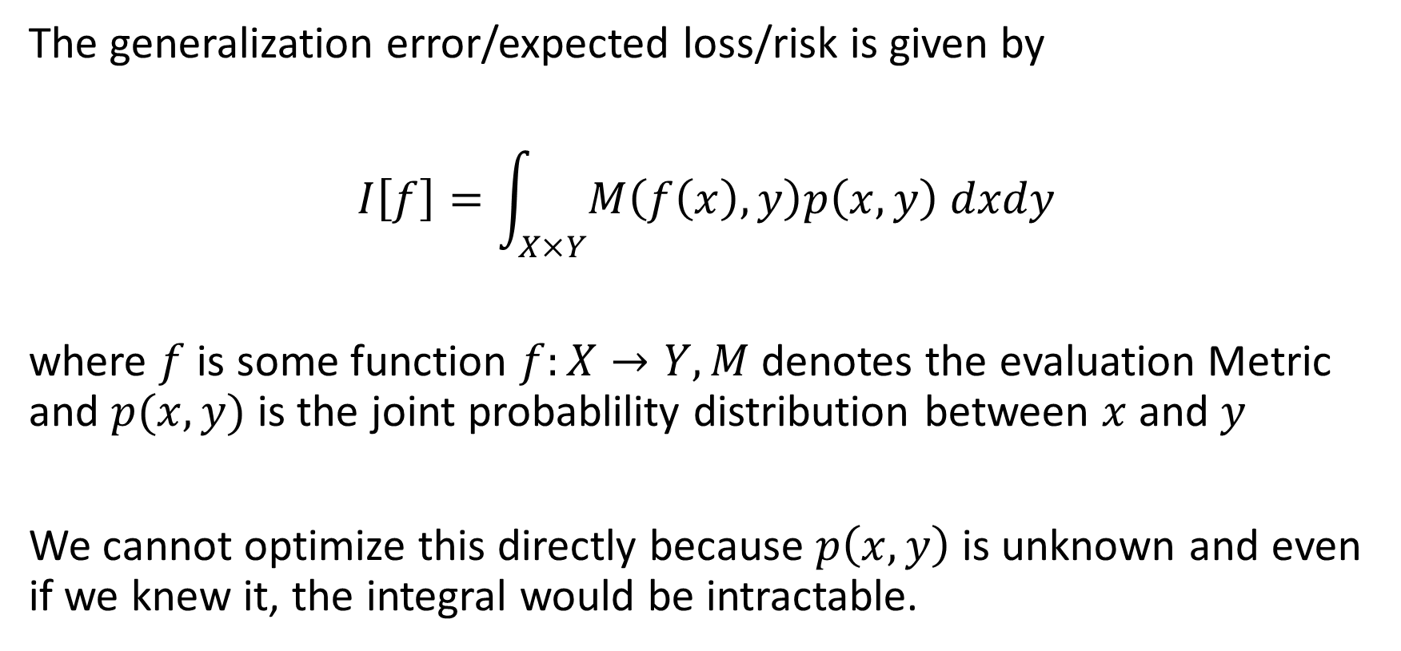
One detour deeper: Generalization error
The generalization error/expected loss/risk is given by
$$I\left[f\right]=\int_{X×Y}{M\left(f\left(x\right),y\right)p\left(x,y\right) dxdy}$$
where $f$ is some function $f:X→Y, M$ denotes the evaluation Metric and $p(x,y)$ is the joint probablility distribution between $x$ and $y$
We cannot optimize this directly because $p\left(x,y\right)$ is unknown and even if we knew it, the integral would be intractable.

Slide 8
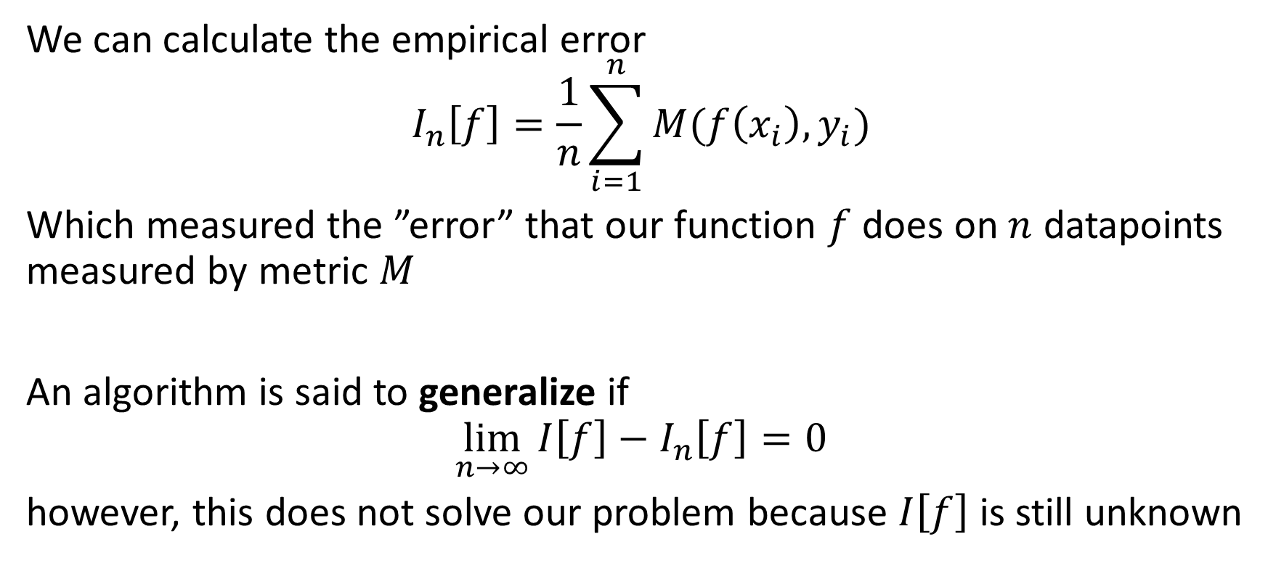
Generalization error
We can calculate the empirical error
$$I_{n}\left[f\right]=\frac{1}{n}\sum_{i=1}^{n}{M(f\left(x_{i}\right),y_{i})}$$
Which measured the ”error” that our function $f$ does on $n$ datapoints measured by metric $M$
An algorithm is said to generalize if
$$\lim_{n→∞}{I\left[f\right]−I_{n}\left[f\right]=0}$$
however, this does not solve our problem because $I\left[f\right]$ is still unknown

Slide 9
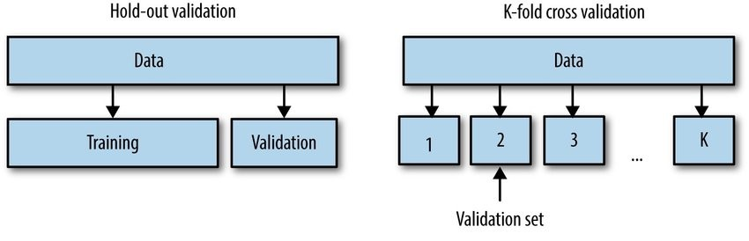

Cross-validation
Cross-validation in a nutshell:
We take some of our data away which we can use to estimate the true generalized loss $I[f]$
Question: Which one do we use in deep learning and why?

Slide 10
Back to topic
We now assume that we have
Some metric we trust
Some way to measure the generalization error (validation set)
Some hyperparameters that we want to optimize
How should we investigate our hyperparameter space?

Slide 11
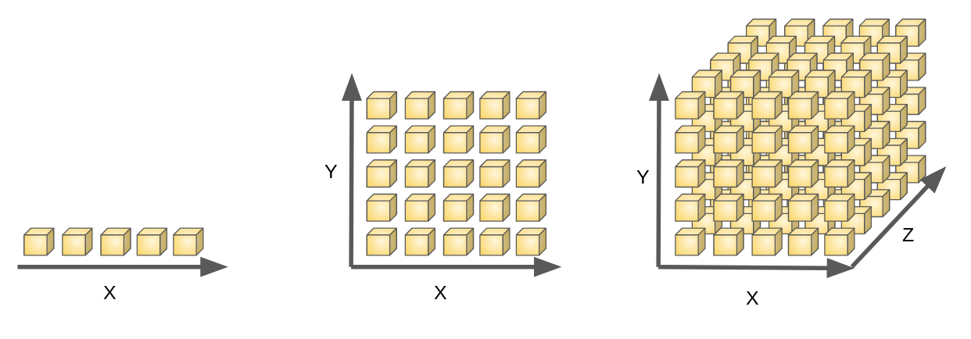
What about doing grid search?
Curse of dimensionality anyone?
The number of combinations grows exponentially in the number of parameters we try to optimize.

Slide 12
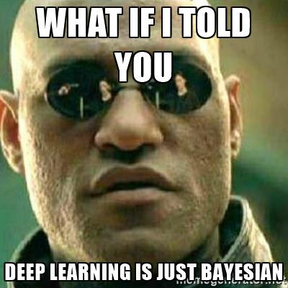
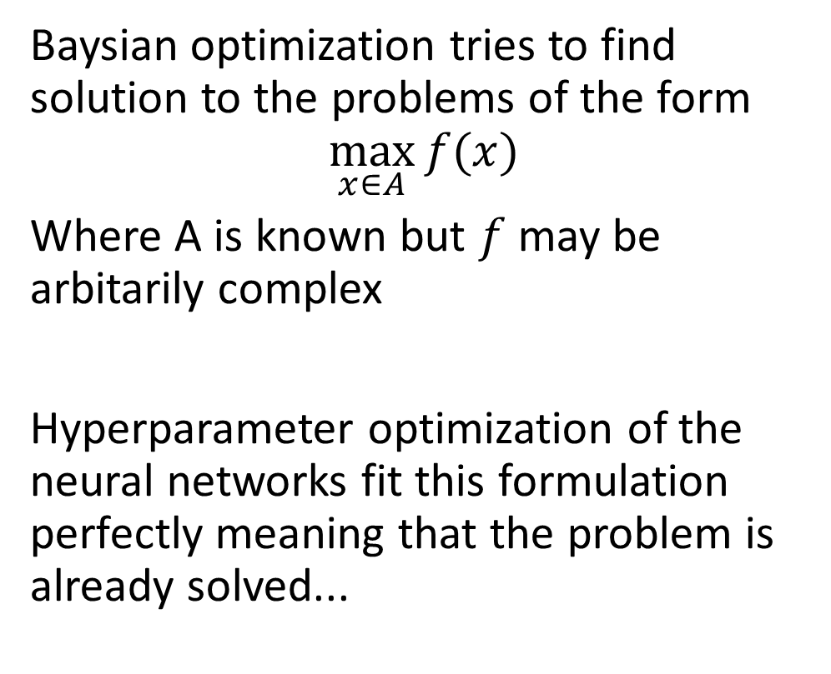
Baysian to the rescue
Baysian optimization tries to find solution to the problems of the form
$$\max_{x∈A}{f(x)}$$
Where A is known but $f$ may be arbitarily complex
Hyperparameter optimization of the neural networks fit this formulation perfectly meaning that the problem is already solved...

Slide 13

Hyperparameter fremework
https://optuna.readthedocs.io/en/stable/
Optuna give easy acess to two tricks for hyperparameter optimization
Sampling
Pruning

Slide 14
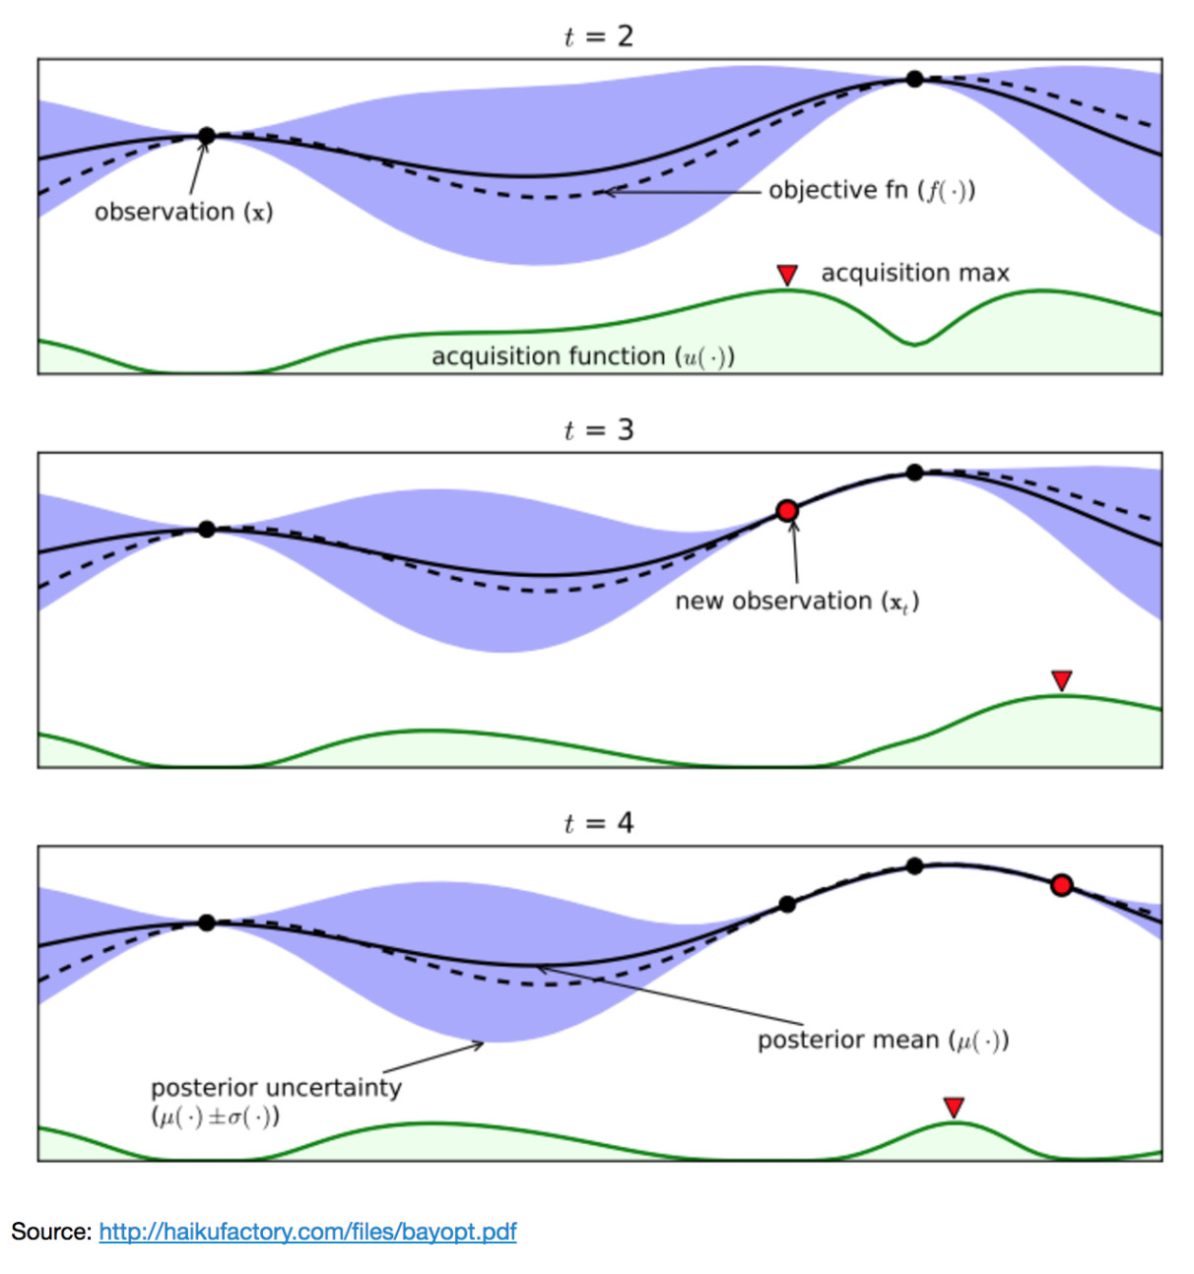
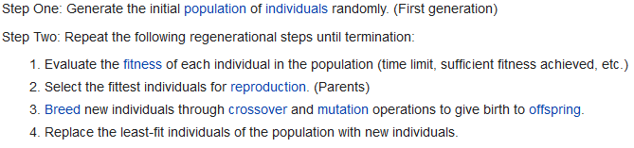
Trick 1: Sampler
Sample hyperparameters in a smart fashion, taken into account the function values we have already seen
Optuna as default uses:
NSGA-II
Evolutionary algorithm
https://ieeexplore.ieee.org/document/996017

Slide 15
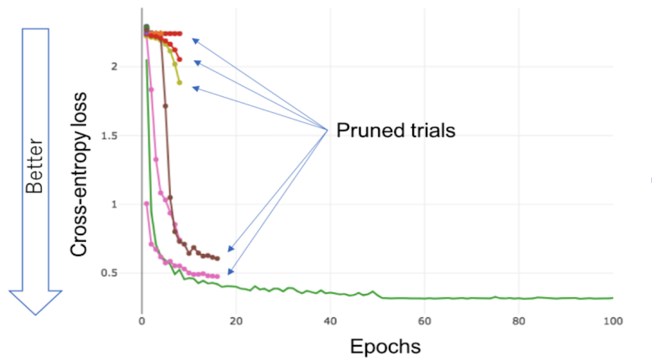
Trick 2: Pruning
Cut away trials that look unpromising (often based on the median performance)
Be careful with over-pruning as you may lose some performance on the floor

Slide 16
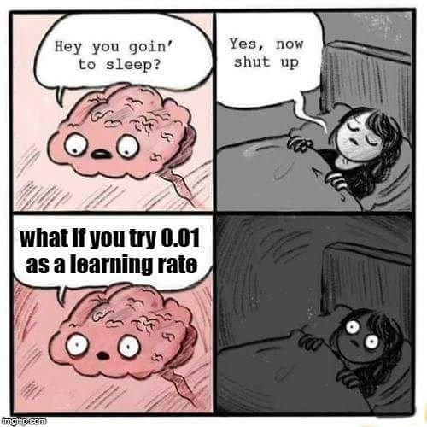
Meme of the day

