Slide 1
Course intro
Machine Learning Operations
Nicki Skafte Detlefsen,
Postdoc
DTU Compute

Slide 2
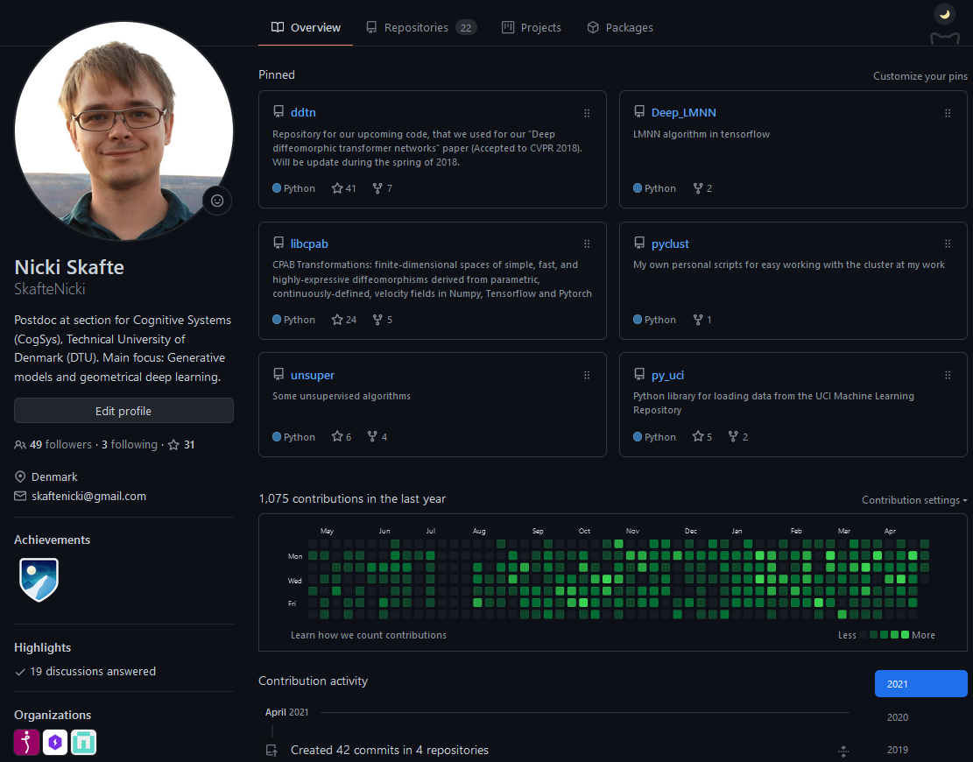
Who am I?
Bachelor, Master and PhD from DTU
Currently: Postdoc at section for cognitive systems
Focus: Inductive biases in deep learning
Eager open-source contributer

Slide 3
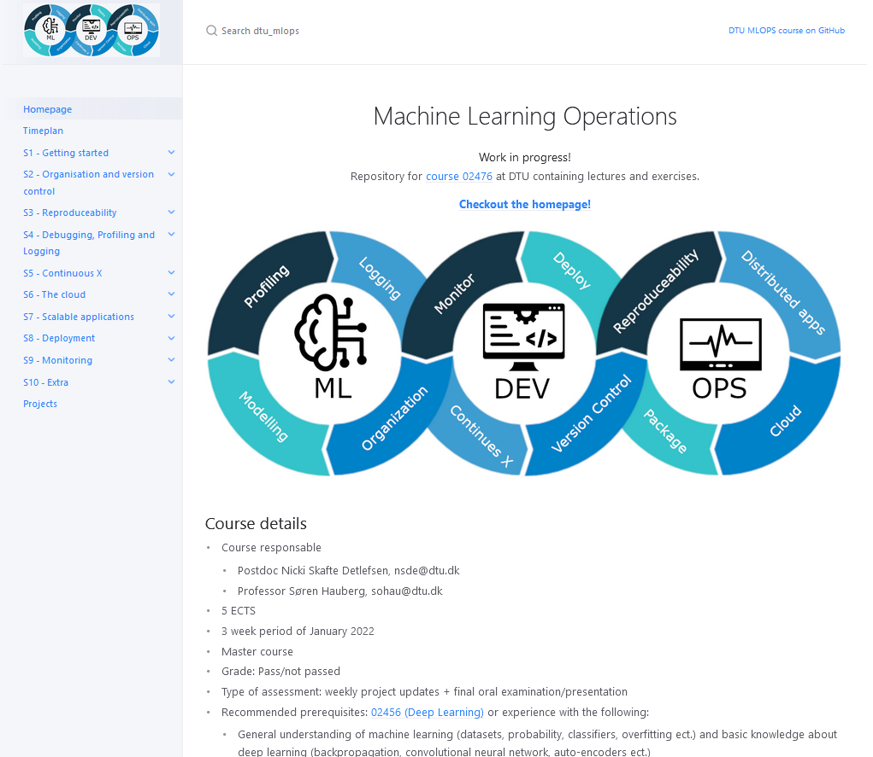
Who am I?
Bachelor, Master and PhD from DTU
Currently: Postdoc at section for cognitive systems
Focus: Inductive biases in deep learning
Eager open-source contributer

Slide 4
Course settings
5 ECTS
3 weeks period
Level: Master
Grade: Pass/not passed
Type of assessment: weekly project updates + final oral examination/presentation
Recommended prerequisites: 02456 (Deep Learning) or
General understanding of machine learning (datasets, probability, classifiers, overfitting etc..) and
Basic knowledge about deep learning (backpropagation, convolutional neural network, auto-encoders etc..)
Coding in Pytorch

Slide 5
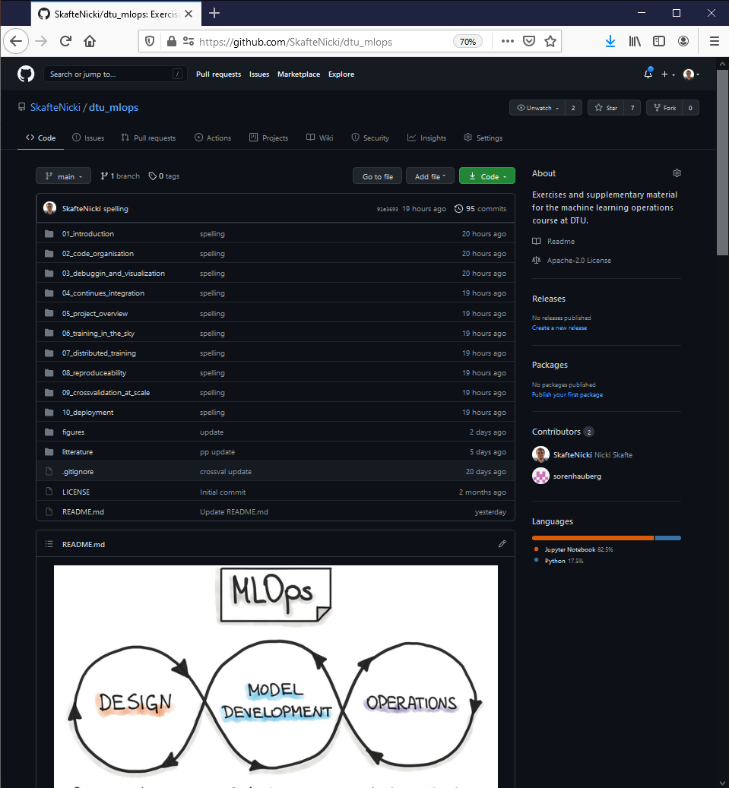
Course webpage
Webpage with lectures + exercises:
https://skaftenicki.github.io/dtu_mlops/
Join slack for communication:
https://join.slack.com/t/slack-ddr8461/shared_invite/zt-qzk7ho8z-1tBT_SkkkxtpgMU8x197pg

Slide 6
What is this course/What is it not
What is this course:
Introduce the student to a number of coding practices that will help them organization, scale, monitor and deploy machine learning models either in a research or production setting. To provide hands-on experience with a number of frameworks, both local and in the cloud, for doing large scale machine learning models.
Keywords:
Organization
Scalability
Reproducibility
Hands-on experience
What this course is not:
How deep learning models works (02456)

Slide 7
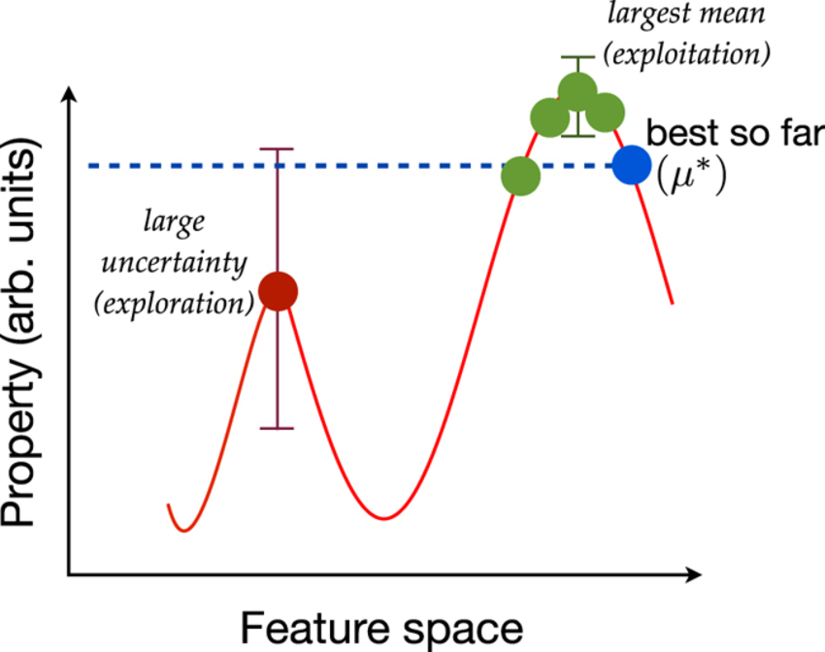

What do I expect from you
Second iteration of this course
This course is still in its development phase, meaning that the material may be suboptimal
We provide lectures, exercises and guidence but encourage self-study
Make sure to both explore and exploit it!
Physical attentence is expected, but not required
Provide all the feedback you have, I can take it!
Your interest
Lectures

Slide 8
I typical day
Exercise days:
Meet in at 9:00
Lecture for 15-30 mins
I am still learning how to do lectures
Lectures are not meant to give teach you anything, but provide some context to the topic of the day
Exercises until 14:00
Remember to take a lunch break
If you are not done at 14:00, you are still free to leave. Rooms are booked until 17:00.
Project days:
Sometimes a small lecture or company presentation
Rest of the day you decide
Office hour

Slide 9

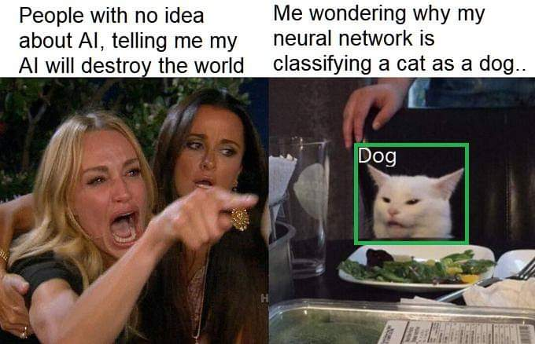
What I hope from this course
Have fun!
Playing around with the different frameworks
Maybe learn something along the way

Slide 10
A note on the projects
Approxemately 1/3 of the course time is spend on project work
More info here:
https://skaftenicki.github.io/dtu_mlops/projects
Already now you are recommende to think about forming groups of
4 people
3 and 5 is also acceptable
Thursday we will do some speeddating to form groups for people not already having one. Also feel free to write in the #find-a-group slack channel.

