Slide 1
Continues Integration (CI)
02457 Machine Learning Operations
Nicki Skafte Detlefsen,
Postdoc
DTU Compute

Slide 2
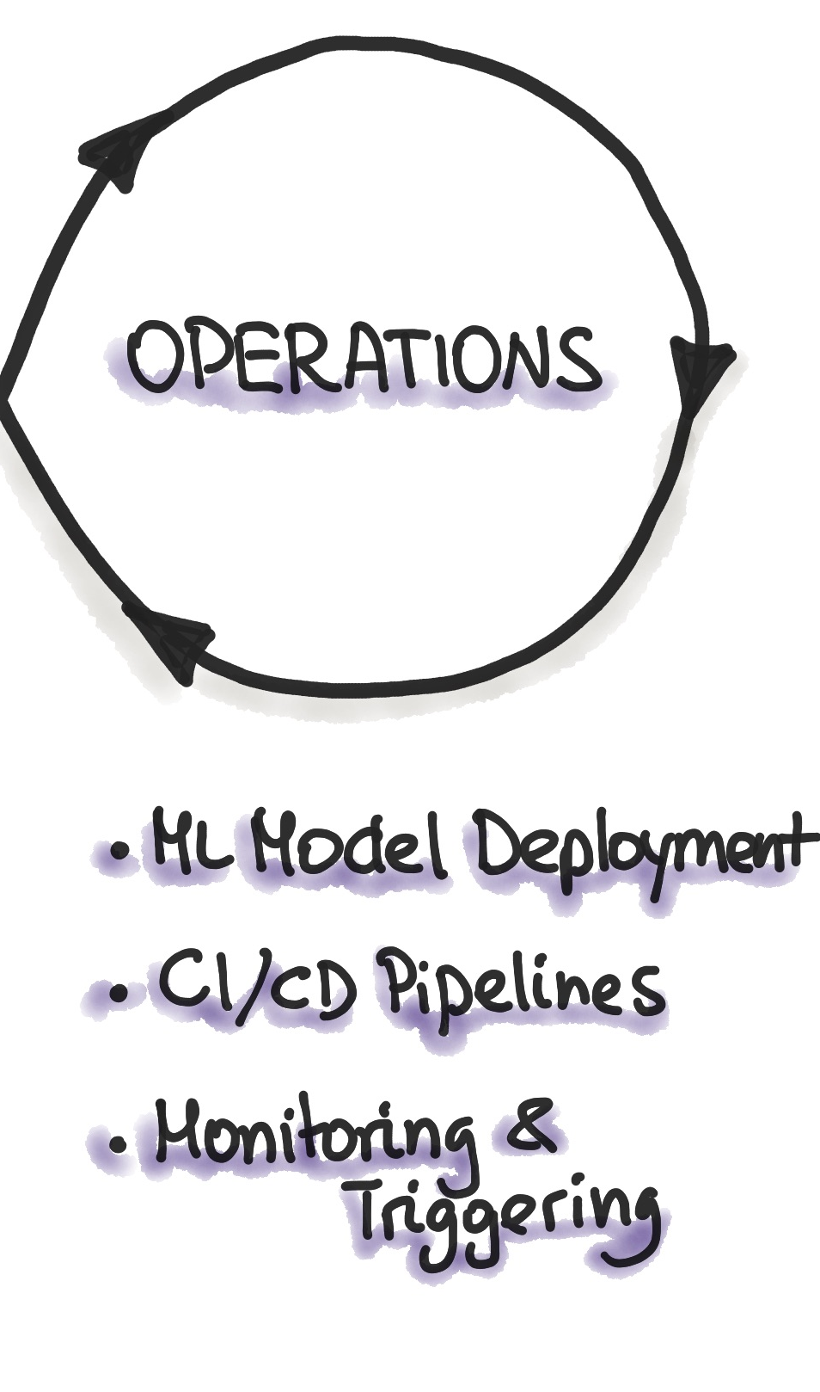
What is continues integration?
Software practise
Frequitly commit code to shared reposatory
By commit sooner than later, errors are captured early
Make merging easier
Automate build + test
App independent

Slide 3
What is continues deployment?
How to get your code to the user
3 phases: Testing, staging and deploying
App dependent
Note: Not covered in this course

Slide 4
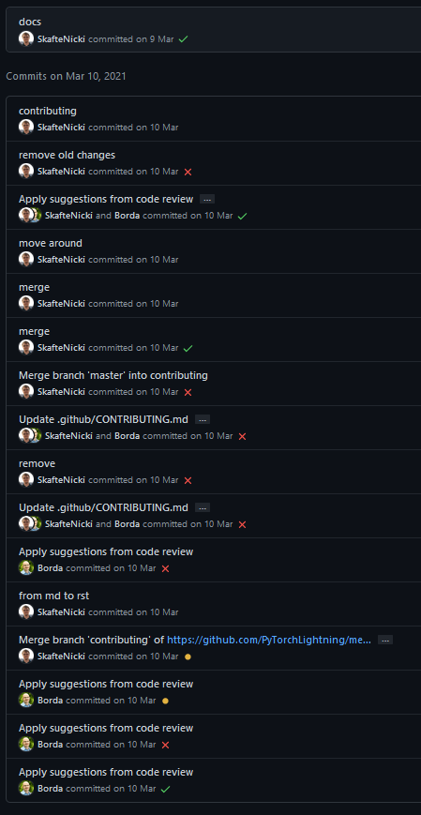
CI step 1: Commiting code
Create someting
Break it
Fix it
Commit frequently

Slide 5
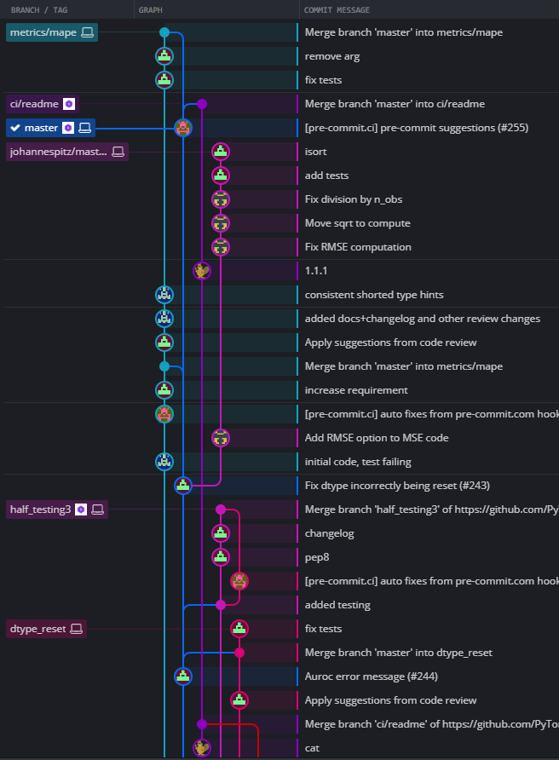
CI step 1: Commiting code
Use branches

Slide 6
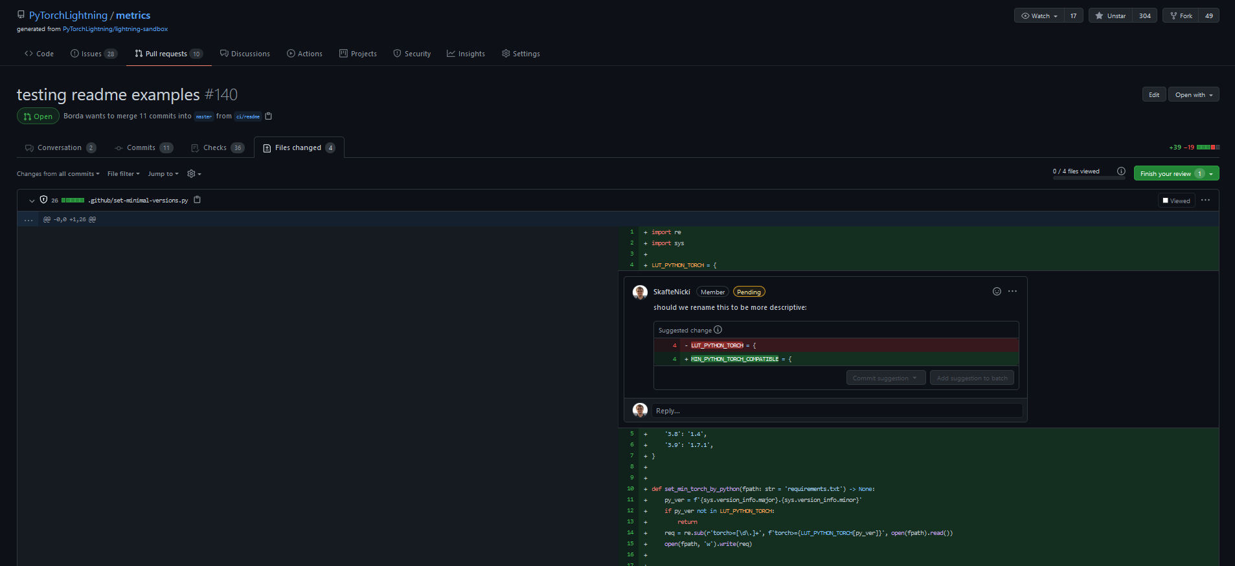
CI step 1: Commiting code
Use PRs, other can review your code
1. Find PR
2. Check changed files
4. Send review
3. Make one or more comments

Slide 7
CI step 2: Automating stuff
What can be automated: EVERYTHING
Functional tests
Documentation creation
Linters (which check style formatting)
Security checks
Code coverage
Custom checks…

Slide 8
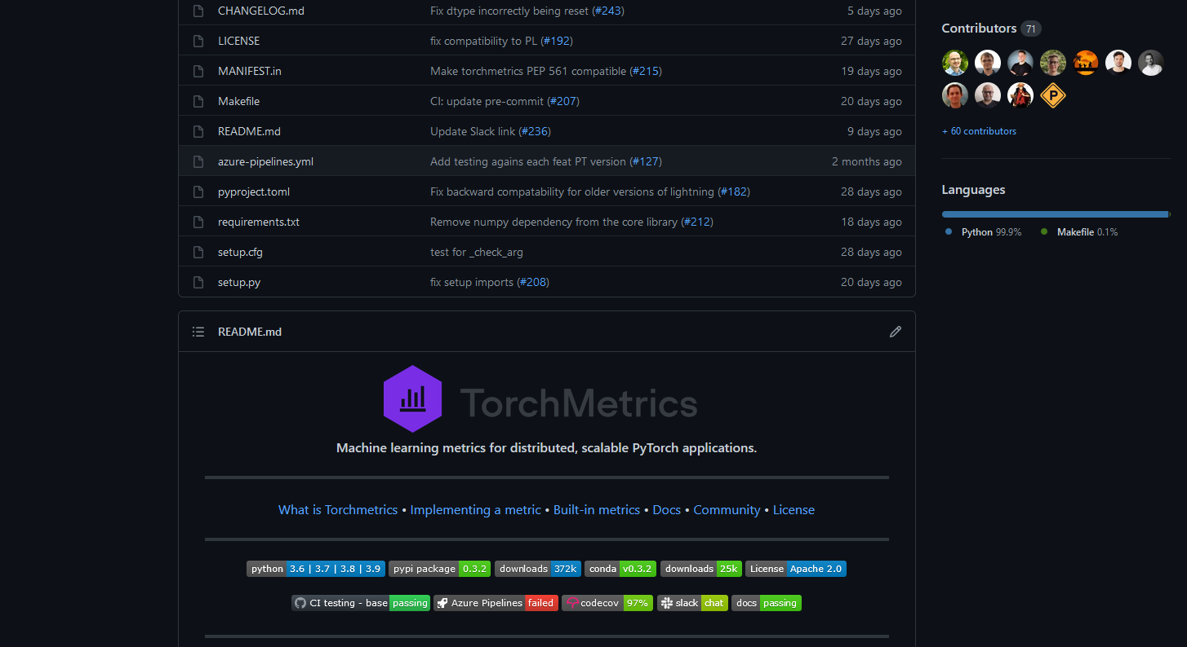
A small case study
All the metric in the world – now in pytorch
Have I seen that guy before?

Slide 9
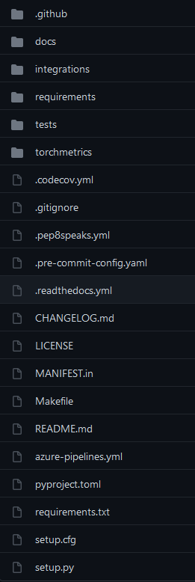
A small case study
Ranked by importance (biased)
Source code
Tests
Setup
CI workflows
Documentation

Slide 10
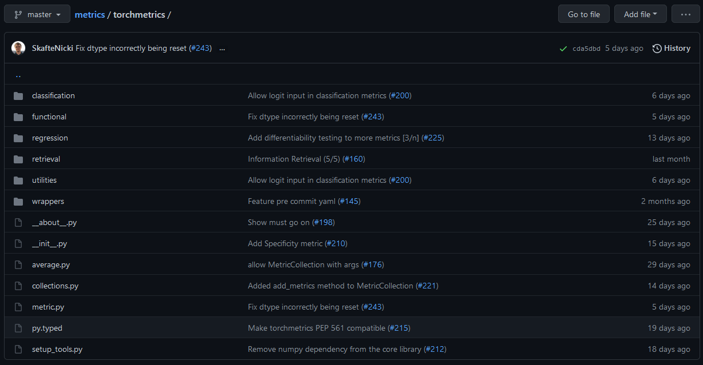
Source code

Slide 11
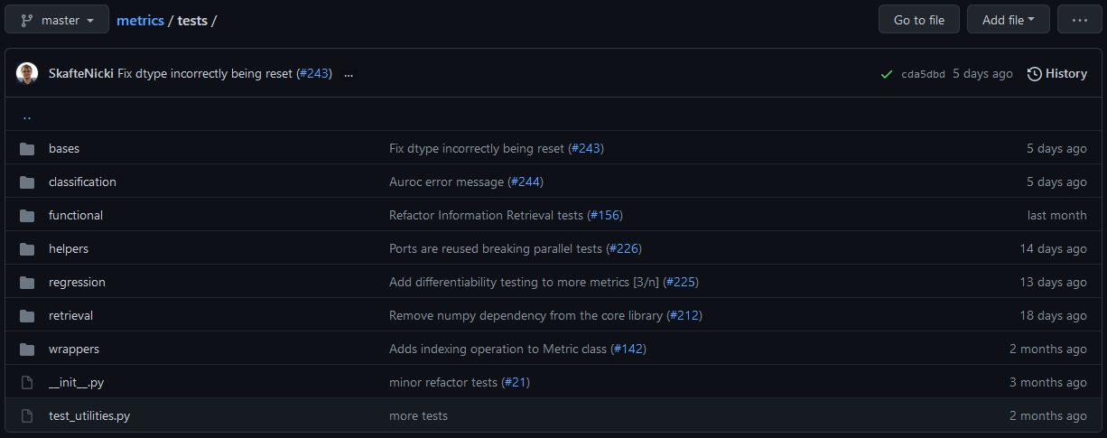
Test code

Slide 12
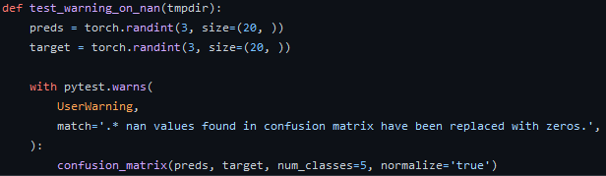
Test example 2
Can be simple

Slide 13
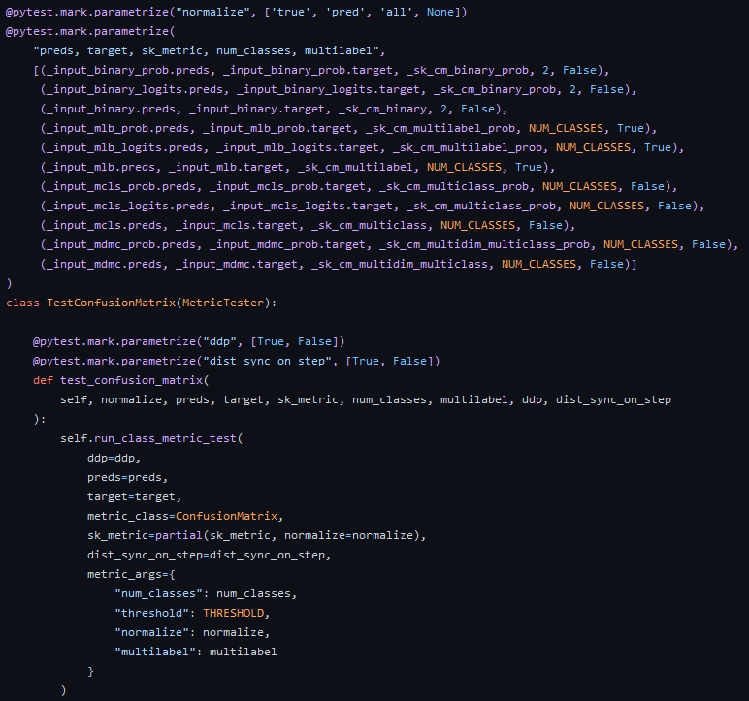
Test example 1
Can be very complex

Slide 14
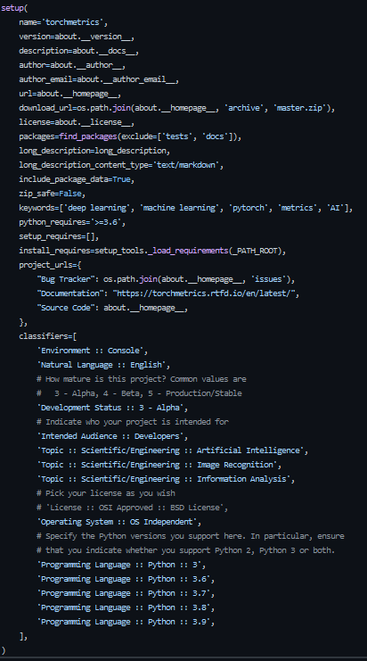
Setup files
Contains all information regarding the project
Allow people to do:
python setup.py install
or if uploaded to pip
pip install my_package

Slide 15
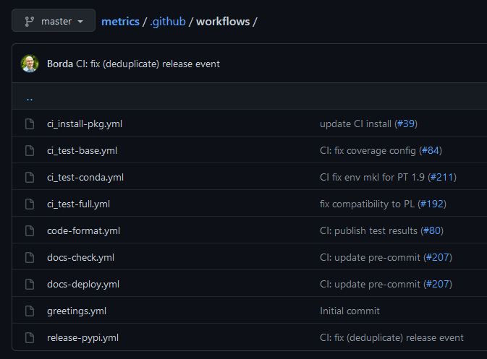
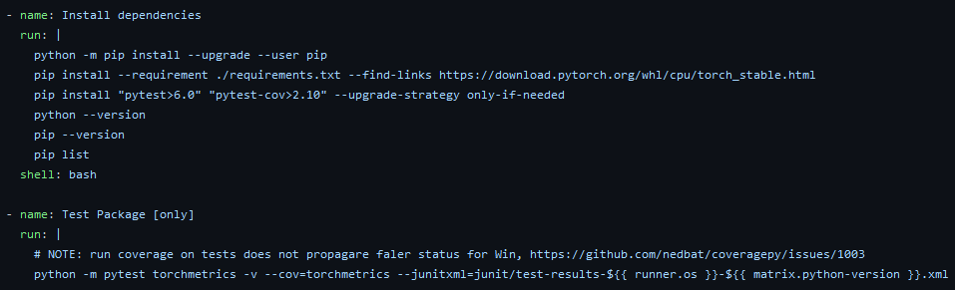
Workflows

Slide 16
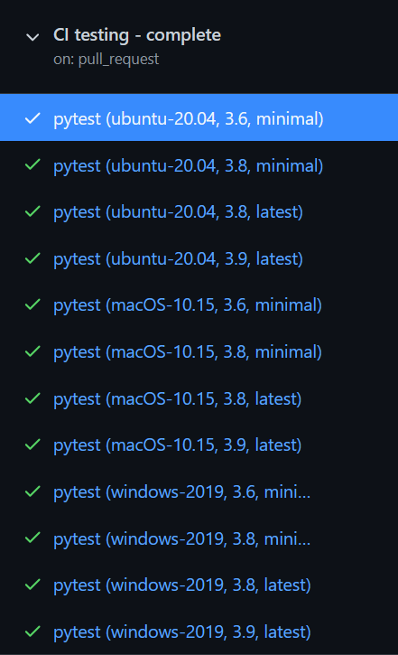
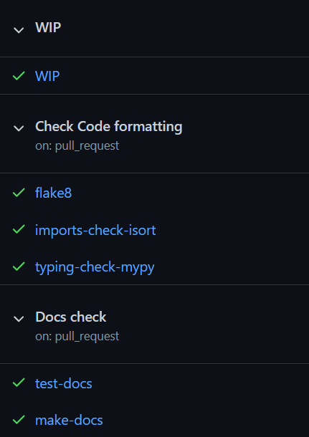
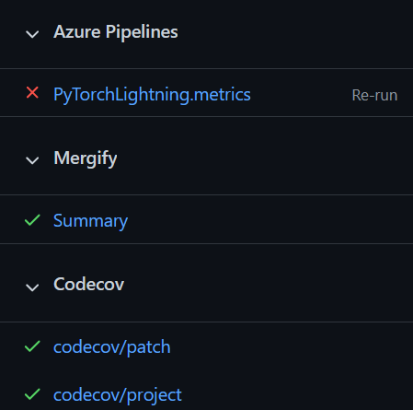
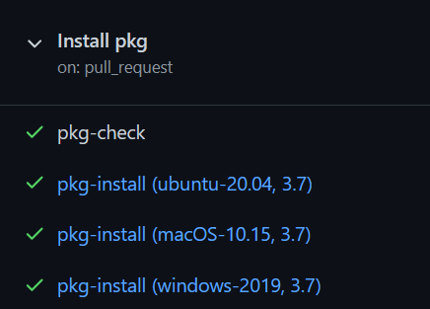
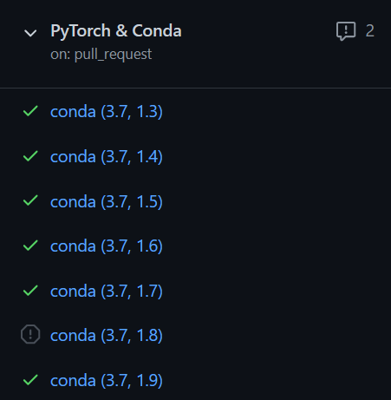
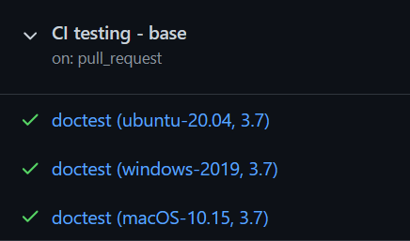
All of our workflows – 36 in total
Test combination of
Hardware setup
Operating system
Python version
Dependencies
Runs tests, docs, coverage, lintint, package install ect

Slide 17
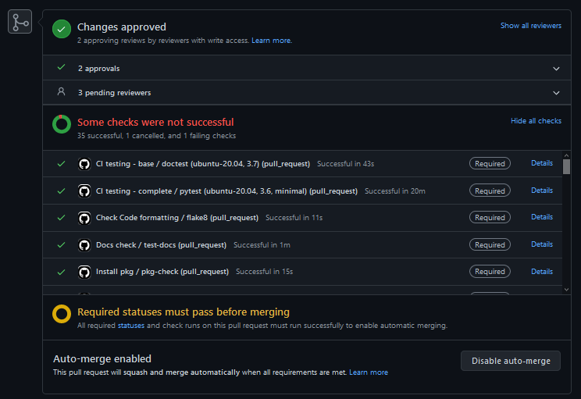

Slide 18
Other files to consider

Slide 19
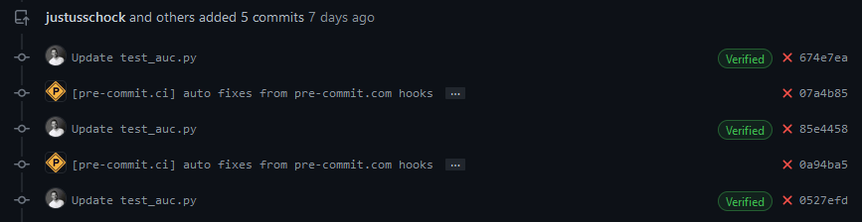
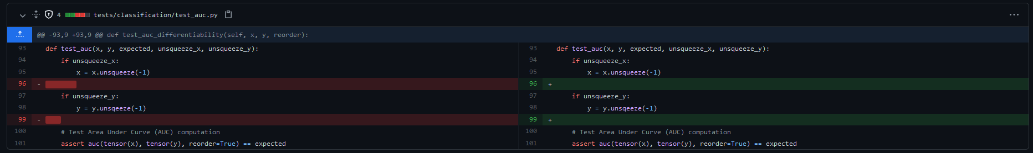
Advanced: Use bots
Bots can take care of tidious task for you (like linting)

Slide 20
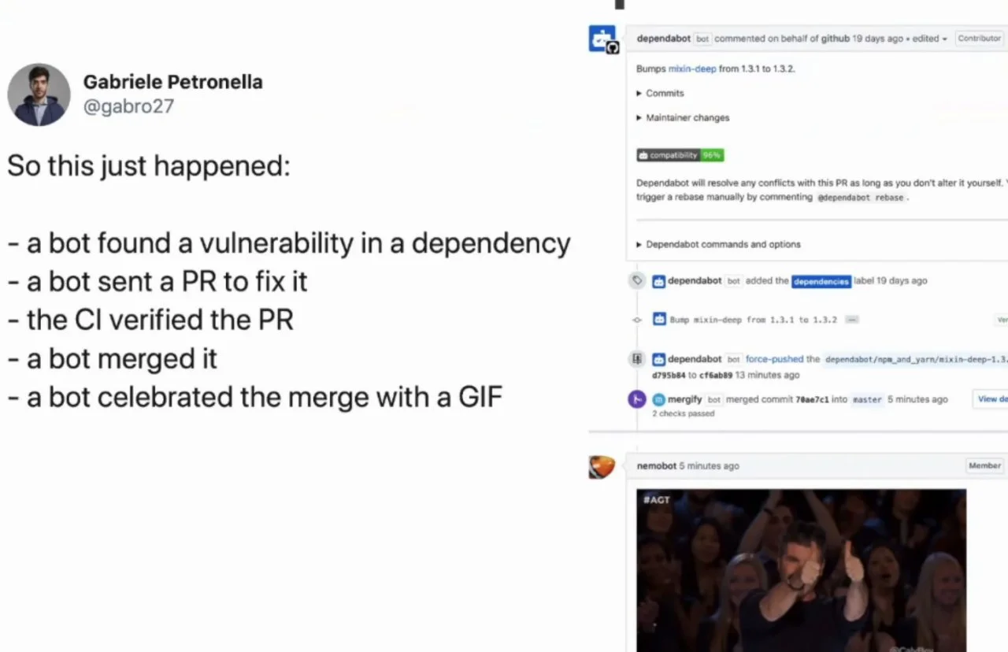
The future is here

