Slide 1
Machine Learning Operations
02457 Machine Learning Operations
Nicki Skafte Detlefsen,
Postdoc
DTU Compute

Slide 2
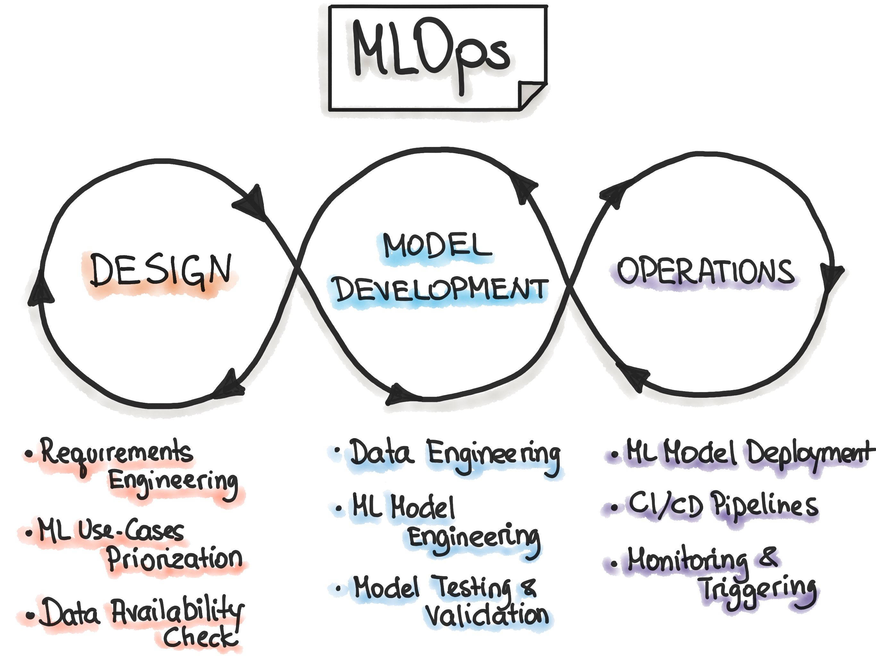
What is machine learning operations
Everything required to keep a model working for long periods of time
Notice: ITS A CYCLE!

Slide 3
Design
The is the main part we train you at DTU
Analyze a problem
Look in litterature for references
Check if you have access to data for investigating this

Slide 4
This is model specific

Slide 5
This is not teached at all
My hope is that you will get at feeling of this topic

