Slide 1
Distributed Training
02457 Machine Learning Operations
Nicki Skafte Detlefsen,
Postdoc
DTU Compute

Slide 2
What is distributed computations?
We focus on training as it is the most computationally expensive part of MLOps

Slide 3
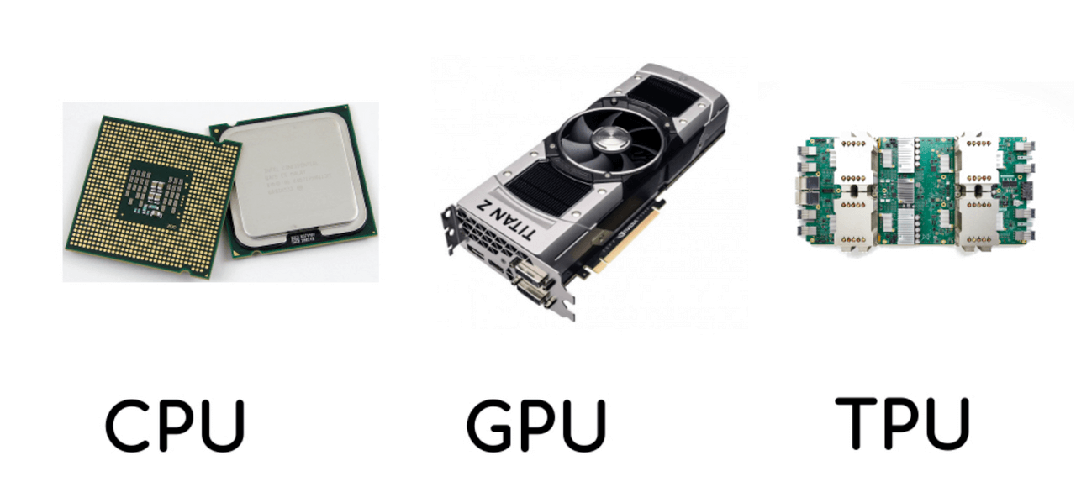
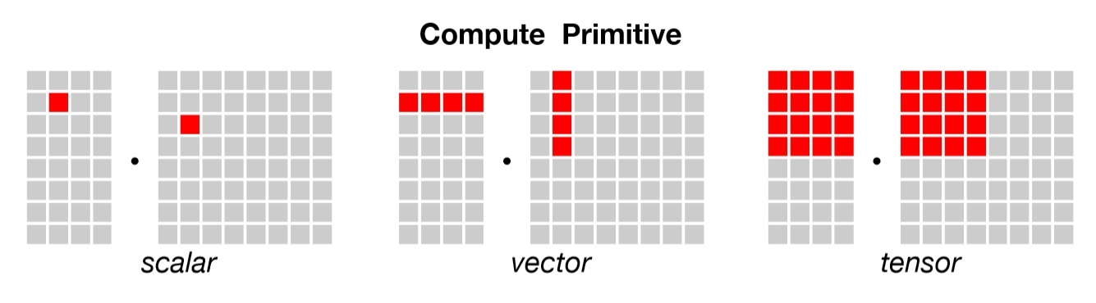
Devices
Three types of devices
CPU
General compute unit
2-128 threads
GPU
Rendering unit
1000-10000 threads
TPU
Specialized unit
8-2048 threads
Note that we are comparing apples to bananas!

Slide 4
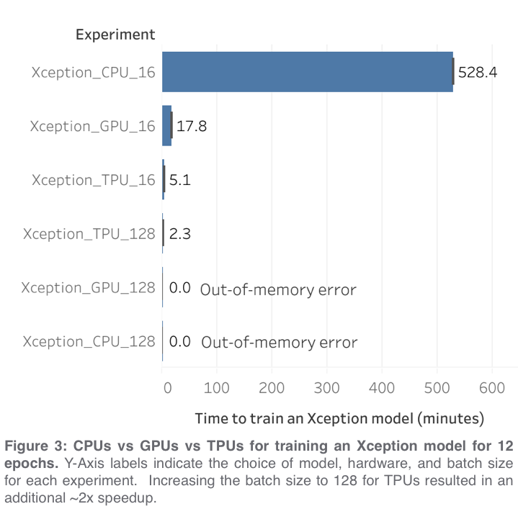
Memory
Equally important to what device you are using, is the amount of memory that you have available
With more memory
Faster data transfer
Higher data modality
Larger models
 | CPU | GPU | TPU
Standard | 32-64 GiB | 12 GiB | 64 GiB
Maximum | 256 GiB | 24 GiB | 32 TiB
https://towardsdatascience.com/when-to-use-cpus-vs-gpus-vs-tpus-in-a-kaggle-competition-9af708a8c3eb

Slide 5
Many layers of distributed computations
Data
Model
Experiment
Load data in paralle
Inference on data in parallel
Stack models in parallel
You may use multiple of these at the same time
Launch multiple experiments at once

Slide 6
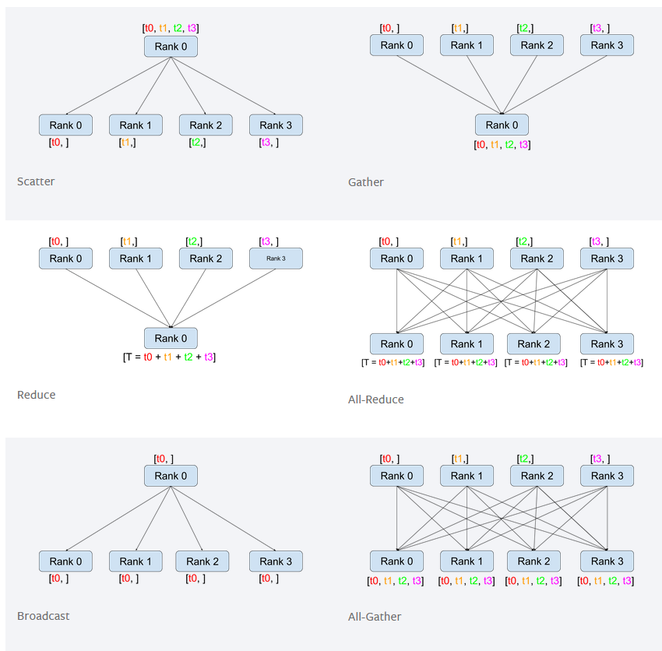
The six imporatnt communication types

Slide 7
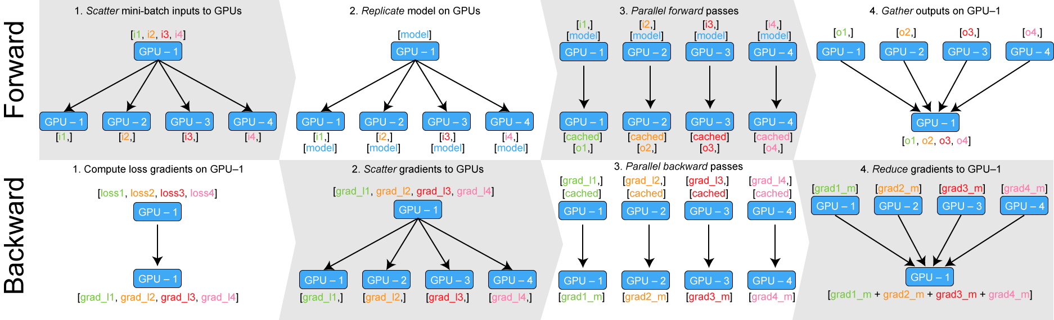
Data Parallel
Simple as parallel_model = torch.nn.DataParallel(model)

Slide 8
Why using a training framework
Reduce boilerplate = increase turn-around time
Focus on what is important
Reproduceability
Shareability
Consistency
Scaleability

Slide 9







Training Fremworks
Many fremeworks exist for reducing boilerplate
Many frameworks for accelerating training

Slide 10
Seperating engineering and research code

