Slide 1
The reproduceability crises
02457 Machine Learning Operations
Nicki Skafte Detlefsen,
Postdoc
DTU Compute

Slide 2
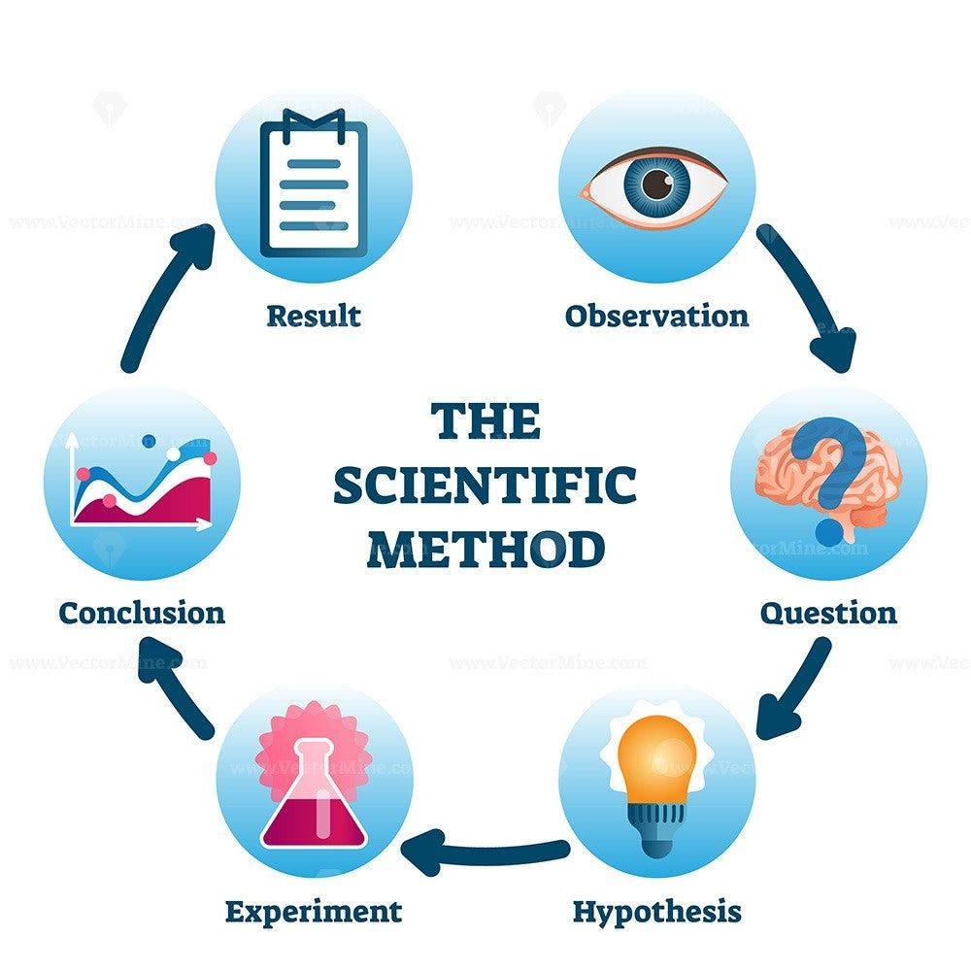
What is it?
Being able to reproduce other peoples experimental results is an essential part of the scientific method
Well known problem thoughout most fields (physics, chemestry, biology and computer science)
With the rise of deep learning, the problem has only been made worse due to competition
This is where it breaks

Slide 3
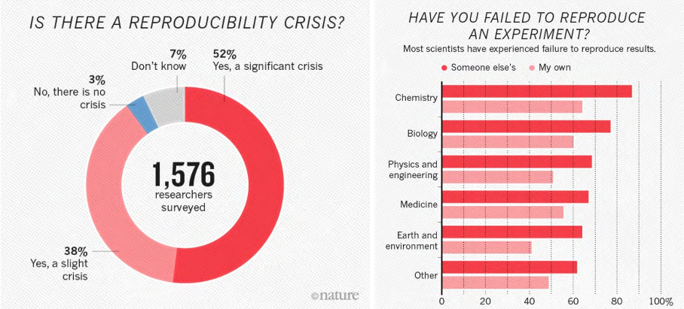
How bad is it?
Wow its bad...
https://www.nature.com/news/1-500-scientists-lift-the-lid-on-reproducibility-1.19970

Slide 4
What can we do about it
Make sure to document everything about our experiments
Physical setup
Number of devices
Type of devices
Software
Operating system
Package versions
Runable code
Public data
Precise configuration
Code
Document this step as thoroughly as possible

Slide 5
Closer look
Physical setup
Number of devices
Type of devices
Easy to document
Software
Operating system
Package versions
Ask Conda
Runable code
Public data
Precise configuration
Seed
Code
This is your job
5/5/2021

Slide 6
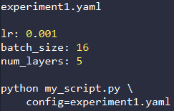


Configurations
There is a lot of subjective choices that we do when running experiments, most noteable the hyperparameters.
Parameters in script | Argparser | Config files
Not easy to configure Experiments may be lost if not carefull | Easy to configure Falls on user to save the configuration | Easy to configure Parameters are systematically saved with the experiment

Slide 7

Hydra
A framework for elegantly configuring complex applications.
https://github.com/facebookresearch/hydra

Slide 8
Other frameworks
https://github.com/IDSIA/sacred
https://mlflow.org/
https://wandb.ai/site

