Slide 1
Hyperparameters
02457 Machine Learning Operations
Nicki Skafte Detlefsen,
Postdoc
DTU Compute

Slide 2

Why do we optimize hyperparameters
https://paperswithcode.com/
Many reasons
Get a working model
Get a more robust model
Get better performance
Something else...

Slide 3
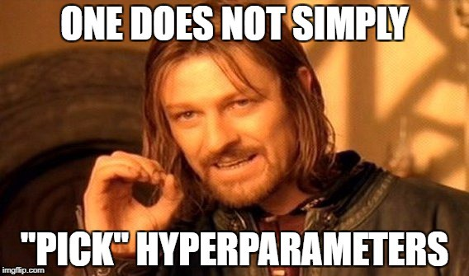
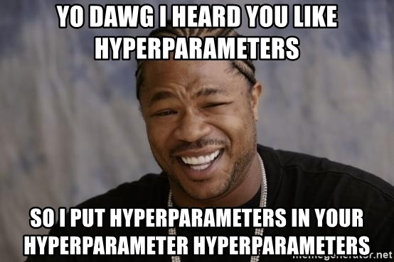
What is considered a hyperparameter?
Everything that effects training:
Model architechture
Optimizer structure
Question: Is the following a hyperparameter?
Dataset
Seed

Slide 4
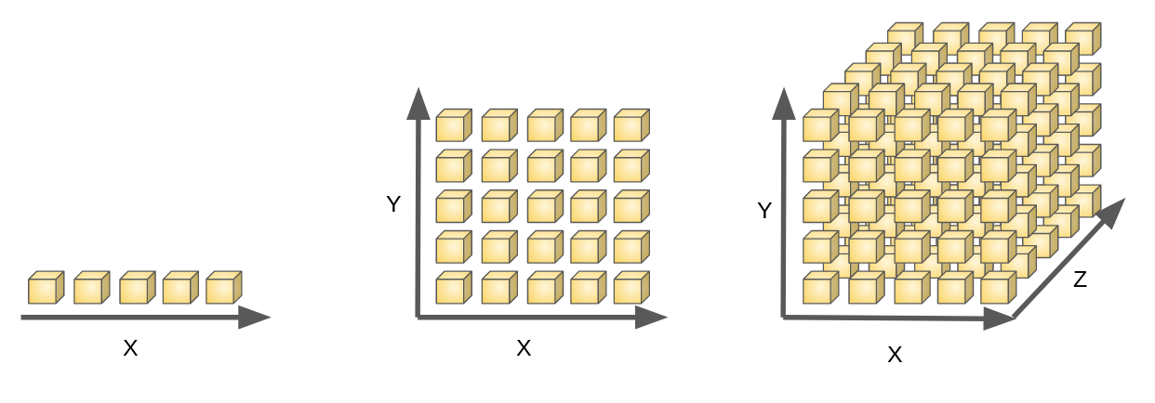
What about doing grid search?
Curse of dimensionality?
The number of combinations grows exponentially in the number of parameters we try to optimize.

Slide 5
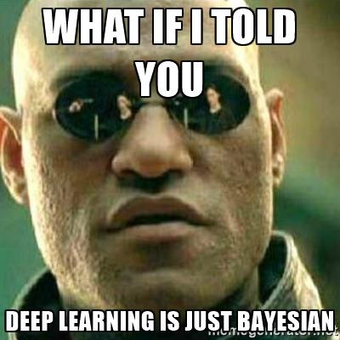
Baysian to the rescue
fafa

Slide 6
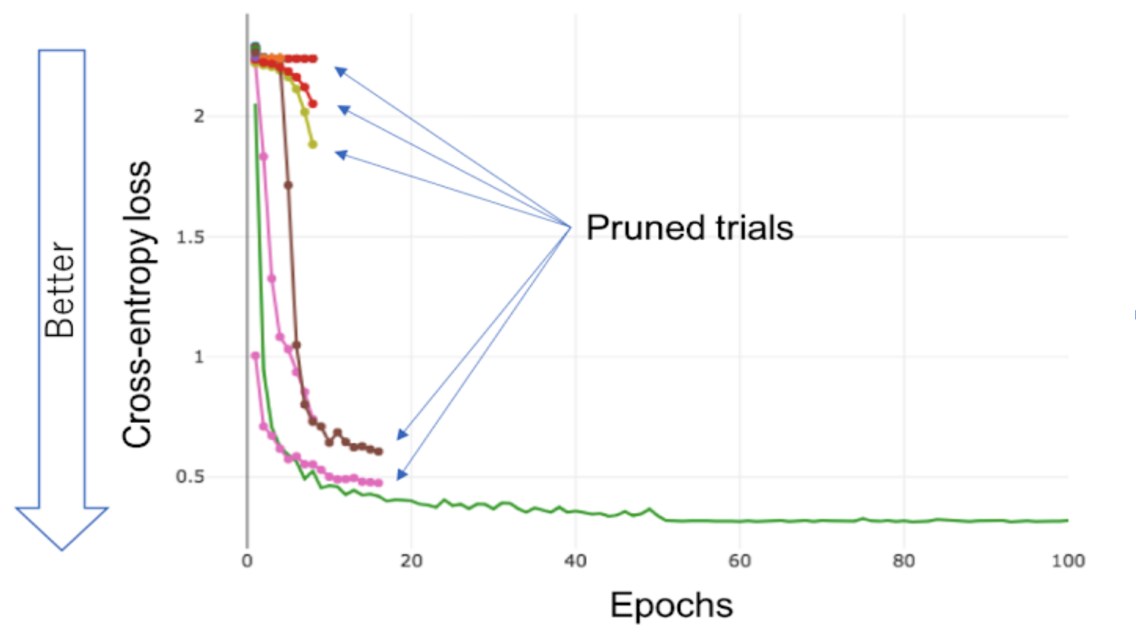
Pruning
Be carefull with over-pruning as you may loose some performance on the floor

Slide 7

Hyperparameter fremework
https://optuna.readthedocs.io/en/stable/

Slide 8
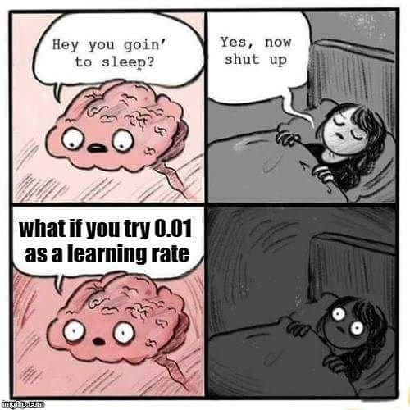
Meme of the day

