Slide 1
Deployment
02457 Machine Learning Operations
Nicki Skafte Detlefsen,
Postdoc
DTU Compute

Slide 2
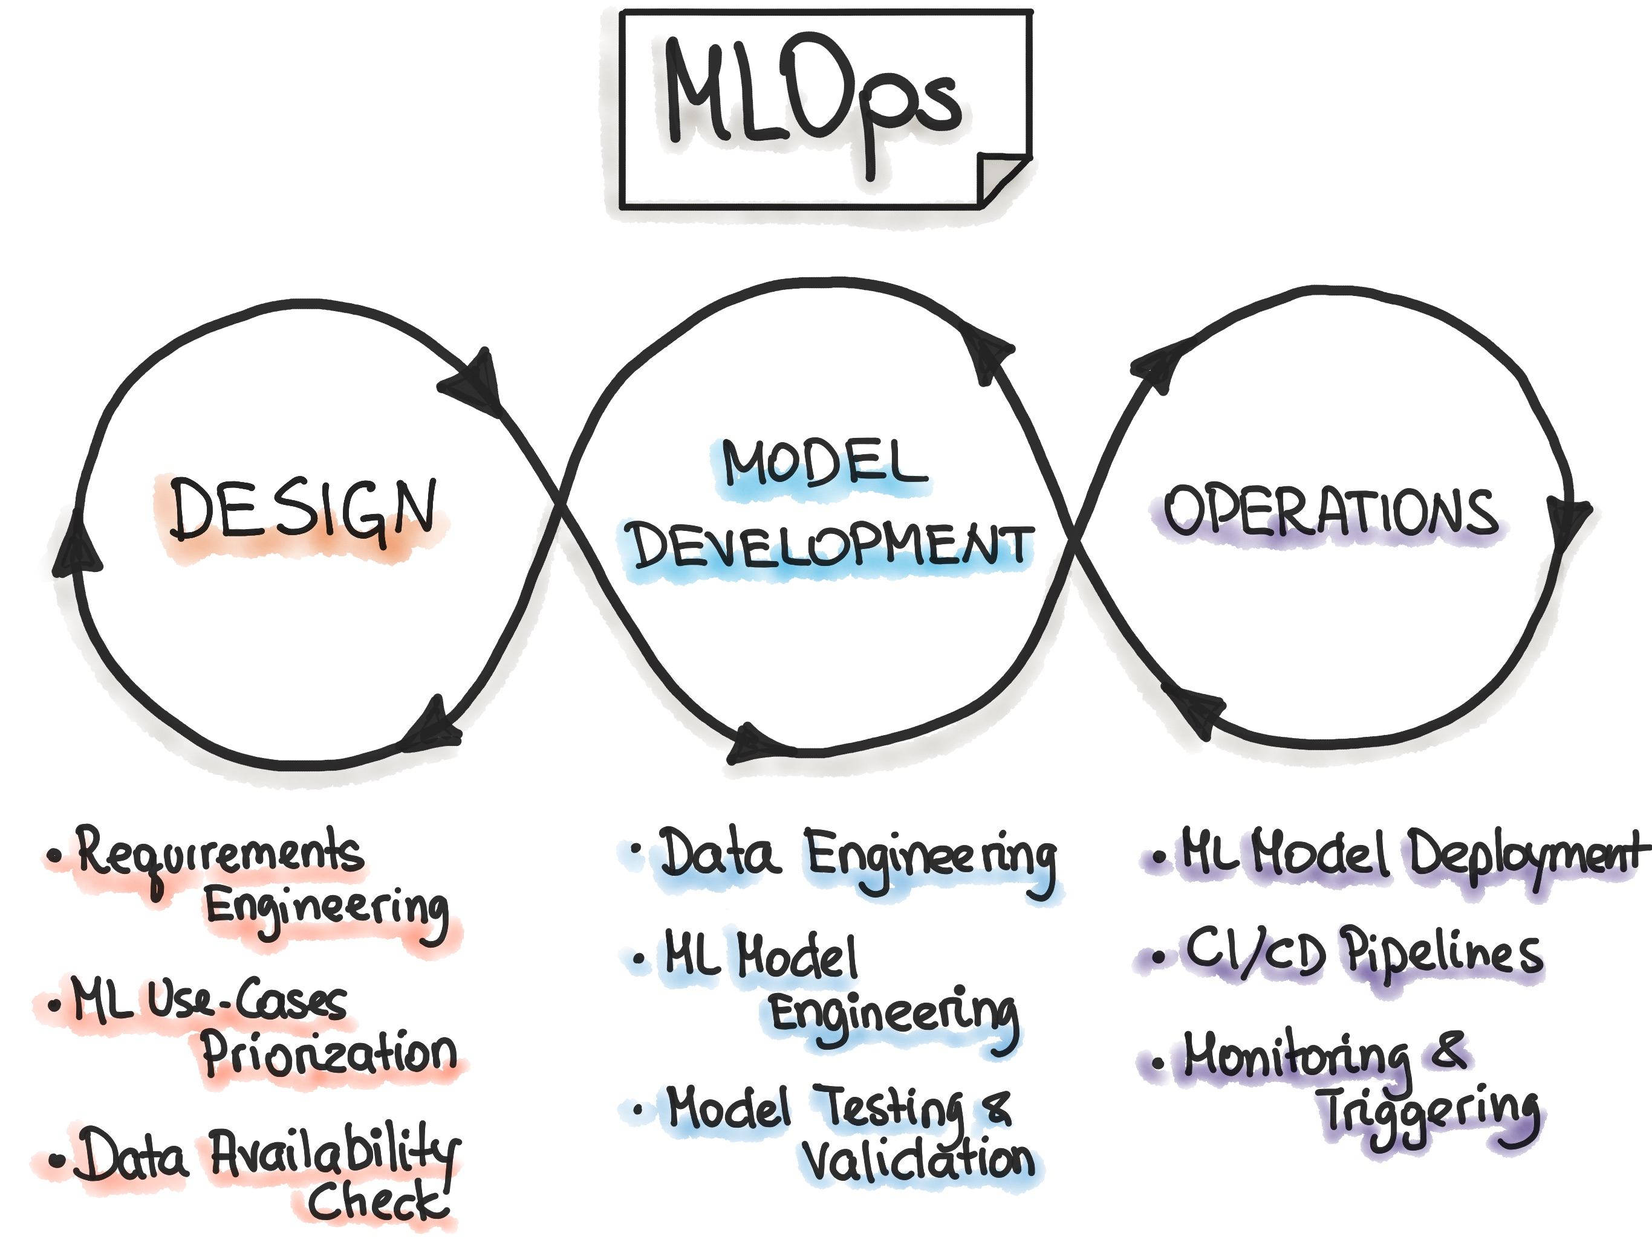
Freeing the model
Model deployment is part of the operations in MLOps
In a nutshell: make the model available to others

Slide 3
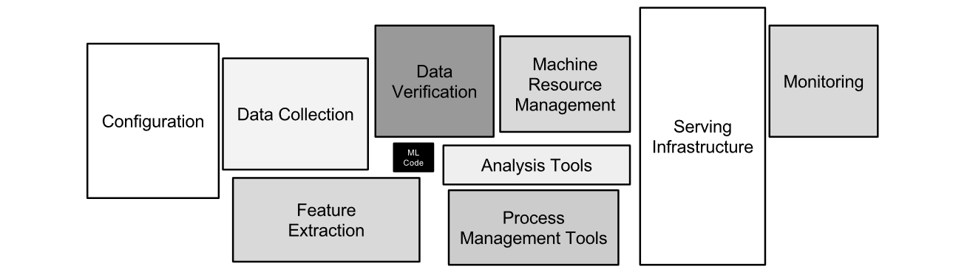
Remember this?
This is big for a reason

Slide 4
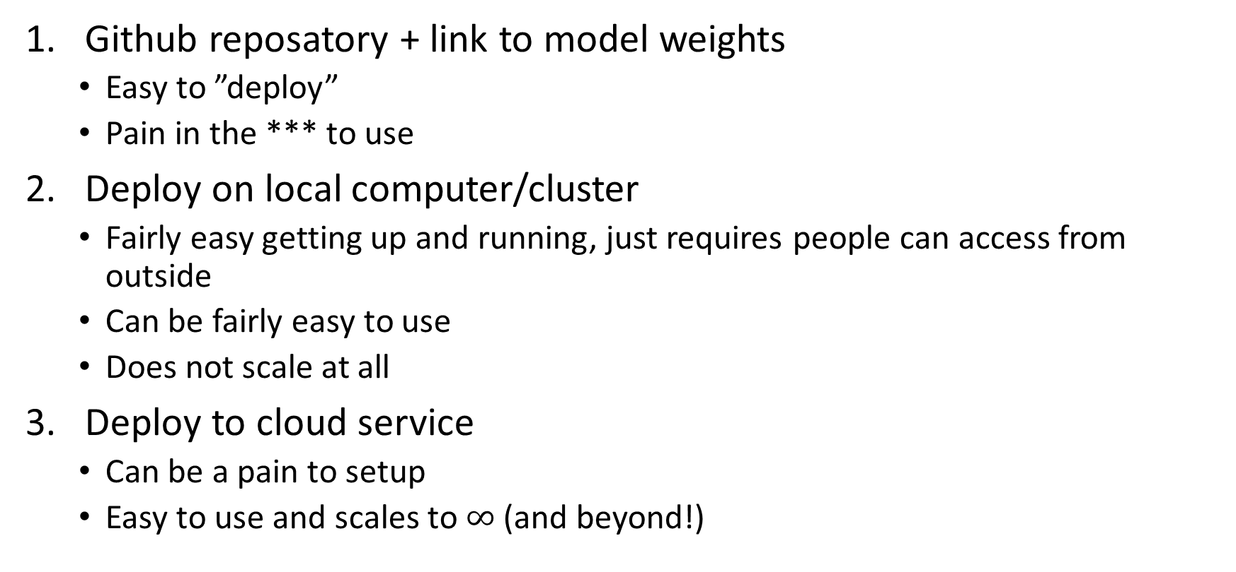
Many levels of deployment (within machine learning)
Github reposatory + link to model weights
Easy to ”deploy”
Pain in the *** to use
Deploy on local computer/cluster
Fairly easy getting up and running, just requires people can access from outside
Can be fairly easy to use
Does not scale at all
Deploy to cloud service
Can be a pain to setup
Easy to use and scales to $∞$ (and beyond!)

