Slide 1



CHATBOT: DR. RECEPTIONIST
By: DEEPAK SHARMA (E16CSE043)
Notes:
Add Caption : Expect More

Slide 2
Problem Statement
Ever went to a hospital's reception and had difficulty booking appointments and getting your queries resolved?
Long waiting lists and queues in hospitals makes it difficult and time consuming to get an appointment.
Also, common queries of doctors aren't solved affectively since there is no efficient way to doing it since it takes a lot of time to manually forward user’s query via a receptionist and get your questions resolved.

Slide 3
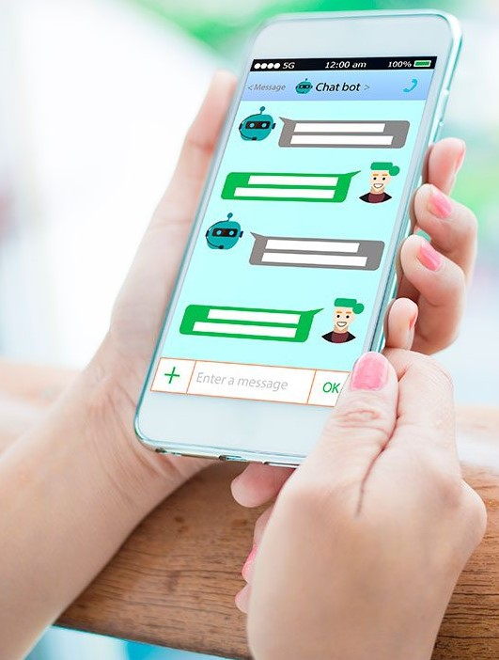
Problem Statement
The whole point of the manual approach and unnecessary human intervention to the process makes it inefficient and time consuming.
Hence, I propose a chatbot that aims to respond to patient’s queries and book/cancel appointments with doctors online in an efficient and effective manner.

Slide 4
Success/Outcome
“How will you measure the quality/success/outcome of the project?”
Features such as booking an appointment, cancelling an appointment, handling queries/questions of customers and getting them answered through the chat bot would be the factor that decides the success of my project. These features can be tested by entering dummy customers queries/questions and getting response to them.
We were not able to implement canceling appointment feature due to time constraint.
Rating for myself: 7.8 out of 10.

Slide 5

Technical Brief
Used NLP & machine learning tools of Dialogflow and Google Cloud Platform to build the chatbot.
Fulfillment webhook call via Node.js and integrations on Twilio API messaging, Skype, Dialogflow Phone Gateway and Web Demo App.
BigQuery and Firebase on GCP for database and maintaining logs respectively.
Intents, follow-up intents, contexts, entities were used to get the desired conversational flow between chatbot and the user.

Slide 6

Results
Our solution consists of allowing users to book appointments & cancel appointments using Google Calendar, asking queries to doctors and respond via email. BigQuery and firebase on GCP were used for database management and maintaining queries etc.
Book appointments, asking queries features were implemented successfully

Slide 7
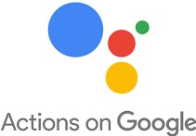
Results
I was not able to implement the cancel appointments feature due to time constraints and busy schedule because of placements.
Also, deployment of the chatbot on Google Assistant using AOG is the future work in order to make it accessible to people worldwide.

Slide 8
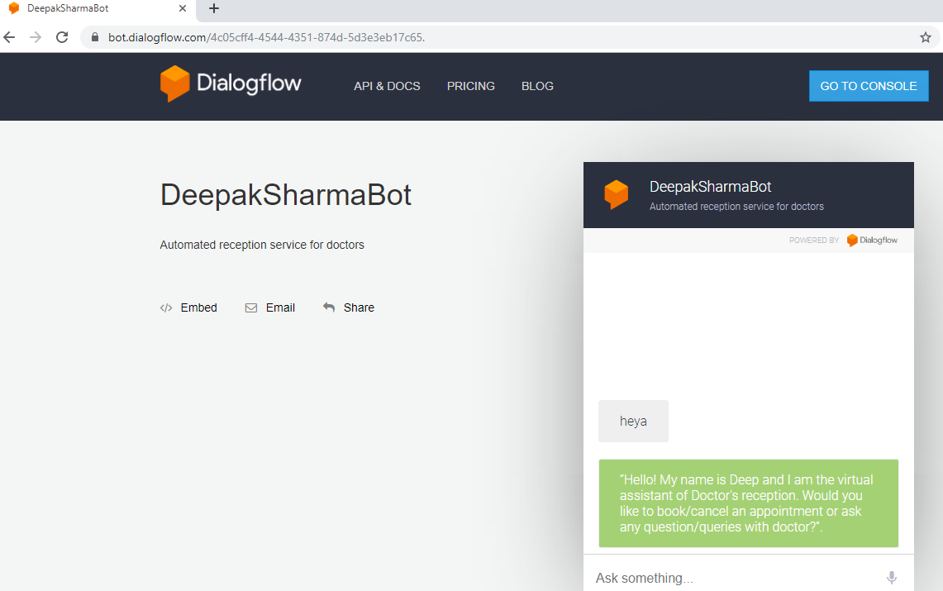
Results

Slide 9
Thanks
(Any Questions?)

