Slide 1
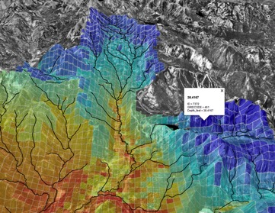
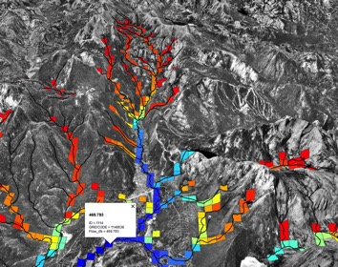
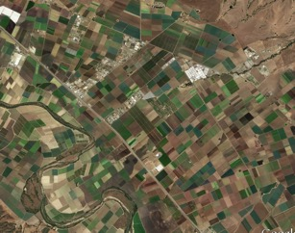
Precipitation-Runoff Modeling (PRMS)
Streamflow Routing Package (SFR)
Drainage
to streams
Irrigation on to PRMS HRUs or UZF cells
SW diversions/GW pumping
For irrigation

Slide 2
A) Surface water (SW) irrigation using IRRIGATION_DIVERSION Option
NIWR set using specified diversions in SFR input
Diversion
flows
ET_{a} calculated in AG using efficiency factor
ET_{a} calculated by UZF/PRMS using soil-water balance
Return
flows
Return flows (SW+GW) calculated by UZF/PRMS

Slide 3
B) Surface water (SW) and groundwater (GW) irrigation using IRRIGATION_DIVERSION and IRRIGATION_WELL
NIWR set using specified diversions in SFR input
NIWR set using specified pumping rates in AG input
GW Demand set as SW shortfall
(SUPPLEMENTALWELL)
GW irrigation
(IRRIGATIONWELL)
SW/GW
Irrigation
ET_{a} calculated by AG using efficiency factor
ET_{a} calculated by UZF/PRMS
Return flows (SW+GW) calculated by UZF/PRMS

Slide 4
C) Surface water (SW) and groundwater (GW) irrigation using IRRIGATION_SFR and IRRIGATION_WELL; demand calculated as ET deficit using ETDEMAND.
Externally (UZF) or internally (PRMS) calculated ET_{d}
Apply SW and GW irrigation
ETa is calculated by UZF/PRMS
Return flows (SW+GW) calculated by UZF/PRMS
Irrigation demand calculated using f(ET_{d}-ET_{a})
(ETDEMAND)
Nonlinear iterations
No SW
GW pumping rate set in AG input
GW right
SW diversion set as Irrigation demand, and limited by available flow and water right
(IRRIGATIONDIVERSION)
Diverted SW
Diversion less than demand with supplemental GW rights
GW Demand set as SW shortfall
(SUPPLEMENTALWELL)
Pumped GW
GW irrigation
(IRRIGATIONWELL)

Slide 5
C) Surface water (SW) and groundwater (GW) irrigation using IRRIGATION_SFR and IRRIGATION_WELL; demand calculated as ET deficit using ETDEMAND.
Externally (UZF) or internally (PRMS) calculated ET_{d}
Apply SW and GW irrigation
ETa is calculated by UZF/PRMS
Return flows (SW+GW) calculated by UZF/PRMS
Irrigation demand calculated using f(ET_{d}-ET_{a})
(ETDEMAND)
Nonlinear iterations
No SW
GW pumping rate set in AG input
GW right
SW diversion set as Irrigation demand, and limited by available flow and water right
(IRRIGATIONDIVERSION)
Diverted SW
Diversion less than demand with supplemental GW rights
GW Demand set as SW shortfall
(SUPPLEMENTALWELL)
Pumped GW
GW irrigation
(IRRIGATIONWELL)

