Slide 1
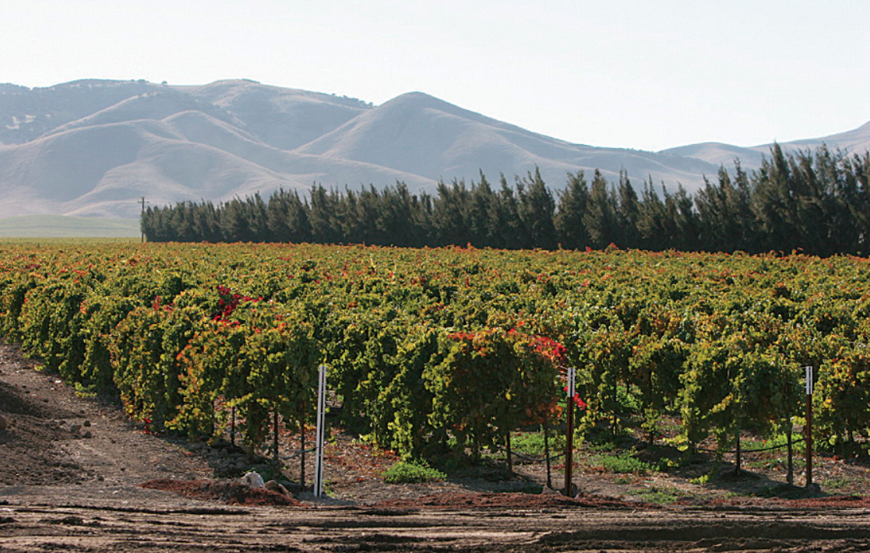
Agricultural-water use (AWU) Package for gsflow
Hyper-resolution modeling of Regional water use by agriculture

Slide 2
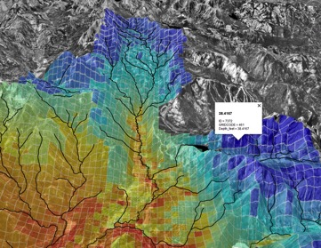
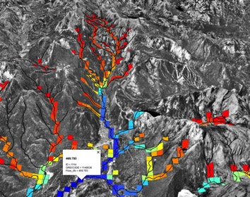
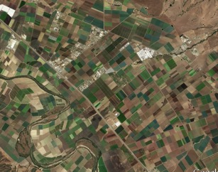
Precipitation-Runoff Modeling (PRMS)
Streamflow Routing Package (SFR), LAK Package
Watershed runoff
to streams
SW and GW supply
ET-based
SW and GW Demand
Irrigation of PRMS HRUs or UZF cells

Slide 3
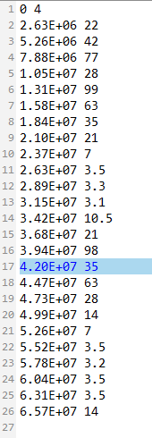
Mode 1
SW diversion
Demand set using SFR2 input variable “FLOW”
(IRRIGATION SEGMENT)
TABFILE
Diversion
flows
ET_{a} calculated in AWU using efficiency factor
(IUZFBND<0)
ET_{a} calculated by UZF/PRMS
(IUZFBND>0)
Surface water (SW) irrigation using IRRIGATIONSEGMENT
Demand specified as SW diversions using TABFILES
Return
flows
Return flows (SW+GW) calculated by UZF/PRMS

Slide 4
Mode 2
SW diversion
Demand set using SFR2 (Tabfiles) input variable “FLOW”
(IRRIGATIONSEGMENT)
Demand set using AGO input variable “Q”
TABFILE
GW Demand set as SW shortfall
(SUPPLEMENTALWELL)
GW irrigation
(IRRIGATIONWELL)
Surface water (SW) and groundwater (GW) irrigation using IRRIGATIONSEGMENT and IRRIGATIONWELL
Demand specified as SW diversions using TABFILES
SW/GW
Irrigation
ET_{a} calculated in AGO using efficiency factor
(IUZFBND<0)
ET_{a} calculated by UZF/PRMS
(IUZFBND>0)
Return flows (SW+GW) calculated by UZF/PRMS

Slide 5
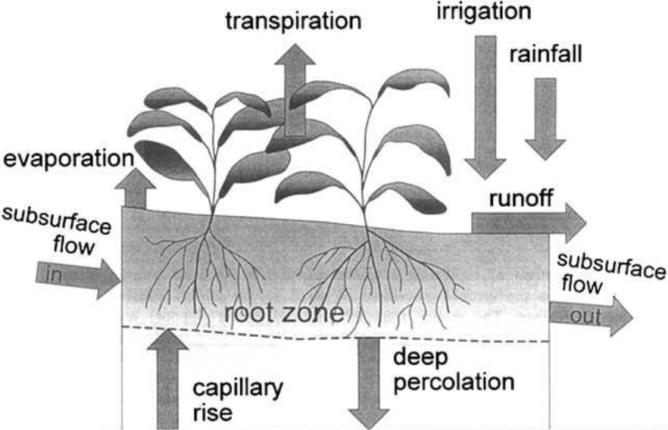
Mode 3
Externally (UZF) or internally (PRMS) calculated ET_{d}
Demand set using ETDEMAND
GW irrigation set using SUPPLEMENTALWELL
Surface water (SW) and groundwater (GW) irrigation using IRRIGATIONSEGMENT and IRRIGATIONWELL
Apply SW and GW irrigation
ETa is calculated by UZF/PRMS
Return flows (SW+GW) calculated by UZF/PRMS
Irrigation demand calculated using f(ET_{d}-ET_{a})
(ETDEMAND)
GW pumping rate set as Irrigation demand, and limited by AGO input “Q”
Nonlinear iterations
No SW
GW right
SW diversion set as Irrigation demand, and limited by the lesser of “FLOW” and Qseg
(IRRIGATIONSEGMENT)
Diverted SW
Diversion less than demand with supplemental GW rights
Pumped GW
GW Demand set as SW shortfall
(SUPPLEMENTALWELL)
GW irrigation
(IRRIGATIONWELL)

Slide 6
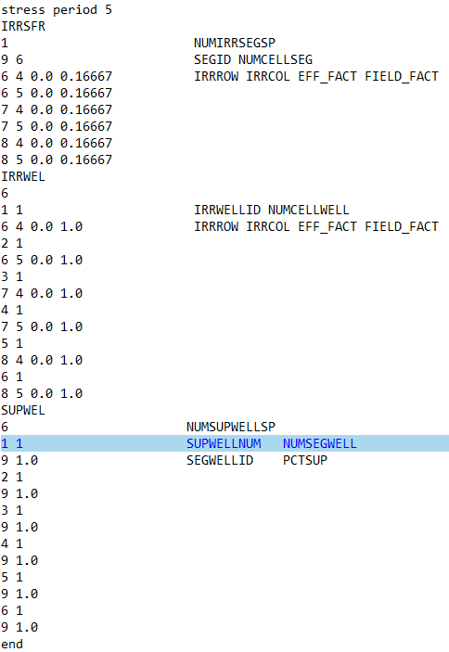
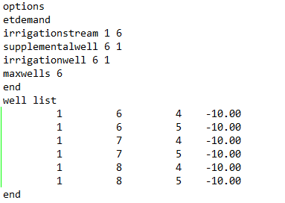
AWU Package Input file structure
Well list can use TABFILES to change max constraint on pumping

Slide 7
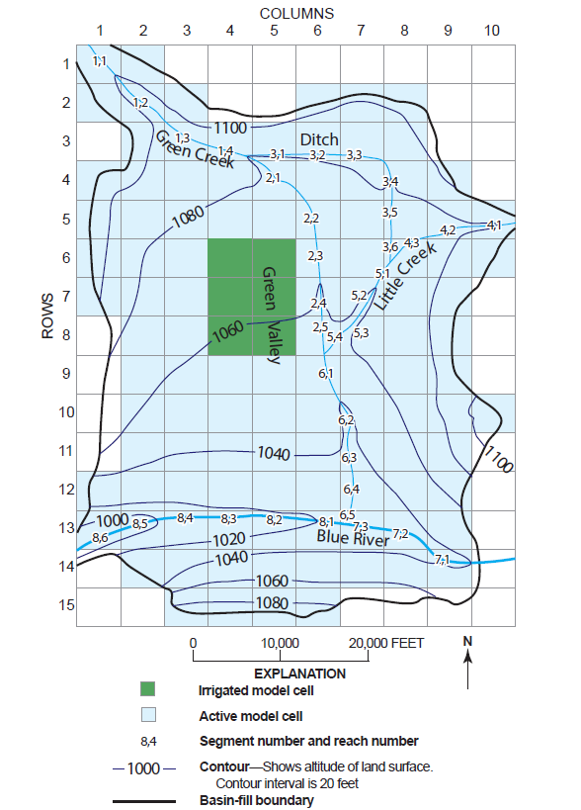
Test Model
Semi-arid
3500 acres of irrigated farms
Conjunctive use of SW and GW
2 year simulation
Mode 3
Irrigation schedule: every other week between April1st and September 30th

Slide 8
Impacts of K on crop consumption- ET based demand
ETa is less than ETo due to irrigation schedule

Slide 9
Cumulative SW and GW Irrigated Amounts for Different Field Hydraulic Conductivity Values

Slide 10
Groundwater return flows

Slide 11
Thanks you. Questions?

