Slide 1
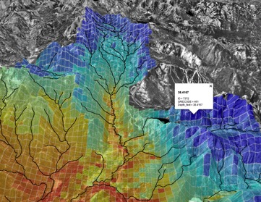
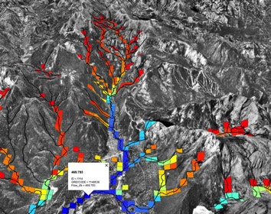
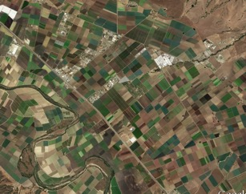
Precipitation-Runoff Modeling (PRMS)
Streamflow Routing Package (SFR)
Drainage
to streams
Irrigation on to PRMS HRUs or UZF cells
SW diversions/GW pumping
For irrigation

Slide 2
A) Surface water (SW) irrigation using IRRIGATIONSEGMENT
SW diversion
Demand set using SFR2 input variable “FLOW”
(IRRIGATION SEGMENT)
Diversion
flows
ET_{a} calculated in AWU using efficiency factor
(IUZFBND<0)
ET_{a} calculated by UZF/PRMS
(IUZFBND>0)
Return
flows
Return flows (SW+GW) calculated by UZF/PRMS

Slide 3
SW diversion
Demand set using SFR2 (Tabfiles) input variable “FLOW”
(IRRIGATIONSEGMENT)
B) Surface water (SW) and groundwater (GW) irrigation using IRRIGATIONSEGMENT and IRRIGATIONWELL
Demand set using AGO input variable “Q”
GW Demand set as SW shortfall
(SUPPLEMENTALWELL)
GW irrigation
(IRRIGATIONWELL)
SW/GW
Irrigation
ET_{a} calculated in AGO using efficiency factor
(IUZFBND<0)
ET_{a} calculated by UZF/PRMS
(IUZFBND>0)
Return flows (SW+GW) calculated by UZF/PRMS

Slide 4
C) Surface water (SW) and groundwater (GW) irrigation using IRRIGATIONSEGMENT and IRRIGATIONWELL; demand calculated as ET deficit using ETDEMAND.
Externally (UZF) or internally (PRMS) calculated ET_{d}
Apply SW and GW irrigation
ETa is calculated by UZF/PRMS
Return flows (SW+GW) calculated by UZF/PRMS
Nonlinear iterations
Irrigation demand calculated using f(ET_{d}-ET_{a})
(ETDEMAND)
No SW
GW pumping rate set as Irrigation demand, and limited by AGO input “Q”
GW right
SW diversion set as Irrigation demand, and limited by the lesser of “FLOW” and Qseg
(IRRIGATIONSEGMENT)
Diverted SW
Diversion less than demand with supplemental GW rights
GW Demand set as SW shortfall
(SUPPLEMENTALWELL)
Pumped GW
GW irrigation
(IRRIGATIONWELL)

