Slide 1

Eternity Calculator for sinh(x) Support
Prepared by:-
Abideep Singh Kondal
40241215
<<D2 deliverable>>
Monday, 28 July 2025

Slide 2
Deliverable 2 – Problems
Problem 4 – Persona Creation
Create a persona that represents a potential user of your function. The persona should be realistic, relevant, and highlight the user’s needs, goals, and environment.
Problem 5 – Java GUI Implementation from Scratch
Modify your D1 implementation to be built from scratch, avoiding Java’s built-in math libraries.
Develop a GUI using Java Swing or JavaFX.
Include exception handling and ensure that error messages are user-friendly.
The implementation must be independent of any IDE.
Problem 6 – Updated Requirements
Revise your D1 requirements based on the new GUI version.
Incorporate changes from your D2 implementation and update identifiers accordingly

Slide 3
Agenda
This phase extends the scientific sinh(x) function by implementing it from scratch in Java, eliminating all built-in mathematical functions.
A graphical user interface is introduced using Java Swing to enhance usability.
A detailed persona is created to represent the target user, guiding design and functionality decisions based on user-centric perspectives.
The requirements from D1 are updated in accordance with the new interface and exception handling mechanisms.
These revised requirements reflect system evolution aligned with ISO/IEC/IEEE 29148 standards.
The development continues in an iterative and incremental manner, showcasing improvement in system accessibility, usability, and robustness.

Slide 4

Persona Creation
Name: Jennifer Miller
Age: 21
Occupation: Undergraduate Physics Student
Technical Background: Moderate – comfortable with basic calculators and scientific functions
Goals: Quickly calculate hyperbolic functions like sinh(x) for physics assignments. Needs clear error messages if input is invalid (e.g., non-numeric values). Appreciates a simple and intuitive interface, as she uses multiple tools during study.
Frustrations: Doesn’t like complex scientific calculators with unnecessary features. Gets frustrated by cryptic error messages or app crashes due to input mistakes.
Environment: Uses the calculator in a quiet study space on her Windows laptop. Prefers desktop applications that don’t require installation or command-line usage.
Girl stock picture from :Link to stock picture

Slide 5
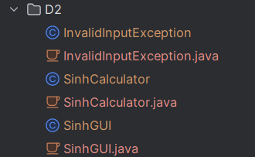
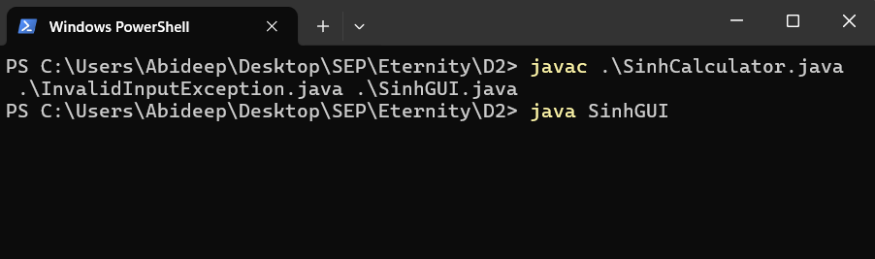
Java GUI Implementation
Re-implemented the sinh(x) function in Java from scratch, avoiding all built-in math libraries (e.g., Math.pow) by manually computing powers and factorials.
Developed a Graphical User Interface (GUI) using Java Swing[8][9], enabling user-friendly input and output interaction.
Ensured tool-independent compilation, keeping the code portable and functional outside any specific IDE[9].
Included exception handling using Java's built-in exception classes to manage invalid input (e.g., non-numeric values). Designed error messages to be clear and helpful, improving the overall usability of the calculator.
Link to repository : https://github.com/DeepKondal/Eternity

Slide 6
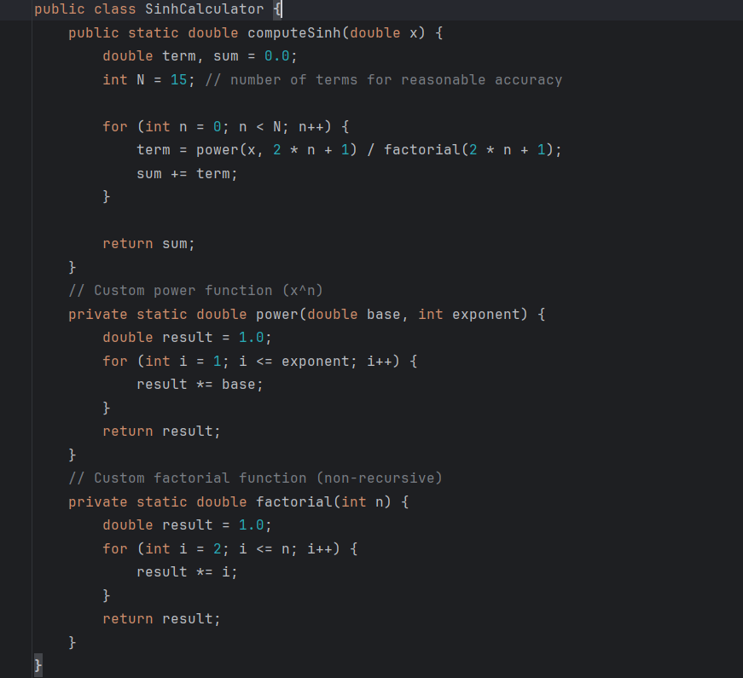
Java Code Snippet

Slide 7
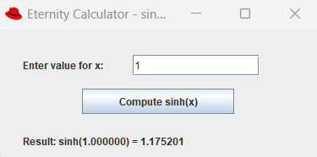
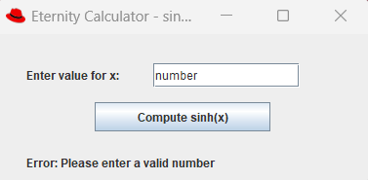
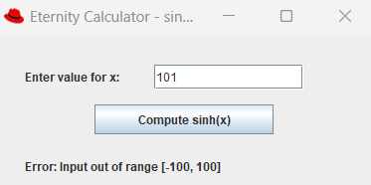
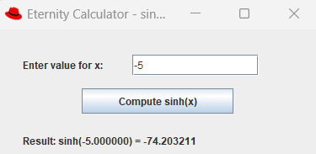
Java GUI Implementation
Hyperbolic sine correctly calculated
Please enter a valid input error
Input out of range error
Hyperbolic sine correctly calculated

Slide 8
Requirements – Functional
REQ-1 | The calculator shall allow the user to input a real number using a graphical text field.
REQ-2 | The calculator shall display the result of sinh(x) in a GUI label component.
REQ-3 | The calculator shall compute sinh(x) using its Taylor Series expansion.
REQ-4 | The calculator shall restrict input values to the range [−100,100] and display an appropriate warning if out of bounds.
REQ-5 | The calculator shall display an appropriate error dialog for any invalid or out-of-bound inputs.
REQ-6 | The calculator shall include a “Compute” button that performs the sinh(x) calculation when clicked.
REQ-7 | The calculator shall only close when the user wants to exit the GUI.

Slide 9
Requirements – Non-Functional
REQ-8 | The calculator’s GUI shall respond to user input within 100 milliseconds under normal operating conditions.
REQ-9 | The GUI shall support usability standards such as clear layout, labeled fields, and accessible controls.
REQ-10 | The calculator shall display error dialogs that help the user identify and correct issues.
REQ-11 | The calculator shall use exception handling to prevent application crashes from invalid input.
REQ-12 | The GUI shall be implemented using Java Swing and not depend on any external libraries.

Slide 10
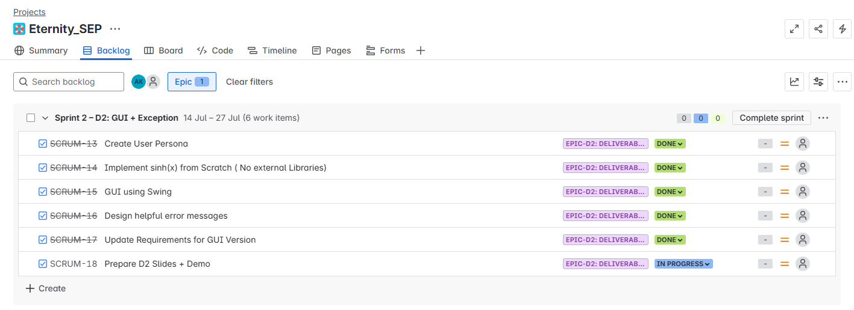
Agile Planning with Jira
The Eternity Calculator project is managed using Jira[11] to align with the agile and DevOps-inspired[4] structure of the course.
Tasks for Deliverable 2 are grouped under Epic-D2 and are individually tracked with progress status.
Sprint 2

Slide 11
Relevance to coursework
In this deliverable, I applied several software engineering techniques[5] emphasized in the course.
I employed mind mapping[3] to visually represent system interactions and dependencies between components such as the user[6] and the Java Swing GUI.
Used User Modeling[6] techniques to create a realistic and goal-driven persona, aligning user needs with functional expectations of the calculator.
Used first-principles programming and modular design, aligning with the fundamentals taught in Software Engineering Principles[12].
Created a Java Swing GUI prototype from scratch, applying lessons from Introduction to Software Prototyping[13].
Ensured clean organization and updated versioning of the project codebase on GitHub repository, reflecting topics in Building, Versioning, and Releasing[14].
Used an iterative and incremental process [5] where requirement updates guided UI and functionality
Additionally, I used Jira for task organization[4] and sprint planning

Slide 12
Conclusion and What’s Next
What's Completed?:
User persona developed for target demographic
Fully working GUI with Java Swing and scratch implementation of sinh(x)
Exception handling with helpful error messages
Updated functional and non-functional requirements
Upcoming in D3:
Full GUI with Swing/JavaFX
Refine GUI with proper design and accessibility principles.
Use Checkstyle, JDB, and SonarLint to ensure code quality.
Apply semantic versioning across source files.
Publish project on GitHub with a clear README and quality commits.

Slide 13
References
[1]Brainstorming and Beyond: A User-Centered Design Method. By C. Wilson. Morgan Kaufmann, 2013.
[2]Supporting Brainstorming Activities with Bots in Software Engineering Education.By J. C. Farah, J. L. Scala, S. Ingram, D. Gillet. 2019.
[3]Mind Mapping For Dummies.By F. Rustler. John Wiley and Sons, 2012.Developing a Glossary for Software Projects.By T. Abdou, P. Kamthan, N. Shahmir. 2021.
[4]Towards an Understanding of Collaborations in Agile Course Projects.By P. Kamthan. 2021.
[5]Introduction to Software Processes (Course Handout). By P. Kamthan. Concordia University, 2025.
[6]Introduction to User Modeling (Course Handout). By P. Kamthan. Concordia University, 2025.
[7]ISO/IEC/IEEE. Systems and software engineering — Life cycle processes — Requirements engineering (ISO/IEC/IEEE 29148:2018). Geneva: International Organization for Standardization, 2018.
[8]Java Documentation https://docs.oracle.com/en/java/javase/21/
[9]IntelliJ Accessibility Support https://www.jetbrains.com/help/idea/accessibility.html
[10]Draw.io Diagram Tool https://www.drawio.com/doc/
[11] https://confluence.atlassian.com/jira
[12] Software Engineering Principles (Course Handout). By P. Kamthan. Concordia University, 2025.
[13] Introduction to Software Prototyping (Course Handout). By P. Kamthan Concordia University, 2025.
[14] Building, Versioning, and Releasing (Course Handout). By P. Kamthan Concordia University, 2025.

Slide 14
Thank you
Thank you
Any questions?

