Slide 1

SSL-HAR OxWearables Paper and Pre-trained model’s performance Analysis
Abideep singh kondal

Slide 2
Paper Analysis
Introduction
data collection
Model training
results

Slide 3
INTRODUCTION

Slide 4
Introduction
The study applies self-supervised learning techniques to the UK-Biobank activity tracker dataset, which is the largest dataset of its kind, containing over 700,000 days of unlabeled wearable sensor data.
Their Claim :
Their resulting activity recognition model outperforms strong baseline models across seven benchmark datasets. The F1 score shows a relative improvement ranging from 2.5% to 100%, with a median improvement of 18.4%. The most significant improvements occur in smaller datasets.

Slide 5
Introduction
Current human activity recognition (HAR) models typically rely on manual feature engineering partly due to the very limited size of existing labelled datasets. Obtaining labelled data is labour intensive, but it is especially so for HAR data. On the other hand, collecting large-scale unlabelled HAR data is highly feasible, as evidenced by projects such as the UK-Biobank.
In their paper, they investigate how learning three simple self-supervised learning tasks independently and jointly could facilitate HAR across a variety of environments using the UKB dataset, which contains terabytes of wearable sensor data collected in the real world. To fully appreciate the benefit of SSL in HAR, they chose the tasks that would prioritise the temporal dependencies of human motion, namely, arrow of time (AoT), permutation and time-warping (TW)
The study shows that multi-task SSL can train HAR models that generalize well across seven different datasets with varying activity classes, devices, and environments.

Slide 6
Evolution of Human Activity Recognition (HAR) Models
HAR models follow the "Activity Recognition Chain," a process that involves pre-processing raw time series data, segmenting it into fixed-length frames, and extracting features for classification.
HAR models (e.g., random forests) use hand-crafted features, performing well on small datasets.
As deep learning gained popularity, researchers tried to apply it to HAR. CNNs and RNNs are good, but their effectiveness is limited by small datasets, sometimes outperformed by traditional methods.
Recently, researchers began exploring Self-Supervised Learning (SSL) for HAR. SSL techniques such as forecasting, masked reconstruction, and contrastive learning allowed models to learn without requiring large amounts of labeled data. However, these studies were also limited by small, laboratory-style datasets.
This paper leverages the largest dataset of wrist-worn accelerometer data (6 billion points) to explore how well SSL generalizes across large, real-world environments.

Slide 7
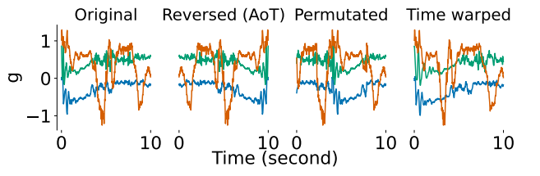
Self-Supervised Tasks
Arrow of Time (AoT): This task flips the time series signal, essentially playing it in reverse. The model must predict whether the signal is normal or reversed.
Permutation: The signal is divided into four chunks, and these chunks are shuffled randomly. The task is to predict whether the signal has been permuted. Each chunk has a minimum length of 10 timestamps to maintain enough data within each chunk.
Time Warping (TW): This task stretches or compresses random segments of the signal, mimicking a speed-up or slow-down effect in the signal. The model must determine whether the signal has been time-warped. (stretching factor = 0.2)

Slide 8
DATA COLLECTION

Slide 9
UKB Dataset for Multi-Task SSL Training
The UK Biobank (UKB) dataset is used for training the SSL models. It contains 700,000 person-days of accelerometer data from over 100,000 participants who wore wrist-worn devices for seven days in free-living conditions. This is crucial because it captures natural, unscripted activities, which makes the models more applicable to real-world scenarios compared to data collected in controlled laboratory settings with predefined tasks.
After training with the UKB dataset, the SSL models are evaluated on seven external labeled datasets that vary significantly in terms of:
Size: Ranging from 600 to 600,000 samples.
Activity Classes: Covering 4 to 18 different activity classes.
Devices: Collected using five different brands of wearable devices.
Collection Protocols: These datasets include data collected in free-living, scripted, and lab-based settings.

Slide 10
Data collection method overview
Data Collection: Wrist-worn devices measuring acceleration on x, y, z axes at 100 Hz.
Windowing: Signals split into 10-second windows to serve as inputs. These windows serve as independent inputs to HAR models, with each window can be labeled based on the activity occurring during that time.
Resampling: Data resampled to 30 Hz for consistency, exceeding the Nyquist rate to retain signal fidelity (most human activities <10 Hz).
The methods involve processing large-scale accelerometer data by splitting it into windows and resampling it for consistency. Multiple datasets with diverse subjects, environments, and activity classes were used to evaluate the HAR models, enabling a robust assessment of the utility of self-supervised learning across various settings. The diverse datasets help test the generalizability of the HAR models in different environments.

Slide 11
MODEL TRAINING

Slide 12
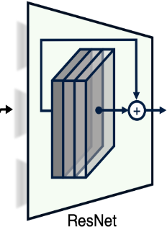
Network Training
ResNet-V2 Architecture:
The model uses a ResNet-V2 with 18 layers and 1D convolutions (which are suitable for time-series data like accelerometer signals).
The model contains 10 million parameters in total and outputs a feature vector of size 1024.
The same feature extractor is shared across all self-supervised tasks (Arrow of Time, Permutation, Time Warping). A softmax layer is then attached for each task.
(A softmax layer is a layer in a neural network that converts raw scores (also known as logits) produced by the model into probabilities)
For downstream HAR tasks, an additional fully-connected (FC) layer of size 512 is inserted between the feature extractor and the softmax readout, enabling better performance when the model is fine-tuned for activity recognition.

Slide 13
Training Setup
The training was distributed across four Tesla V100-SXM2 GPUs, each with 32GB of memory.
The model took about 420 GPU hours to train, completing around 20 epochs in total.
The train/test split for the SSL tasks was set to 80:20, meaning 80% of the data was used for training and 20% for testing.
Fine-tuning:
For fine-tuning the model on downstream HAR tasks, the same training setup was used as in SSL pre-training, except that the batch size was adjusted depending on the dataset size.

Slide 14
Data Sampling, Augmentation and Optimization
During SSL training, up to four subjects were loaded per iteration from the UK Biobank (UKB) dataset. For each subject, one day of data was selected, and 1500 10-second windows were sampled to create a training batch.
The self-supervised transformations (AoT, Permutation, Time Warping) were then applied to this batch.
To account for variations in axis orientation across different devices, the data was augmented by applying random axis swaps and rotations, helping the model learn to be invariant to these changes.
The model was optimized using the Adam optimizer with a learning rate of 1e-3.
Due to the large batch size (1500 × 4 = 6000 samples), the learning rate was linearly scaled as per standard practice for large batches, with a 5-epoch burn-in period.

Slide 15
Binary Classification for Each Task:
Each of these self-supervised tasks (AoT, Permutation, Time Warping) is framed as a binary classification problem. The model predicts whether or not the signal has undergone one of these transformations.
By learning to recognize these signal transformations, the model becomes better at recognizing meaningful activity patterns in the data.
Multi-task Learning (MTL) Setup:
The model is trained on multiple tasks simultaneously (AoT, Permutation, TW).
Loss Calculation: The performance for each task is optimized using cross-entropy loss. All tasks contribute equally to the overall model’s learning during training by having equal weights in the loss calculation.
Weighted Sampling:
Inactivity Problem: Real-world accelerometer data often contains periods of low activity, which do not provide much useful information for training.
To avoid wasting training time on static data, the model uses weighted sampling. It gives higher priority to data windows with more movement (identified by higher standard deviations), making the training process more efficient by focusing on dynamic, informative data segments.

Slide 16
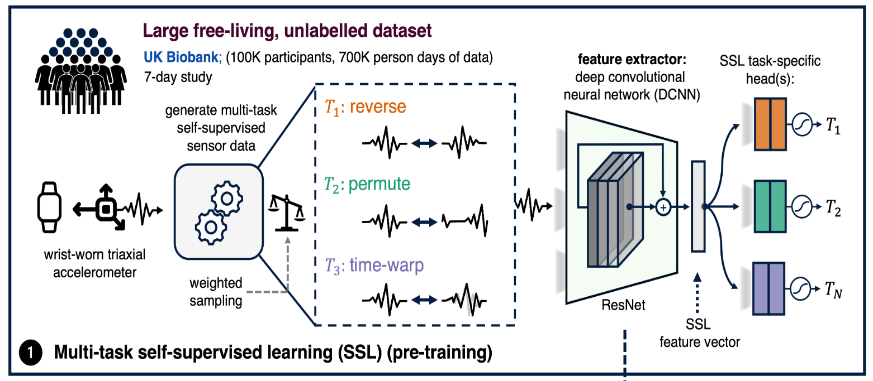

Slide 17
RESULTS

Slide 18
Evaluation techniques
Cross-Validation Approaches:
Held-One-Subject-Out: For datasets with fewer than 10 subjects, one subject is held out as the test set while the remaining subjects are used for training and validation. This ensures a robust evaluation when data is limited.
Five-Fold Subject-Wise Cross-Validation: For datasets with 10 or more subjects, five-fold cross-validation is used, where subjects are split into five groups. Each group is used as a test set once, while the others serve as training and validation sets.
Data Split: In both cross-validation methods, the data is split into:
70% for training,
10% for validation, and
20% for testing. This ensures that there is sufficient data for training while also allowing for validation and testing.

Slide 19
Evaluation techniques
Early Stopping: A patience of five epochs is used during training to avoid overfitting. If the model’s performance does not improve for five consecutive epochs, training is halted.
Fine-Tuning Strategies:
After pre-training the model on the UKB dataset, the network is fine-tuned on seven labelled downstream datasets using two approaches:
Fine-Tuning All Layers: Adjusts all layers of the network.
Freezing the Trunk: Keeps the feature extractor (the trunk) unchanged while only fine-tuning the fully connected (FC) layers at the end. This is often done to preserve learned representations from the larger dataset.
Comparison with Other Models: The performance of the SSL-trained model is compared with:
A model trained from scratch with the same architecture.
A strong random forest model that uses traditional time series features. This comparison is essential for establishing a performance baseline.

Slide 20
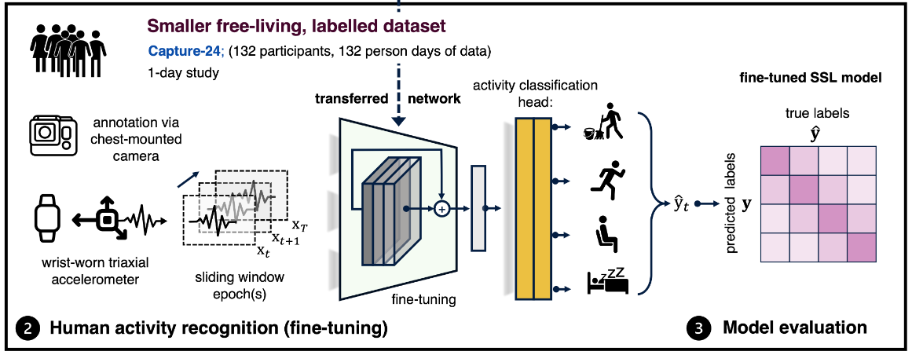

Slide 21
Weighted Single Task Training
Weighted Sampling:
Weighted sampling gives more importance to high-movement periods during training because, in real-world motion data, there are large portions of low movement or static periods that don’t provide much useful information for learning.
Without this adjustment, the model might learn more from static periods, which aren’t useful for detecting activities or solving pretext tasks.
Pretext Tasks:
The study evaluates three self-supervised tasks: Arrow of Time (AoT), permutation, and time warping. These tasks aim to help the model learn representations of the data that can be useful for downstream tasks like human activity recognition (HAR).
When each of these tasks is trained individually (rather than in a multi-task setting), their performance is evaluated.

Slide 22
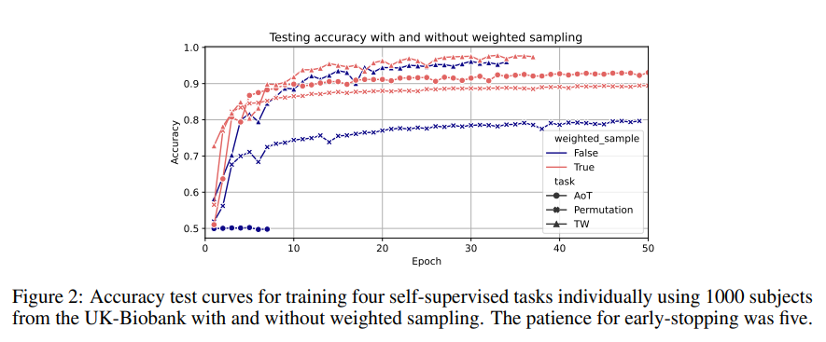
Convergence Behaviour
The results showed that without weighted sampling, the tasks performed worse. Specifically, the model’s convergence (ability to improve performance over training) was negatively affected.
For the AoT task, the test performance remained at the random chance level, meaning the model didn’t learn anything useful for this task without weighted sampling.

Slide 23
Multi-Task Self-Supervised Learning
Here they evaluate the performance of different self-supervised learning (SSL) task combinations on human activity recognition (HAR) benchmarks using a multi-task approach.
Dataset Selection:
Three datasets of varying sizes were used for evaluation:
Capture-24 (large dataset)
Rowlands (medium dataset)
Opportunity (small dataset)
These datasets help assess how different SSL configurations perform across different data sizes.
Training Setup:
Models were trained on 1,000 subjects from the UK Biobank (UKB) dataset, using combinations of the three self-supervised tasks:
Arrow of Time (AoT): Detects whether a signal is played in reverse.
Permutation: Randomly shuffles chunks of the signal.
Time Warping (TW): Randomly speeds up or slows down segments of the signal.
Models were fine-tuned on the downstream HAR benchmarks.

Slide 24
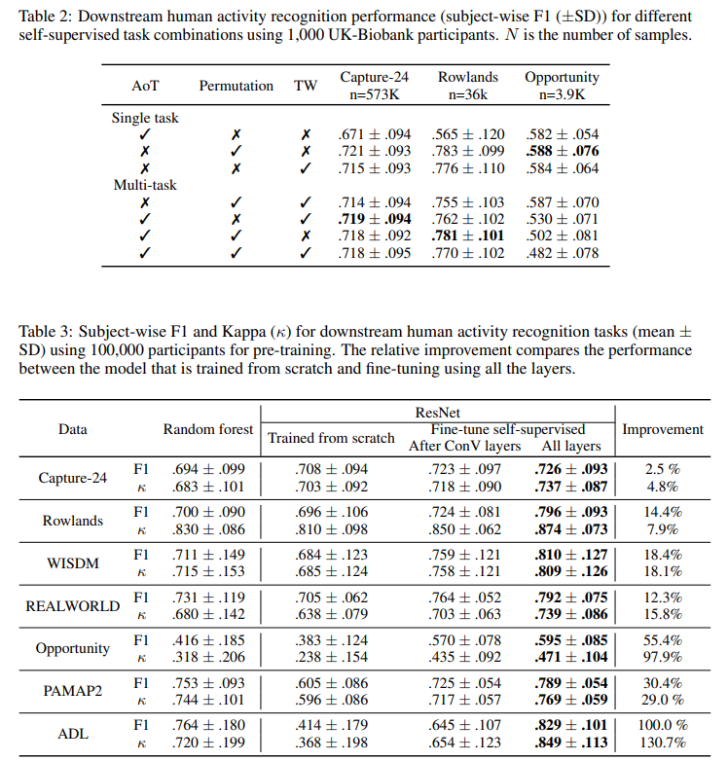
Large and Medium Datasets: The differences in performance across different SSL task combinations were relatively small on the large (Capture-24) and medium (Rowlands) datasets.
Small Dataset (Opportunity): Performance differences were more significant, indicating that small datasets are more sensitive to the choice of SSL task combinations.
Best Performing SSL Configurations: There wasn’t a clear, consistently superior SSL configuration. Therefore, for simplicity, all three tasks (AoT, Permutation, and TW) were used in pre-training for the remaining experiments. This generalizes the model for better performance across different datasets.

Slide 25
Transfer Learning and Fine-Tuning:
Table 3 compares models that were pre-trained on 100,000 participants and then fine-tuned on downstream datasets, versus models trained from scratch.
Fine-tuning generally outperformed models trained from scratch, with improvements in the F1 score values across all datasets.
Fine-tuning All Layers was more effective than only fine-tuning the Convolutional Layers.
Transfer learning success varied based on the similarity between the source (pre-training) and target (downstream) datasets.

Slide 26
Analysis and Impact of Data Volume
Performance improved with more data, but even with limited labeled data, pre-trained models were still effective.
Multi-task SSL showed the most generalizable performance across various downstream datasets.
Fine-tuning models that were pre-trained on large datasets provided significant improvements over training from scratch, especially when using a large number of subjects during pre-training.
The use of all three SSL tasks in pre-training ensures broader coverage and generalization for downstream HAR tasks, regardless of dataset size.

Slide 27

Downstream Performance

Slide 28
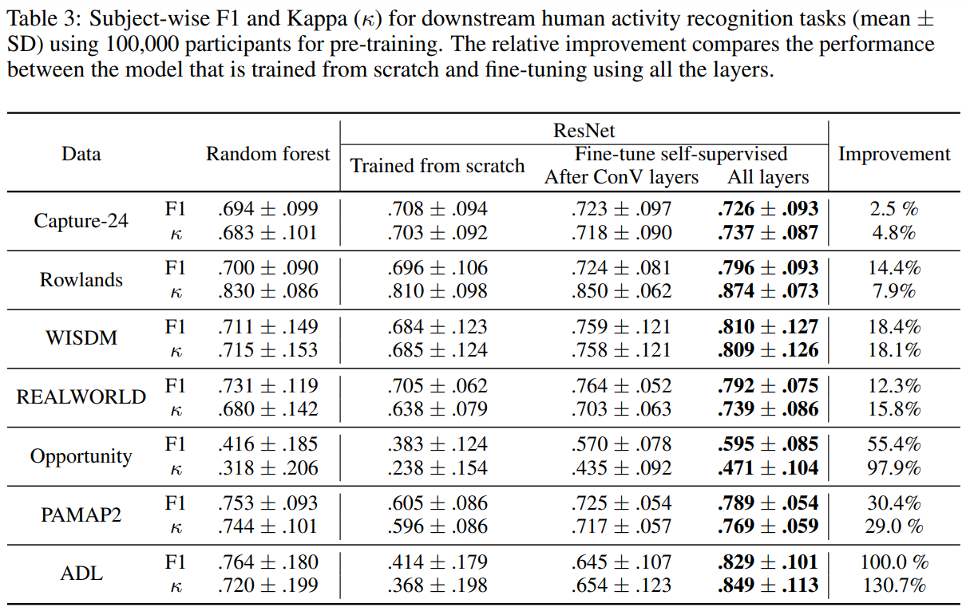
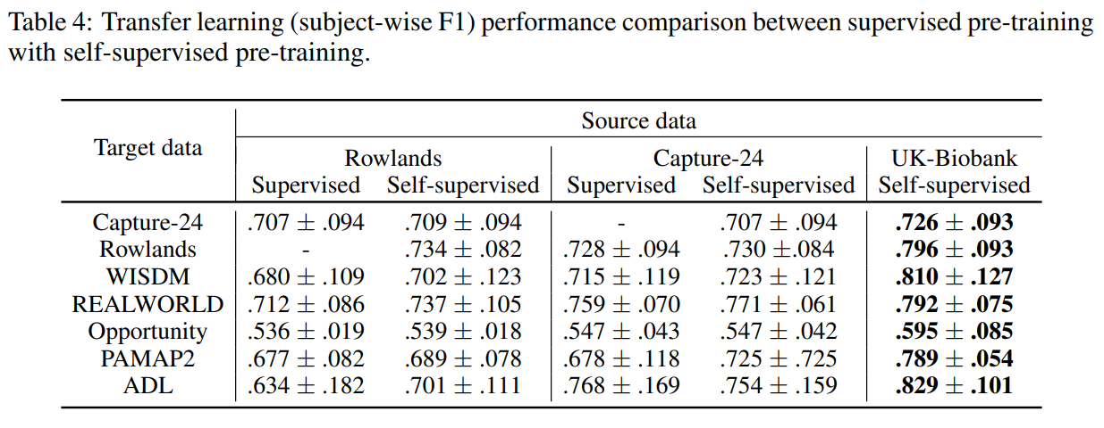
Random Forest vs. Deep Learning Models:
In smaller datasets, random forest models perform better than deep learning models trained from scratch. However, deep learning models with SSL pre-training outperform both models trained from scratch and random forest models across all seven HAR datasets.
Fine-tuning vs. Training from Scratch:
Pre-trained models consistently perform better, especially when all layers are fine-tuned. Fine-tuning after convolution layers alone is effective but fine-tuning all layers results in higher performance.

Slide 29
Impact on Small vs. Large Datasets:
The improvement from SSL pre-training is more significant in smaller datasets. For example, in the Opportunity dataset, the F1 improvement is as high as 55.4%, while in larger datasets like Capture-24, the improvement is modest (around 2.5%).
Varying Data in SSL:
Adding more unlabeled data during SSL pre-training improves performance, but the improvement levels off after a certain point. This is particularly useful for smaller datasets, where labeled data might be scarce, but larger datasets do not see the same proportional benefit from additional unlabeled data. There is a diminishing return as the data volume increases beyond a certain point.

Slide 30
Key Insight:
Even though supervised pre-training can boost the learning outcome substantially than training from scratch (Table 3 vs Table 4), it was surprising to see self-supervised pre-training could outperform supervised pre-training when using Rowlands and Capture-24 as the source data. We suspect the limited number of labels that the source datasets had did not contain enough information as what would have been learnt using the SSL pretext tasks.

Slide 31

Ablation Studies

Slide 32
Varying Data
Labelled
data
Unlabelled
data
These are studies related to varying the amount of labeled and unlabeled data in downstream tasks and SSL pre-training.
Downstream Tasks
Pre-Training

Slide 33
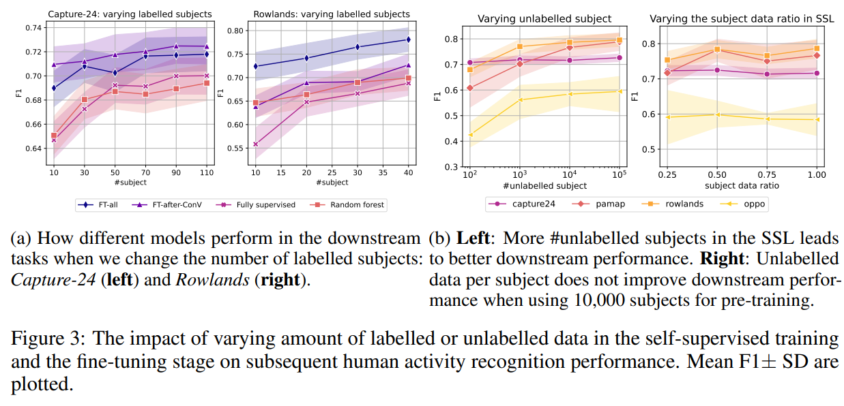
Varying Labeled Data in Downstream Tasks:
Pre-trained models (using SSL) performed well, regardless of the number of labeled subjects. Supervised models and random forest models were more sensitive to the number of labeled subjects, showing linear performance improvements as more labeled subjects were added.
SSL pre-training helps models generalize well, even when the amount of labeled data is limited, while supervised models and simpler models like random forests are more reliant on larger labeled datasets.
Varying Unlabeled Data in Pre-Training:
Downstream performance improves as more unlabeled subjects are added for SSL pre-training. The performance boost is particularly significant for smaller datasets (e.g., Opportunity dataset). However, for larger datasets, the improvements are smaller, aligning with previous research.

Slide 34
Conclusion
SSL pre-training significantly enhances human activity recognition performance by creating better feature representations. The improvement is most notable when labeled data is scarce.
Labeled data: Models with SSL pre-training show robust performance even with a limited number of labeled subjects, while fully supervised models require more labeled data to improve linearly.
Unlabeled data: Adding more unlabeled data during SSL pre-training enhances performance, especially in smaller datasets. Increasing the data ratio per subject becomes less effective after a certain point.
Augmentation techniques, like time-warping and permutation, help improve the recognition of both low and high-intensity activities.

Slide 35

Cluster Analysis

Slide 36
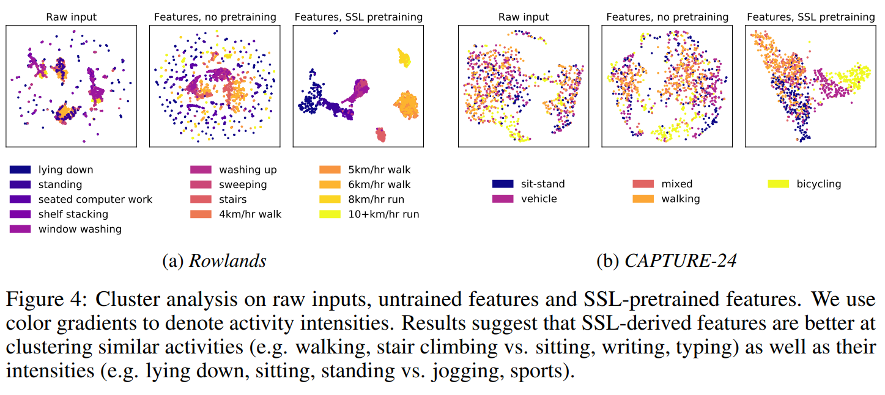
The analysis used UMAP (Uniform Manifold Approximation and Projection) for visualizing the data by projecting it into a low-dimensional space.
Three types of inputs were visualized:
Raw inputs: The unprocessed data from sensors or activities.
Untrained features: Features from models that were not pre-trained.
SSL-derived features: Features learned through SSL without any fine-tuning.
As seen in Figure 4, the SSL-derived features are significantly better at:
Clustering similar activities (e.g., walking, stair climbing).
Differentiating activity intensities (e.g., sitting vs jogging or sports).

Slide 37
This clustering improvement is measured by:
Intra-class compactness: How close data points of the same activity are grouped.
Inter-class separability: How well different activities are separated from one another.
SSL-derived features create more distinct and meaningful clusters, improving the separation between activities, making the task of activity recognition easier and more accurate.

Slide 38

Feature Interpretation
(Using Layer-wise Relevance Propagation)

Slide 39
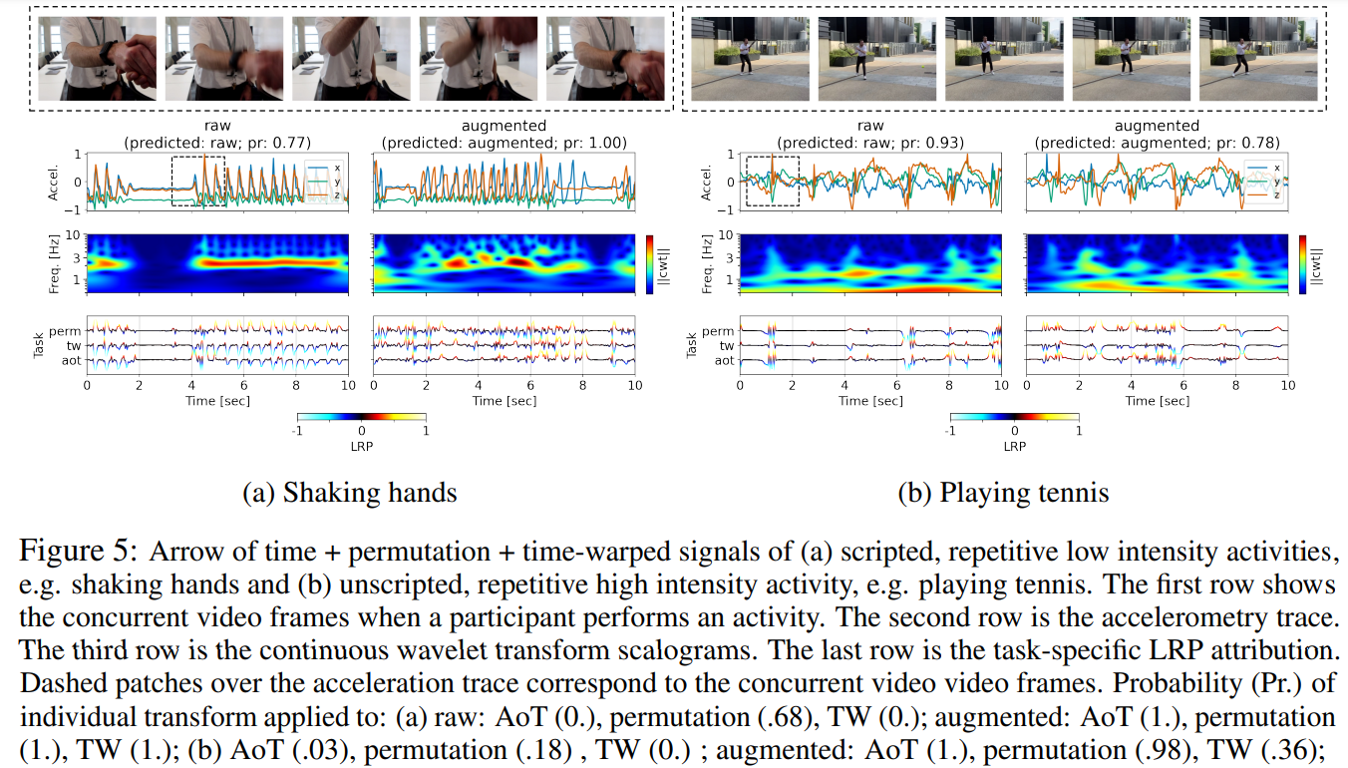
Interpreting the features and understanding models' decision-making processes using LRP during two activities: shaking hands and playing tennis
Shaking hands (Figure 5a):
A low-intensity repetitive activity.
The LRP model focuses on the natural periodicity (regular patterns) and intensity of the motion to identify the activity.
Augmented signals (artificially altered) showed different attributions, sometimes focusing on unnatural or unrealistic motion patterns due to augmentation-induced mismatches.

Slide 40
Playing tennis (Figure 5b):
A high-intensity repetitive activity.
LRP highlighted moments of natural movement, such as swinging and hitting the tennis ball, indicating the model’s ability to focus on critical motion periods.
Like in shaking hands, augmented signals showed attributions during unrealistic or fragmented motion patterns, highlighting some limitations in augmentation techniques.
The LRP model can interpret important moments in activities, focusing on periodic motion (for low-intensity activities) and key motion bursts (for high-intensity activities).
The model was sensitive to realistic motion, with augmented signals being more challenging due to unnatural dynamics introduced by artificial transformations.

Slide 41
Key Points
SSL-derived features improve clustering, making activities and their intensities easier to differentiate.
LRP interpretation shows that the model focuses on natural, periodic movements in low-intensity activities and key dynamic actions in high-intensity activities.
Augmentation techniques can introduce challenges, with unrealistic attributions occurring during fragmented or mismatched motion.
The use of movement-based sampling during training, where stationary periods are ignored, leads to better feature learning.
The XAI models tested in the study (Like LRP) reliably identified important patterns that distinguished transformed data from the original, ensuring that the model’s decision-making process was grounded in meaningful features.

Slide 42
Paper Conclusion
Self-Supervised Learning (SSL) Enhances HAR:
The study demonstrated that self-supervised pre-training consistently improves Human Activity Recognition (HAR) performance, especially when there is limited labeled data. This reduces the dependency on labeled datasets, making the model more efficient in scenarios with smaller datasets.
Generalization Across Datasets, Tasks, and Devices:
The SSL-trained models showed an ability to generalize well across different datasets, tasks, devices, and even populations. This is a significant improvement over previous studies, which mostly trained and evaluated on the same dataset, limiting their generalization ability.
Human Motion Dynamics and Synchronization:
The study suggests that multi-task SSL helps the model learn crucial aspects of human activities such as motion dynamics, intensity levels, and axis synchronization (the relationship between different sensor axes). This capability is evident even before any fine-tuning, where pre-trained models are already distinguishing between different activities.

Slide 43
Harnet10 Pre-trained SSL model’s performance
Models available
model performance across various datasets
Performance comparison with randomforest (realdisp dataset)

Slide 44
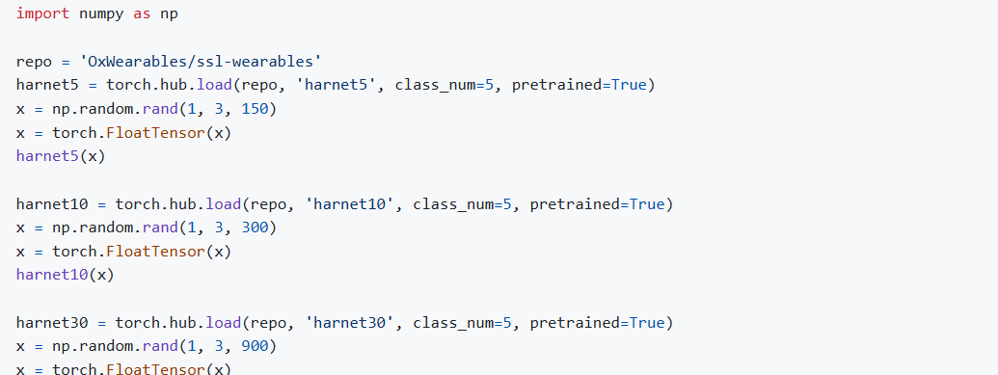
OxWearables available SSL models
Harnet5 (Window shape = (n, 3, 150))
Harnet10 (Window shape = (n, 3, 300))
Harnet30 (Window shape = (n, 3, 900))

Slide 45

SSL Model performance across various datasets

Slide 46
ADL Dataset
(Mentioned in paper)

Slide 47
HaRNet10 Performance on ADL Dataset (Fine-tuning Overview)
Dataset: Cleaned ADL dataset (30 Hz sampling frequency).
Subjects: 7
Data Split: 80% training, 20% validation.
Model: Pretrained HaRNet10 SSL model.
Selected for its balance between performance and computational efficiency compared to HaRNet5 and HaRNet30.
Adjusted classifier layer for 12 activity classes in the ADL dataset.
Training Process:
Optimizer: Adam, Learning rate: 1e-4.
Batch size: 32, Sliding window size: 300 samples.
Fine-tuned for 10 epochs.

Slide 48
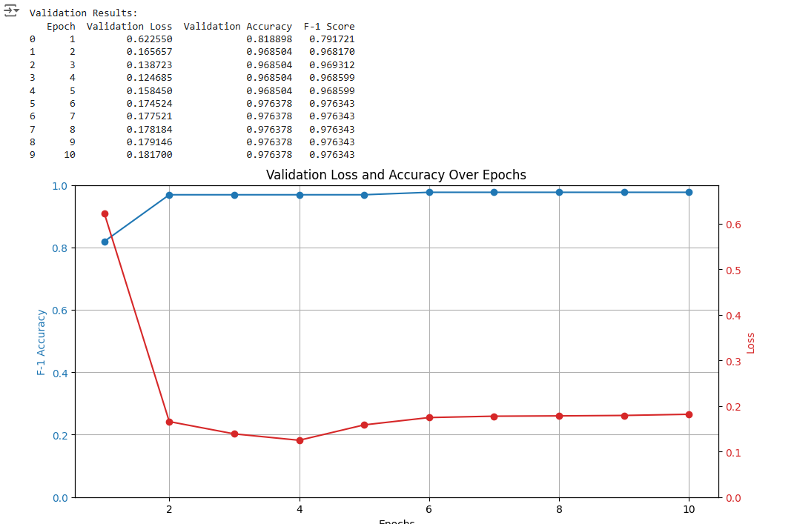
Results and Observations
Validation Performance (After 10 Epochs):
F1 Score: Increased steadily from 0.79 (Epoch 1) to 0.97 (Epoch 10).
Strong Transfer Learning Capability: Fine-tuning on ADL dataset with HaRNet10 achieved high accuracy and F1 score.
Stability: The model showed consistent improvement in performance with no signs of overfitting.
Class Imbalance Handling: Weighted F1 score reflects robust activity recognition despite dataset imbalance.

Slide 49
HMP ADL Recognition with
Wrist-worn Accelerometer Dataset

Slide 50
About the dataset
The dataset captures multivariate, sequential, time-series data of users performing daily activities in their homes over 35 days.
Sampling Frequency =30Hz
It is designed for classification and clustering tasks in domains like smart home automation and healthcare.
Each user’s data is provided in three files: a description, sensor events (features), and activity labels.
The dataset is fully labeled, contains no missing values, and supports research in human activity recognition.

Slide 51
Fine-Tuning Harnet10 on the Dataset
Data Split: 80% training, 20% validation using stratified sampling.
Subjects: 16
Data Preparation Highlights: Normalized X, Y, Z sensor data and activity labels.
Sliding Window Approach:
Sequence Length: 300 samples, Overlap: 50%.
Dataset split into 8 chunks for structured training and validation.
Key Metrics: Trained for 5 epochs with high F1 scores and accuracy achieved on validation.

Slide 52
Dataset Splitting and Batch Validation
Training-Validation Splitting:
Dataset divided into 8 chunks, each containing ~12.5% of the data in each chunk.
4 validation batches (20 windows each) randomly selected from each chunk.
Remaining data used for training.
Reason for Chunking and Batching:
Ensures non-overlapping, representative validation data.
Prevents overfitting by maintaining strict separation between training and validation.

Slide 53
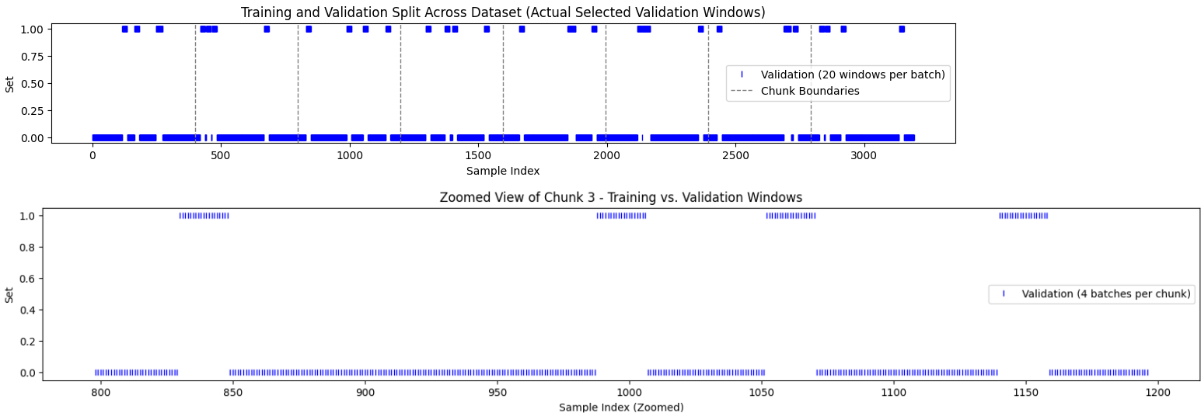
Train data : 80%
Test data : 20%

Slide 54
Model Performance and Results
Harnet10 SSL Model Modifications:
Pre-trained Harnet10 fine-tuned with CrossEntropyLoss and Adam optimizer.
Final classifier replaced to match the number of activity classes in ADL dataset.
Training Details:
Training: 80% of dataset, Validation: 20%.
Batch Size: 16 windows.
Sliding Window Analysis:
Shows where validation windows were selected within chunks.
Zoomed Chunk Example: Clear separation of training and validation batches.

Slide 55

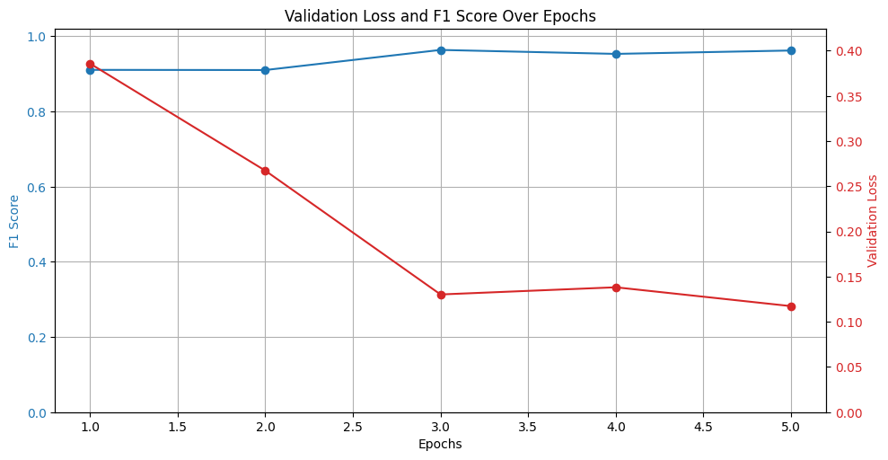
Epoch-Wise Metrics:
Validation Accuracy: 91.3% → 96.1%.
Validation F1 Score: 91.0% → 96.4%.
Key Observations:
Sliding windows and batching improve representation and generalization.
Chunking ensures balanced and diverse validation.
Harnet10 effectively adapts to the dataset with fine-tuning.

Slide 56
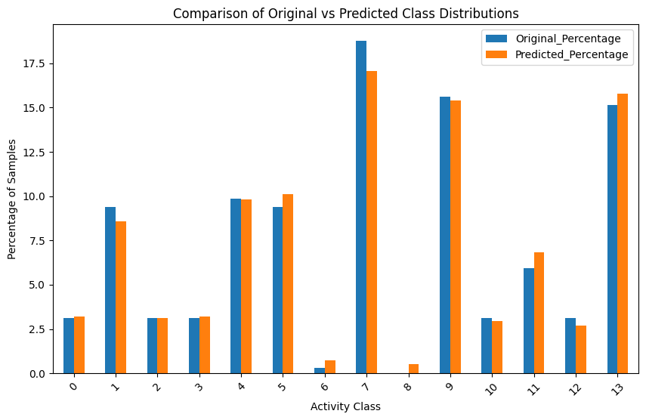
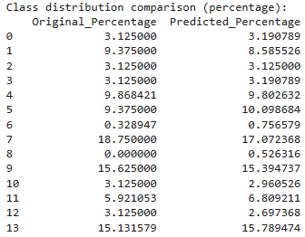
Class Distribution Comparison: Original vs Predicted Percentages in the testing sample

Slide 57
REALDISP Activity Recognition
Dataset

Slide 58
About the dataset
The Realdisp dataset serves as a benchmark for evaluating activity recognition under various sensor placement scenarios:
Ideal Placement: Sensors are positioned by an instructor.
Self-Placement: Users position sensors themselves, simulating real-world variability.
Mutual Displacement: Sensors are intentionally displaced to evaluate performance under incorrect placements.
Includes data from 9 Xsens inertial measurement units placed on different body parts. It captures:
Tri-directional acceleration
Gyroscope
Magnetic field
Quaternion orientation data
In our study, we specifically focus on Left Wrist Arm accelerometer data (X, Y, Z).

Slide 59
Objective and process Overview
Evaluate activity recognition accuracy and F1 scores using the REALDISP dataset with HaRNet10, focusing on ideal vs. self-placement scenarios.
Dataset: REALDISP activity recognition dataset:
Includes sensor data from ideal-placement (instructor-positioned) and self-placement (user-positioned) scenarios.
Data captured using left lower arm accelerometer (X, Y, Z) signals.
Performance evaluation conducted for 17 participants.
Finally, we will compare our fine-tuned model against Random Forest.

Slide 60
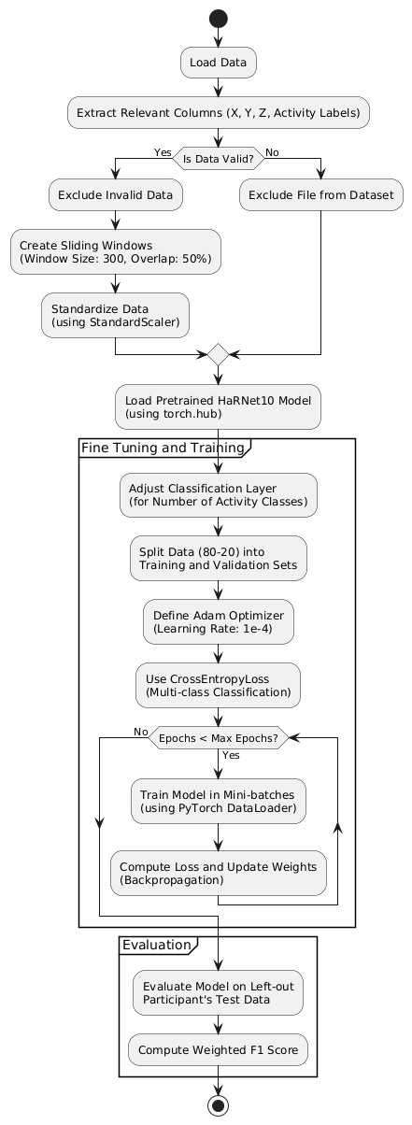
SSL Model Evaluation Pipeline
Data Preprocessing:
Extract X, Y, Z accelerometer data and activity labels.
Exclude invalid or noisy data files.
Create sliding windows (300 samples, 50% overlap).
Standardize data using StandardScaler.
Model Training:
Load pre-trained HaRNet10 model.
Adjust classification layer for the number of activity classes.
Split data (80-20) into training and validation.
Train using Adam optimizer (Learning rate: 1e-4) and CrossEntropyLoss.
Evaluation:
Test on left-out participant's data.

Slide 61
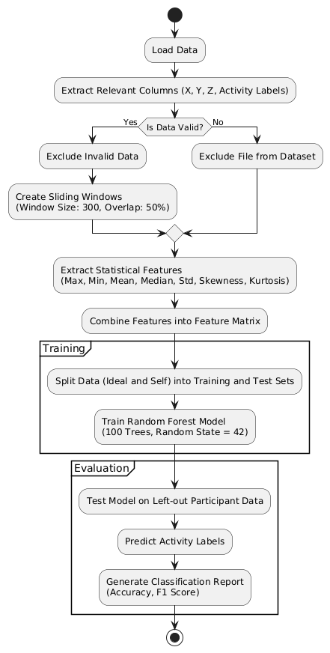
RandomForest Evaluation Pipeline
Data Preprocessing:
Extract X, Y, Z accelerometer data and activity labels.
Create sliding windows (300 samples, 50% overlap).
Extract statistical features: max, min, mean, std, skewness, kurtosis, etc.
Model Training:
Combine ideal and self-placement data for training.
Train Random Forest model with 100 trees (random_state=42).
Evaluation:
Test on left-out participant's ideal and self-placement data.
Generate classification report with accuracy and F1 score.

Slide 62
Evaluation Scenarios and Methodology
Evaluation Scenarios:
Ideal (train) vs. Ideal (test):Evaluates the performance of the model when both training and testing data are collected under ideal conditions.
Ideal (train) vs. Self (test):Tests the generalizability of the model trained on ideal placement data when tested on self-placement data.
Self (train) vs. Self (test):Measures the model's ability to handle variability in real-world sensor placements by training and testing on self-placement data.

Slide 63
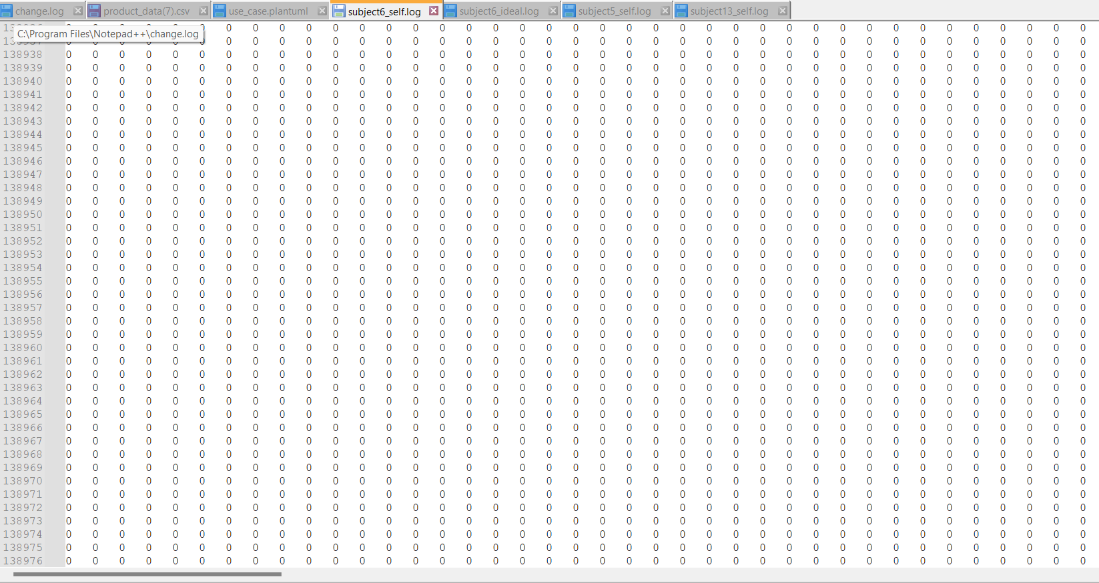
Exclusion of Participants 5, 6, and 13
Reason for Exclusion:
Data from Participants 5, 6, and 13 contained a majority of zero values, indicating:
Possible hardware issues leading to incomplete or invalid recordings.
These zero values acted as noise, potentially skewing model performance evaluation.
The lack of meaningful signals rendered the data unusable for training or testing.
Impact of Exclusion:
Improved the quality of the dataset by removing noisy and unreliable data.
Ensured the results reflect the true performance of models on valid, representative data.

Slide 64
Participant wise F1 score for each scenario
Participant_id | Ideal_Ideal_F1(SSL) | Ideal_Ideal_F1(RF) | Ideal_Self_F1(SSL) | Ideal_Self_F1(RF) | Self_Self_F1(SSL) | Self_Self_F1(RF)
1 | 0.9076 | 0.84 | 0.9134 | 0.82 | 0.8833 | 0.78
2 | 0.9266 | 0.87 | 0.8986 | 0.85 | 0.9068 | 0.84
3 | 0.8102 | 0.72 | 0.8703 | 0.81 | 0.8793 | 0.8
4 | 0.8398 | 0.75 | 0.8427 | 0.81 | 0.8337 | 0.81
7 | 0.9575 | 0.92 | 0.9116 | 0.83 | 0.8788 | 0.83
8 | 0.8898 | 0.84 | 0.92 | 0.87 | 0.9136 | 0.86
9 | 0.914 | 0.88 | 0.893 | 0.87 | 0.9297 | 0.86
10 | 0.9399 | 0.88 | 0.8964 | 0.89 | 0.9053 | 0.88
11 | 0.8106 | 0.77 | 0.866 | 0.81 | 0.9007 | 0.81
12 | 0.8406 | 0.78 | 0.8395 | 0.8 | 0.8535 | 0.81
14 | 0.9254 | 0.87 | 0.8966 | 0.85 | 0.926 | 0.83
15 | 0.8796 | 0.84 | 0.8891 | 0.86 | 0.8645 | 0.84
16 | 0.7742 | 0.69 | 0.809 | 0.79 | 0.8415 | 0.8
17 | 0.8328 | 0.74 | 0.9541 | 0.91 | 0.9496 | 0.9

Slide 65
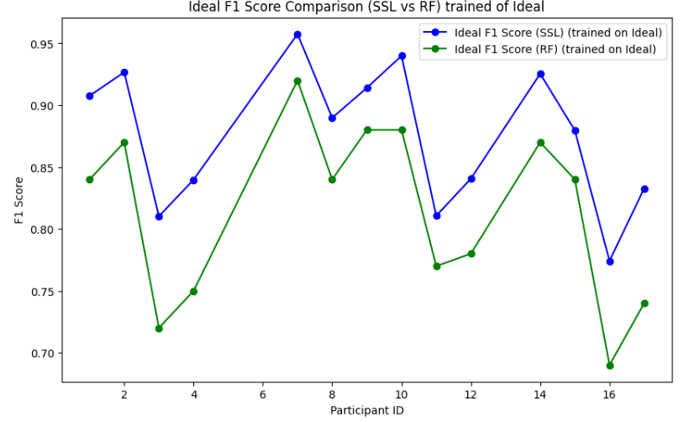
Scenario1 : Ideal (train) vs. Ideal (test)
Performance evaluated using REALDISP dataset with leaving each participant out once from training set and then testing on that participant.
Models compared: Self-Supervised Learning (SSL) vs Random Forest (RF).
Key Findings:
Ideal_F1(SSL): 0.8749
Ideal_F1(RF): 0.8136
Observation: SSL models show better average performance compared to Random Forest, highlighting their effectiveness in controlled scenarios.

Slide 66
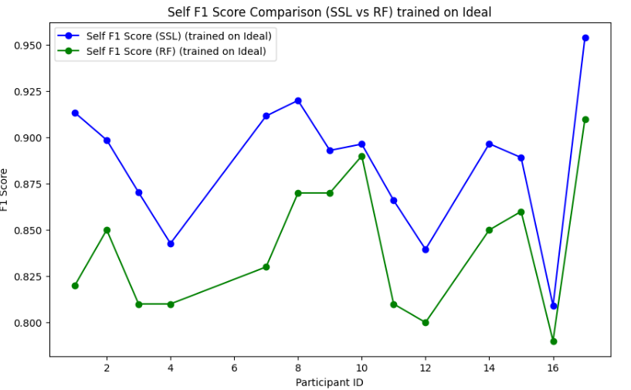
Scenario2 : Ideal (train) vs. Self (test)
Performance evaluated using REALDISP dataset with leaving each participant out once from training set and then testing on that participant.
Models compared: Self-Supervised Learning (SSL) vs Random Forest (RF).
Key Findings:
Self_F1(SSL): 0.8857
Self_F1(RF): 0.8407
Observation: Here also SSL models outperform Random Forest. This demonstrates that SSL models generalize better to real-world, user-positioned scenarios, preserving higher F1 scores across participants.

Slide 67
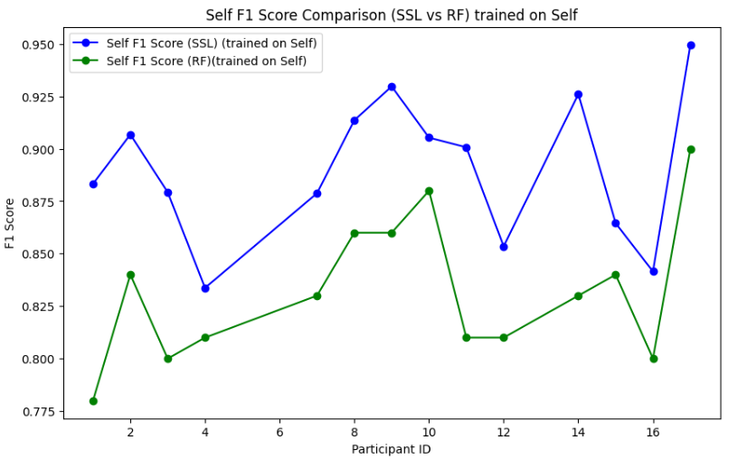
Scenario3 : Self (train) vs. Self (test)
Performance evaluated using REALDISP dataset with leaving each participant out once from training set and then testing on that participant.
Models compared: Self-Supervised Learning (SSL) vs Random Forest (RF).
Key Findings:
Self_F1(SSL): 0.8905
Self_F1(RF): 0.8321
Observation: Training and testing on self-placement data confirms the robust performance of SSL models with a consistently higher average F1 score compared to Random Forest. While both models adapt to user-positioned data, SSL demonstrates superior fine-tuning capabilities, achieving better alignment with real-world applications.

Slide 68
Conclusion
Across all scenarios, SSL models consistently demonstrated superior performance compared to RF models, showcasing their robustness and adaptability in activity recognition tasks.
In Scenario 1 (Train on Ideal, Test on Ideal), Self-Supervised Learning (SSL) achieved an average F1 score of 0.8749, outperforming Random Forest (RF), which scored 0.8136. This demonstrates that SSL models deliver superior accuracy in controlled, ideal conditions, highlighting their effectiveness when sensor placement and data collection are consistent.
In Scenario 2 (Train on Ideal, Test on Self), SSL exhibits the ability to generalize to self-placement scenarios, with an average self F1 score of 0.8857 compared to 0.8407 for RF. This shows that SSL models maintain their performance edge even when tested in real-world scenarios, where sensor placement may vary compared to controlled setting.
In Scenario 3 (Train on Self, Test on Self), SSL again demonstrated robust performance in real-world self-placement scenarios, achieving an average self F1 score of 0.8905, while RF scored 0.8321. This further highlights SSL's adaptability and superior fine-tuning capabilities when dealing with real-world data variability.

Slide 69
Challenges Faced

Slide 70
Thank You

