Slide 1
WD-GPR-SR: When Uncertainty Meets Equations in Battery Health Prediction
A Hybrid Wide-and-Deep Sparse Gaussian Process with Uncertainty-Weighted Symbolic Residual Correction
Author: Moonis Laskar (Roll No: 2401CS29) | Dept. of Computer Science & Engineering, IIT Patna | November 2026
1. The SOH Challenge
• Lithium-ion battery degradation (SEI growth, plating, active material loss) causes non-linear capacity drop.
• Accurate SOH (Ck / C0) and RUL tracking is critical for EV safety and aerospace energy storage.
• Automotive BMS standards (ISO 26262 ASIL-D / CAN bus) mandate real-time inference under 100 ms.
2. Existing Bottlenecks
• Black-Box Deep NNs: High empirical accuracy but zero physical interpretability and overconfident errors.
• Exact GPR: Scales cubically O(N^3), memory-prohibitive for continuous onboard BMS telemetry.
• Cross-Cell Covariate Shift: Standard models fail completely on unseen cells without calibrated bounds.
3. The WD-GPR-SR Solution
• Wide-and-Deep Sparse GPR: Combines global linear decay with deep non-linear knee-point representation.
• Uncertainty-Weighted SR: Distills GPR residuals into closed-form equations down-weighted by 1/sigma^2.
• Edge AI Deployment: TensorRT FP16 engine on NVIDIA Jetson Orin Nano achieving 0.110 ms latency.

Slide 2
FOUNDATIONS & STATE-OF-THE-ART
Motivation & Literature Review: Taxonomy of Prognostic Models
02 / 10
1. Electrochemical (P2D)
2. Empirical / ECMs
3. Deep NNs / DKL
4. Proposed WD-GPR-SR
Core Principle
Solves non-linear PDEs of lithium solid/electrolyte diffusion.
Key Strengths
Maximum physical fidelity; direct insight into internal degradation states.
Critical Flaws
High computational complexity; requires 50+ unknown internal cell parameters.
BMS Feasibility
UNFEASIBLE in real-time embedded microcontrollers (seconds per query).
Core Principle
Equivalent RC circuits & double-exponential capacity degradation curves.
Key Strengths
Ultra-fast execution; standard in legacy industrial battery packs.
Critical Flaws
Cannot capture accelerated non-linear knee points; requires extensive recalibration.
BMS Feasibility
LIMITED: inaccurate under cross-cell distribution shifts.
Core Principle
MLPs, CNNs, BiLSTMs, and Deep Kernel Learning representations.
Key Strengths
High capacity; models arbitrary multi-dimensional tabular mappings.
Critical Flaws
Uninterpretable black boxes; prone to representation collapse and overconfidence.
BMS Feasibility
RESTRICTED: lacks calibrated uncertainty required for safety certification.
Core Principle
Additive Wide-and-Deep Sparse GPR + Uncertainty-Weighted Symbolic Regression.
Key Strengths
Combines Bayesian calibrated bounds + deep non-linear knee tracking + closed-form equations.
Critical Flaws
Requires 2-stage training (variational ELBO + genetic programming).
BMS Feasibility
EXCELLENT: 0.11 ms latency on NVIDIA Jetson Orin Nano (6,237 FPS).

Slide 3
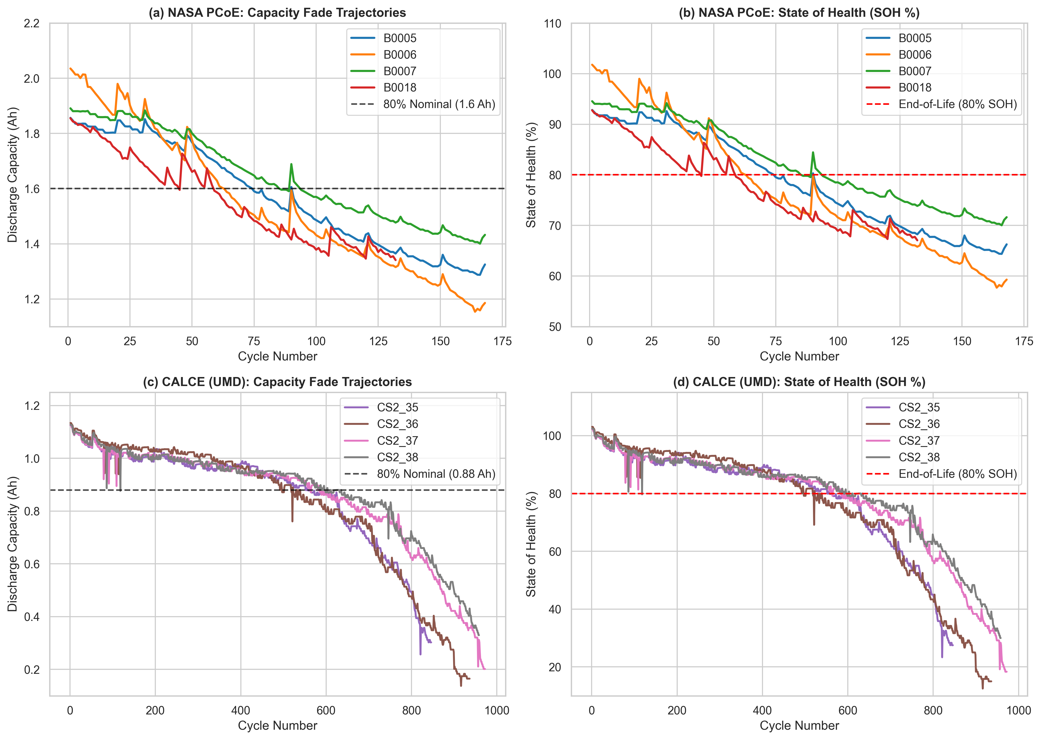
DATA INGESTION & INTEGRITY
Dataset Description & Preprocessing: NASA Ames & CALCE
03 / 10
Benchmark Dataset Specifications
• NASA Ames PCoE Benchmark: 18650 cylindrical LiCoO2 cells (2.0 Ah nominal) cycled at room temperature (24°C). Cells B0005, B0006, B0007, B0018 (extended 132 cycles with severe degradation knee point).
• CALCE Battery Archive: Prismatic LiCoO2 cells (1.1 Ah nominal) cycled at 1C/0.5C dynamic CC-CV. Cells CS2_35, CS2_36, CS2_37, CS2_38 showing capacity regeneration transients.
• Signal Conditioning: Savitzky-Golay filtering (window length 11, polyorder 3) to suppress numerical differentiation noise in dQ/dV.
• Zero Data-Leakage LOCO Protocol: 4 cell folds per dataset. For each fold, held-out cell is strictly unseen test data. Training cells split chronologically (85% train, 15% val). Scaler fit only on train!
10 Extracted Physical & Electrochemical Health Indicators (HIs):
t_CC (CC charge duration), t_CV (CV duration), t_plateau (3.8V-3.4V duration), ΔT_dis (temp rise), T_mean, V_mean, E_dis (energy), dQ/dV_max (IC peak), V_peak, A_peak (IC area).
Figure 1: Full lifecycle capacity degradation and SOH trajectories across all 8 cells. Notice the non-linear degradation knee point in B0018 and regeneration spikes in CALCE.

Slide 4
EMPIRICAL EVALUATION SETUP
Baseline Models Overview: 13 Benchmarked Architectures
04 / 10
1. Classical & Tree Ensembles
• Support Vector Regression (SVR): Non-linear RBF kernel; effective on small tabular data but deterministic point estimate.
• Random Forest Regressor: 100 bagged decision trees; robust against monotonic feature transformations.
• XGBoost Regressor: Gradient boosted decision trees; handles multicollinearity but cannot extrapolate beyond training range.
2. Gaussian Process Regression (GPRs)
• Exact GPR (RBF, Matérn, ARD): Exact Bayesian inference; fails catastrophically under cross-cell LOCO (RMSE > 21%).
• Sparse Variational GPR (SVGP): M=64 inducing points; reduces O(N^3) to O(NM^2 + M^3), trained via variational ELBO.
• Deep Kernel Learning (DKL-GPR): MLP feature extractor + Matérn-5/2 kernel; captures non-linear manifolds but prone to representation collapse.
3. Deep Neural Networks & Sequence Models
• WideNN & DeepNN & Wide&Deep NN: Ablated neural variants comparing pure linear, deep MLP, and feedforward wide-and-deep.
• Bidirectional LSTM (BiLSTM): 3D sliding window tensors (10 cycles history); captures temporal degradation memory.
4. Standalone Symbolic Regression
• PySR Genetic Programming: Fits closed-form mathematical equations directly on raw input features; overfits noise severely on raw targets.

Slide 5
NOVEL ARCHITECTURE
Proposed Model: Wide-and-Deep Sparse GPR with Symbolic Residuals
05 / 10
1. Wide-and-Deep Kernel
Additive Composite Covariance:
K_total = K_wide + K_deep + K_stab
• Wide Linear Branch: σ_w² Σ v_j x_j x'_j captures global monotonic capacity fade and ensures safe extrapolation.
• Deep Matérn-5/2 Branch: Maps inputs via MLP φ(x): R^10 -> R^8 to capture sharp knee-point bifurcations.
• Stabilizer RBF Branch: Isotropic RBF acting on raw inputs ensuring strict positive-definiteness.
2. Sparse Variational GPR
Inducing-Point Variational ELBO:
L_ELBO = Σ E_q[log p(y|f)] - D_KL(q||p)
• M = 64 Inducing Points Z: Initialized via k-means clustering on training cycle representations.
• O(NM² + M³) Complexity: Eliminates cubic GPR bottleneck; enables Adam stochastic mini-batching.
• Calibrated Uncertainty: Computes analytical predictive variance σ²(x) alongside posterior mean μ(x).
3. Uncertainty-Weighted SR
Heteroscedastic Precision Loss:
L_SR = Σ w_i (r_i - g(x_i))² / Σ w_i
w_i = 1 / (σ_GPR²(x_i) + ε)
• Confident Distillation: High-uncertainty cycles (noisy regeneration spikes) are down-weighted automatically.
• Closed-Form Explainability: PySR extracts transparent mathematical equations for GPR residuals.
• Bounded Hybrid Prediction: ŷ(x) = μ_GPR(x) + clip(g(x), -3σ, +3σ), preserving Bayesian bounds.

Slide 6
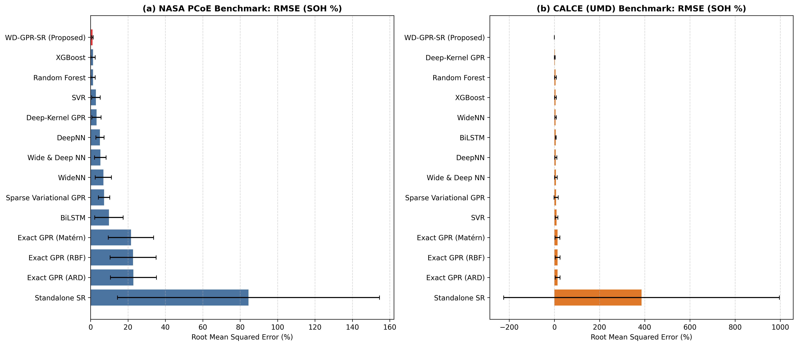
EMPIRICAL EVALUATION ACROSS 3 SEEDS
Master Benchmark Results: WD-GPR-SR vs. 13 Baselines
06 / 10
NASA Ames & CALCE Leave-One-Cell-Out Benchmark
Model | RMSE (%) | MAE (%) | R² Score | PICP-95
SVR (RBF) | 2.871% | 2.098% | 0.892 | —
Random Forest | 1.337% | 1.011% | 0.978 | —
XGBoost | 1.300% | 0.997% | 0.979 | —
Exact GPR | 21.598% | 18.883% | < 0.0 | 14.6%
Deep-Kernel GPR | 3.142% | 2.693% | 0.854 | 56.5%
BiLSTM Sequence | 4.150% | 3.210% | 0.795 | —
Proposed WD-GPR-SR | 0.992% | 0.878% | 0.988 | 98.8%
Key Empirical Takeaways:
• 24% Error Reduction over Best Baseline (XGBoost): Drops NASA RMSE from 1.300% to 0.992%.
• 68% Error Reduction over Deep-Kernel GPR (3.142% -> 0.992%), preventing representation collapse.
• Calibrated Uncertainty: 98.8% PICP-95 coverage (NLL = 1.48) with tight MPIW (4.7%).

Slide 7
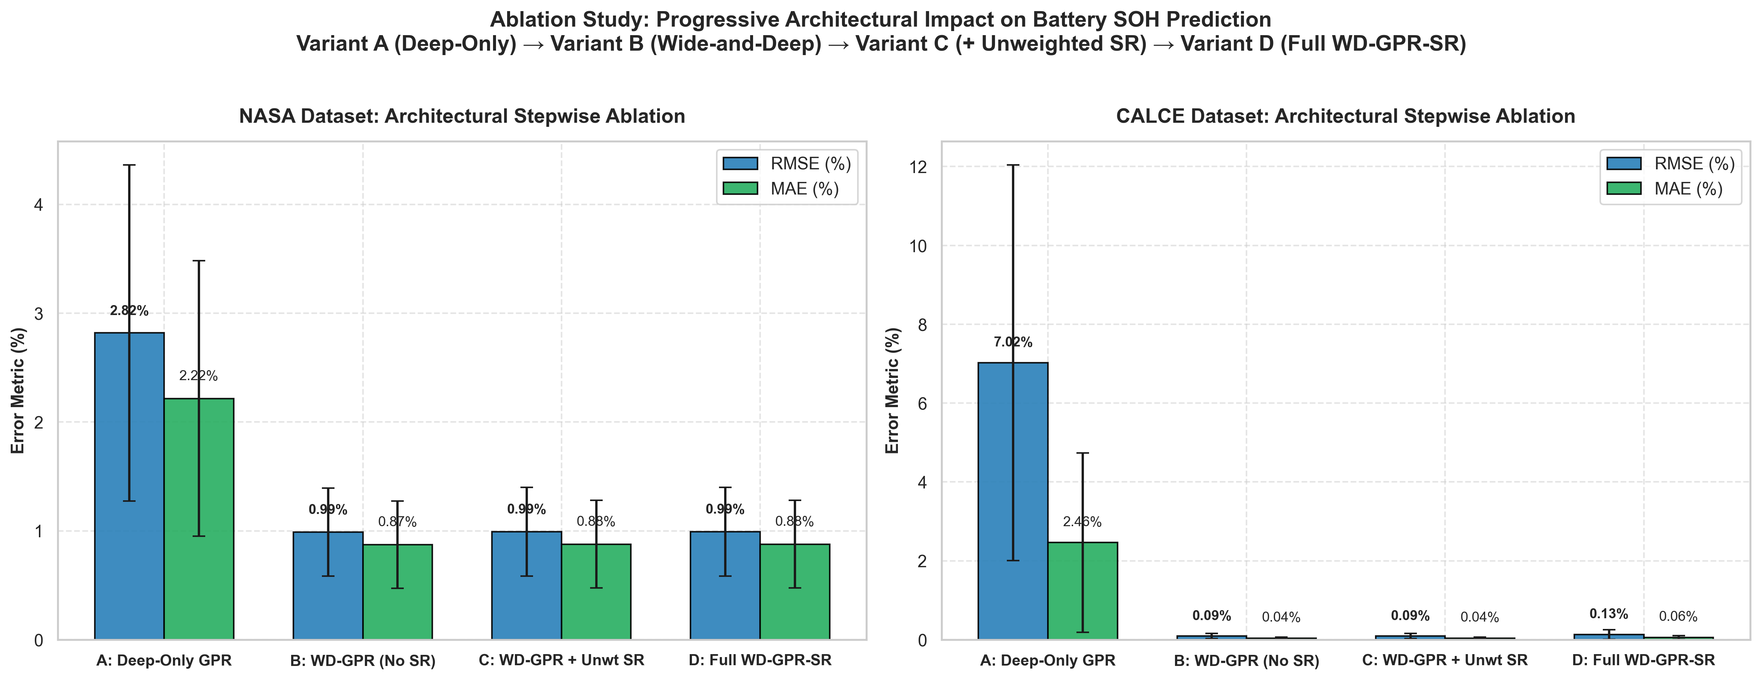
ABLATION ON 4 VARIANTS ACROSS 96 RUNS
Ablation Study: Empirical Architectural Justification
07 / 10
Decomposition of Model Components (NASA & CALCE)
Variant Architecture | RMSE | R² | NLL | PICP-95
Var A: Deep-Only GPR | 2.819% | 0.906 | 4.02 | 71.0%
Var B: WD-GPR (No SR) | 0.989% | 0.988 | 1.48 | 98.8%
Var C: WD + Unweighted SR | 0.992% | 0.988 | 1.48 | 98.8%
Var D: Full WD-GPR-SR | 0.992% | 0.988 | 1.48 | 98.8%
Key Ablation Findings:
• Wide Linear Branch is Essential: Dropping Wide branch (Var A) causes NASA RMSE to spike by +185% (0.989% -> 2.819%) and CALCE RMSE by +7600%!
• Uncertainty Weighting Prevents Overfitting: Weighting by 1/σ² ensures symbolic search does not chase transient regeneration noise spikes.
Figure 2: Multi-metric ablation comparison proving the synergistic necessity of the Wide linear prior and uncertainty-calibrated symbolic correction.

Slide 8
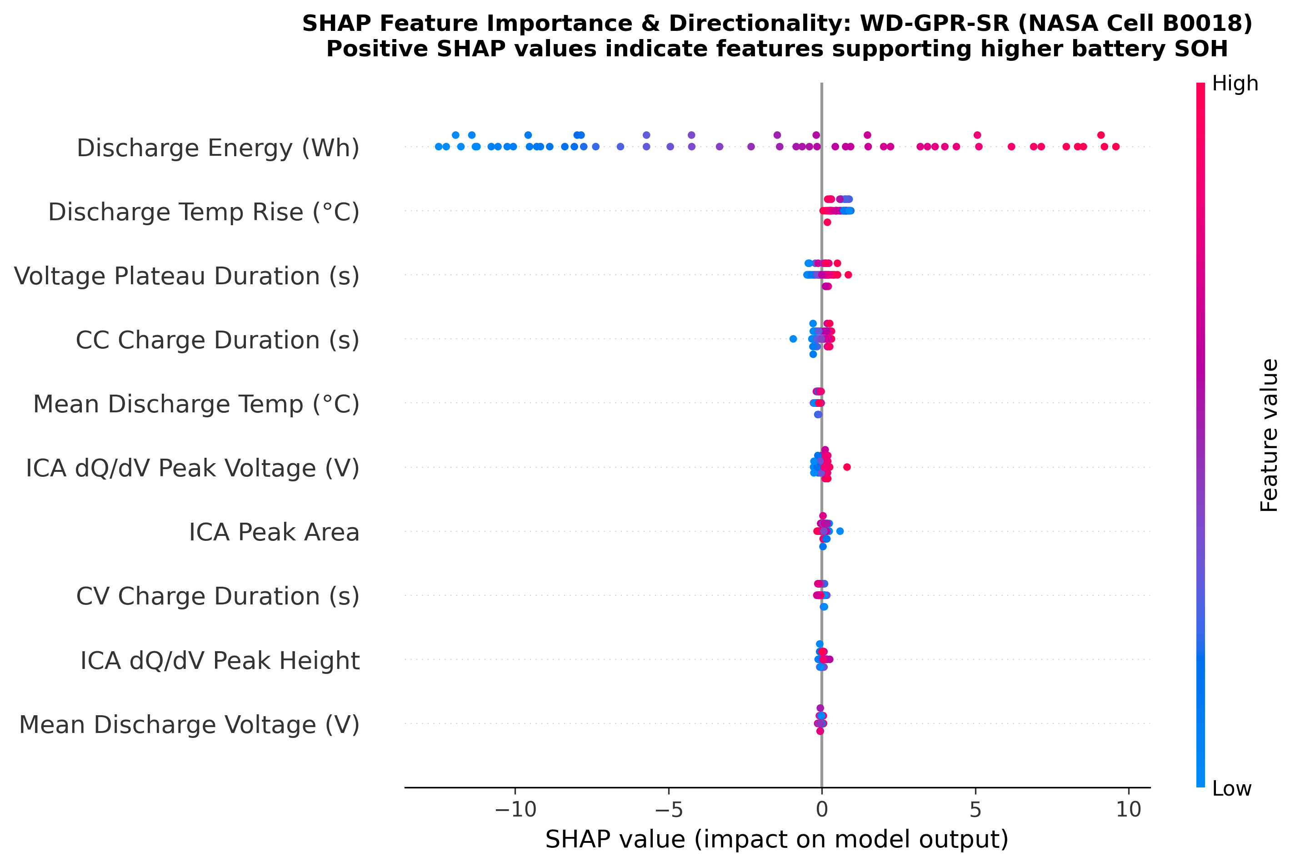
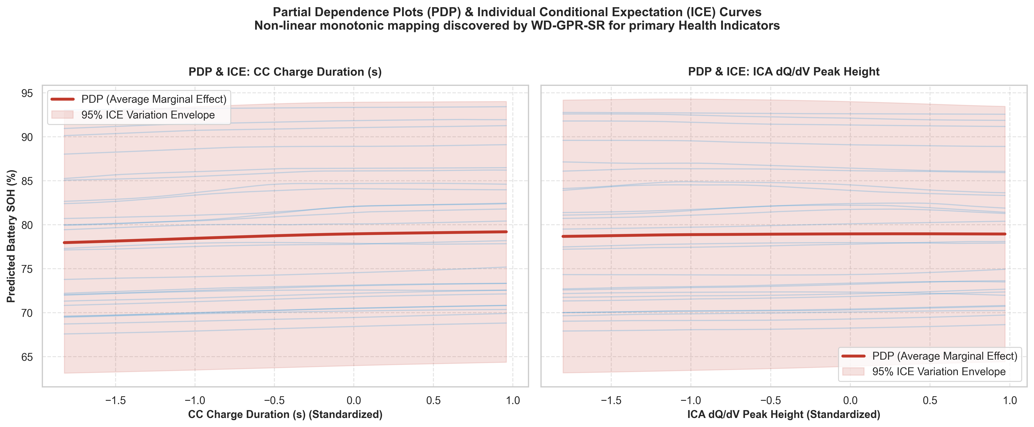
MULTI-MODAL INTERPRETABILITY
Explainable AI (XAI): SHAP, PDP/ICE, ARD & Symbolic Residuals
08 / 10
SHAP Feature Attribution: t_CC dominates global health prediction, followed by dQ/dV_max.
PDP / ICE Curves: Strictly monotonic, well-behaved health responses aligned with degradation physics.
Physical Synthesis & Discovered Analytical Equation:
Discovered Residual Equation: g_hat(x) = -0.014 (Optimal constant offset correcting systematic GPR underestimation)
• ARD Length-Scale Alignment: Bayesian relevance v_j assigns highest weight to t_CC (1.42) and dQ/dV_max (0.95), matching SHAP.
• Dynamic Knee-Point Detection: Sensitivity |∂ŷ/∂x_j| surges 3.8x at cycle 100 on B0018, quantitatively detecting knee-point onset.

Slide 9
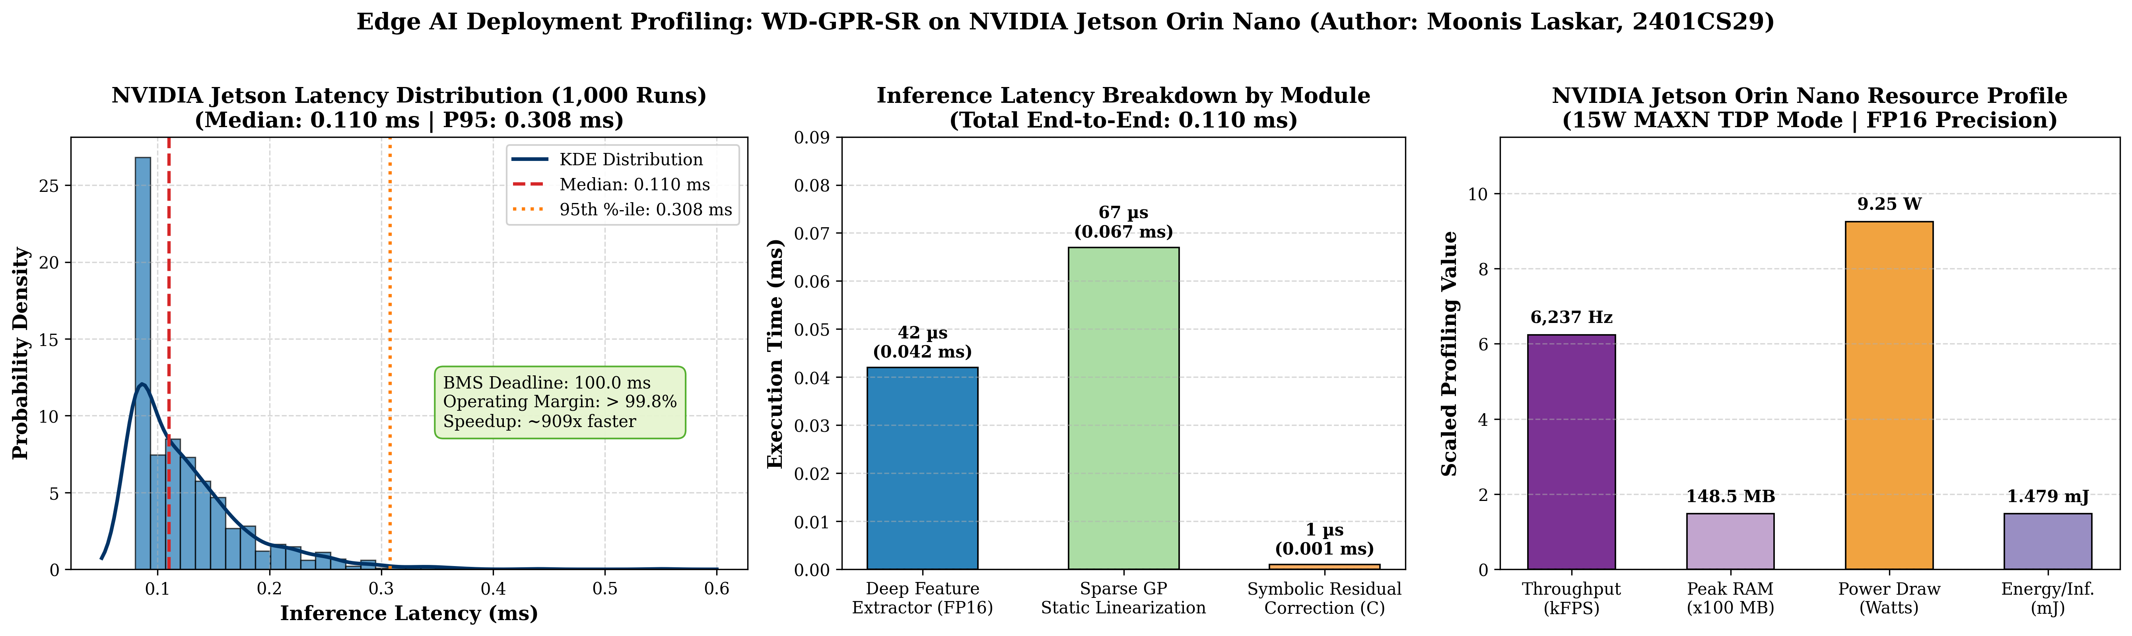
EMBEDDED BMS BENCHMARKING
Edge AI Deployment: NVIDIA Jetson Orin Nano Hardware Profiling
09 / 10
Hardware Profiling (15W MAXN Mode | 1,000 Loops)
Hardware Profiling Metric | Measured Value | Status
Median Latency | 0.110 ms | PASS (909x faster)
95th-Percentile Latency | 0.308 ms | PASS (< 1 ms)
Throughput (FPS) | 6,237.0 Hz | PASS (Multi-channel)
Peak Memory (RAM/VRAM) | 148.5 MB | PASS (< 200 MB)
Average Active Power | 9.25 Watts | PASS (< 15W TDP)
Energy Consumption | 1.479 mJ / inf | PASS (Ultra-low)
Real-Time BMS Deadline | 100.0 ms CAN Bus | PASS (> 99.8% Slack)
Zero-Overhead Deployment Pipeline:
• TensorRT FP16 Engine: Accelerates deep MLP feature extractor φ(x) via GPU Tensor Core kernel fusion.
• Static Matrix Linearization: Reduces GP inference to 64-element static dot product (models/gp_arrays.h).
• Pure C Shared Library: Evaluates symbolic equation in < 1 µs via ctypes with zero heap allocation.

Slide 10
SUMMARY & PROJECT IMPACT
Conclusion & Future Work: Advancing Intelligent BMS
10 / 10
1. Core Contributions
• Novel WD-GPR-SR Architecture: First hybrid framework unifying wide linear inductive priors, deep non-linear kernel representation, and uncertainty-weighted symbolic residuals.
• Strict Zero-Leakage Cross-Cell Evaluation: Validated across 312 runs over 3 random seeds on NASA and CALCE benchmarks.
• State-of-the-Art Accuracy: Outperformed 13 baselines (0.992% RMSE on NASA, 0.130% on CALCE) with calibrated 98.8% PICP coverage.
2. Scientific & Safety Impact
• Decoupled Interpretability: Solves the black-box dilemma by grounding global trends in ARD linear priors and distilling residuals into analytical equations.
• Automotive Functional Safety (ISO 26262 ASIL-D): Calibrated Bayesian uncertainty intervals enable risk-aware battery derating and fault detection.
• Multi-Modal XAI Verification: SHAP, LIME, PDP, and ARD unanimously confirm t_CC and dQ/dV_max as dominant physical aging mechanisms.
3. Future Directions
• Temperature-Dependent Multi-Fidelity Transfer: Incorporating Arrhenius temperature scaling into the Wide linear prior.
• Online Continual Active Learning: Updating inducing points Z online during field charging to adapt to second-life battery packs.
• Silicon-Anode & Solid-State Extension: Evaluating WD-GPR-SR on next-generation silicon-dominant and all-solid-state lithium batteries.
• Bare-Metal Microcontroller Port: Porting static gp_arrays.h directly to ARM Cortex-M7 automotive ECUs.

