Slide 2

Diffusion models
Коновалова Нина
@ReadingAI
@AfeliaN

Slide 3
PART 1
Diffusion models
Basics: forward & reverse processes, training, guidance and text-to-image

Slide 4
PART 1 · BASICS
Agenda
01
Forward process
How noise is added: variance exploding vs variance preserving
02
Reverse process
Step-by-step denoising and how it compares to a VAE
03
Training
ELBO, the simplified loss and the training / sampling algorithms
04
DDPM & guidance
Samples in pixel space, classifier and classifier-free guidance
05
Text-to-image
GLIDE, Imagen, Dalle2

Slide 5
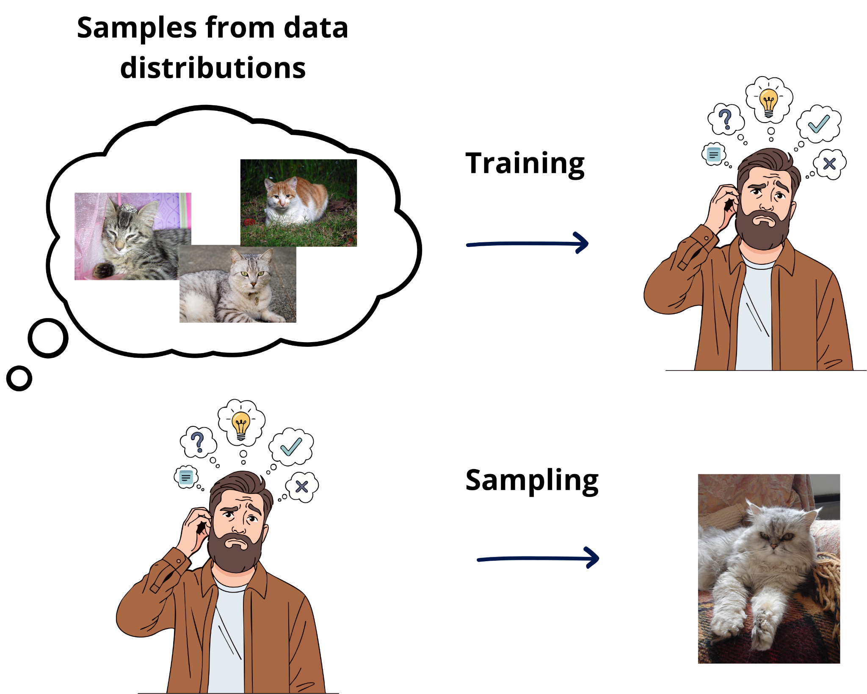
01 · FORWARD PROCESS
Generative models
1
Training
Learn the data distribution p(x) from a set of samples
2
Sampling
Draw new, previously unseen samples from the learned distribution
Images: FLUX.2 [klein]

Slide 6
01 · FORWARD PROCESS
Generative models: a taxonomy
Generative models
Likelihood-based
Likelihood-free
Approximate density
Tractable density
GANs
VAEs
Normalizing Flows
Diffusion models
Autoregressive
↑ topic of this lecture

Slide 7
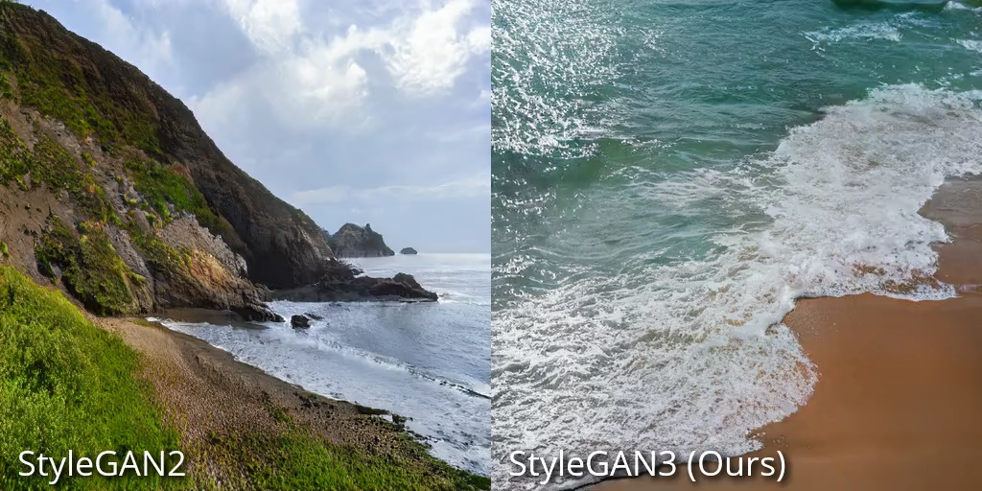
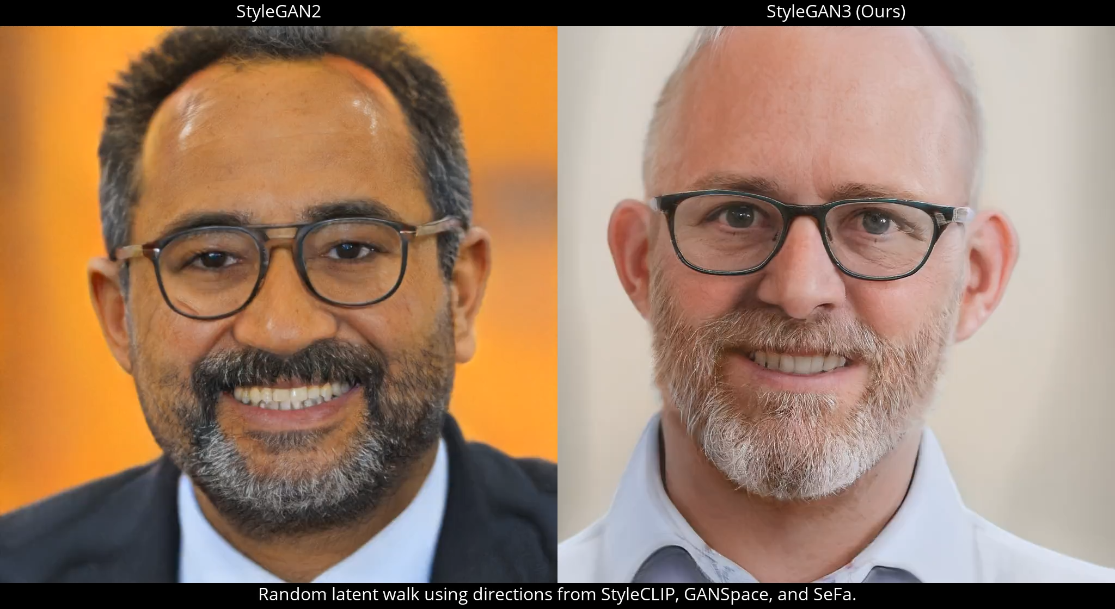
01 · FORWARD PROCESS
StyleGAN3 vs StyleGAN2
Source: nvlabs.github.io/stylegan3

Slide 8
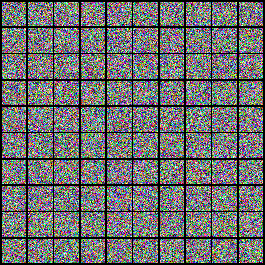
01 · FORWARD PROCESS
Diffusion models

Slide 9
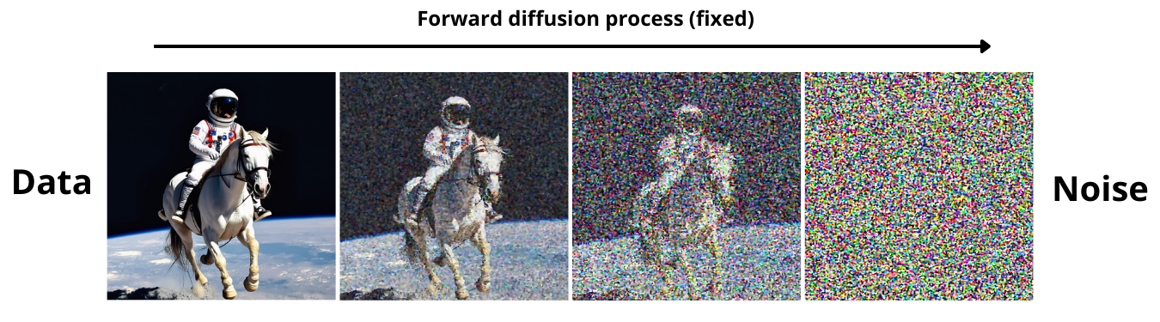
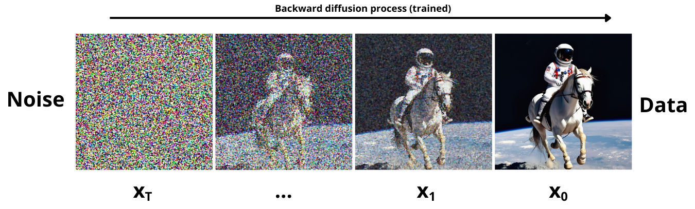
01 · FORWARD PROCESS
Diffusion models: the idea
→ Forward process
fixed
← Reverse process
trained
Gradually adds noise to the input
Learns to generate data by denoising

Slide 10
01 · FORWARD PROCESS
Forward process
Variance Exploding (VE)
Variance Preserving (VP)

Slide 11

01 · FORWARD PROCESS
Forward process
START
Variance Exploding (VE)
Variance Preserving (VP)

Slide 12
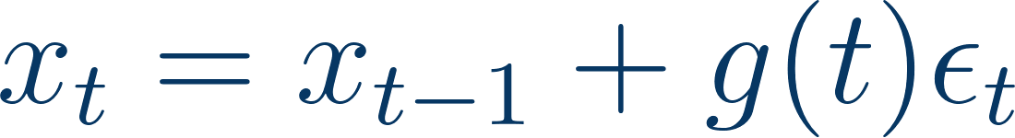
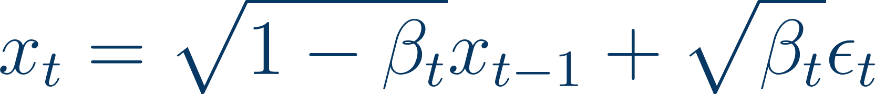
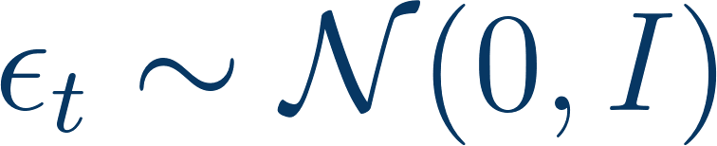
01 · FORWARD PROCESS
Forward process
SAMPLE
Variance Exploding (VE)
Variance Preserving (VP)

Slide 13
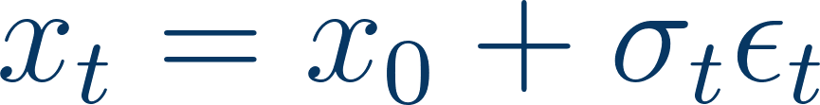
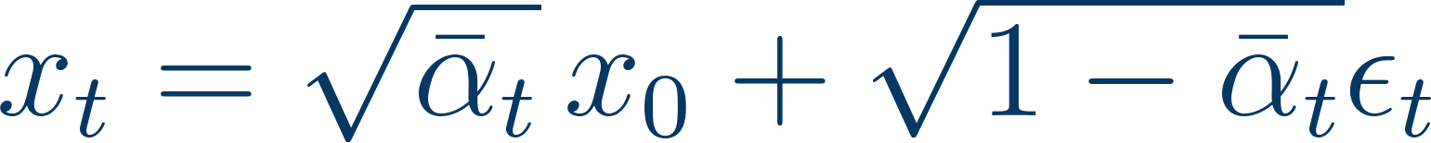
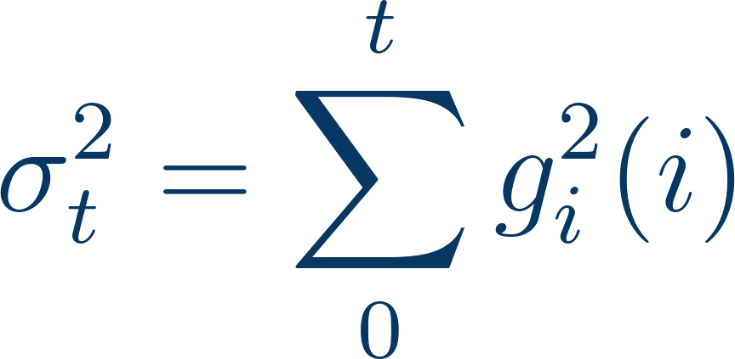
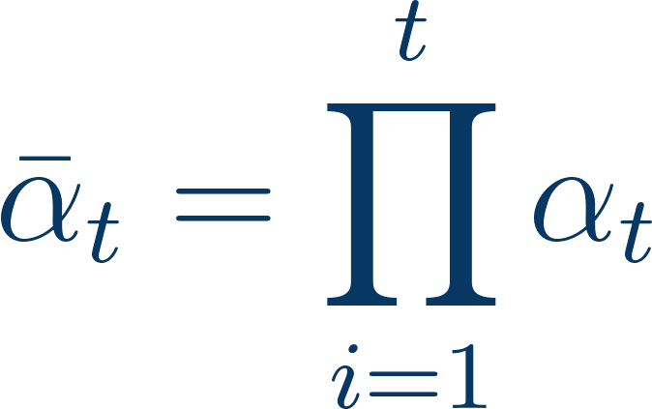

01 · FORWARD PROCESS
Forward process
SAMPLE
Variance Exploding (VE)
Variance Preserving (VP)

Slide 14
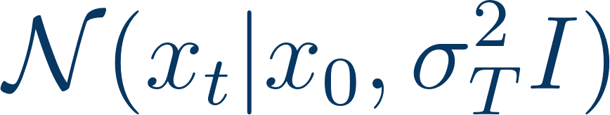

01 · FORWARD PROCESS
Forward process
DISTRIBUTION
Variance Exploding (VE)
Variance Preserving (VP)

Slide 15
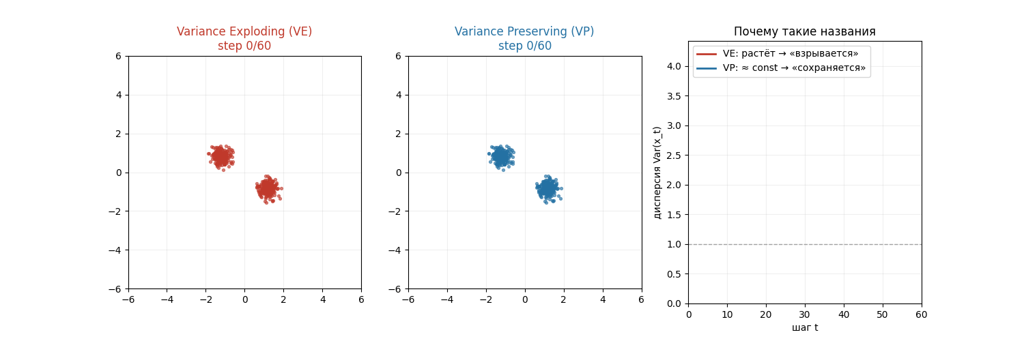
01 · FORWARD PROCESS
Forward process: VE vs VP in action
step t

Slide 16
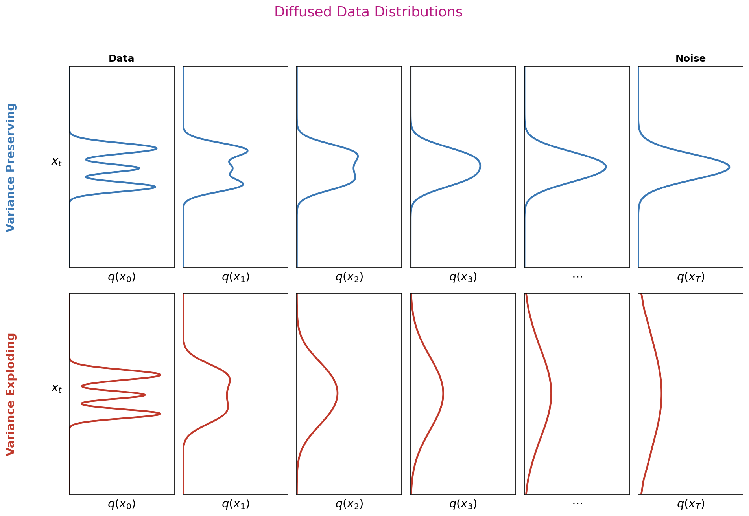
01 · FORWARD PROCESS
Forward process: marginal distributions

Slide 17
02
Reverse process
Generating data by step-by-step denoising · Diffusion vs VAE

Slide 18
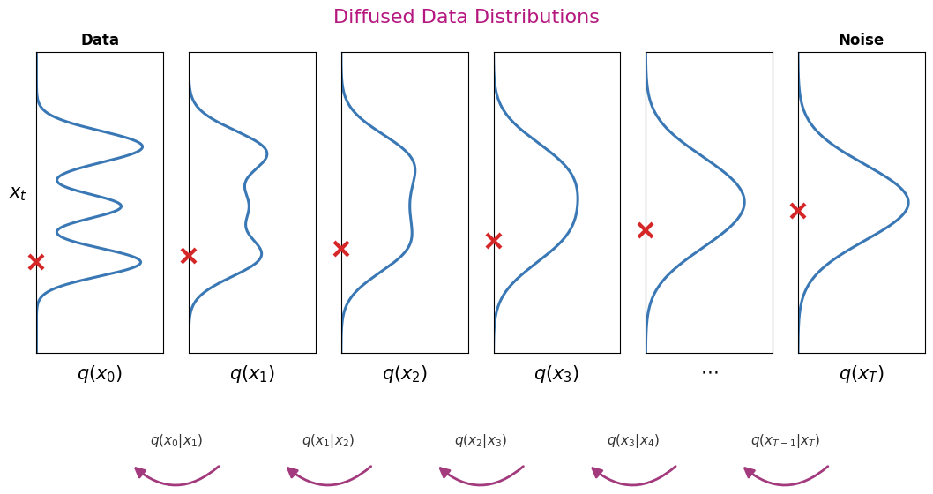
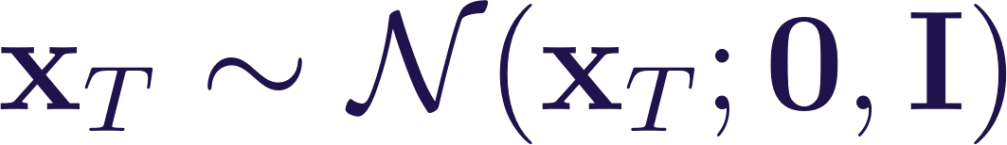
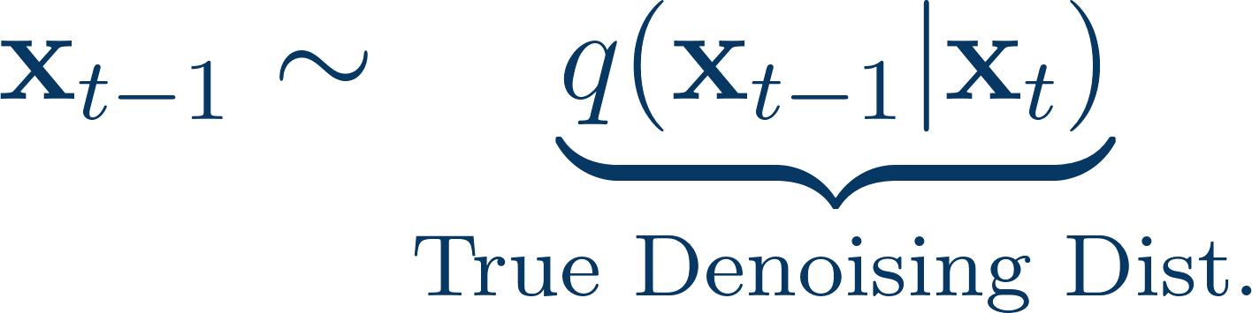
02 · REVERSE PROCESS
Generation by step-by-step denoising
1
Sample pure noise
2
Iteratively denoise

Slide 19
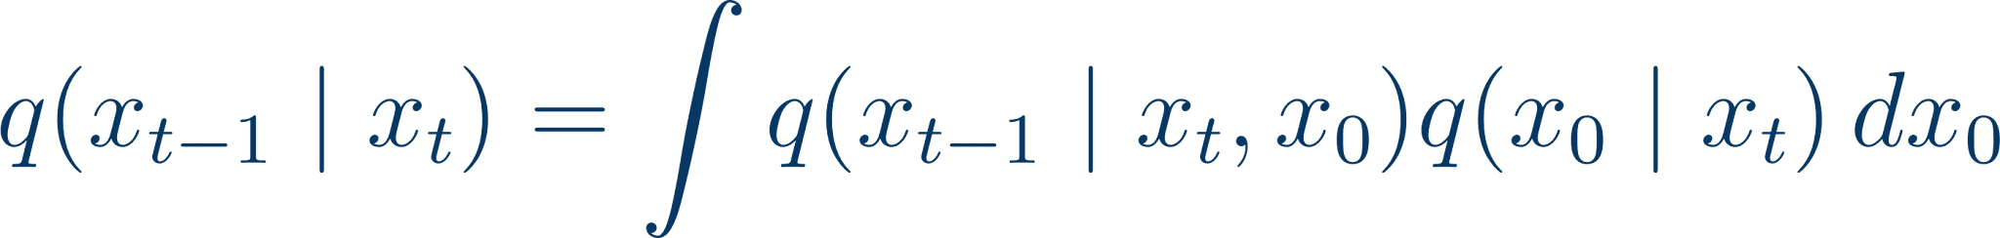
02 · REVERSE PROCESS
Generation by step-by-step denoising
1
Sample pure noise
2
Iteratively denoise
intractable :(

Slide 20
02 · REVERSE PROCESS
Generation by step-by-step denoising
1
Sample pure noise
2
Iteratively denoise
intractable :(
But can we approximate?

Slide 21
02 · REVERSE PROCESS
Generation by step-by-step denoising
1
Sample pure noise
2
Iteratively denoise
intractable :(
But can we approximate? Yes! Use a normal distribution with a small step for adding noise.

Slide 22
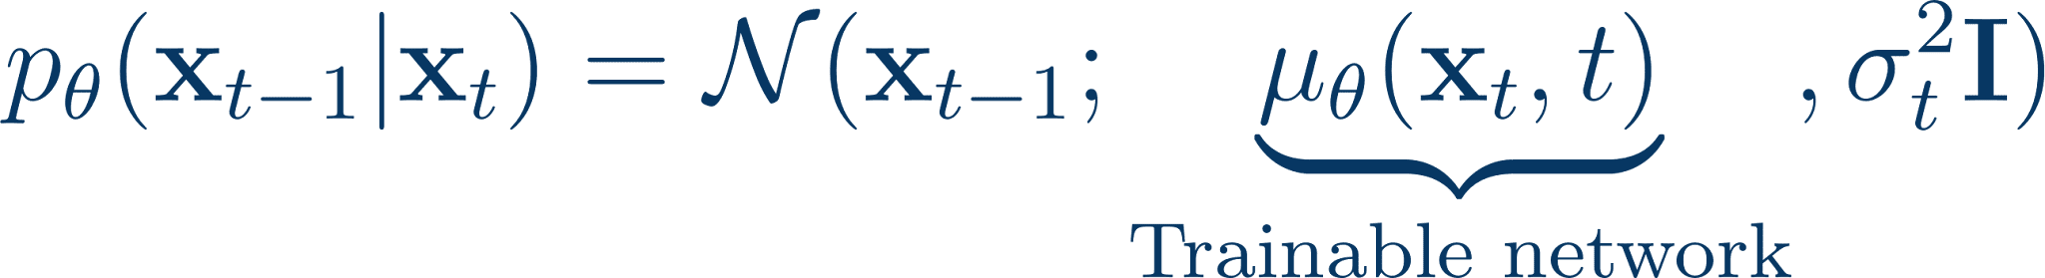
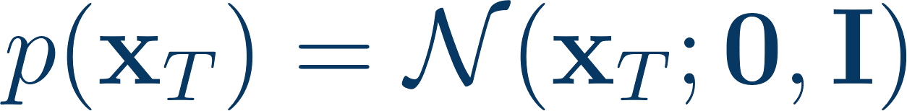
02 · REVERSE PROCESS
Reverse (backward) process
prior: pure noise
learned denoising step

Slide 23
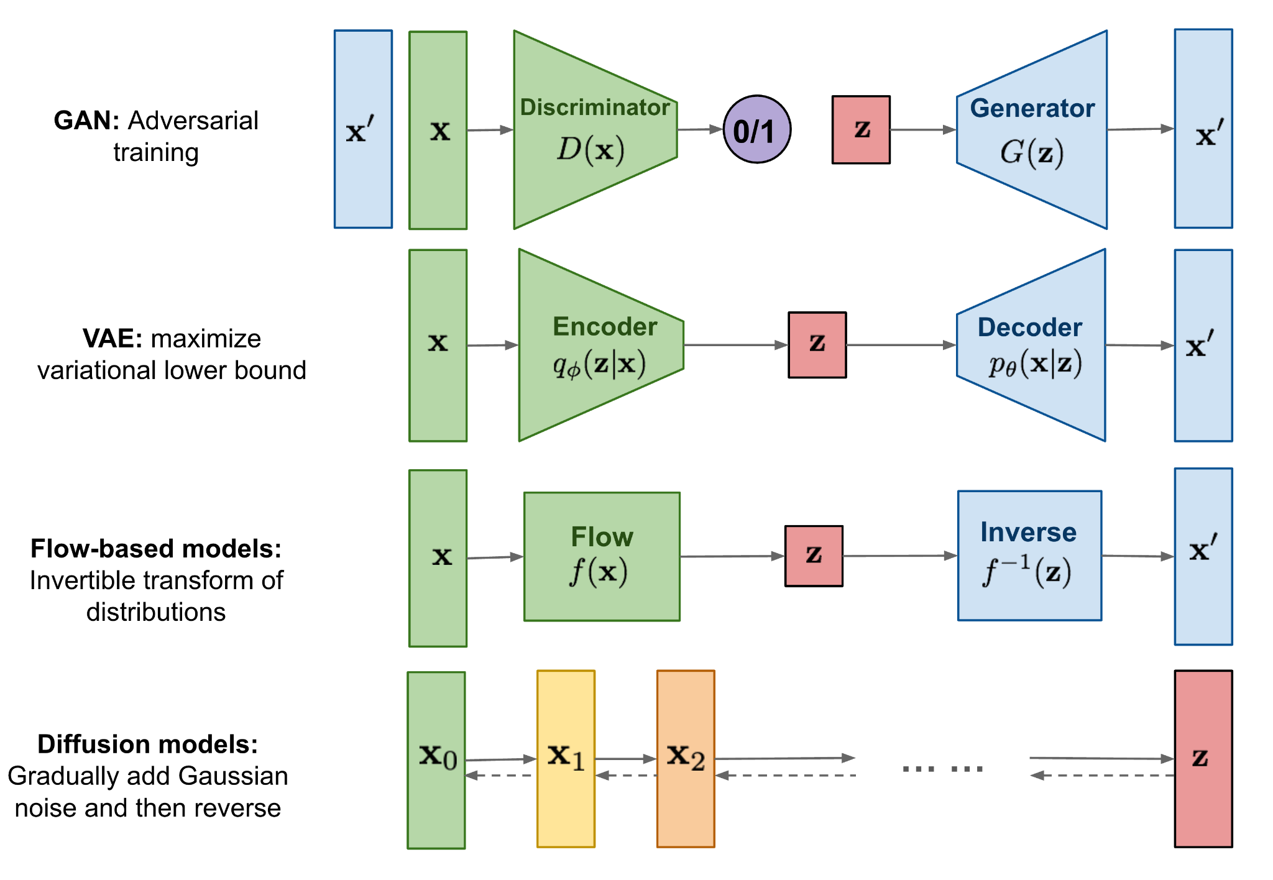
02 · REVERSE PROCESS
Recap: VAE vs diffusion

Slide 24
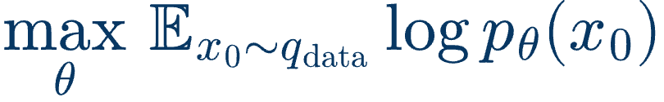
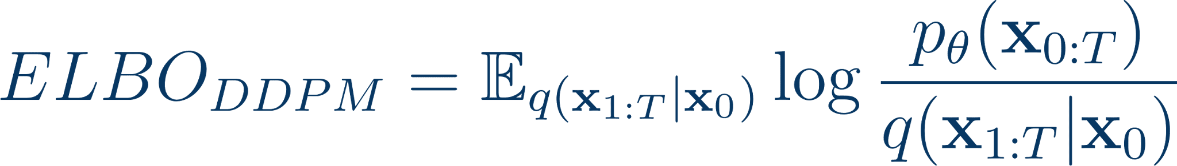
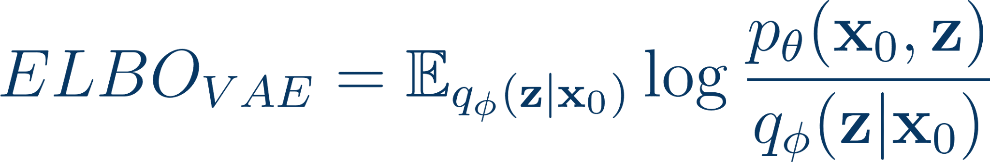
02 · REVERSE PROCESS
Diffusion models vs VAE
Diffusion models
VAE
many latent states
LATENT STATES
one latent state
not trainable encoder
ENCODER
trainable encoder
same as data dim
LATENT DIM
differs from data dim

Slide 25
03
Training
From the ELBO to the simplified noise-prediction loss

Slide 26
03 · TRAINING
Training objective
ELBO loss
FORWARD POSTERIOR — TRACTABLE

Slide 27
03 · TRAINING
Training objective
ELBO loss
FORWARD POSTERIOR — TRACTABLE
LEARNED REVERSE STEP

Slide 28
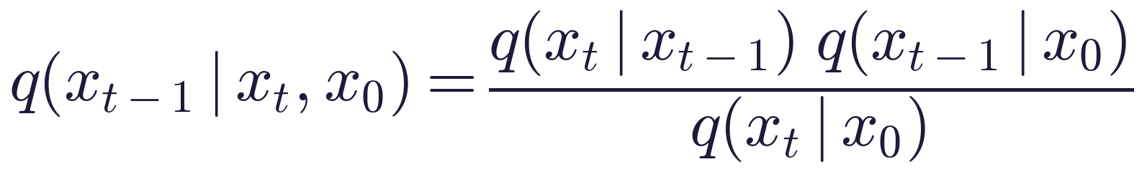
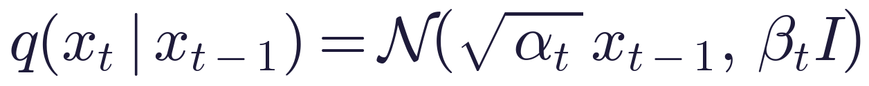
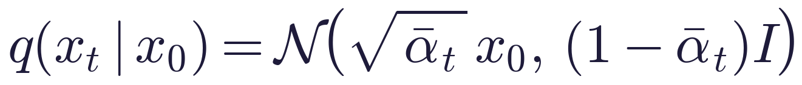
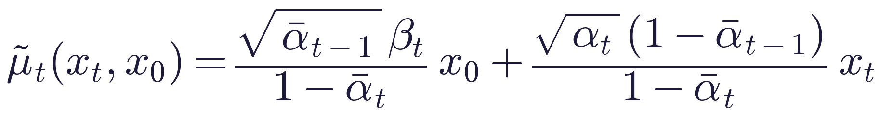
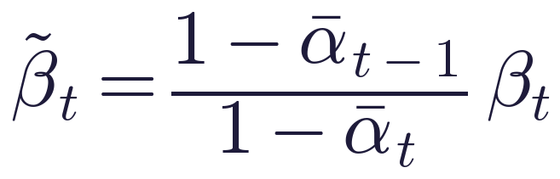
03 · TRAINING
Forward posterior via Bayes' rule
If x₀ is known, the reverse step is a Gaussian with a known mean and variance
Bayes' rule
ALL THREE TERMS ON THE RIGHT ARE KNOWN GAUSSIANS
forward step
marginal at t − 1
marginal at t
RESULT
Product of Gaussians is Gaussian: mean and variance in closed form

Slide 29
03 · TRAINING
Forward posterior via Bayes' rule
If x₀ is known, the reverse step is a Gaussian with a known mean and variance
Bayes' rule
ALL THREE TERMS ON THE RIGHT ARE KNOWN GAUSSIANS
forward step
marginal at t − 1
marginal at t
RESULT
Product of Gaussians is Gaussian: mean and variance in closed form

Slide 30
03 · TRAINING
Training objective
ELBO loss
FORWARD POSTERIOR — TRACTABLE
LEARNED REVERSE STEP

Slide 31
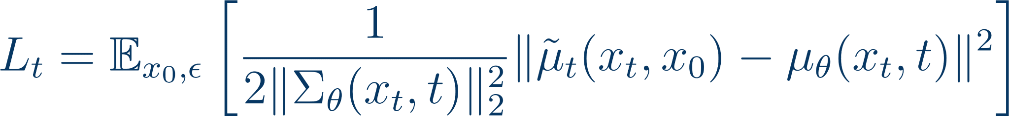
03 · TRAINING
Training objective
ELBO loss
FORWARD POSTERIOR — TRACTABLE
LEARNED REVERSE STEP
KL BETWEEN TWO GAUSSIANS

Slide 32

03 · TRAINING
Training objective
ELBO loss
FORWARD POSTERIOR — TRACTABLE
LEARNED REVERSE STEP
the variance depends only on the timestep, not on the image
it is the same for all coordinates
FIX THE VARIANCE: ONLY THE MEAN IS LEARNED

Slide 33
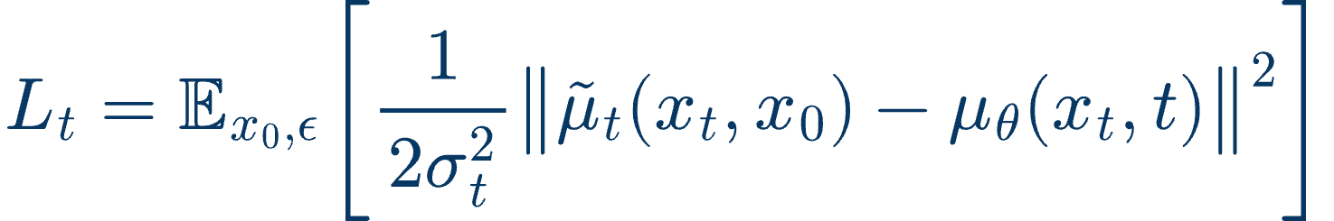
03 · TRAINING
Training objective
ELBO loss
FORWARD POSTERIOR — TRACTABLE
FIX THE VARIANCE: ONLY THE MEAN IS LEARNED
LOSS WITH FIXED VARIANCE

Slide 34
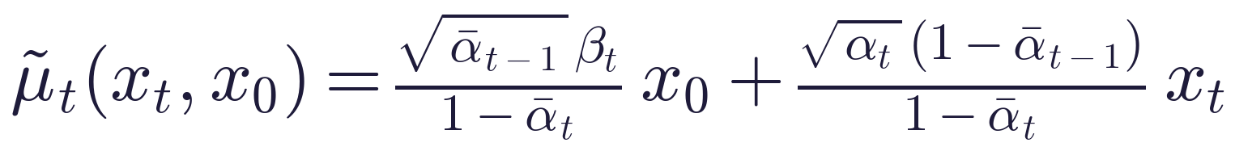
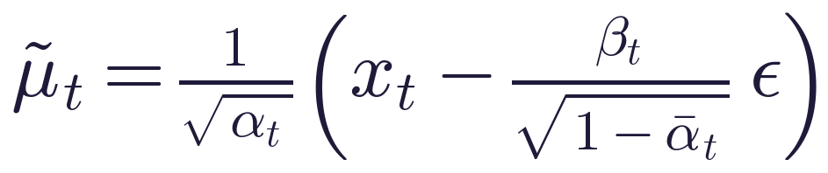
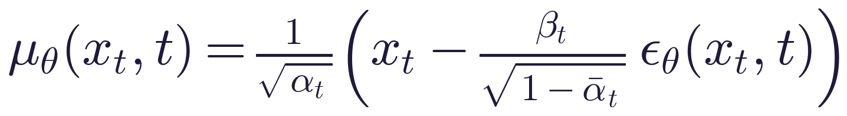
03 · TRAINING
From μ to ε: reparametrizing the mean
1
Forward process in closed form
express x₀ through xₜ and the noise ε
2
Posterior mean of q(xₜ₋₁ | xₜ, x₀)
tractable, depends on x₀ and xₜ
3
Substitute x₀
the mean is xₜ minus scaled noise
4
Same form for the model
the network predicts ε instead of μ
RESULT
μ-matching becomes ε-matching (next slide)

Slide 35
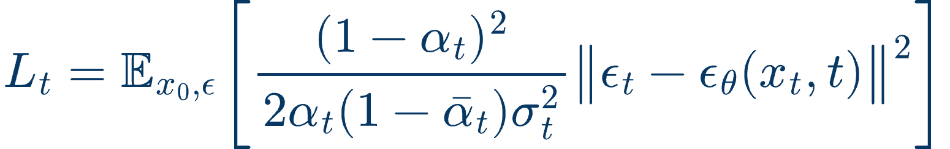
03 · TRAINING
Training objective
ELBO loss
LOSS WITH FIXED VARIANCE
PREDICT THE NOISE Ε INSTEAD OF THE MEAN
SIMPLIFIED OBJECTIVE
Source

Slide 36
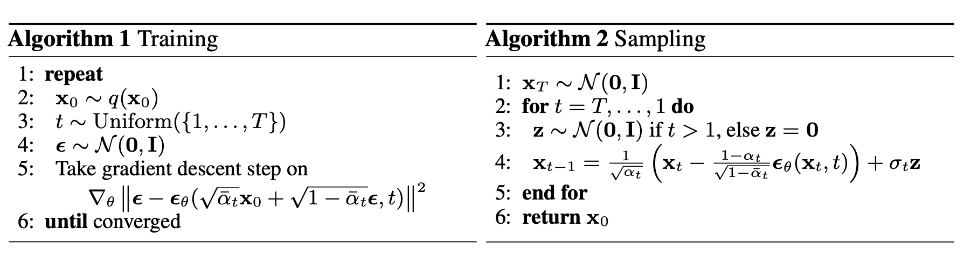
03 · TRAINING
Summary: training & sampling
Source

Slide 37
03 · TRAINING
Summary
+
Pros
Good quality
Diverse generation

Slide 38
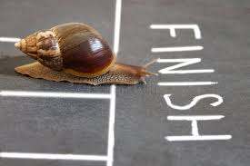
03 · TRAINING
Summary
+
Pros
Good quality
Diverse generation
−
Cons
Low speed — many denoising steps

Slide 39
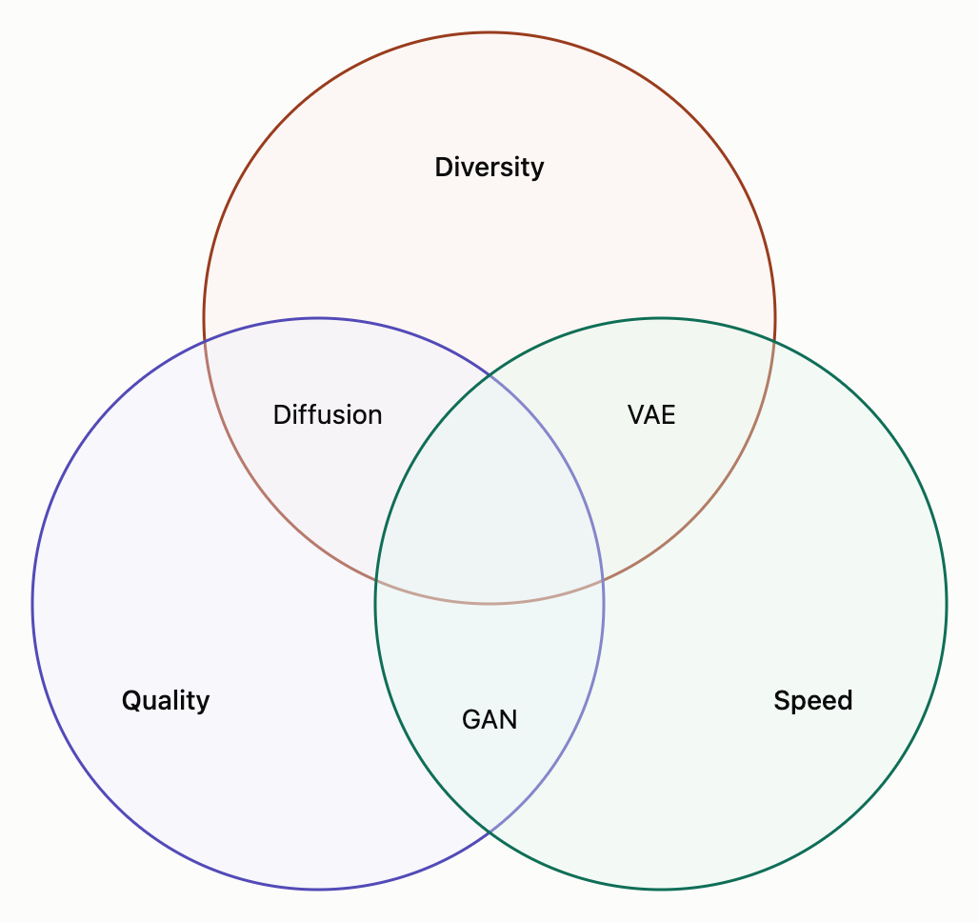
03 · TRAINING
Summary: the generative trilemma
+
Pros
Good quality
Diverse generation
−
Cons
Low speed — many denoising steps

Slide 40
04
DDPM & guidance
Pixel-space samples · classifier and classifier-free guidance

Slide 41
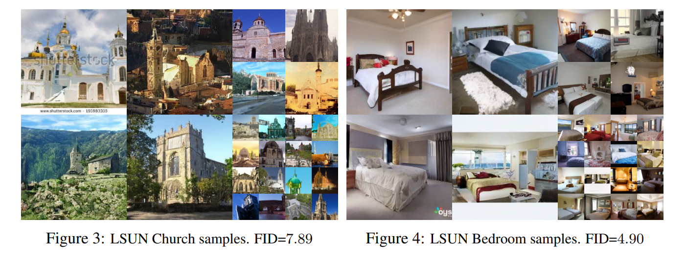
04 · DDPM & GUIDANCE
DDPM: diffusion in pixel space
Source

Slide 42
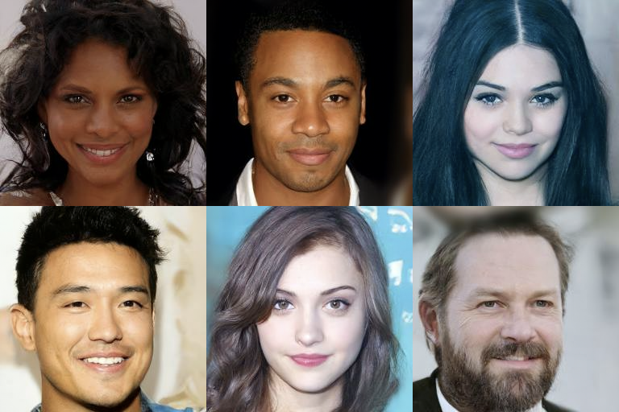
04 · DDPM & GUIDANCE
DDPM: diffusion in pixel space
Source

Slide 43

04 · DDPM & GUIDANCE
DDPM: diffusion in pixel space
LSUN 256×256
Church, Bedroom and Cat samples. Notice that the model occasionally generates dataset watermarks.
Source

Slide 44
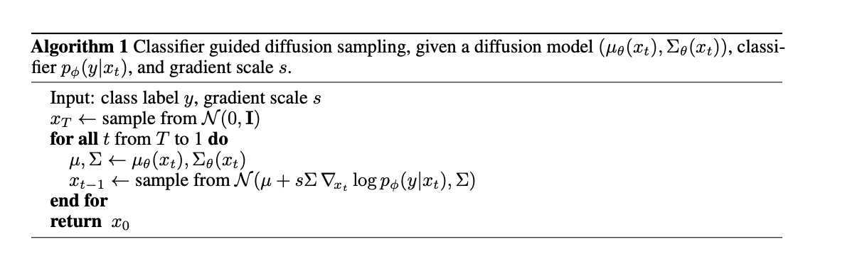
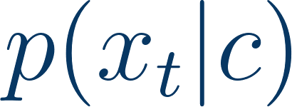
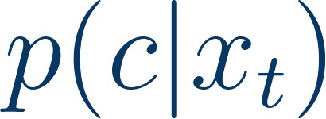
04 · DDPM & GUIDANCE
Classifier guidance
classifier gradient
1
Class-conditional modeling of
2
Train an extra classifier
3
Mix its gradient with the diffusion model during sampling
Source

Slide 45
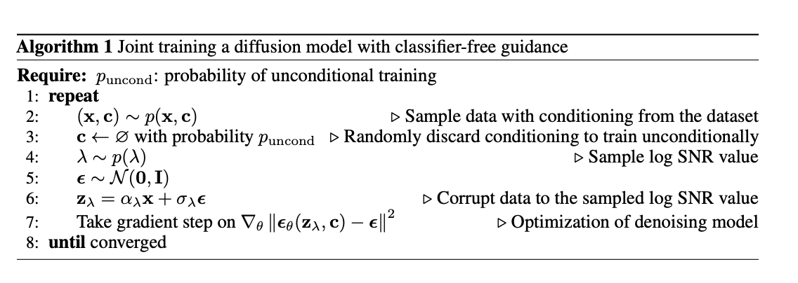
04 · DDPM & GUIDANCE
Classifier-free guidance: training
Source

Slide 46
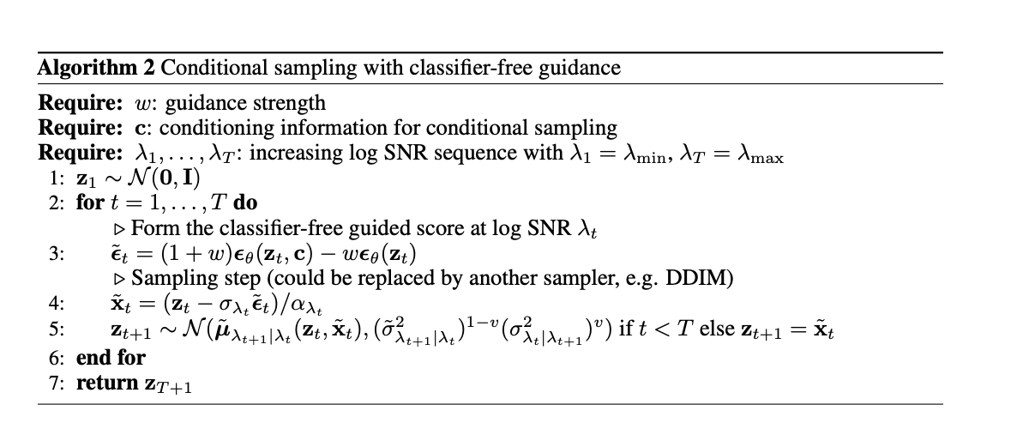
04 · DDPM & GUIDANCE
Classifier-free guidance: sampling
Source

Slide 47
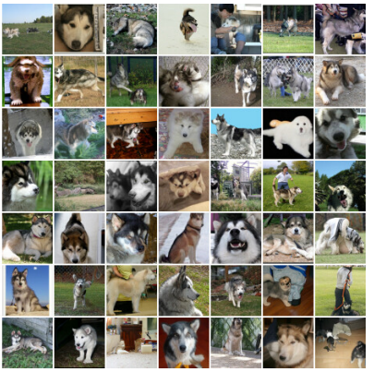
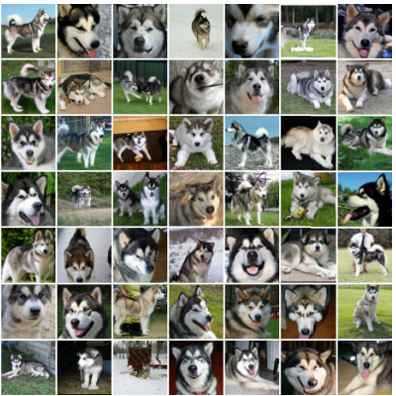
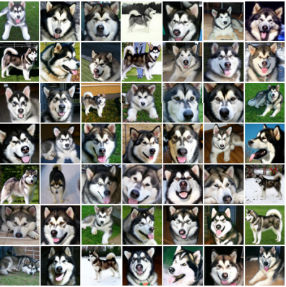
04 · DDPM & GUIDANCE
Classifier-free guidance: effect of scale w
no guidance
w = 1
w = 3
stronger guidance → higher fidelity, lower diversity

Slide 48
05
Text-to-image
GLIDE, Imagen, DALLE

Slide 49

05 · TEXT-TO-IMAGE
GLIDE: text-guided generation
Source

Slide 50

05 · TEXT-TO-IMAGE
GLIDE: CLIP guidance vs classifier-free
Source

Slide 51


05 · TEXT-TO-IMAGE
Imagen: cascaded diffusion
Source

Slide 52

05 · TEXT-TO-IMAGE
Imagen: cascaded diffusion
1
Frozen text encoder
T5-XXL turns the prompt into text embeddings
2
Base diffusion model
generates a 64 × 64 image from the text
3
Super-resolution ×2
two diffusion models upsample to 256 and then 1024 px
Source

Slide 53


paper →
05 · TEXT-TO-IMAGE
DALL·E 2 (unCLIP)
Why a prior?
Generating the image embedding improves diversity with minimal loss in photorealism
Guidance only on the decoder
Editing in CLIP space
Variations of an input image
Interpolations
Text diffs

Slide 54

Thank you for attention!
Коновалова Нина
@ReadingAI
@AfeliaN

