Slide 1
EXPOSYS DATA LABS DATA SCIENCE INTERNSHIP
Project Presentation
Topic : Customer Segmentation Analysis
Created by-
DEEP MAJHI

Slide 2
Problem Statement: Customer Segmentation is a popular application of unsupervised learning. Using clustering, identify segments of customers to target the potential user base. They divide customers into groups according to common characteristics like gender, age, interests, and spending habits so they can market to each group effectively. Use K-means clustering and also visualize the gender and age distributions. Then analyze their annual incomes and spending scores.

Slide 3
What Is Customer Segmentation?
Customer segmentation, also known as market segmentation, is the practice of dividing consumers into segments that can be focused on. Data, for example, a clients’ socioeconomics, topography, psychographic and behavioural preferences are considered while deciding customer segmentation.
Segmenting a market according to customers is sound practice. It empowers you to build up a more profound comprehension of your clients and find what influences them to tick. When you’re conveying a message, it will be more compelling if the beneficiary of the message thinks that its applicable.
Division is essentially a method for orchestrating your clients into littler gatherings as indicated by write. These unmistakable sub-gatherings or fragments ought to be described by specific traits. Presently you can target particular, pertinent advertising messages at each gathering.

Slide 4
The most common ways in which businesses segment their customer base are:
Demographic information, such as gender, age, familial and marital status, income, education, and occupation.
Geographical information, which differs depending on the scope of the company. For localized businesses, this info might pertain to specific towns or counties. For larger companies, it might mean a customer’s city, state, or even country of residence.
Psychographics, such as social class, lifestyle, and personality traits.
Behavioral data, such as spending and consumption habits, product/service usage, and desired benefits.

Slide 5
Customer segmentation procedures :
Customer segmentation, also called consumer segmentation or client segmentation, procedures include:
Deciding what data will be collected and how it will be gathered
Collecting data and integrating data from various sources
Developing methods of data analysis for segmentation
Establishing effective communication among relevant business units (such as marketing and customer service) about the segmentation
Implementing applications to effectively deal with the data and respond to the information it provides

Slide 6
Advantages of Customer Segmentation
Determine appropriate product pricing.
Develop customized marketing campaigns.
Design an optimal distribution strategy.
Choose specific product features for deployment
.
Prioritize new product development efforts.

Slide 7
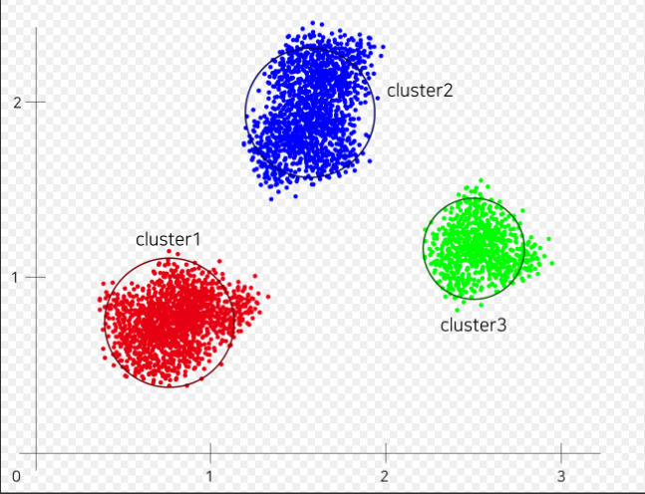
K Means Clustering Algorithm
Specify number of clusters K.
Initialize centroids by first shuffling
the dataset and then randomly
selecting K data points for the
centroids without replacement.
Keep iterating until there is no
change to the centroids. i.e
assignment of data points to
clusters isn’t changing.
K Means Clustering where K=3

Slide 8
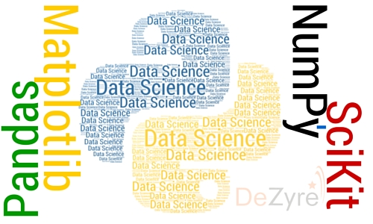
Environment and tools used
Python 3.8.2
Jupyter Notebook
numpy 1.19.1
pandas 1.1.0
matplotlib 3.3.0
seaborn 0.10.1
scikit-learn 0.23.2

Slide 9
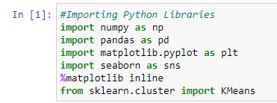
CODE & DATA ANALYSIS:
importing the necessary Python Libraries-
Numpy for linear algebra
Pandas for data processing, CSV file I/O
Matplotlib for data visualization
Seaborn for data visualization
Scikit-learn for predictive data analysis

Slide 10

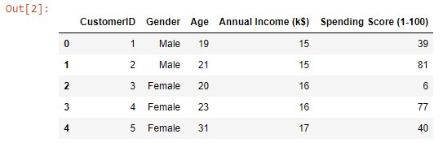
Importing the dataset and viewing the first five rows of the data-
So we can see the columns in the dataset are CustomerId, Gender, Age, Annual Income and Spending Score.

Slide 11

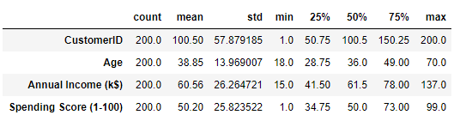
To understand more about the data data.describe() is used

Slide 12
We can see that-
The count is 200 means we have records of 200 customers with us.
The minimum age of customer in our data is 18 yrs and maximum age is 70.
The mean here is 38 and median is 36.Here Mean>Median means our data has high outliers that is more of youngsters prefer to go malls.
The minimum annual income of customer is 15k$ and maximum is 137k$. The mean and median here is 60k$ and 61k$ respectively.
Spending Score is something you assign to the customer based on your defined parameters like customer behaviour and purchasing data. Here the minimum spending score assigned is 1 and maximum ranges till 99.Both mean and median is 50.

Slide 13
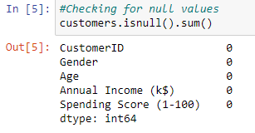
now checking whether the data has null value or not –
So, there is no null values in the dataset.

Slide 14
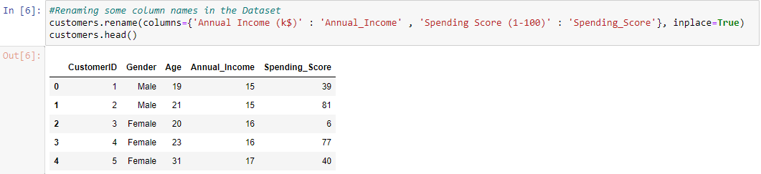
Renaming some columns for the ease of use –

Slide 15
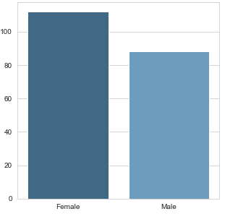

Checking the distribution of male and female population in the dataset. –
Bar Plot

Slide 16
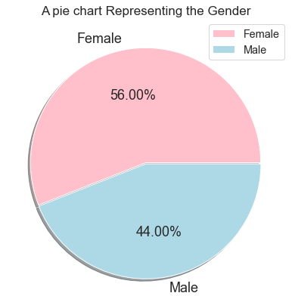
Pie Chart :
Interestingly, The Females are in the lead with a share of 56% whereas the Males have a share of 44%, that’s a huge gap specially when the population of Males is comparatively higher than Females.

Slide 17
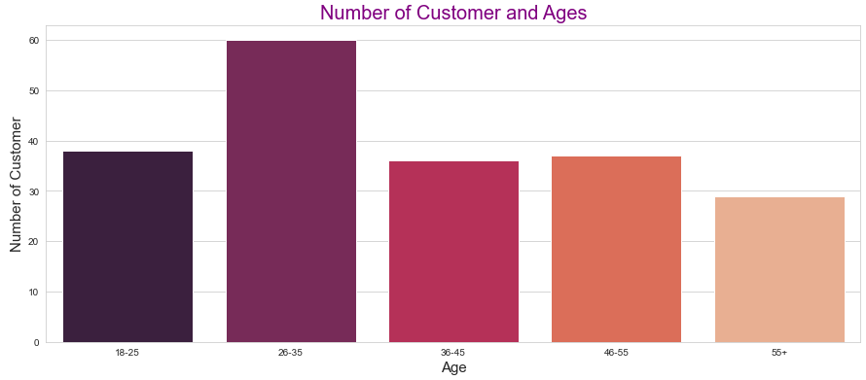
Checking for the Distribution of number of customers in each age group :
So most of the customers falls under the age group of 26 to 35 so they are the most frequent visitors in the mall where the people above of ages 55 and above are very less frequent in the mall.

Slide 18
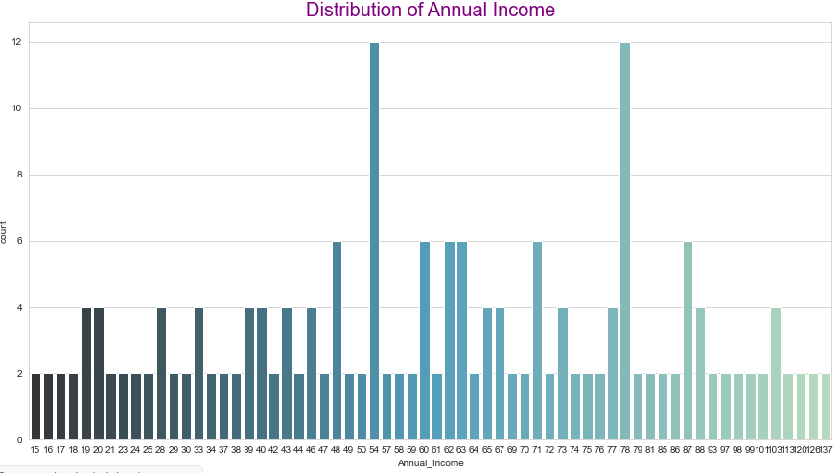
Count plot to see the distribution of Annual Income
Interestingly there are customers in the mall with a very much comparable frequency with their Annual Income ranging from 15 US Dollars to 137K US Dollars. There are more Customers in the Mall whoc have their Annual Income as 54k US Dollars or 78 US Dollars.

Slide 19
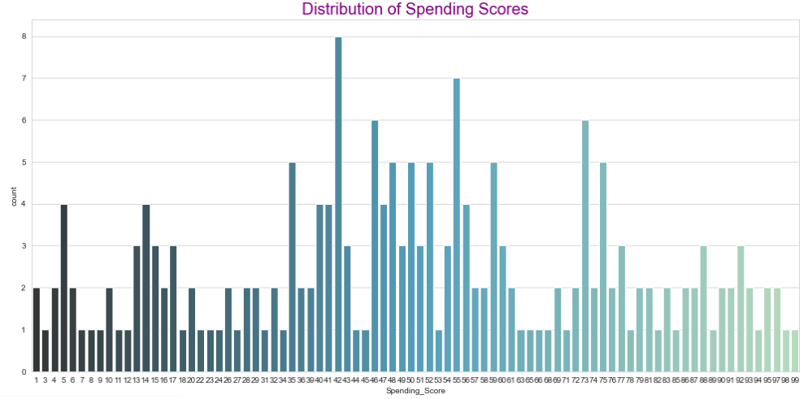
Countplot to see the distribution of Spending Score –
On a general level, we may conclude that most of the Customers have their Spending Score in the range of 35–60. Interesting there are customers having 1 spending score also, and 99 Spending score also, Which shows that the mall cares to the variety of Customers with Varying needs and requirements available in the Mall.

Slide 20
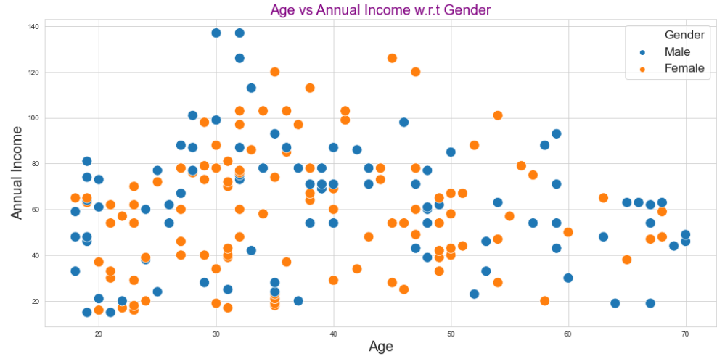
Age vs Annual Income –
We can see in scatter plot that most of the people annual income is more when there age is in between 20 to 50.

Slide 21
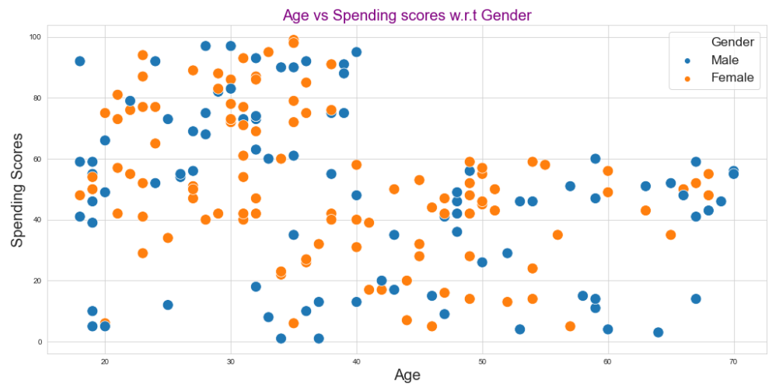
Age vs Spending scores :
We can see in the scatter plot that people of ages between 20 and 40 spend more

Slide 22
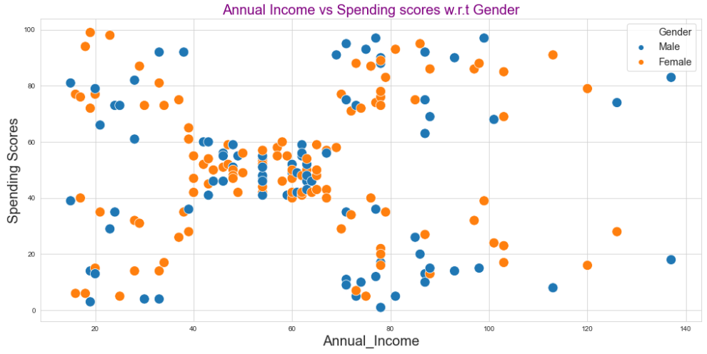
Annual Income vs Spending Scores –

Slide 23
The Elbow Method
Calculate the Within Cluster Sum of Squared Errors (WSS) for different values of k, and choose the k for which WSS first starts to diminish. In the plot of WSS-versus k, this is visible as an elbow.
The steps can be summarized in the below steps:
Compute K-Means clustering for different values of K by varying K from 1 to 10 clusters.
For each K, calculate the total within-cluster sum of square (WCSS).
Plot the curve of WCSS vs the number of clusters K.
The location of a bend (knee) in the plot is generally considered as an indicator of the appropriate number of clusters.

Slide 24
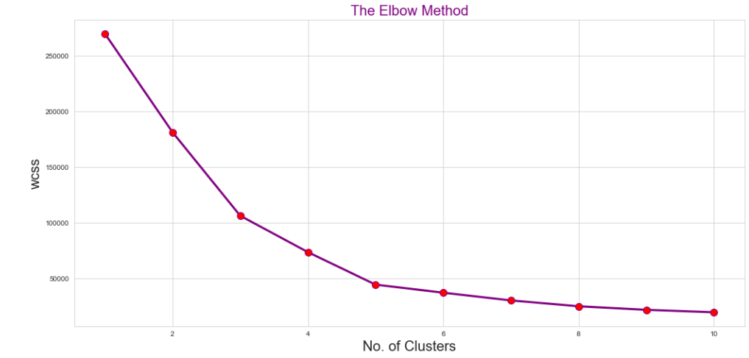
choosing the optimal no of clusters by plotting elbow plot.
So we found the optimal value of k is 5 using elbow method.

Slide 25
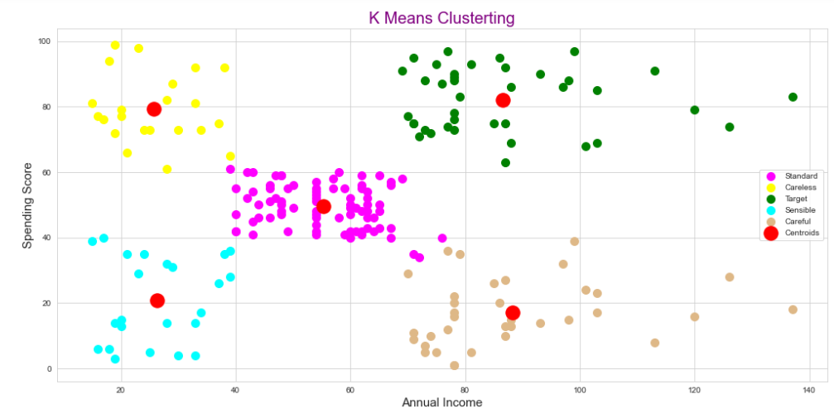
Visualizing the clusters Using K Means clustering algorithm
Cluster 1- High income low spending =Careful
Cluster 2- Medium income medium spending =Standard
Cluster 3- High Income and high spending =Target
Cluster 4- Low Income and high spending =Careless
Cluster 5- Low Income and low spending =Sensible

Slide 26
Inference from Clustering Analysis
This Clustering Analysis gives us a very clear insight about the different segments of the customers in the Mall. There are clearly Five segments of Customers namely Careful, Standard, Target, Careless, Sensible based on their Annual Income and Spending Score which are reportedly the best factors/attributes to determine the segments of a customer in a Mall.

Slide 27
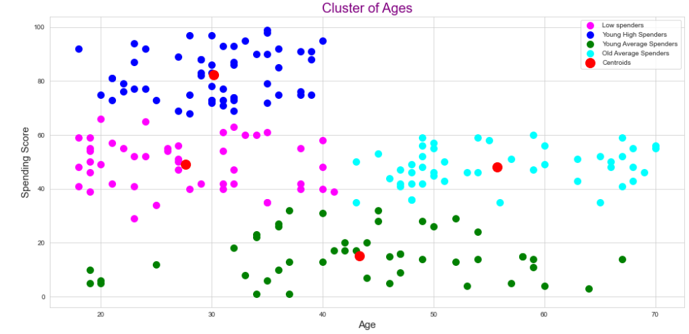
Finding the relation between Age and spending score
We can clearly see that Only young people(18-40 age group) are involved in High Spending. As age increases people fall into average or Low spending category.

Slide 28
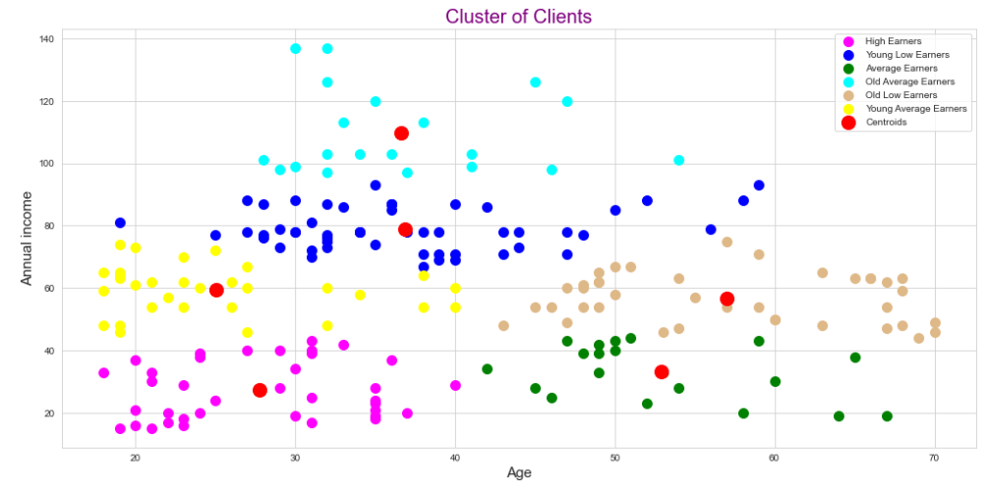
Finding out the relation between Age and Income
We can see people in age group 0f 30-40 have high number of high income people

Slide 29
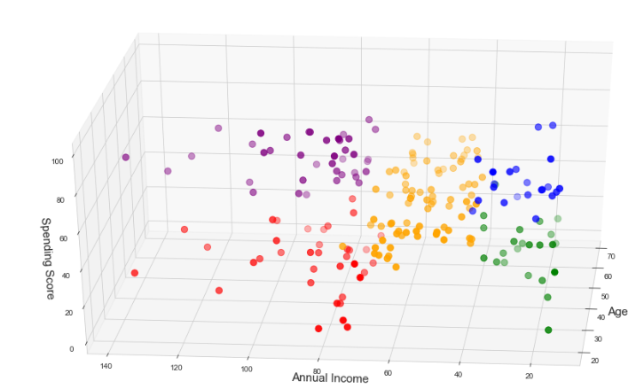
Finding out the relation between Age,Annual Income and spending score
It is a 3D plot to visualize the spending score of the customers with their annual income. The data points are separated into 5 classes which are represented in different colours as shown in the 3D plot.

Slide 30
Conclusions
Now we have 4 different clusters grouped by Age and Spending Score.
The analysis shows there is low score concentration in male gender (between 0 and 25 score points). In female gender, we have high concentration in ranges between 75 and 100 compared to male gender. In general, women have higher Spending Score than men.
In other hand, the Annual Income distribution shows that in general, men have higher annual income than women. These two analysi together could give good insights for mall administrators.
Senior Spending Scores concentrates in low and medium values; In high score valuation, adults have the highest levels; In gender comparison, young and senior women have higher Spending Score values than young and senior men.

Slide 31
THANK YOU

