Slide 1
Azure Multi-Region Resilient Infrastructure
POC Application - Technical Architecture Overview
February 2026

Slide 2
Agenda
• Executive Summary & Business Requirements
• Solution Architecture Overview
• Multi-Region Design & Components
• Disaster Recovery Strategy
• Automated DR Failover (Alert-Triggered)
• Manual DR Drill Process
• Recovery Objectives & SLAs
• Next Steps

Slide 3
Executive Summary

Slide 4
Business Requirements & Resiliency Targets
Metric | Target | Implementation
RTO (Recovery Time) | ≤ 1 hour | SQL MI Auto-Failover, Front Door Health Probes
RPO (Data Loss) | ≤ 4 hours | Synchronous SQL Replication, Geo-Redundant Storage
Availability SLA | 99.99% | Multi-region Active-Active with Zone Redundancy
DR Testing | Quarterly | Automated + Manual DR Drill Runbooks
Security | Zero Trust | Private Endpoints, Managed Identities, No Public Access

Slide 5
Solution Overview
• Multi-Region Active-Active Architecture
  Primary Region: East US 2 | Secondary Region: Central US (Azure Paired Regions)
• Zone-Redundant Deployment across 3 Availability Zones per region
• Global Traffic Management with Azure Front Door Premium
  Weighted load balancing (50/50) with automatic failover
  WAF policies for DDoS protection and security
• Data Replication across all stateful services
  SQL MI Failover Groups with synchronous replication
  Redis Premium with Geo-Replication
  Storage Accounts with RA-GZRS (Read-Access Geo-Zone-Redundant)
• Fully Private Architecture with Private Endpoints

Slide 6
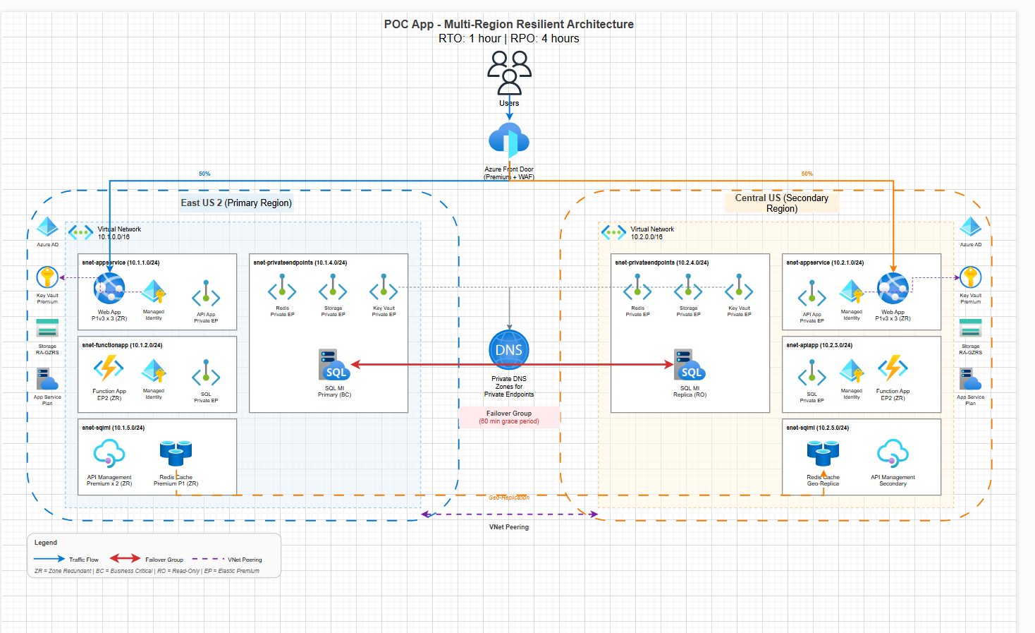
Architecture Overview

Slide 7
Architecture Components

Slide 8
Azure Services & Configuration
Component | Primary Region (EUS2) | Secondary Region (CUS) | Replication
App Service | P1v3 x 3 instances (Zone Redundant) | P1v3 x 3 instances (Zone Redundant) | N/A (Stateless)
Function Apps | Elastic Premium EP2 | Elastic Premium EP2 | N/A (Stateless)
SQL MI | Business Critical (8 vCores) | Business Critical (8 vCores) | Failover Group (Sync)
Redis Cache | Premium P1 (6GB) | Premium P1 (6GB) | Geo-Replication
Storage | RA-GZRS | RA-GZRS | Cross-Region Replication
Key Vault | Premium (RBAC) | Premium (RBAC) | Manual (DR only)
Front Door | Premium + WAF (Global) | — | Global Service

Slide 9
Network Architecture
Virtual Networks
Private Connectivity
• Primary VNet: 10.1.0.0/16 (East US 2)
• Secondary VNet: 10.2.0.0/16 (Central US)
• Global VNet Peering between regions
• Dedicated subnets per service tier
• Network Security Groups (NSGs)
• Private Endpoints for all PaaS services
• Private DNS Zones for name resolution
• No public IPs on backend services
• Front Door as single ingress point
• VNet Integration for App Service

Slide 10
Disaster Recovery Strategy

Slide 11
Two-Pronged DR Approach
🤖 Automated Failover
👨‍💻 Manual DR Drill
• Real-time alert-triggered response
• Azure Monitor alerts detect outages
• Webhook triggers Automation Runbook
• Automatic SQL MI failover group switch
• Automatic Redis geo-rep promotion
• No human intervention required
• RTO: Minutes (for automated components)
• Scheduled quarterly DR testing
• PowerShell scripts for controlled execution
• Step-by-step validation checkpoints
• Detailed logging and reporting
• Failback procedures included
• Compliance documentation
• Training for operations team

Slide 12
Automated DR Failover Flow
• 1️⃣ Alert Fires — Azure Monitor detects unhealthy metrics
  SQL MI CPU = 0%, App Service Health < 90%, Redis Server Load > 99%
• 2️⃣ Action Group Executes — Triggers configured actions
  Email notifications sent to operations team
  Webhook calls Azure Automation runbook
• 3️⃣ Automation Runbook Executes — PowerShell script runs
  Authenticates via Managed Identity (no credentials)
  Parses Common Alert Schema webhook payload
• 4️⃣ Failover Operations — Components switch to secondary
  SQL MI: Switch-AzSqlDatabaseInstanceFailoverGroup
  Redis: Remove-AzRedisCacheLink (promotes secondary)
• 5️⃣ Front Door — Automatic via Health Probes
  No action needed — health probes detect and route automatically

Slide 13
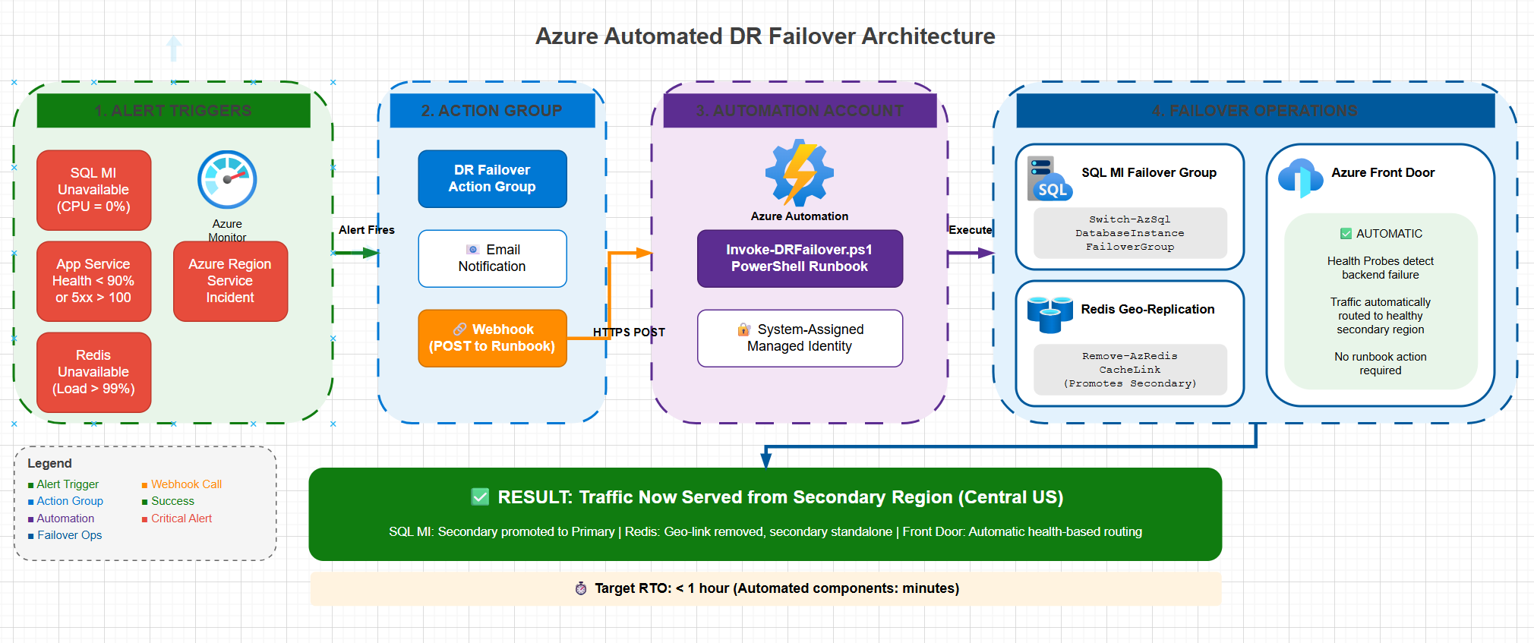
Automated DR Failover Architecture

Slide 14
Manual DR Drill Process (5-Step Runbook)
• Step 1: Pre-Drill Validation (01-PreDrillValidation.ps1)
  Verify all resources are healthy before starting
  Check replication status, connection strings, DNS
• Step 2: Initiate Failover (02-InitiateFailover.ps1)
  Execute SQL MI failover group switch
  Remove Redis geo-replication link
• Step 3: Validate Failover (03-ValidateFailover.ps1)
  Test application connectivity to secondary region
  Verify database read/write operations
• Step 4: Initiate Failback (04-InitiateFailback.ps1)
  Return to primary region after testing
  Re-establish Redis geo-replication
• Step 5: Post-Drill Report (05-PostDrillReport.ps1)
  Generate compliance report with timestamps
  Document any issues for remediation

Slide 15
Automated vs Manual DR: When to Use
Scenario | Automated | Manual
Production Outage (Real) | ✅ Primary | ❌ Not recommended
Scheduled DR Testing | ❌ Not recommended | ✅ Primary
Compliance DR Drill | ❌ Insufficient | ✅ Required
Training / Learning | ❌ Too fast | ✅ Recommended
Unattended Response | ✅ Designed for this | ❌ Requires operator
RTO Target | Minutes | < 1 hour

Slide 16
DR Alert Configuration
Alert | Trigger Condition | Severity | Action
SQL MI Availability | avg_cpu_percent = 0% | Critical (Sev0) | Failover Runbook
SQL MI Health | ResourceHealth = Unavailable | Critical | Failover Runbook
App Service Health | HealthCheckStatus < 90% | Critical | Failover Runbook
App Service 5xx | Http5xx > 100 in 5min | Critical | Failover Runbook
Redis Server Load | serverLoad > 99% | Critical | Failover Runbook
Redis Connectivity | connectedclients < 1 | Critical | Failover Runbook
Region Service Health | Azure Incident in EUS2/CUS | Critical | Failover Runbook

Slide 17
Infrastructure as Code

Slide 18
Terraform Implementation
• Modular Architecture — Reusable modules per service
  12 modules: networking, app-service, sql-mi, redis, automation, etc.
• Environment Separation — Prod configuration in environments/prod/
  Variables, locals, and tfvars for configuration management
• State Management — Terraform state with Azure Backend
  Supports team collaboration and state locking
• Key Modules:
  modules/automation/ — Azure Automation Account, Runbook, Webhook
  modules/monitoring/ — Log Analytics, App Insights, DR Alerts
  modules/sql-mi/ — SQL MI with Failover Groups
  modules/redis/ — Redis Premium with Geo-Replication
  modules/front-door/ — Azure Front Door Premium with WAF
GitHub Repository: DeepMalh44/ResiliencyPOC

Slide 19
Summary & Next Steps

Slide 20
Summary
✅ What's Implemented
🔜 Next Steps
• Multi-region Active-Active architecture
• Zone-redundant services (3 AZs)
• SQL MI Failover Groups (auto-failover)
• Redis Geo-Replication
• Azure Automation for DR (alert-triggered)
• Manual DR Drill runbooks (5 scripts)
• Terraform IaC (fully modularized)
• Comprehensive monitoring and alerts
• Deploy SQL MI (pending vCore quota approval)
• Configure Front Door health probes
• Test automated failover end-to-end
• Schedule first quarterly DR drill
• Document runbooks for operations
• Set up Azure DevOps CI/CD pipeline
• Security review and penetration testing
• Cost optimization review

