Slide 1



A PROJECT DEMONSTRATION BY DEEP MALVIYA
BUILDING AN AI PIPELINE FOR IMAGE SEGMENTATION AND OBJECT ANALYSIS
21 AUGUST 2024

Slide 2
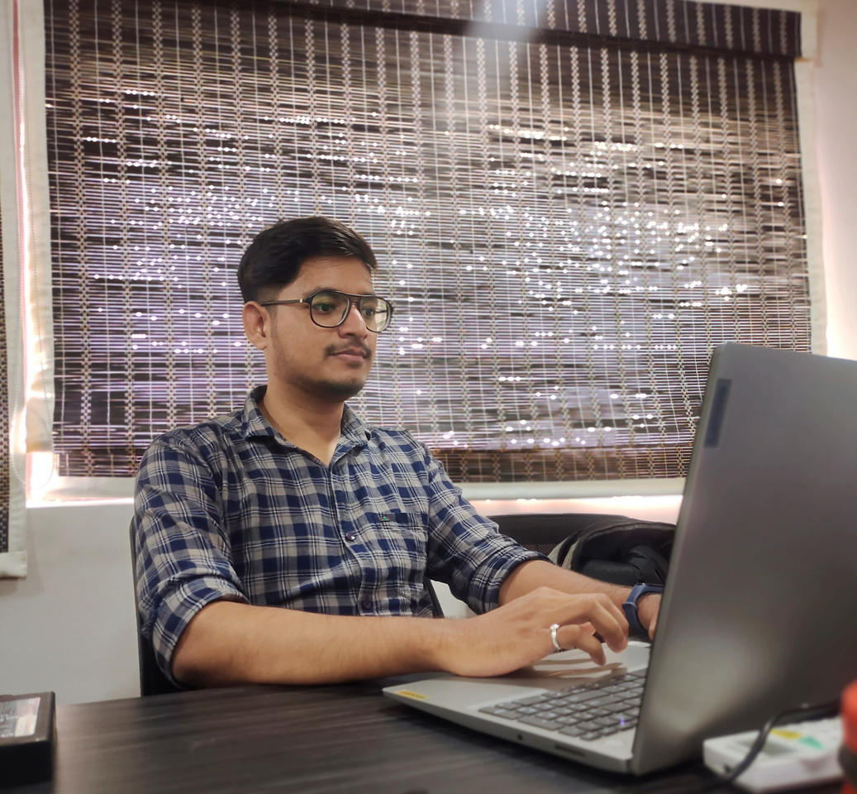


About the Developer:
Deep Malviya
I'm an AI enthusiast with a B.Tech in Artificial Intelligence from GHRCE, Nagpur, currently working as a Junior Product Developer. I’m passionate about using AI to tackle real-world problems, especially in areas like image segmentation and object detection. Recently, I completed a project where I built an AI pipeline and a user-friendly Streamlit app, which was a rewarding challenge. I love the blend of creativity and problem-solving that AI offers, and I’m always eager to learn more and take on new challenges. Whether it's coding late into the night or collaborating with a team, I’m driven by the idea of making technology that truly helps people.

Slide 3
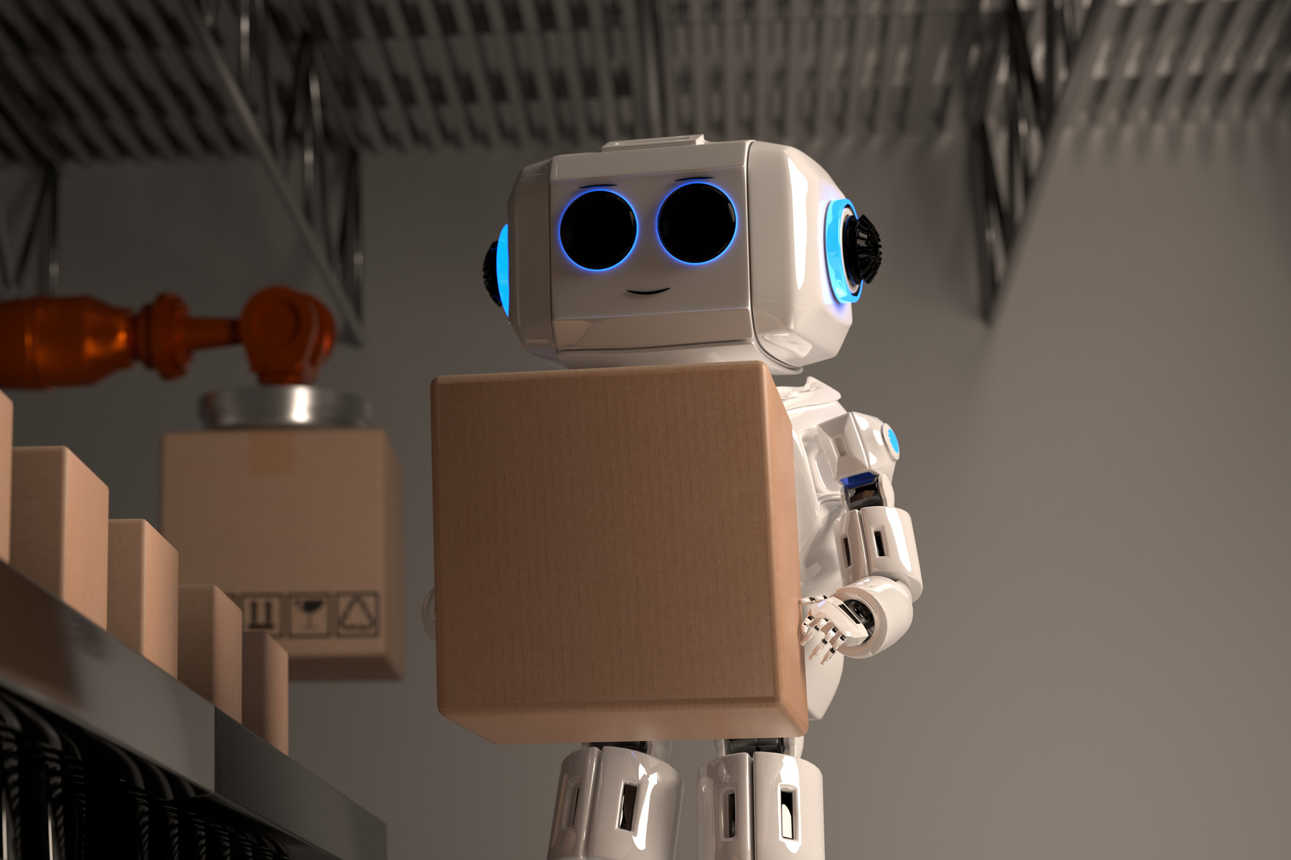

Problem Statement & Objectives
Problem: The task was to build a comprehensive AI pipeline capable of segmenting images, extracting objects, identifying them, and generating a detailed report.
Objectives:
Develop a robust image segmentation pipeline.
Ensure accurate object extraction and identification.
Provide a user-friendly interface for processing and visualization.
Organize output files systematically for easy access.

Slide 4

Approach:
Step 1: Image Segmentation using pre-trained models.
Solution Strategy & Approach
Step 2: Object Extraction from the segmented image.
Strategy:
Break the problem into modular steps: segmentation, extraction, identification, and reporting.
Use pre-trained models for efficient processing.
Implement a user interface for smooth operation and visualization..
Step 3: Object Identification using
YOLOv5.
Step 4: Text Extraction and
summarization of object attributes.
Step 5: Data Mapping and JSON output generation.

Slide 5
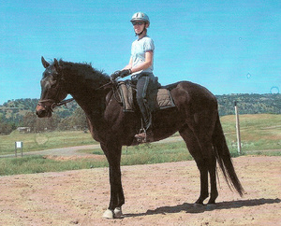

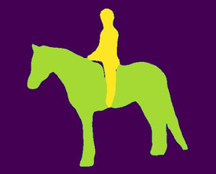

AI Pipeline Flowchart
Image Segmentation: Segment the uploaded image into various objects.
Object Extraction: Extract each segmented object.
Input: Image Upload
Object Identification: Identify extracted objects using YOLOv5.
Data Mapping: Generate a final report in JSON format.
Data Mapping: Generate a final report in JSON format.
Text Extraction: Summarize object identification data.
Output: Display results, save images and JSON files in structured folders.

Slide 6
Implementation & Results
Implementation:
Each step was implemented as a separate script in the pipeline.
A Streamlit app was developed to integrate and visualize the entire process.
Careful organization of output files into designated folders.
Results:
Successfully segmented and identified objects from images.
Generated a comprehensive JSON report with mapped data.
The UI allows easy uploading, processing, and visualization of images.

Slide 7
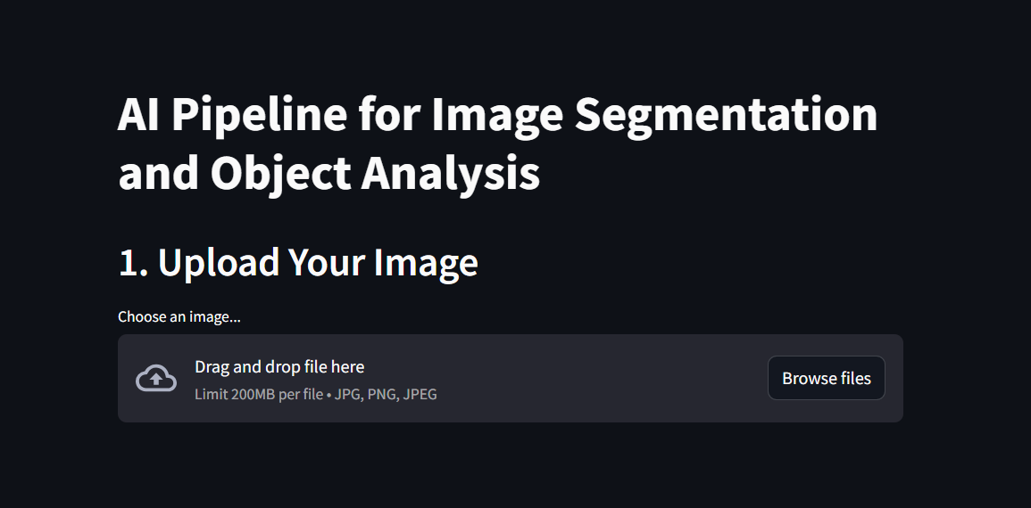
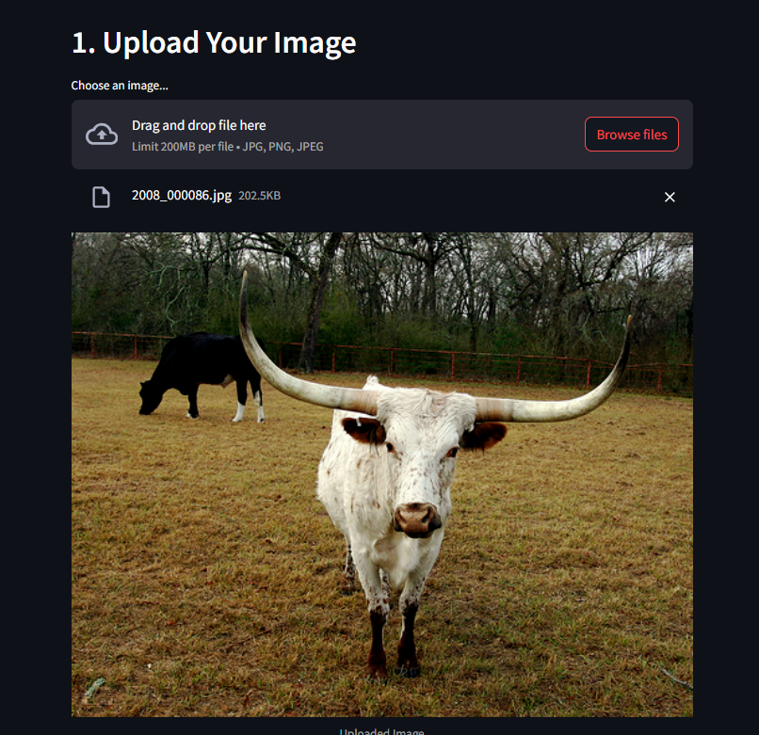
Glimpse of UI

Slide 8
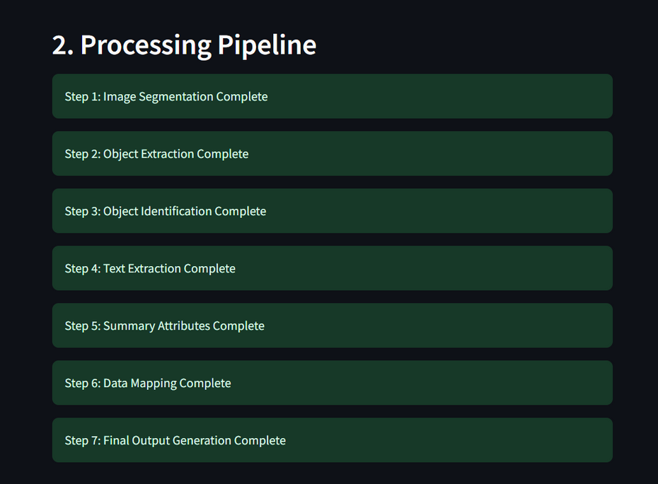
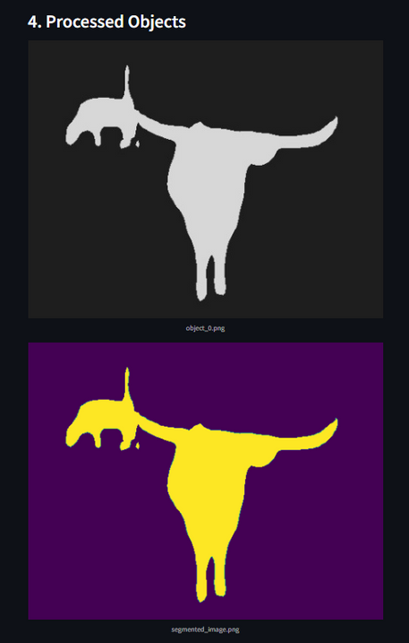
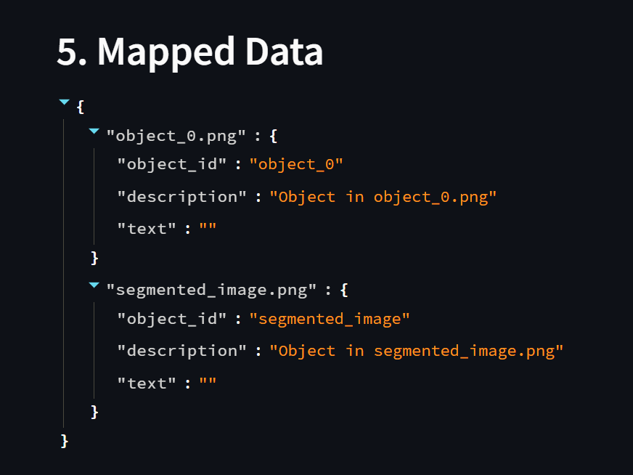
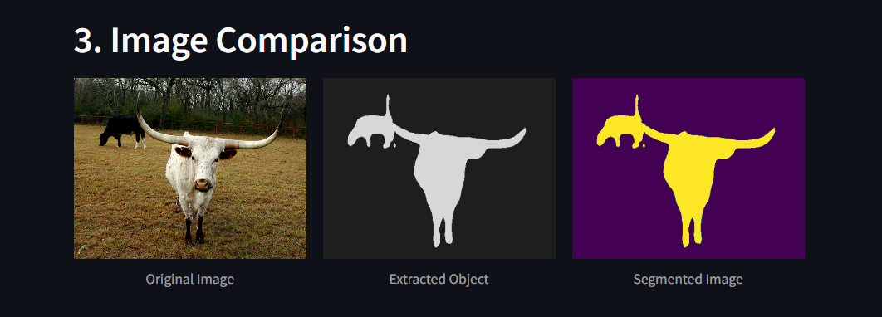
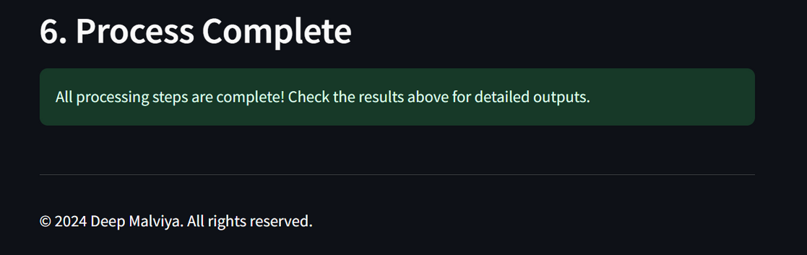

Slide 9
Conclusion & Future Work
Conclusion:
The AI pipeline successfully addressed the task requirements.
Achieved a high level of accuracy and user-friendliness in processing images.
Ensured all outputs were organized and accessible.
Future Work:
Enhance the model's accuracy with more advanced techniques.
Expand the pipeline to handle additional image processing tasks.
Improve the UI with more features for better user interaction.

Slide 10

Thank you!
For questions, requests and further discussion. please email me at deepmalviya.aie@gmail.com

