Slide 1

Collaborative Filtering based Recommendation System using Deep Learning
A presentation on
Presented By:
Deep Mendha(14IT061)
Supervised By:
Amit Thakkar

Slide 2
Outline…
Graph-lab
Google Cloud
Sci-kit learn
Tensor-flow
Surprise lib

Slide 3
Graph-lab Create
GraphLab Create is a Python library, backed by a C++ engine, for quickly building large-scale, high-performance data products. Some key features of GraphLab Create are:
Analyze terabyte scale data at interactive speeds, on your desktop.
A Single platform for tabular data, graphs, text, and images.
State of the art machine learning algorithms including deep learning, boosted trees, and factorization machines.
Run the same code on your laptop or in a distributed system, using a Hadoop Yarn or EC2 cluster.
Focus on tasks or machine learning with the flexible API.
Visualize data for exploration and production monitoring.

Slide 4
Main interest is in similarity type and there are few parameters that can be configure:
Seed item set size
Target memory usage
Training methods(Imp)
Auto, Dense, Sparse and Nearest Neighbour
Max data pass

Slide 5
 | Pearson | Cosine | Jaccard
Auto | 0.523 | 0.25 | 0.196
Dense | 1.408 | 1.223 | 1.164
Sparse | 2.198 | 2.25 | 2.211
NN | 1.413 | 1.901 | 1.395

Slide 6
Sci-kit learn
scikit-learn is a Python module for machine learning built on top of SciPy and distributed under the 3-Clause BSD license.
Collaborative filtering has 2 main type
Memory based (cosine similarity)
Model based (SVD)

Slide 7
Tensorflow
TensorFlow is a tool for machine learning. While it contains a wide range of functionality.
TensorFlow is mainly designed for deep neural network models.
It is bind in python and C++.
It is most popular tool for ML and DL
It trains machine distributed across network
It can be deployed on Android and IOS.

Slide 8
WHY tensorflow??
Factorization helps to discover underlying latent features
Helps us to deal with large data sets
Provides General Computation framework
Make most of the task simpler
Varity of optimizer like Stochastic/Gradient Descent
Also works with GPU’s

Slide 9
What is tensor?
Can be viewed as MUTLI-DIMENSIONAL ARRAY OF NUMBERS
Means it can be:
Scalar
Vector
Matrix

Slide 10
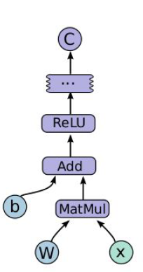
Data Flow Graph
Nodes represents the operation
Edges represent the tensor
Mainly 2 phases:
Construction Phase: graph model
Execution phase: pushing data

Slide 11
How does it works ?
Compute data flow graph mainly directed graph
Largely used to define ML algorithm
Natively supports DL models

Slide 12
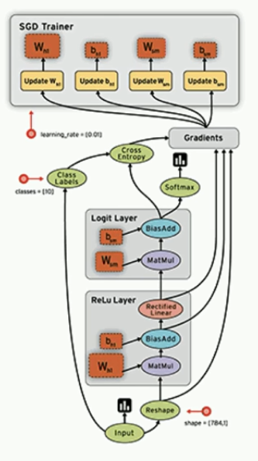

Slide 13
Surprise Lib
Surprise is a Python sci-kit building and analyzing recommender systems.
It was designed with the following purposes in mind:
Give users perfect control over their experiments.
Alleviate the pain of Dataset handling. Users can use both built-in datasets (Movielens,Jester), and their own custom datasets.
Provide various ready-to-use prediction algorithms and Matrix factorization based and many others
Provide tools to evaluate, analyze and compare the algorithms performance.

Slide 14
Analysis
All the analysis is done on Movie lens data set of 100k and 1m.
Lower the RSME value better the algorithm performance.
 | K-NN | SVD/TF-svd | SVD++ | TF | AE
RSME | 0.98 | 0.947/.881 | 0.9272 | .847 | 0.955

Slide 15


