Slide 1


Healthware

Slide 2

The Problem
Our 21st Century Health and Wellness is being addressed with 20th Century Tools

Slide 3
Useful Fact
A recent market intelligence report predicts that by the year 2020, 100 percent of smartphones, wearables and tablets will have biometric capabilities.

Slide 4
The Solution
Make it easier for Doctors and Psychiatrists to leverage wearable technology

Slide 5

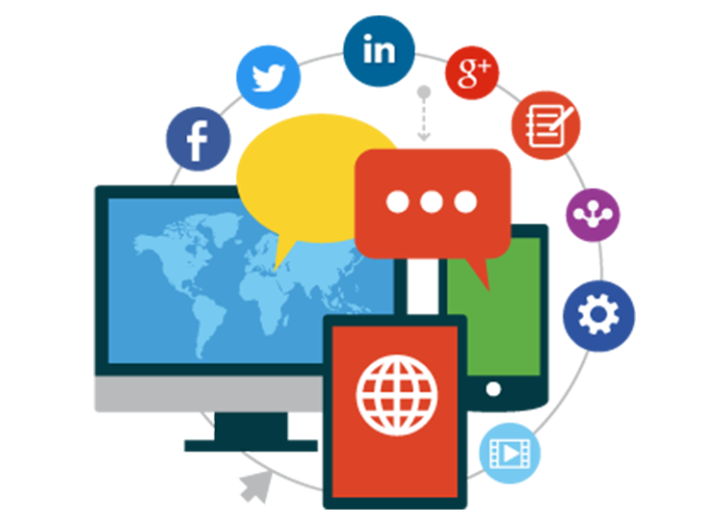
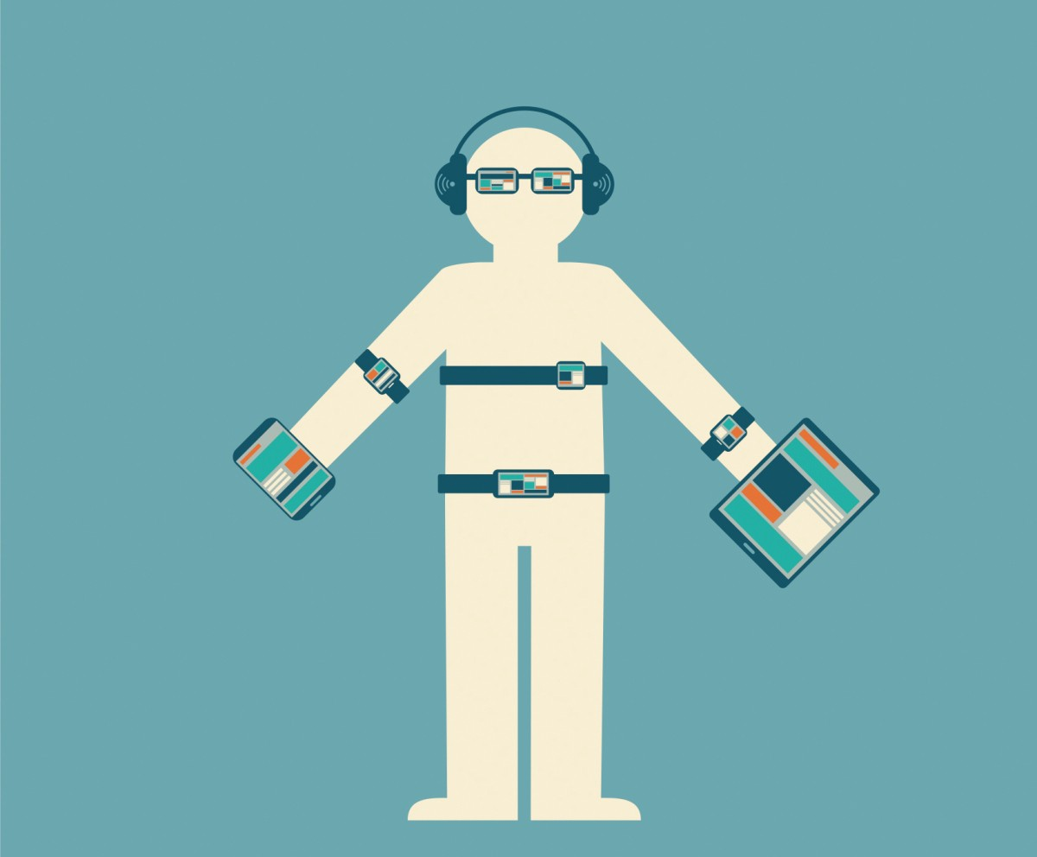

Healthware: AI Powered wearables
Wearable Data
Your Day-to-Day Data
Actionable Health Data Insights

Slide 6



Approach
Doctor Prescribes an app from Healthware App store
Data gets collected and analyzed before next visit
Healthware provides actionable insights

Slide 7

Use Case: Sam

Slide 8

Visits Therapist bi-weekly
Linked TD Banking App to Healthware
Tends to keep a lot of info to himself
Torontonian: Sam

Slide 9

Trying to improve productivity of sessions
Her Hospital purchased a mood monitoring Healthware App recently
Knows the App’s AI will continuously improve with feedback and use
Therapist: Julia

Slide 10
But Wait..
What does this specific Healthware App do and how would apps like it help the city?

Slide 11
“More than nine in ten people with mental health issues say they overspend and struggle to make sensible financial decisions when unwell”
Notes:
Well, lets give some context first

Slide 12
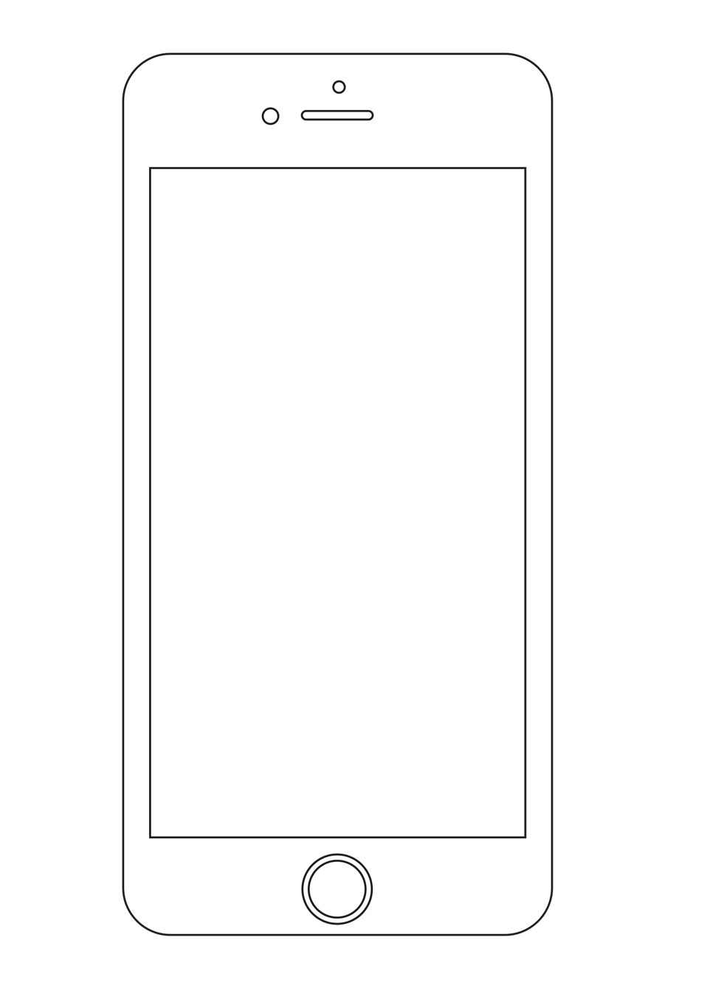
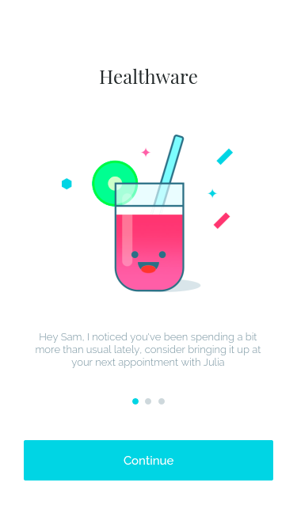
Sam Receives actionable insights from Healthware that no one else can see, based on his spending behavior
...In fact, the Healthware AI never stored Sam’s data, only the insights it had about it!
Therefore, Privacy is Conserved while leveraging the full force of AI

Slide 13



Who Benefits?
Policy Makers
Torontonians
AI Startups

Slide 14
Implementation
Create Anonymized Data Exchange Platform
Build API integration for current Wearables
Build Healthware App store on top of exchange platform and APIs

Slide 15

Key Assumptions about the Future
Policy Makers will ultimately be supportive of “Phantom AI’s”
Augmented Reality wearables will become widely adopted
Mental Health breakthroughs can come from data
Quantum Computers Will Dominate

Slide 16
Appendix

Slide 17
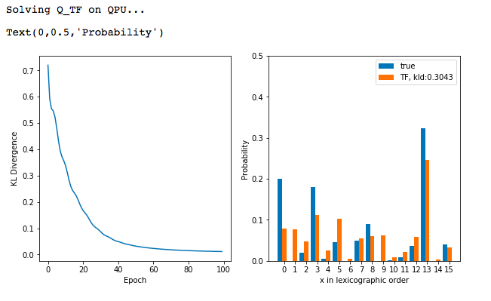

Slide 18
Insights Example
Poor Health Spending Insight
7 day trend spending over 10 dollars at McDonalds
Good Health Insight
You’ve hit 10 days in a row reaching over 10,000 steps
Good Spending Insight
You haven’t spent more than 10 dollars at a fast food restaurant in the last week!
Sporadic Spending Insight
Given a person’s income and personal banking information we could warn if they are spending too much on random items on Amazon
Note: These will be in a nice visual format in the app.

