Slide 1
CRD:
Contrastive Representation Distilation
Yonglong Tian, Dilip Krishnan, Phillip Isola
MIT CSAIL, Google Research
ICLR 2020
Sungman Cho

Slide 2
Contributions
Contrastive-based objective for transferring knowledge between deep networks.
Application to model compression, cross-modal transfer, and ensemble distillation.
New state-of-the-art in many transfer tasks, and sometime even outperforms the teacher network when combined with knowledge distillation.

Slide 3
Introduction
Knowledge distillation(KD) originally proposed by minimizes the KL divergence between the teacher and student outputs. → KL divergence makes intuitive sense when the output is a distribution. (probability mass function over classes)

Slide 4
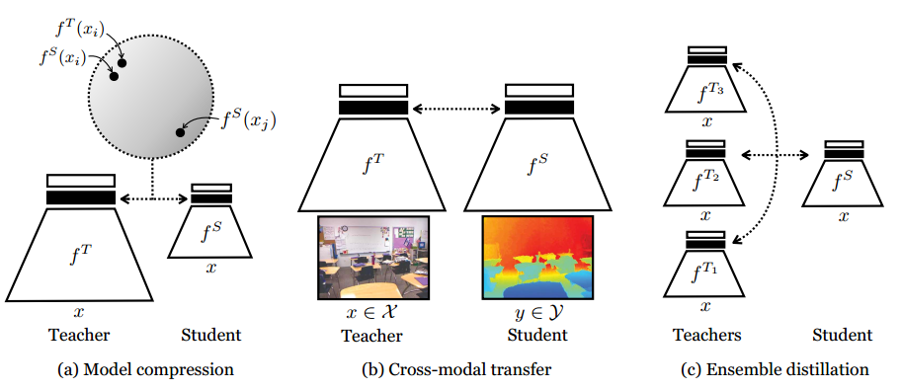
Introduction
However, often we instead wish to transfer knowledge about a representation. → “Cross-modal distillation” (image to sound or depth)

Slide 5
Introduction
Representational knowledge is structured. (The dimensions exhibit complex interdependencies)
Original KD treats all dimensions as independent, conditioned on the input. Such a factored objective is insufficient for transferring structural knowledge. (i.e. dependencies between output dimensions i and j )
Similar to L2 objective produces blurry results. (Image generation tasks)

Slide 6
Introduction
Captures correlations and higher order output dependencies. → We leverage the family of contrastive objectives.
Contrastive objectives have been used successfully in representation learning, self-supervised settings

Slide 7
Introduction
Our objective maximizes a lower-bound to the mutual information between the teacher and student representations.
Contrastive objective better transfers all the information in the teacher’s representation, rather than only transferring knowledge about conditionally independent output class probabilities.

Slide 8
Related Work
Hinton et al. (2015) : matching output logits
Bucilua et al. (2006) : introduced the idea of temperature in the softmax outputs to better represent smaller probabilities in the output of a single sample.
Large temperatures : increase entropy
Zagoruyko & Komodakis et al. (2016) : attention transfer
Focuses on the feature maps of the network.
Limitation : only with same spatial resolution.

Slide 9
Related Work
FitNets (Romero et al., 2014) : regressions to guide the feature activations
Zagoruyko & Komodakis (2016) : weighted form of this regression.
CMC (Tian et al., 2019) : contrastive objective
InfoNCE, NCE (Oord et al., 2018; Gutmann & Hyvarinen., 2010) : use contrastive learning in the context of self-supervised representation learning. : objective maximizes a lower bound on mutual information.

Slide 10
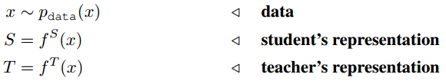
Method
Contrastive Learning
Positive pairs : close
Negative pairs : push apart

Slide 11

Method
Distribution q with latent variable C
Suppose in our data, we are given 1 congruent pair for every N incongruent pairs. 1 congruent pair : drawn from the joint distribution, i.e. the same input provided to T and S N incongruent pairs : drawn from the product of marginals; independent randomly drawn inputs provided to T and S

Slide 12
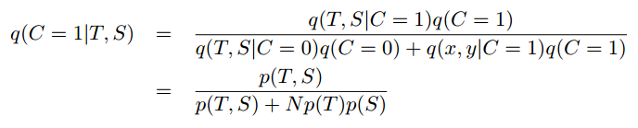
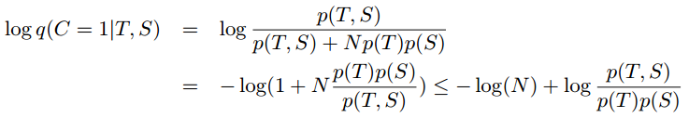
Method
By simple manipulation and Baye’s rule
Next, we observe a connection to mutual information as follows:

Slide 13

Method
Taking expectation on both sides
Fitting data distribution, [0,1]

Slide 14

Method
Gibb’s inequality

Slide 15
Method
Gibb’s inequality

Slide 16
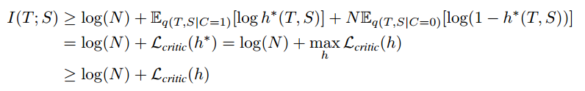
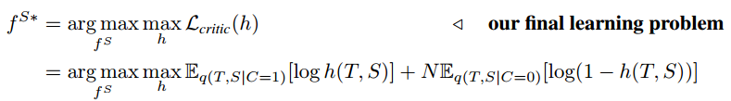
Method
Weakening the bound

Slide 17


Method
Represent :

Slide 18
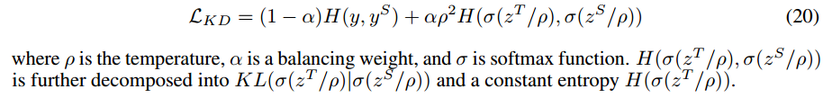
Knowledge Distillation Objective

Slide 19

Cross-Modal Transfer Loss
Features of teacher network are still valuable to help with learning of the student on another domain.

Slide 20

Ensemble Distillation Loss
We have M > 1 teacher networks,

Slide 21
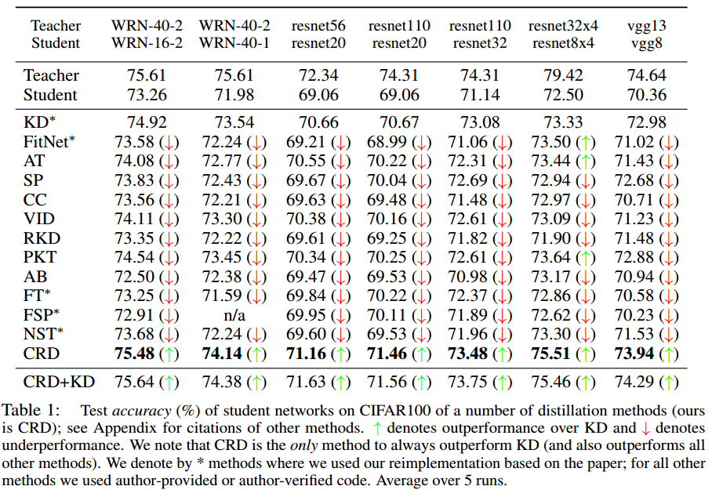
Experiments : Accuracy (CIFAR 100)

Slide 22
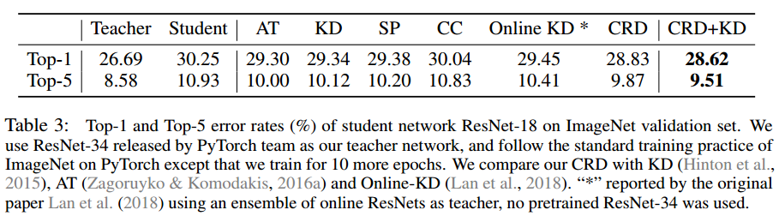
Experiments : Accuracy (ImageNet)

Slide 23
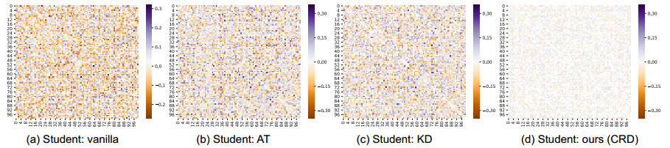
Experiments : Correlation (CIFAR 100)

Slide 24
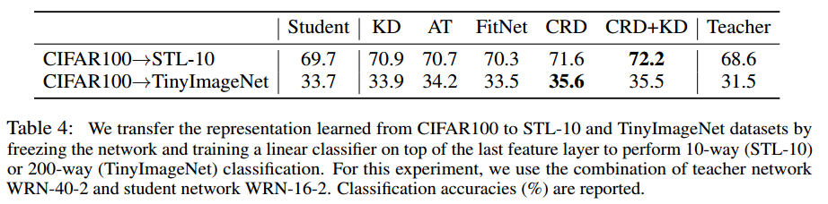
Experiments : Transfer

Slide 25
Experiments : Transfer

Slide 26
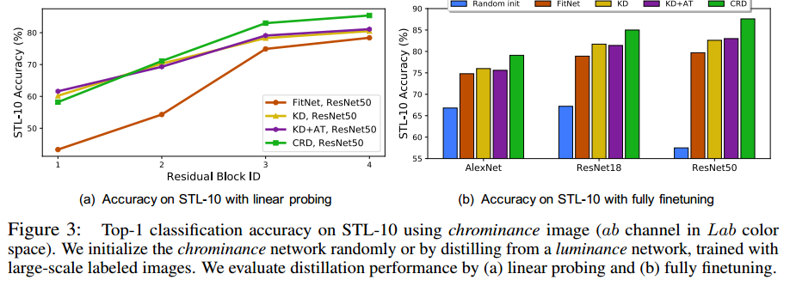
Experiments : Cross-modal Transfer

Slide 27
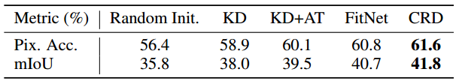
Experiments : Cross-modal Transfer
ImageNet → NYU-Depth

Slide 28
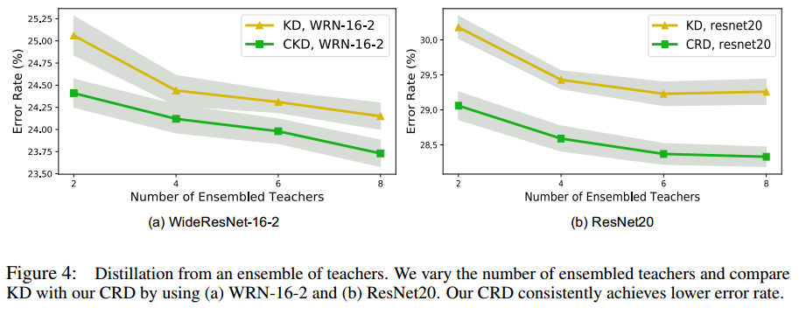
Experiments : Ensemble distillation

Slide 29
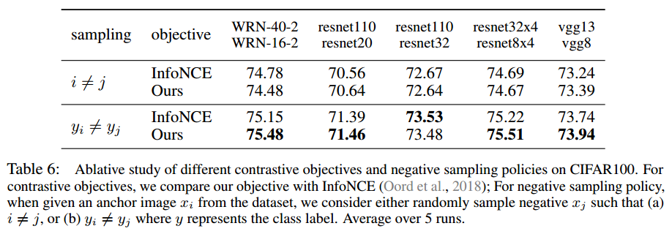
Ablation Study

Slide 30
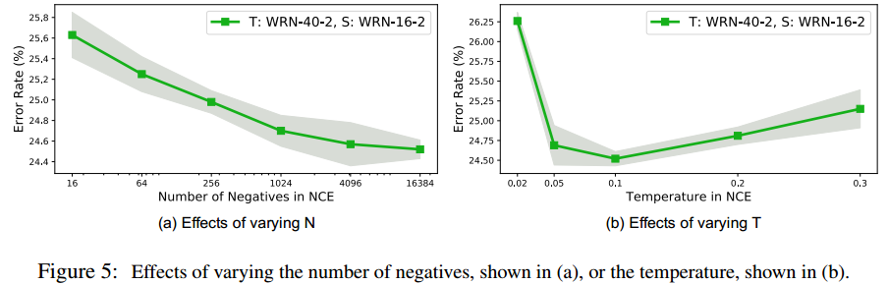
Ablation Study
Computational Cost :
Original : 2GFLOPs
CRD : 260 MFLOPs (12% of the original)
The memory bank for storing all 128-d features of ImageNet only costs around 600MB

Slide 31
Conclusion
Developed a novel technique for neural network distillation, using the concept of contrastive objectives, which are usually used for representation learning.
Experimented with our objective on a number of applications such as model compression, cross-modal transfer and ensemble distillation.
Contrastive learning is a simple and effective objective with practical benefits.

