Slide 1
CSE523 : Machine Learning
Roshani Navdiya AU2040114
1
PROJECT :
SHIPMENT PRICE PREDICTION
Deep Patel
AU2040250
2
TEAM:
REVOLUTION
Aditya Padhariya AU2040151
3
Keval Parmar
AU1940133
4

Slide 2
To develop a solution that can save time and money by accurately predicting their shipment costs.
This project aims to predict the cost of shipping a package using machine learning techniques.
1
4
The problem to be addressed the need for an accurate and reliable model that can predict the cost of shipping a package based on various input parameters.
The main objectives of this project are to collect and preprocess data
PROBLEM STATEMENT
2
INTRODUCTION
1.
5
Select relevant features, and develop a machine learning model that can predict shipment prices accurately.
Shipping costs can vary widely based on several factors, Hence to accurately estimate their shipping costs and can lead to unexpected expenses
3
6

Slide 3
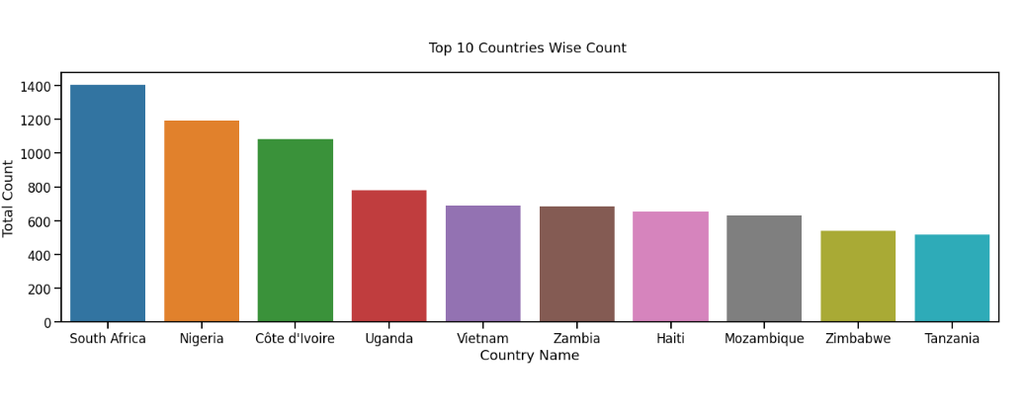
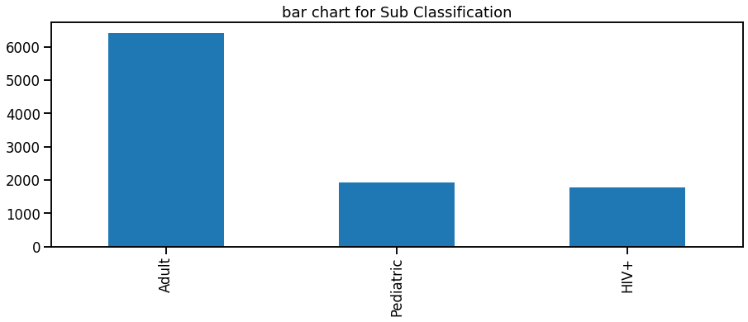
The function will display the statistical description of the numeric variable, skewness, histogram or distplot to view the distribution
Visualizing Missing Values
& Missing Data imputation
Exploratory data analysis through univariate analysis
Sub-classification
EXISTING BODY OF WORK

Slide 4
OUR APPROACH
Trained and evaluated our models, with a focus on selecting the best model for predicting shipment prices.
Step
03
Step
01
*
selecting relevant features, and experimenting with various machine learning algorithms.
collecting and preprocessing shipment data
Step
02

Slide 5
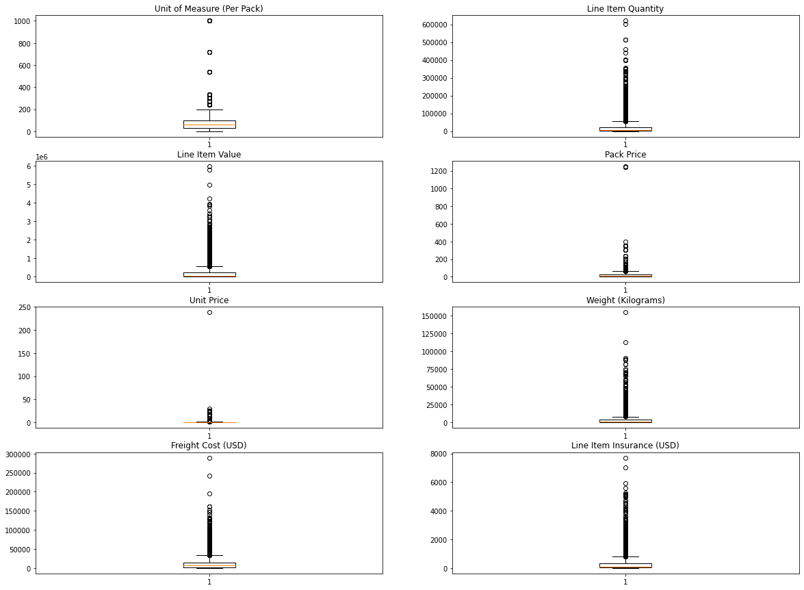
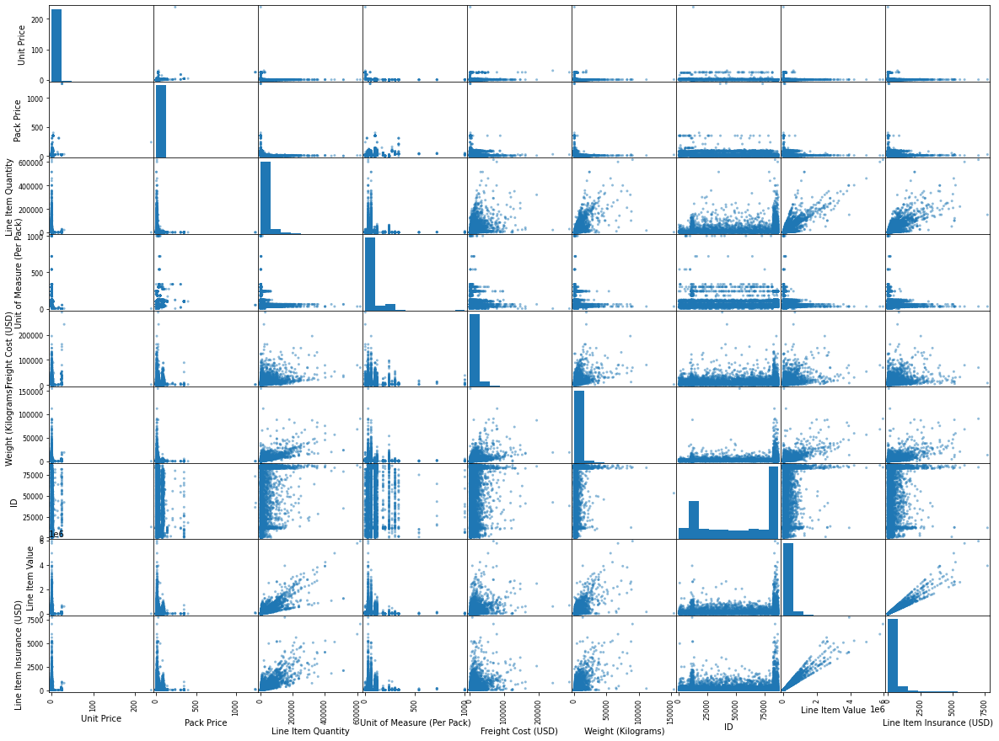
INITIAL RESULTS
SCATTER PLOT
OUTLIER BY BOXPLOT

Slide 6
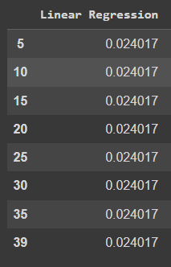
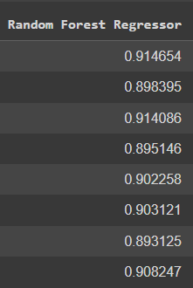
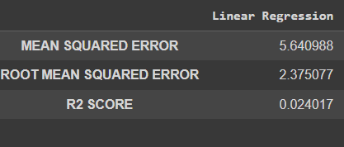
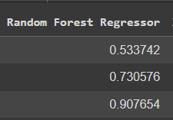
INITIAL RESULTS

Slide 7
ROLES & FUTURE WORKS
Keval
1
Roshani
Data preprocessing, cleaning & implementing different ML models
Optimising the model with help of two more models
Creating User Interface
MODEL FITTINGS & TRAINING DATASET
2
3
4
FW
Deep
Aditya
Studied & Researched different Algorithms
Finding Dataset

Slide 8
Supply Chain Shipment Pricing Dataset
https://www.kaggle.com/datasets/divyeshardeshana/supply-chain-shipment-pricing-data
References
Shipment Cost Prediction Dataset
https://www.kaggle.com/code/klmsathishkumar/shipping-cost-prediction/data
Research Paper
K. L. Keung, C. K. M. Lee and Y. H. Yiu, "A Machine Learning Predictive Model for Shipment Delay and Demand Forecasting for Warehouses and Sales Data," 2021 IEEE International Conference on Industrial Engineering and Engineering Management (IEEM), Singapore, Singapore, 2021, pp. 1010-1014, doi: 10.1109/IEEM50564.2021.9672946.B. Rieder, Engines of Order: A Mechanology of Algorithmic Techniques. Amsterdam, Netherlands: Amsterdam Univ. Press, 2020.

