Slide 1

SHIPMENT PRICE PREDICTION
GROUP 12 : REVOLUTION
DEEP PATEL - AU2040250
ROSHNI NAVDIYA - AU2040114
ADITYA PADHARIYA - AU2040151
KEVAL PARMAR - AU1940133

Slide 2
Introduction
The aim of this project is to develop a machine learning model for predicting shipment prices.
To apply various machine learning techniques such as regression, decision trees, and ensemble methods to develop a model that accurately predicts shipment prices.
By the end of the project, we expect to have a well-performing machine learning model that can predict shipment prices with a high degree of accuracy.

Slide 3
Problem Statement
STATEMENT 1
STATEMENT 2
STATEMENT 3
This project aims to predict the cost of pack price and unit price using machine learning techniques
The problem to be addressed the need for an accurate and reliable model that can predict the cost.
Shipping costs can vary widely based on several factors, Hence to accurately estimate their shipping costs and can lead to unexpected expenses

Slide 4
PROGRESS TIMELINE
Jan1-10 | Jan10-31 | Feb1-15 | Feb15-28 | March1-15 | March15-31 | April1-10 | April10-15
Literature Study & Initial planning
Data Cleaning, Analysing & Visualisation
Implementing various algorithm & Data Splitting
Model Fitting & calculating accuracy of various tested Algorithms
Execution & Testing

Slide 5
The Existing Body Of Work
The terms "vehicle tonnage" and "vehicle type" were used to describe the owner's characteristics.The investigation's findings demonstrated that machine learning models like DNN, XGBoost, and LightGBM outperformed conventional analytical techniques like linear regression. Among the models tested, the LightGBM model, decision tree regressor had the greatest prediction ability.
After initial feature engineering, three alternative regression models—support vector regression (SVR), random forest regression (RFR), and gradient booster regression (GBR)—have been used across the collected datasets to achieve data-driven prediction. Research findings demonstrate that GBR exceeds all other models by providing a test accuracy of 84% and decision tree regressor comes close second . The LightGBM model was one of the ones employed.

Slide 6
Our Approach
Cleaning the shipment data like removing features
Removing features like First Line Designation and handling weight feature to have all numeric values.
Selecting relevant features, and experimenting with various machine learning algorithms.
Splitting the data and used algorithms on test and train divisions.
Trained and evaluated our models, with a focus on selecting the best model for predicting shipment prices.
Model Fitting is done using pack price and unit price optimization.

Slide 7
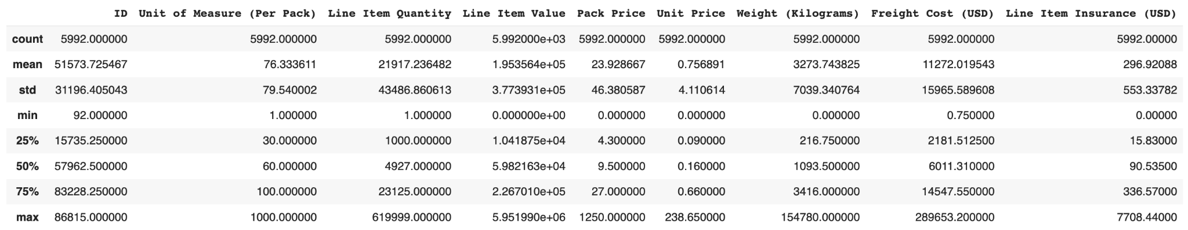
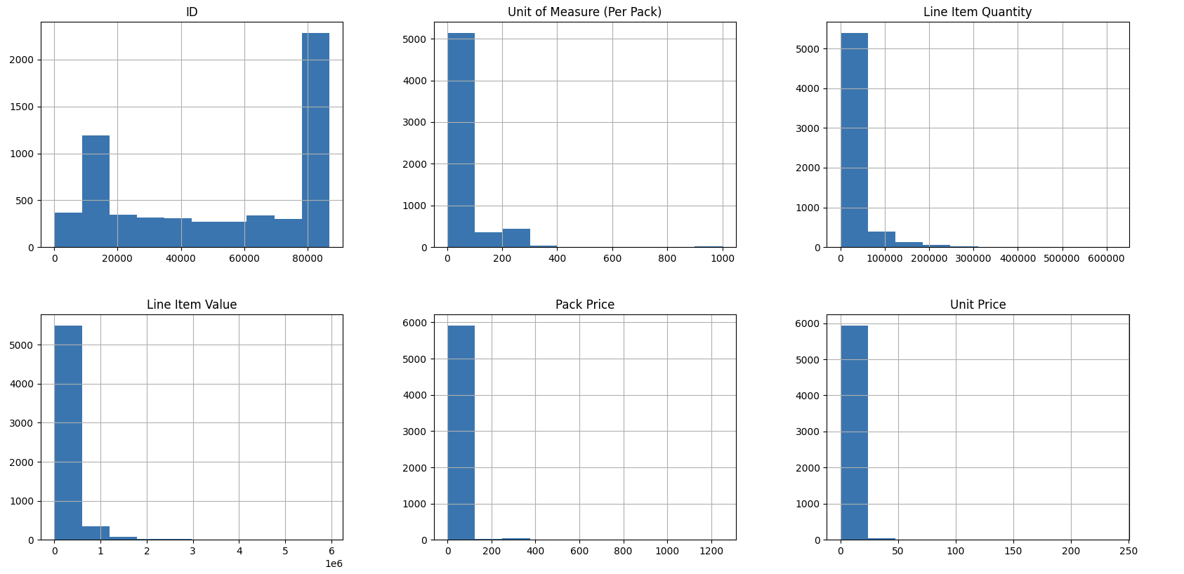

Slide 8
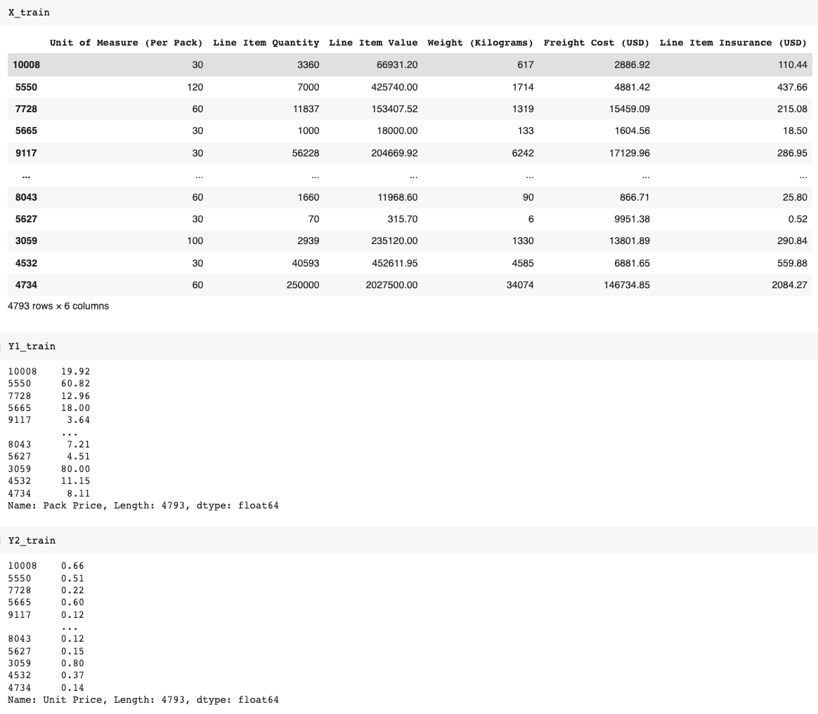

Slide 9
Final Results
For implementing the final model for both Pack Price an unit Price we followed three steps:
Model fitting & evaluating its performance using various metrics.
Derive R2_Score values in table.
Show table for every regressor value.
Then we saved the trained model and load the model with which we can input our data to get the output of predicted pack price and unit price.
To get the output we need to input 6 parameters Unit of Measure (Per Pack), Line Item Quantity, Line Item Value, Weight (Kilograms), Freight Cost (USD), Line Item Insurance (USD)

Slide 10
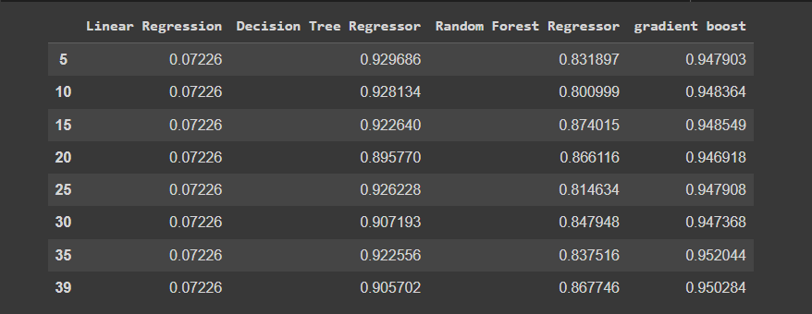
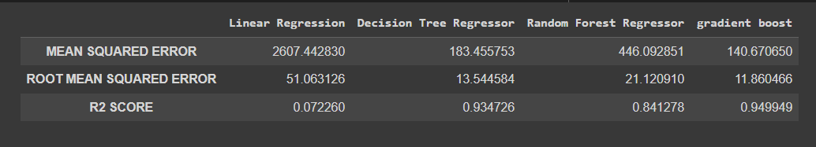
For Pack Price

Slide 11
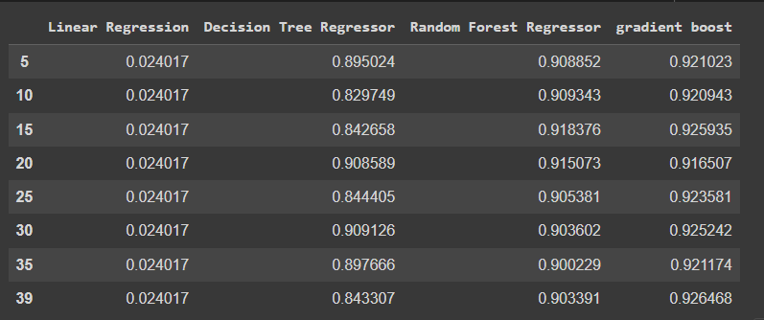
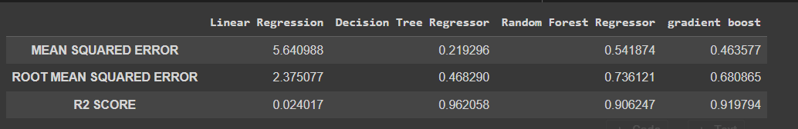
For Unit Price

Slide 12
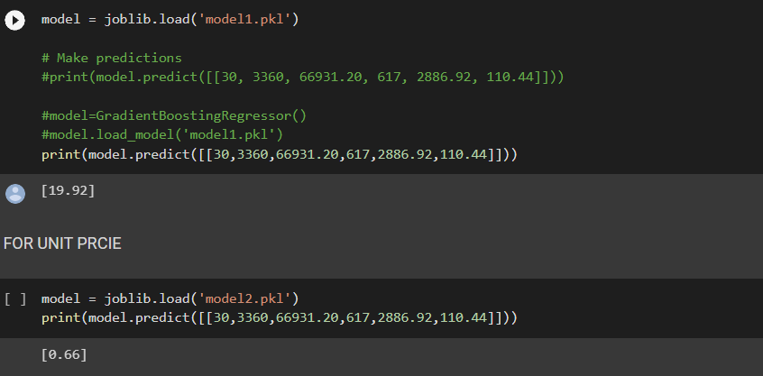
Loading the Model and output Shown
PREDICTED PACK PRICE
PREDICTED UNIT PRICE

Slide 13
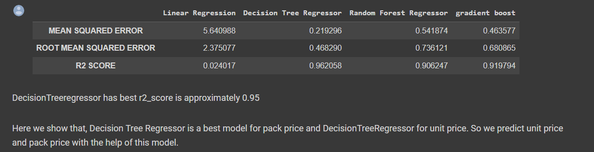
Conclusions
Decision Tree Regressor model has the best R2 score and gives around 95% accuracy in predicting the unit price and pack price.
While dealing with the large dataset Decision tree regressor and gradient boost regressor will give the highest accuracy scores and also are easy to tune the hyperparameters, assures smooth flow.

Slide 14
Contributions
Keval
Data Cleaning and Model Performance Optimization
Roshani
Report Writing and Literature Survey.
Deep
Data Preprocessing and Model Implementation
Aditya
Poster Presentation

Slide 15
References:
K. L. Keung, C. K. M. Lee and Y. H. Yiu, "A Machine Learning Predictive Model for Shipment Delay and Demand Forecasting for Warehouses and Sales Data," 2021 IEEE International Conference on Industrial Engineering and Engineering Management (IEEM), Singapore, Singapore, 2021, pp. 1010-1014, doi: 10.1109/IEEM50564.2021.9672946.B. Rieder, Engines of Order: A Mechanology of Algorithmic Techniques. Amsterdam, Netherlands: Amsterdam Univ. Press, 2020.
Jang, Hee-Seon & Chang, Tai-Woo & Kim, Seung-Han. (2023). Prediction of Shipping Cost on Freight Brokerage Platform Using Machine Learning. Sustainability. 15. 1122. 10.3390/su15021122.
Ubaid, Ayesha & Hussain, Farookh & Charles, Jon. (2020). Machine Learning-Based Regression Models for Price Prediction in the Australian Container Shipping Industry: Case Study of Asia-Oceania Trade Lane. 10.1007/978-3-030-44041-1_5.
https://www.kaggle.com/datasets/divyeshardeshana/supply-chain-shipment-pricing-data
https://www.kaggle.com/code/klmsathishkumar/shipping-cost-prediction/data

