Slide 1




Political Sentiment Analysis Using
Deep Learning
Presented By:
Name: Deep Patel(190303105018)
Jeel Patel (190303105064)
Pranav Pal (190303105493)
Supervised by:
Guide Name : Ms. Charmi Purohit

Slide 2
OUTLINE
Introduction
Literature Survey
Research Gap
Problem Statement
Tools and technologies
Methodology
Implementation
Classifiers
Political Sentiment Analysis
Conclusion & Future Work
Reference

Slide 3
Introduction
Emotion is one type of affect, other type of being mood, temperament and sensation. Emotions have been widely studied in psychology and in behavior sciences, as they are an important element of human nature. Our emotions influence every aspect of our lives, from how we connect with each other, to how we make decisions, to our health and well-being.
Extraction of emotions from text can be applied for deciding the human computer interaction which governs communication and many more. Emotions may be expressed by a person’s speech, facial expressions and text-based emotions respectively. Emotions may be expressed by one word or a bunch of words. Sentence level emotion detection method plays a crucial role to trace emotions or to search out the cues for generating such emotions.

Slide 4
Literature Review
Sl. No. | Paper Title | Journal with Year | Methods | Shortcomings
1 | Semantic-Emotion Neural Network for Emotion Recognition From Text | IEEE, 2019 | Emotion model | Identify a robust technique for extracting this contextual information from text.
2 | Classification Model To Determine The Polarity Of Movie Review Using Logistic Regression | IRJCS | Feature extraction and Classification using Machine learning approach | One drawback of feature extraction is that the new features generated are not interpretable by humans.
3 | Emotion Analysis: A Survey | IEEE, Manipal Uniersity , Jaipur | Analyze the human and machine interactions | Text emotion analysis introduces some challenges in our work in the sense that emotions and the ways to express these emotions are all subjective.
4 | EmoTxt: A toolkit for emotion recognition from text | IEEE, Uniersity of Bari | Measured using a tool which is developed | Tone can be difficult to interrupt and even more difficult to figure out in written words.
5
6
7
8
9
10

Slide 5
LITERATURE reVIEW
Sl no. | Paper Title | Journal with Year | Methods | Shortcomings
5 | A Corpus for Sentiment Analysis and Emotion Recognition for a Learning Environment | Technological Institute of Culiacan , Spain | Corpus Pre-Processing Transformation Classification Evaluation | Social organization may ask peoples opinion on current debates. All these information can be obtained from microblogging services and their opinions and many aspects of their life
6 | Emotion Recognition from Text Based on Automatically Generated Rules | American University of Beirut , Lebanon | Keyword based detection Learning based detection | A major issue identified is the necessity to propose a robust technique for extracting this contextual information from text.
7 | Emotion Detection From Text Documents | International Journal of Data Mining | Opinion mining | Sometimes it is not able to detect and recognize types of feelings through the expression of text.

Slide 6
Literature reView
Sl no. | Paper Title | Journal with Year | Methods | Shortcomings
8 | Text Based Emotion Recognition: A Survey | IEEE | Case-Based Reasoning And Emotion model | Ambiguity in Keyword Definitions Incapability of Recognizing Sentences without Keywords
9 | Sentiment Analysis of Twitter Data | Columbia University , New York | Create a twitter sentiment analysis model, Choose a model type, Decide what type of classification you’d like to do ,Import your twitter data. | It is difficult to analyze whether the given information Is fake or not.
10 | Sentiment Analysis Algorithms And Applications : A Survey | Ain Shams engineering journal | Opinion mining | The uses of hybrid methods are not yet frequent because its computational complexity is higher

Slide 7
Literature reView
Sl no. | Paper Title | Journal with Year | Methods | Shortcomings
11 | Survey on Aspect-Level Sentiment Analysis | IEEE | Opinion mining | Sarcasm emojis Idioms are difficult to identify.
12 | A survey on sentiment analysis challenges | Faculty of Computers and Information, Cairo University, Cairo, Egypt
13 | Music Sentiment and Stock Returns Around the World | Journal of Financial Economics (JFE), Forthcoming | Audio Valence | Combat negative sentiment by playing an upbeat song

Slide 8
Literature review
Sl no. | Paper Title | Journal With Year | Methods | Shortcomings
14 | Sentiment analysis: A combined approach | School of Computing and Information Technology, University of Wolverhampton Wulfruna Street | Multiple classifiers such as GIBC RBC SBC, etc. | Public services or political issues
15 | Sentiment analysis: A review and comparative analysis of web services | Department of Computer Science and Artificial Intelligence, University of Granada, 18071 Granada, Spain | Opinion mining | NLP techniques are always necessary to achieve good results.

Slide 9
Research Gap
The research gap which we have noticed is that the efficiency of the model is still in question and we are going to try to compare some of the algorithms and try to come up with an efficient model.

Slide 10
Problem Statement
In today’s internet world, human expresses their emotions , sentiments, feelings via text or comments, emojis, likes and dislikes . Understanding the true meanings behind these electronic text is very crucial. The available approaches are work in the direction of recognizing the polarity of sentiment. The sentiment maybe positive or negative. Among the less explored sentiment areas is the recognition of types of emotions from text documents. Recognizing emotions conveyed by a text can provide an insight into the author’s intent and may lead to better understanding of the text’s content.

Slide 11
Tools and technologies
Python
Colab
Natural Language Processing
Deep Learning Algorithms such as LSTM, CNN, SNN
Pycharm
SnScrape for tweets

Slide 12
Methodology
Keyword-based Method:
This method checks the related keyword from the emotional database. If no related keywords are found, it gives a simple message.
For example,
Happy, Courageous, Excited… etc – These words are positive in nature thus in the pre-downloaded data will have polarity of greater than 0.5 associated with it.
Disgusting, Sad… etc – These words are negative in nature thus polarity of less than 0.5 is associated with it.

Slide 13
Implementation
The steps are as follows:
Step 1: Loading the dataset
Step 2: Data preprocessing, removing punctuations, stop words, lowercase
Step 3: Convert words into tokens and create a matrix
Step 4: Split the data into training and testing and train the model
Step 5: Compare the accuracies

Slide 14
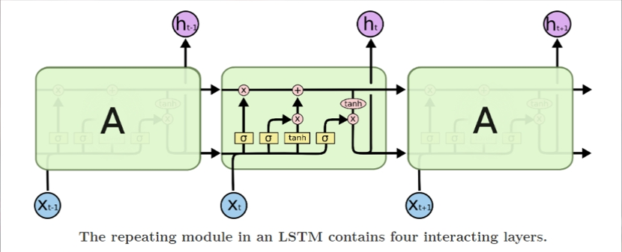
Classifiers
Long Short Term Memory
Long Short Term Memory Networks – usually just called as LSTMs are special kind of RNN , capable of learning long term dependencies.
The core concept of LSTMs are the cell state, and it’s various gates. The cell state act as a transport highway that transfers relative information all the way down to sequence chain.

Slide 15
Classifiers
Sigmoid
Instead of squishing values between -1 and 1, it squishes between 0 and 1 which is helpful to update or forget data.

Slide 16
classifiers
Forget Gate
This gate decides which information should be kept and which to be thrown out.

Slide 17
classifiers
Input gate You also pass the hidden state and current input into the tanh function to squish values between 1 and -1 to help regulate the network Then you multiply the tanh output with the sigmoid output. The sigmoid output will decide which information is important to keep from the tanh output. | Cell State Then we take the output from the input gate and do a pointwise addition which updates the cell state to new values that the neural network finds relevant. That gives us our new cell state.

Slide 18
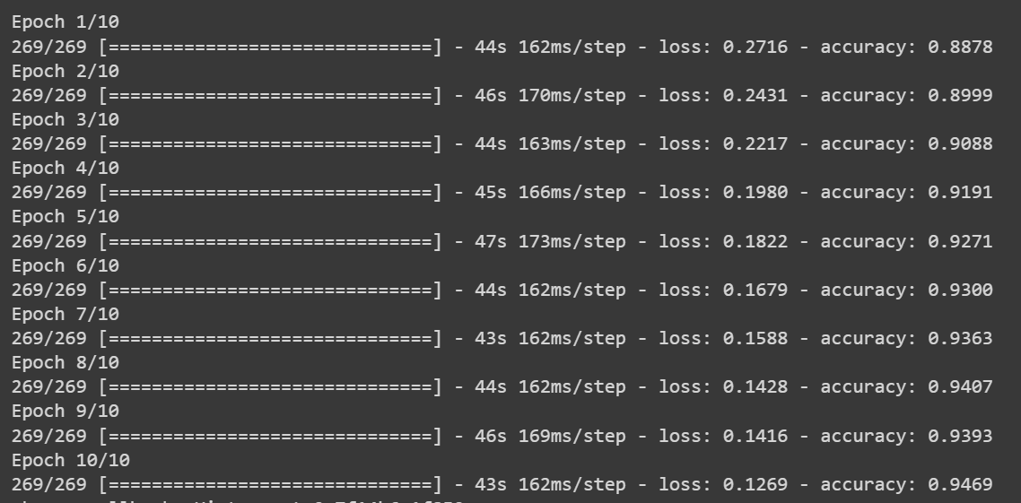
classifiers
LSTM EPOCHS

Slide 19
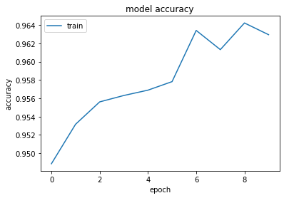
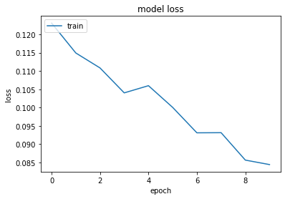
classifiers

Slide 20
classifiers
Convolutional Neural Network
Convolutional Neural Network is a deep, feed-forward artificial neural networks and use a variation of multilayer perceptron.
It contains one or more convolutional layers which uses a convolution operation to the input passing the result to the next layer.
Text as sequence is passed to a different layers in CNN.
CNN can achieve outstanding performance without knowledge of words, phrases, sentences.

Slide 21
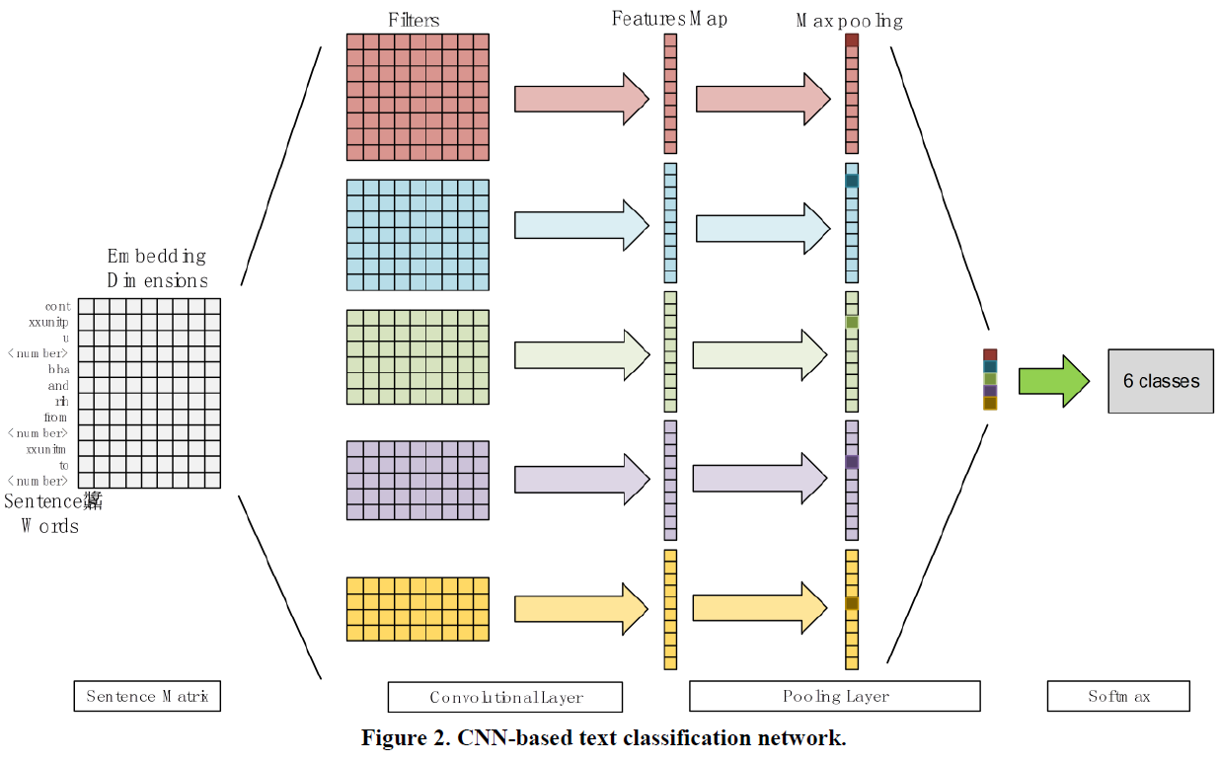
classifiers

Slide 22
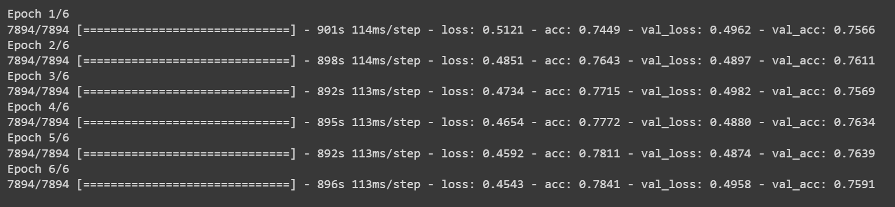
classifiers
CNN EPOCHS

Slide 23
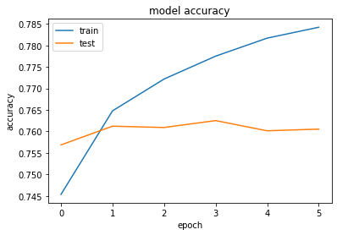
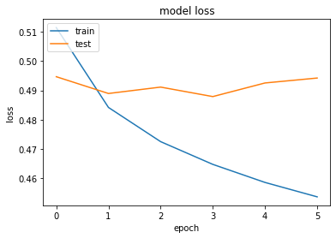
classifiers

Slide 24
classifiers
Summary of all Algorithms
Upon training all three models, we found out that LSTM has the best training accuracy. Here is the comparison table.
Classifier | Training Accuracy | Validation Accuracy
LSTM | 94.56% | 0
CNN | 78.41% | 75.91%
SNN | 69.52% | 70%

Slide 25
Political sentiment analysis
Steps for implementing the trained model in a political context are as follows:
Step 1: Use SnScrape to fetch retweets for a specific candidates during the time of election.
Step 2: Processing the tweets using the same function we used to clean the training data while creating the model
Step 3: We use the pre-trained model to predict the sentiment for a list of clean retweets posted by users.
Step 4: Average the polarity of retweets and compare the two, whichever candidate has higher polarity which will be between 0 and 1, is more likely to be on the positive side in common peoples mind.

Slide 26
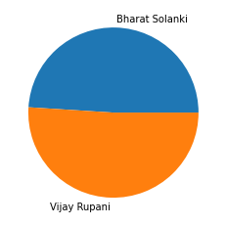
POLITICAL SENTIMENT ANALYSIS
For testing sample, we took the data of 2017’s Gujarat Legislative Assembly Election in which there were two candidates Mr. Vijay Rupani (BJP) and Mr. Bharat Solanki.
In this election, BJP won with a slightly more seats and when our model predicted the sentiments of the people towards these politicians, it was seen that Mr. Vijay Rupani had a slightly more polarity of 0.51 where as Mr. Bharat Solanki had a polarity of 0.49.

Slide 27
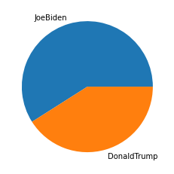
POLITICAL SENTIMENT ANALYSIS
Similarly, we took the data of 2020’s US Presidential Election in which there were two candidates Mr. Joe Biden(Democratic) and Mr. Donald Trump(Republican).
In this election, Democrates won with more seats and when our model predicted the sentiments of the people towards these politicians, it was seen that Mr. Joe Biden had a slightly more polarity of 0.59 where as Mr. Donald Trump had a polarity of 0.41.

Slide 28
Conclusion & Future Work
Conclusion -
In the era of the rapid development of social network and internet of things, it is very meaningful to explore the emotional recognition of user-generated data through technology. In our project, we have implemented emotion recognition method from text, based on the network which consists of CNN, LSTM, SNN algorithm. A novel model is implemented and applied on real-world datasets. In the experimental work, we have conducted the realtime data and offline datasets and then analyzed using the 3 classification machine learning and deep learning models. Experiments on emotionally related datasets shows that our method can achieve better performances compared with baseline methods. Our framework is general enough to be applied to more scenarios. Experiments proved that human emotion recognition is a challenge due to the subjectivity of language and phenomena such as irony or sarcasm.
Future Work –
In the future works, we will extend this emotion encoding to other tasks such as affective computing and sentiment analysis. It is possible to improve the performance of this model by using the larger emotion word embeddings. In future, this method can be develop to find emotion like skepticism, hope, anxiety, excitement, sarcasm.

Slide 29
References
[1] Chetan R. Chopade. Text based emotion recognition: A survey. International Journal of Science and Research (IJSR), 2013.
[2] M. Li E. Batbaatar and K. H. Ryu. Semantic-emotion neural network for emotion recognition from text. IEEE Access, 2019.
[3] F. Lanubile F. Calefato and N. Novielli. In EmoTxt: A toolkit for emotion recognition from text, 2017.
[4] Mahira Kirmani Mudasir mohd Nida Manzoor Hakak, Mohsin Mohd. Emotion Analysis: A Survey. International Conference on Computer, Communications and Electronics
(Comptelix)Manipal University Jaipur, Malaviya National Institute of Technology Jaipur and IRISWORLD, 2017.
[5] Dr. Ashok Kumar R Priyanka H S, Ramya B V. Classification model to determine the polarity of movie review using logistic regression. International Research Journal of Computer Science (IRJCS), 2019.
[6] R. Zatarain-Cabada R. Oramas-Bustillos, M. L. Barron-Estrada and S. L. Ram´ırez-Avila. A corpus for sentiment analysis and´ emotion recognition for a learning environment. 2018.
[7] H. Hajj S. Shaheen, W. El-Hajj and S. Elbassuoni. Emotion recognition from text based on automatically generated rules. IEEE International Conference on Data Mining Workshop, 2014, 2014.
Chetan R. Chopade. Text based emotion recognition: A survey. International Journal of Science and Research (IJSR), 2013
[9] Agarwal, A., Xie, B., Vovsha, I., Rambow, O. and Passonneau, R.J., 2011, June. Sentiment analysis of twitter data. In Proceedings of the workshop on language in social media (LSM 2011) (pp. 30-38).
[10]Medhat, W., Hassan, A. and Korashy, H., 2014. Sentiment analysis algorithms and applications: A survey. Ain Shams engineering journal, 5(4), pp.1093-1113.

Slide 30
References
[11]Schouten, K. and Frasincar, F., 2015. Survey on aspect-level sentiment analysis. IEEE Transactions on Knowledge and Data Engineering, 28(3), pp.813-830.
[12]Hussein, D.M.E.D.M., 2018. A survey on sentiment analysis challenges. Journal of King Saud University-Engineering Sciences, 30(4), pp.330-338.
[13]Edmans, A., Fernandez-Perez, A., Garel, A. and Indriawan, I., 2021. Music sentiment and stock returns around the world. Journal of Financial Economics.
[14]Prabowo, R. and Thelwall, M., 2009. Sentiment analysis: A combined approach. Journal of Informetrics, 3(2), pp.143-157.
[15]Serrano-Guerrero, J., Olivas, J.A., Romero, F.P. and Herrera-Viedma, E., 2015. Sentiment analysis: A review and comparative analysis of web services. Information Sciences, 311, pp.18-38.

Slide 31
Thank you

