Slide 1
MSREN Web-chat application
Name:- Deepak
Roll no:- CSE-19/034
Branch:- B.Tech (CSE)

Slide 2

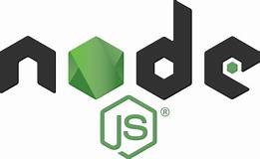

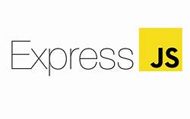

What the name suggest MSREN ?
MSREN means >> MongoDB
>> Socket.io
>> React.JS
>> Express.JS
>> Node.JS

Slide 3

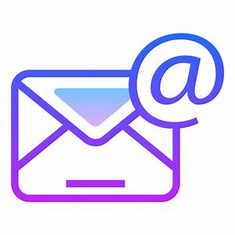

Requirements for this
You must have Internet Connection.
You know your Email for this.
This wants a Browser for run this.

Slide 4
Important things about THIS
UI is awesome
You need to LOGIN first.
When you come back day after tomorrow then you will saw you don’t need to login again.
Browser will login you automatically after first login
This project remember you life long

Slide 5
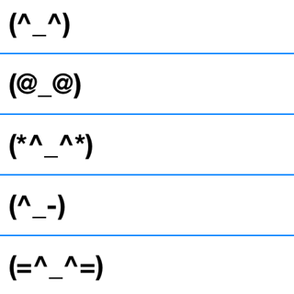

Chat with EMOJI’s
We use emoji’s in this for chat
When you write character something like emoji, then you see after clicking SEND button it will automatically change to real emoji
If you don’t know about emoji’s characters then you will also use emoji’s just by click of a button

Slide 6
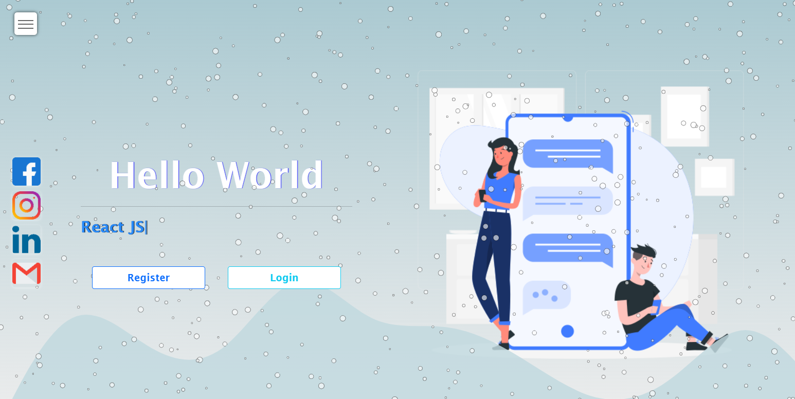
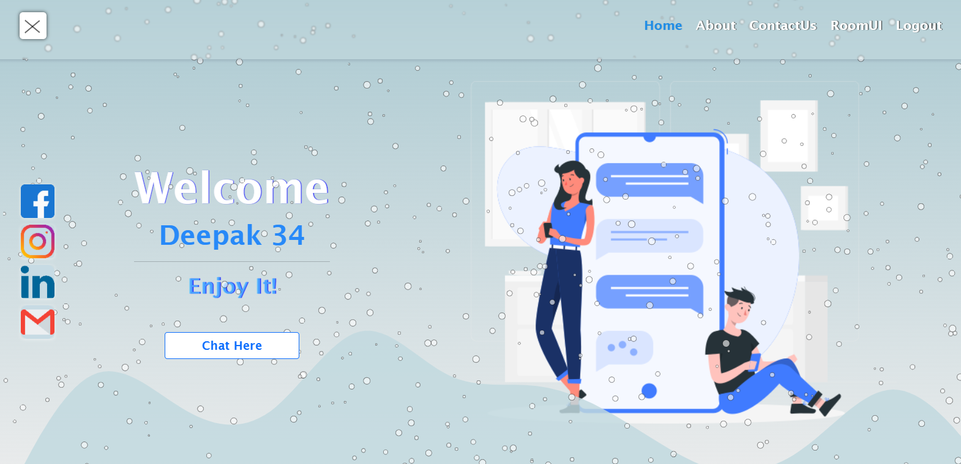
Home Page

Slide 7
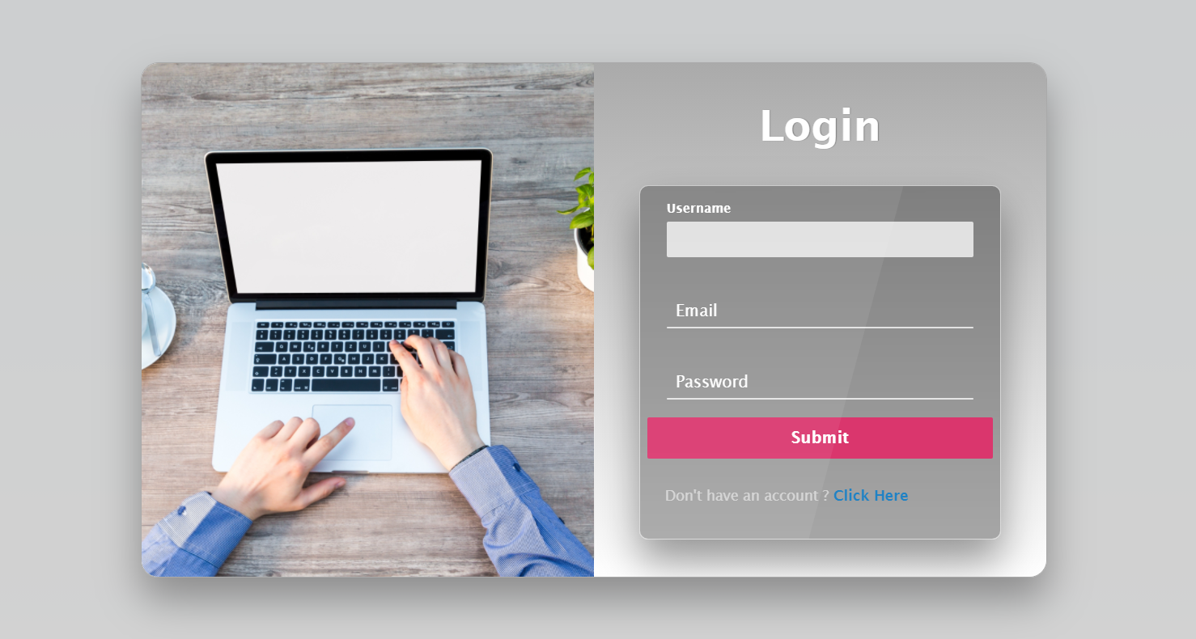

Slide 8
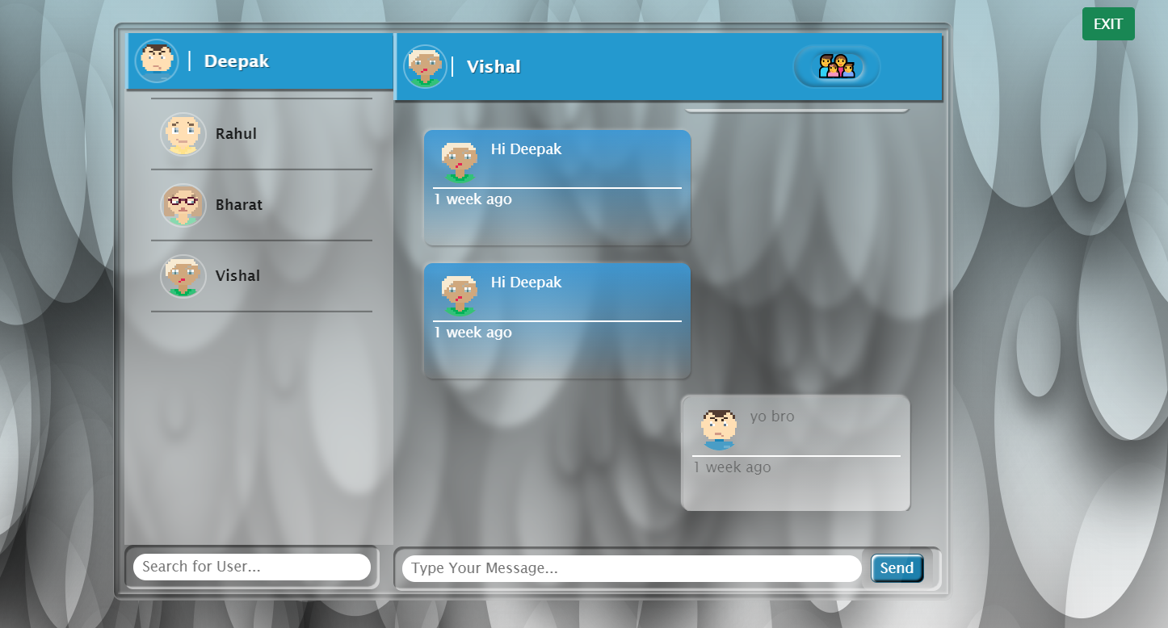
Room UI

Slide 9
_________________________________________
ANY QUERY ??
_________________________________________

Slide 10
______________________
Thank you
______________________

