Slide 1
Towards an Ecosystem for Verifying Implementations of BFT protocols
Ivana Vukotic, Vincent Rahli, Marcus Völp and Paulo Esteves-Veríssimo
Univ. of Luxembourg SnT
Luxembourg
<name>.<surname>@uni.lu
http://wwwen.uni.lu/snt/research/critixv
Supported by the SnT and the National Research Fund Luxembourg (FNR), through PEARL grant FNR/P14/8149128
DeepSpec 2018
Ivana Vukotic
An Ecosystem for Verifying Implementations of BFT protocols
DeepSpec 2018

Slide 2
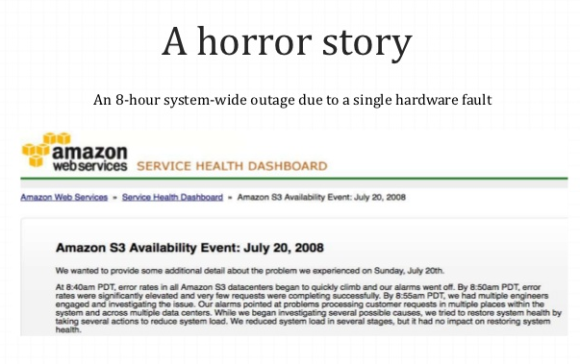
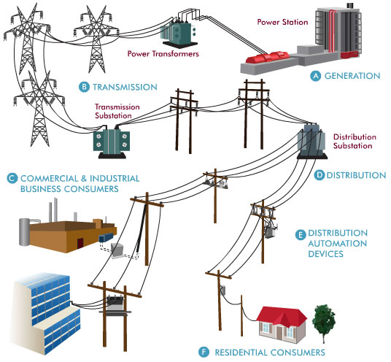
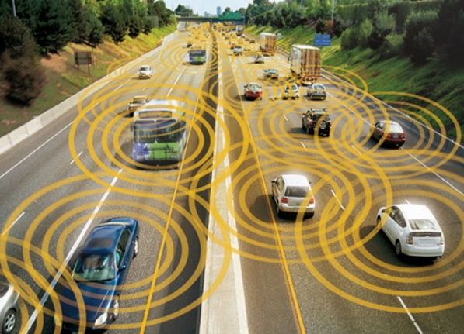


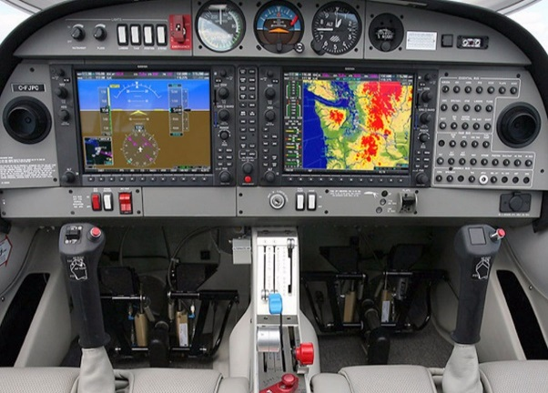

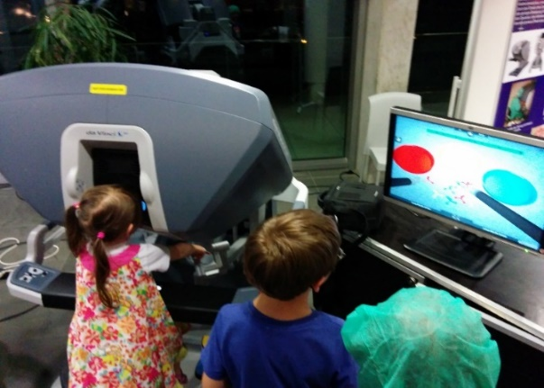
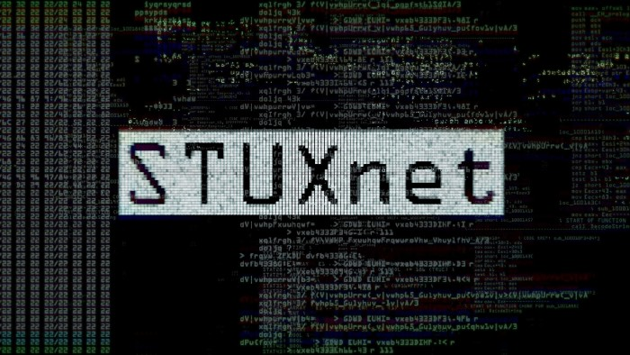
Critical information infrastructure
Testing?
Verification?
Ivana Vukotic
An Ecosystem for Verifying Implementations of BFT protocols
DeepSpec 2018

Slide 3
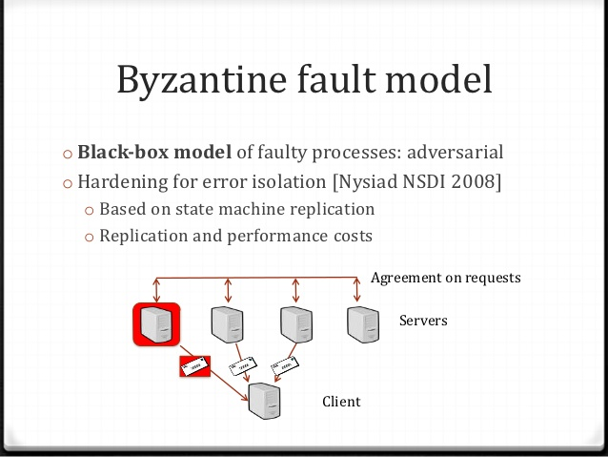


BFT-SMR
There is NO lunch for free!
Very complex
No formal specification
No implementation
Ivana Vukotic
An Ecosystem for Verifying Implementations of BFT protocols
DeepSpec 2018

Slide 4

Our Goal
BFT
Formal tools
Ivana Vukotic
An Ecosystem for Verifying Implementations of BFT protocols
DeepSpec 2018

Slide 5

Velisarios
Velisarios
Coq
OCaml
BFT model
PBFT implementation
Runtime envinronment
Model of Byzantine faults
Model of distributed knowledge
Safety
(agreement)
Automation
Ivana Vukotic
An Ecosystem for Verifying Implementations of BFT protocols
DeepSpec 2018

Slide 6



Lines of Research for my PhD
SGX
SGX
Hybrid protocols
SGX
State transfer and rejuvenation
Ivana Vukotic
An Ecosystem for Verifying Implementations of BFT protocols
DeepSpec 2018

