Slide 1

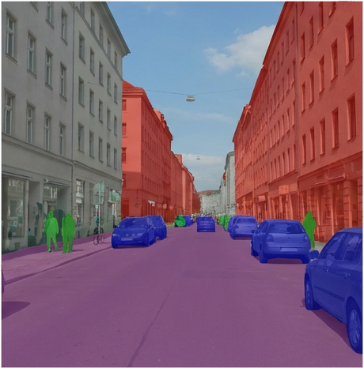
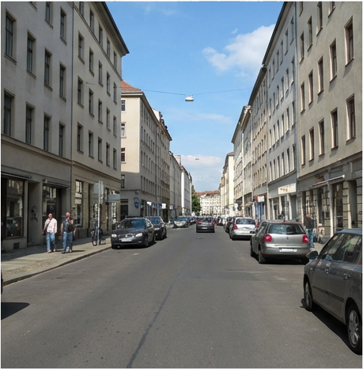
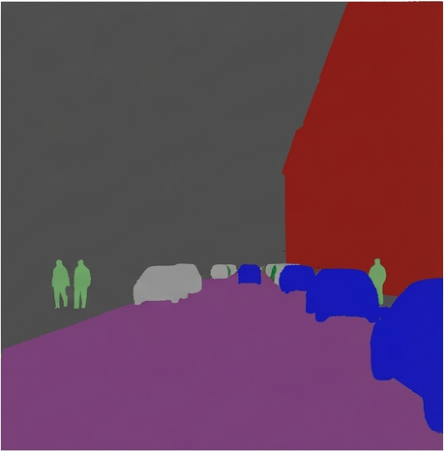
L_cls
Classification Head
L_ce
Segmentation Decoder
Patch Embedding (Small Patches)
Localization Token
SegFormer Backbone
Adapter Module
Patch Clustering
Memory Bank
Pseudo-label Generator

