Slide 1
Fox Adventure

Slide 2
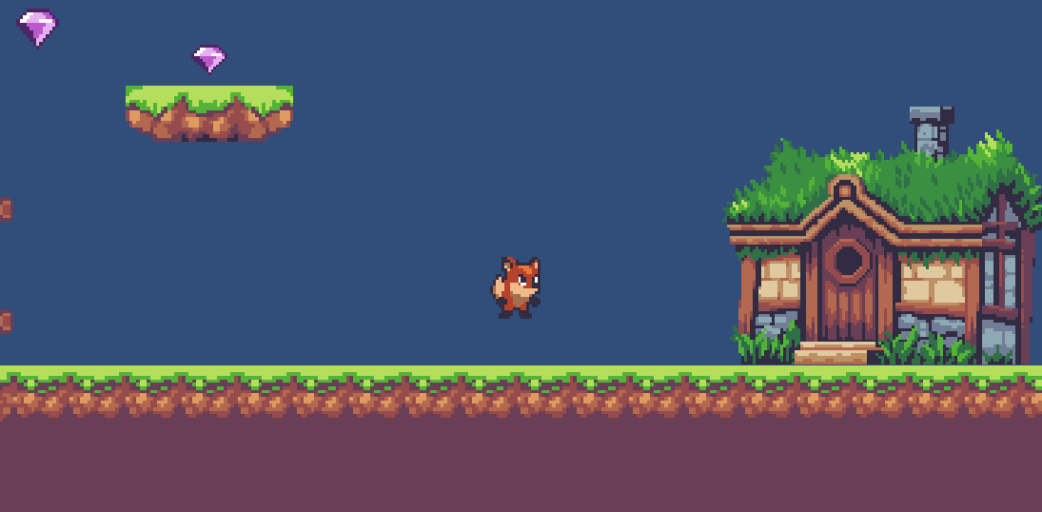
Game concept
Fox Adventure is 2D game where you can dive directly in the special amazing environment. The game contains multiple levels that the player can explore. A player controls the Fox and can travel around the locations finding different objects such as gems and mushrooms.

Slide 3
Game mechanics
Player movement (allows user to control the fox's movement that includes jumping and left/right moving)
Gem collecting (the fox can automatically gather gems that are close enough to its position)
Color changing (sometimes you can find special mushrooms that are able to change the color of your fox)
Level changing (fires if the fox is near her house with all gems collected)

Slide 4
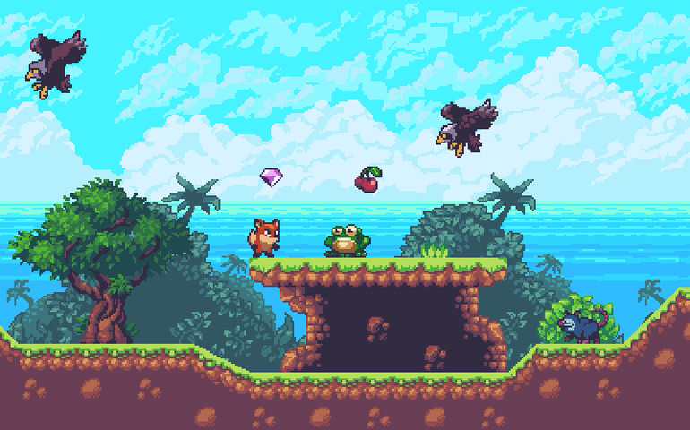
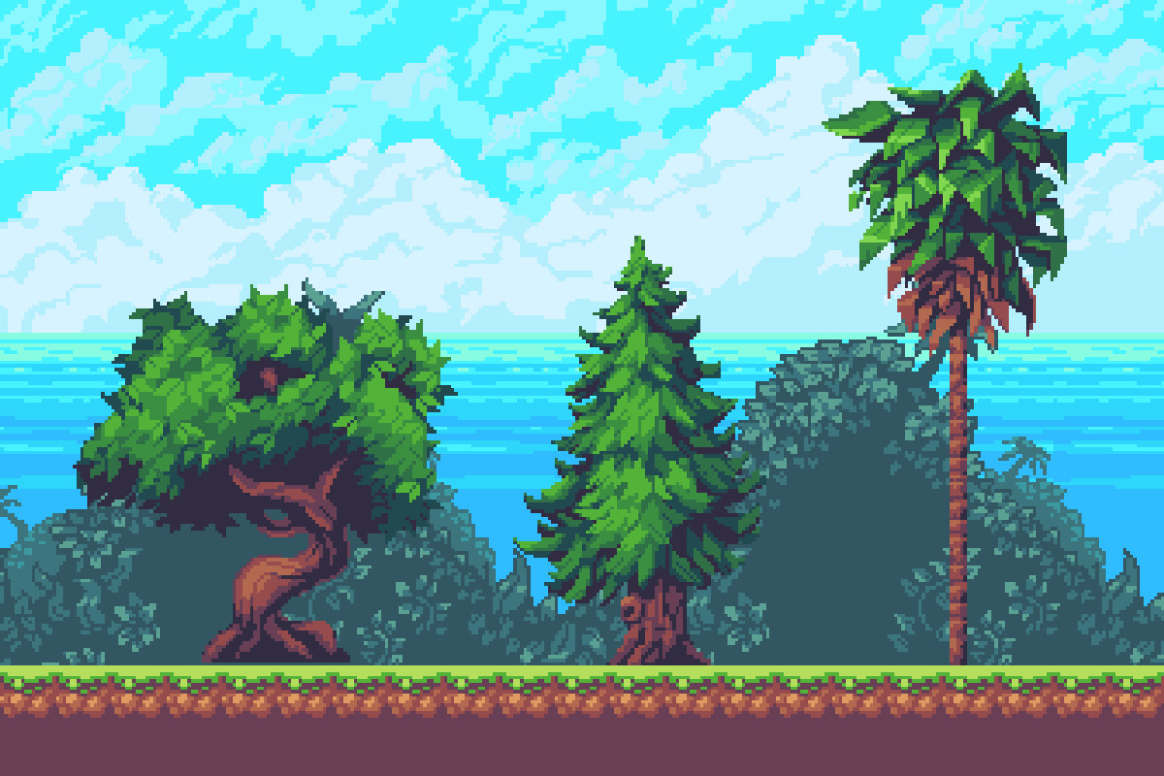
design

Slide 5
Gameplay
Core Gameplay | Meta Gameplay
Movement | Unique levels
Collecting gems | Finding hidden items
Changing colors
Teleportation

Slide 6

monetization
Banner Ads (annoying, easy to implement)
Expandable Ads (less annoying, user's choice to open)
Ads as a reward (effective, integrated into the gameplay)
Game Ads (the user gets a list of related games he might be interested in)
Game exit Ads (one last full size ad)

