Slide 1
A Comparative Study and Tool to Early Predict Diabetes using Various Machine and Deep Learning Based Techniques (DDCIOT -41)
Ms. Shrusti Porwal , Ms. Deepa Tilwani, Mr. Shrikrishn Bansal
(Research Scholars, The LNM Institute of Information Technology, Jaipur)
Mr. Chintal Kumar Patel
(Assistant Professor , Geetanjali Institute of Technical Studies, Udaipur)

Slide 2
Introduction:
Diabetes is a disease that occurs when your blood glucose, also called blood sugar, is too high.
Over time, having too much glucose in your blood can cause health problems.
The different types of diabetes:
Type 1
Type2
Gestational diabetes

Slide 3
How common is diabetes?
Introduction Continued…
Introduction Continued…
One in six people with diabetes in the world is from India.
India comes among the top 10 countries for people with diabetes.
As of 2015, 30.3 million people in the United States.
Diabetes affects 1 in 4 people over the age of 65.
About 90-95 percent of cases in adults are type 2 diabetes.

Slide 4
What health problems can people with diabetes develop?
Introduction Continued…
Over time, high blood glucose leads to problems such as
heart disease
stroke
kidney disease
eye problems
dental disease
nerve damage
foot problems

Slide 5
Related Pervious Work:
Algorithm Used:
Decision Tree,
Support Vector Machine
Naive Baye
Random Forest (RF) Algorithm
Logistic Regression (LR) Algorithm
Dataset Used :
Early stage diabetes risk prediction dataset. (UCI Dataset)
This has been collected using direct questionnaires from the patients of Sylhet Diabetes Hospital in Sylhet, Bangladesh and approved by a doctor.
Accuracy:70-90%

Slide 6
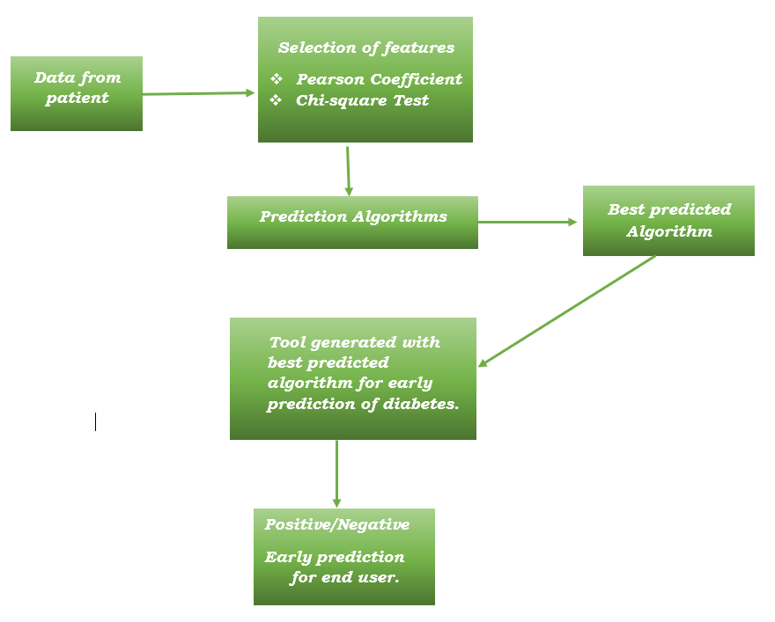
Methodology :

Slide 7
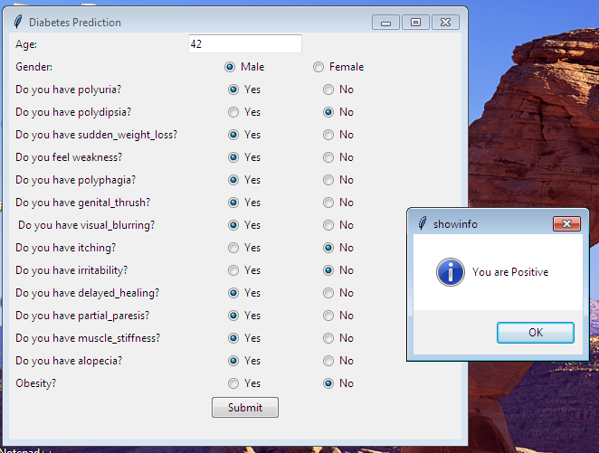
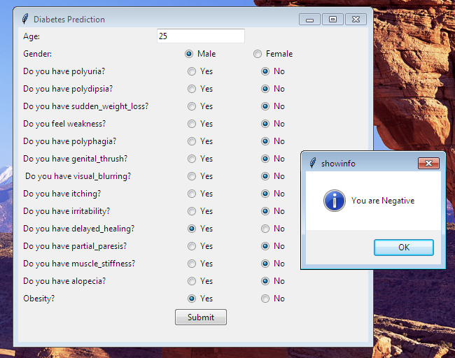
Tool Snapshots:

Slide 8
Algorithms Compared in our study:
Support vector machine (SVM)
Naive Bayes
Logical Regression
Decision Tree
XGBoost
Random forest
KNN
ANN

Slide 9
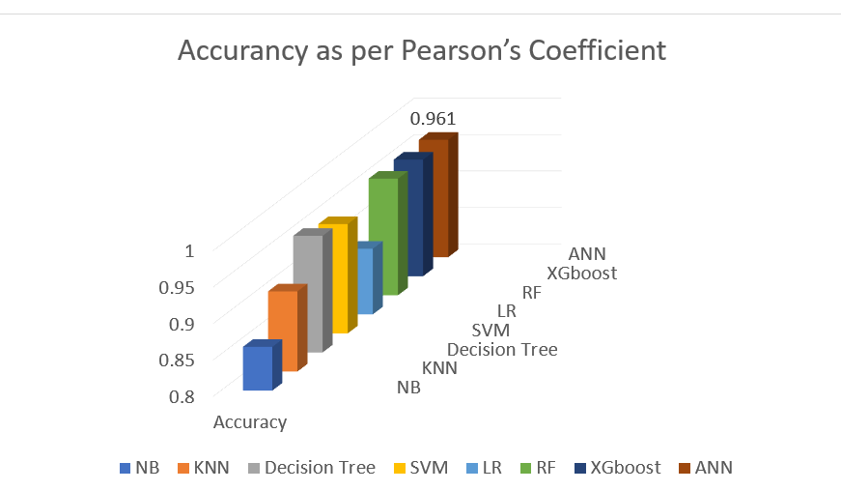
Results:
Pearson’s Coefficient Features Results:
Performance parameters | Class | NB | KNN | Decision Tree | SVM | LR | RF | XGboost | ANN
F- score measure | Positive Negative Weighted | 0.81 0.88 0.86 | 0.93 0.89 0.91 | 0.97 0.95 0.96 | 0.96 0.93 0.95 | 0.92 0.86 0.89 | 0.97 0.95 0.96 | 0.97 0.95 0.96 | 0.971
Recall | Positive Negative Weighted | 0.86 0.84 0.84 | 0.91 0.92 0.91 | 0.97 0.95 0.96 | 0.98 0.89 0.95 | 0.91 0.87 0.89 | 0.97 0.95 0.96 | 0.97 0.95 0.96 | 0.971
Precision | Positive Negative Weighted | 0.90 0.78 0.86 | 0.95 0.85 0.92 | 0.97 0.95 0.96 | 0.94 0.97 0.95 | 0.92 0.85 0.89 | 0.97 0.95 0.96 | 0.97 0.95 0.96 | 0.971
Accuracy |  | 0.86 | 0.91 | 0.96 | 0.95 | 0.89 | 0.96 | 0.96 | 0.961

Slide 10
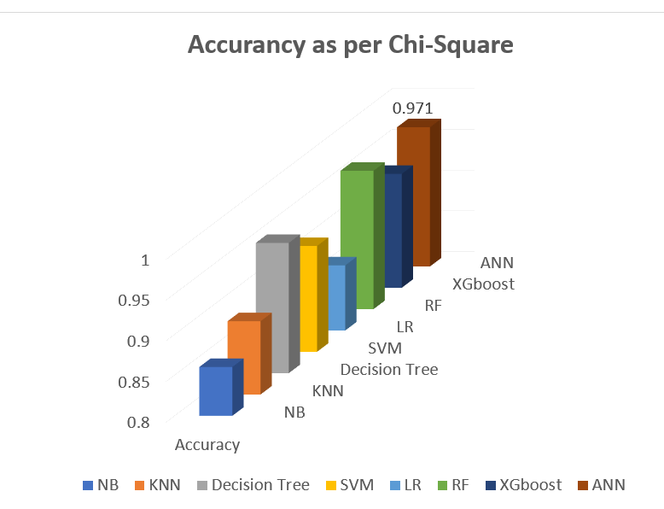
Chi-Square Features results :
Results Continued…
Performance parameters | Class | NB | KNN | Decision Tree | SVM | LR | RF | XGboost | ANN
F- score measure | Positive Negative Weighted | 0.88 0.81 0.86 | 0.91 0.86 0.90 | 0.97 0.95 0.96 | 0.95 0.91 0.93 | 0.91 0.85 0.89 | 0.98 0.96 0.97 | 0.96 0.92 0.94 | 0.979
Recall | Positive Negative Weighted | 0.86 0.84 0.86 | 0.88 0.92 0.89 | 0.98 0.92 0.96 | 0.95 0.89 0.93 | 0.89 0.87 0.88 | 0.98 0.95 0.97 | 0.97 0.89 0.94 | 1.0
Precision | Positive Negative Weighted | 0.90 0.78 0.86 | 0.95 0.81 0.90 | 0.96 0.97 0.96 | 0.94 0.92 0.93 | 0.92 0.82 0.89 | 0.97 0.97 0.97 | 0.94 0.94 0.94 | 0.959
Accuracy |  | 0.86 | 0.89 | 0.96 | 0.93 | 0.88 | 0.97 | 0.94 | 0.971

Slide 11
References:
1. Priyanka Sonar and Prof. K. JayaMalini (2019), “Diabetes Prediction Using Different Machine Learning Approaches”, IEEE Xplore Part Number: CFP19K25-ART; ISBN: 978-1- 5386-7808-4.
2. Abdullah A.Aljumah, Mohammed Gulam Ahamad and Mohammad Khubeb Siddiqui (2013),”Application of data mining: Diabetes health care in young and old patients”, Journal of King Saud University - Computer and Information Sciences, Volume 25, Issue 2, July 2013, Pages 127-136.
3. Lejla Alic, Hasan T. Abbas, Marelyn Rios, Muhammad AbdulGhani, and Khalid Qaraqe (2019), “Predicting Diabetes in Healthy Population through Machine Learning”. 2372- 9198/19/$31.00 ©2019 IEEE.
4. M. M. Faniqul Islam, Rahatara Ferdousi, Sadikur Rahman and Humayra Yasmin Bushra (2020), “Likelihood Prediction of Diabetes at Early Stage Using Data Mining Techniques”, Springer, Singapore.10.1007/978-981-13-8798-2_12.
5. C. R. Rao (2002), “Karl Pearson Chi-Square Test the Dawn of Statistical Inference”, 10.1007/978-1-4612-0103-8_2, ISBN978-1-4612-6613-6
6. Mohammed Chaouki Abounaima; Fatima Zahra El Mazouri; Loubna Lamrini; Najib Nfissi; Noureddine El Makhfi and Mohamed Ouzarf (2020), “The Pearson Correlation Coefficient Applied to Compare Multi-Criteria Methods: Case the Ranking Problematic”, 10.1109/IRASET48871.2020.9092242 ©2020 IEEE.
7. Vasileios Tsoukas, Konstantinos Kolomvatsos, Vasileios Chioktour and Athanasios Kakarountas (2019), “A Comparative Assessment of Machine Learning Algorithms for Events Detection”, 10.1109/SEEDA-CECNSM.2019.8908366 Piraeus,©2019 IEEE.
8. Susmita Ray (2019), “A Quick Review of Machine Learning Algorithms”, ISBN: 978-1- 7281-0212-2, 10.1109/COMITCon.2019.8862451, Faridabad india, ©2019 IEEE.
9. Nabila Shahnaz Khan, Mehedi Hasan Muaz, Anusha Kabir and Muhammad Nazrul Islam (2017), “Diabetes Predicting mHealth Application Using Machine Learning”, WIECONECE, 978-1-5386-2621-4/17/$31.00 ©2017 IEEE. 10. Deepti Sisodia and Dilip Singh Sisodia (2018), “Prediction of Diabetes using Classification Algorithms”, ICCIDS, 10.1016/j.procs.2018.05.122, 132 (2018) 1578–1585.
11. Choubey, D.K., Paul, S., Kumar, S. and Kumar, S., (2017), “Classification of Pima Indian diabetes dataset using naive bayes with genetic algorithm as an attribute selection”, Communication and Computing Systems: Proceedings of the International Conference on Communication and Computing System (ICCCS 2016), pp. 451–455.
12. Orabi, K.M., Kamal, Y.M., Rabah and T.M. (2016), “Early Predictive System for Diabetes Mellitus Disease”, Industrial Conference on Data Mining, Springer. Springer. pp. 420– 427.
13. Tiebin Liu, Rodolfo Valdez, Marta Gwinn and Muin J Khoury (2010), “Application of support vector machine modeling for prediction of common diseases: The case of diabetes and pre-diabetes” BMC Medical Informatics and Decision Making 10. DOI:10.1186/1472- 6947-10-16, arXiv:arXiv:1011.1669v3.
14. Ioannis Kavakiotis, Olga Tsave, Athanasios Salifoglou, Nicos Maglaveras, Ioannis Vlahavas and Ioanna Chouvarda (2017), “Machine Learning and Data Mining Methods in Diabetes Research”, Computational and Structural Biotechnology Journal 15, 104–116. DOI:10.1016/j.csbj.2016.12.005.

Slide 12
Thank You! QUESTIONS…??

