Slide 1
KameKazi
The secure messenger

Slide 2
What it does?
KameKazi is a project that allows you to send secure messages.
Each message receives a completely unique ID and is encrypted, so absolutely nobody can see the message without the key, not even with access to the database.
All messages are destroyed as soon as the receiver opens them.

Slide 3
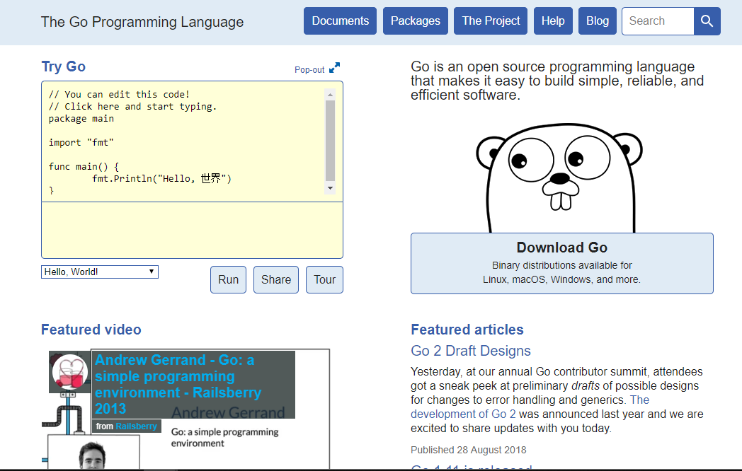
What language it has been written in?
Golang
https://golang.org/

Slide 4
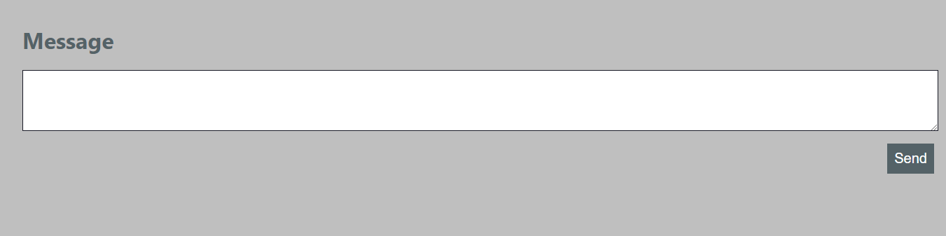
How it works
You open this webpage : https://kamekazi-169920.appspot.com
It opens something like this :
Enter your message in there
and click send.

Slide 5
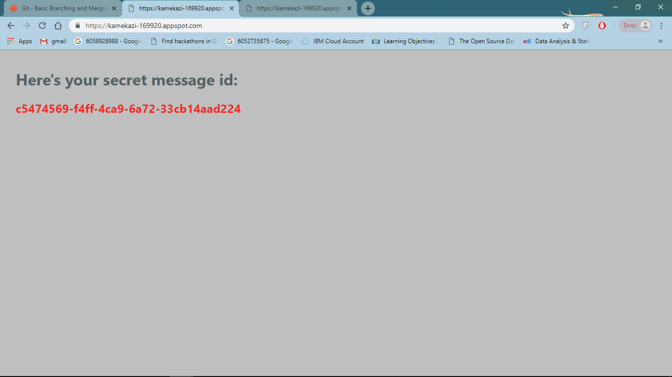
It leads to this page:
Copy the red code(copy address link) and share with the recipient.
They will see the message and as son as they close the tab the message gets removed from our servers.
Give it a try at : https://kamekazi-169920.appspot.com/

Slide 6
Thank You

