Slide 1
DIGITALIZED PAPER CORRECTION USING OPENCV
TEAM MEMBER:DEEPAVARSHNI.K
REG NO:211418104044
PROJECTGUIDE: Dr.L.Jabasheela

Slide 2
INTRODUCTION
In this system I proposed a paper correction format in digitalized way using opencv.
The system needs the answer paper in image format and then it makes correction out of it to give the score.
The user needs to enter the answer and also the answers written by the student should be highlighted inside a box.

Slide 3
OVERVIEW
Nowadays everything has become digitalized.In this system I have proposed a concept to detect the handwritten text and to verify whether the solution written by the student is correct or not.
I have used HTR concept to first detect the answers written by the student and compare to with the answers given by the staff.
Handwriting text recognition (HTR) is that the process of adjusting handwritten characters or phrases into a format that the system understands. It's a vigorous network of educational researchers studying it for the past few years as advances during this subject help to automate differing kinds of habitual tactics and job work.

Slide 4
LITERATURE SURVEY
SOURCE | TITLE | ALGORITHMS | FINDINGS
Shilpa Mangesh Pande, Bineet Kumar Jha, | Character Recognition System for Devanagari Script Using Machine Learning Approach | Proposes various machine learning classifiers like Decision Tree classifier | 2021
Naragudem Sarika, Nageswararao Sirisala, Muni Sekhar Velpuru | CNN based Optical Character Recognition and Applications | To translate text in a picture into text format, the Optical Character Recognition system is employed. | 2021
Daniyar Nurseitov, Kairat Bostanbekov, Maksat Kanatov | Classification of handwritten names of cities and Handwritten text recognition using various deep learning models | The first model uses deep convolutional neural networks (CNNs) for feature extraction and a totally connected multilayer perceptron neural network (MLP) for word classification | 2021

Slide 5
Daniyar Nurseitov, Kairat Bostanbekov, Maksat Kanatov, Anel Alimova, Abdelrahman Abdallah, Galymzhan Abdimanap | Classification of Handwritten Names of Cities and Handwritten Text Recognition using Various Deep Learning Models | The first model uses deep convolutional neural networks (CNNs) for feature extraction and a fully connected multilayer perceptron neural network (MLP) for word classification | 2021
R. Reeve Ingle, Yasuhisa Fujii, Thomas Deselaers, Jonathan Baccash, Ashok C. Popat | A Scalable Handwritten Text Recognition System | We describe our image data generation pipeline and study how online data is wont to build HTR models | 2021

Slide 6
PROBLEM STATEMENT
To accurately predict the text from a scanned handwritten text image using Machine Learning algorithms.
For this we need to assume that all the images that contain same letters have same features and we can conclude that an image having those features contains that alphabet.
The problem convert a handwritten text which is in the form of pixels into its digital for is a data driven approach. The data which is already collected can be used for extracting the features of each letter. The availability of more powerful machine learning algorithms introduces an efficient and better approach to solve this problem.

Slide 7
DEVELOPMENT ENVIRONMENT
3.4 HARDWARE ENVIRONMENT
OS-Windows 10
RAM-4.00 GB
ProcessorIntel(R) Core(TM) i3-2328M CPU @ 2.20GHz
SOFTWARE ENVIRONMENT
Pycharm IDE

Slide 8
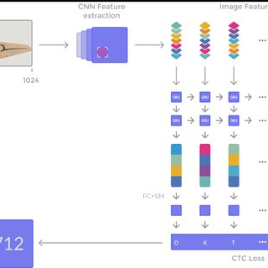
ARCHITECTURAL DIAGRAM

Slide 9
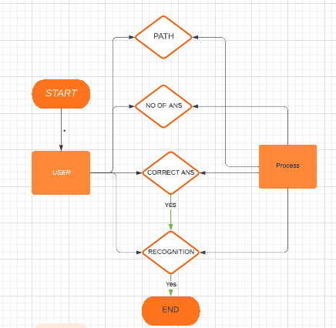
ENTITY DIAGRAM

Slide 10
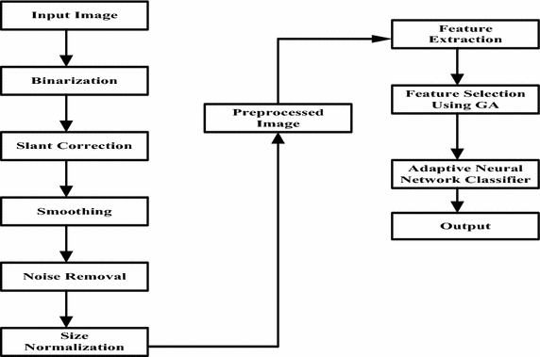
SYSTEM FLOW DIAGRAM

Slide 11
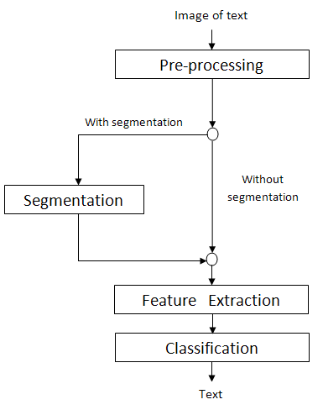
ACTIVITY DIAGRAM

Slide 12
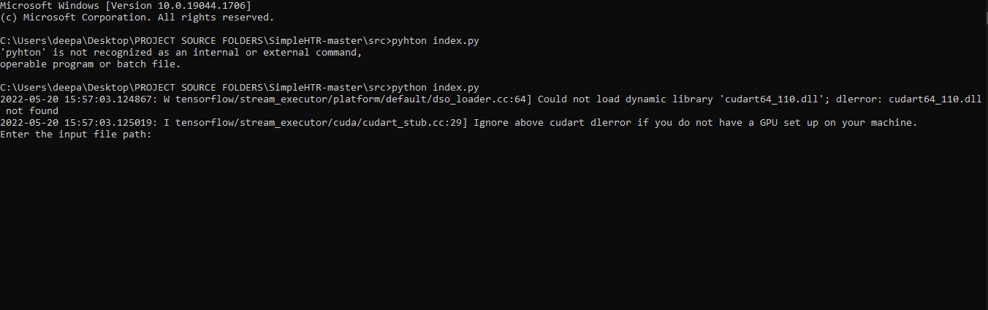
MODULE DESCRIPTION
DATA ENTRY MODULE

Slide 13
The student has to write the answer within the box so that the system finds it easy to scan the answers only inside the box to detect the handwritten answers.
The staff can have the downloaded file anywhere in the system required they need to enter the path as like ../desktop/admin.filetype

Slide 14
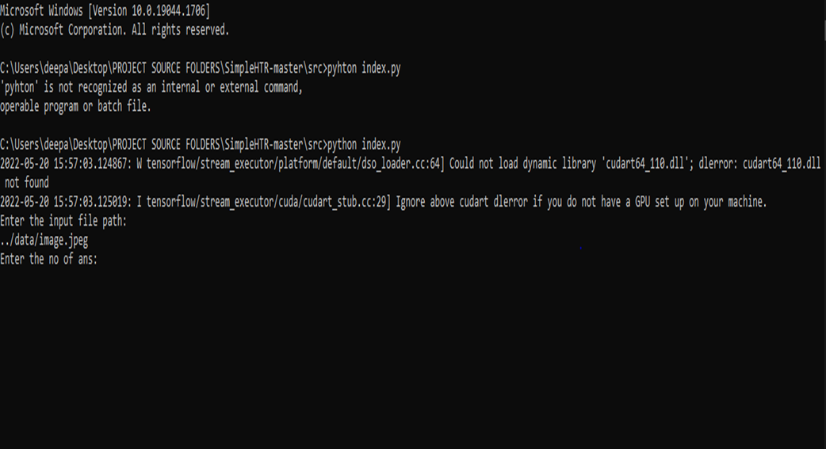
RECOGNITION MODULE
The staff tries to enter the number of answers according to the questions paper and the correct answers.

Slide 15
TEST CASE REPORT
S.NO | SCENARIO | INPUT | EXPECTED OUTPUT | ACTUAL OUTPUT | PASS/FAIL
1. | Enter the file path | User enters the document path | The correct path destination | Correct file path | PASS
2. | According to the question paper the staff enters the number of answers | Enters the number of questions | Correct number of answers | Type the number of answers | PASS
3. | Entering the correct answers relevant to the question | Enter the answers | Specifying the answers to be correct or not | System checks to the answers and | PASS

Slide 16
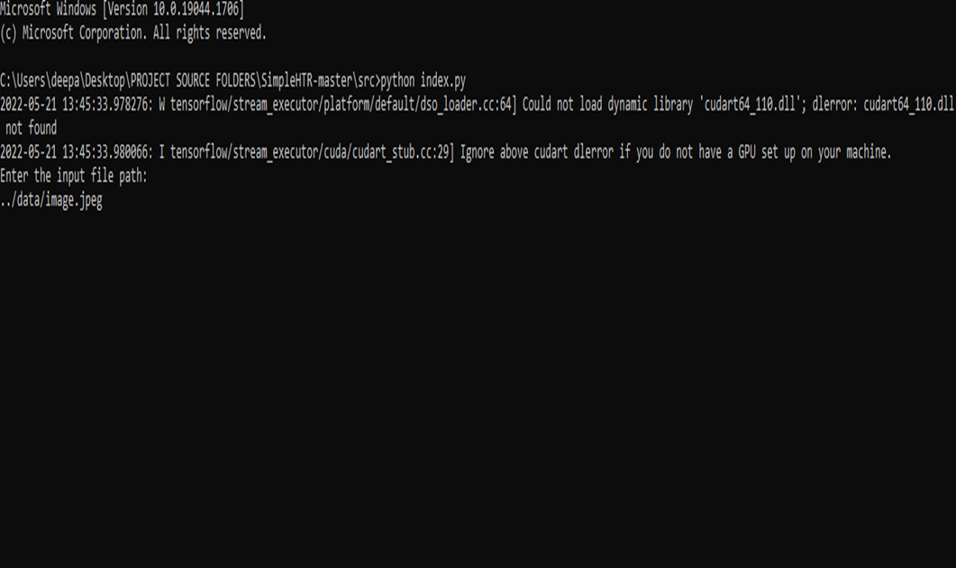
SCREENSHOTS

Slide 17
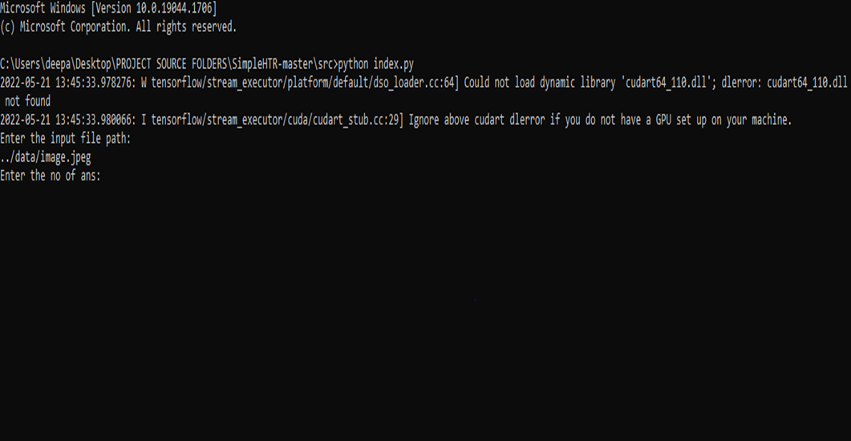

Slide 18
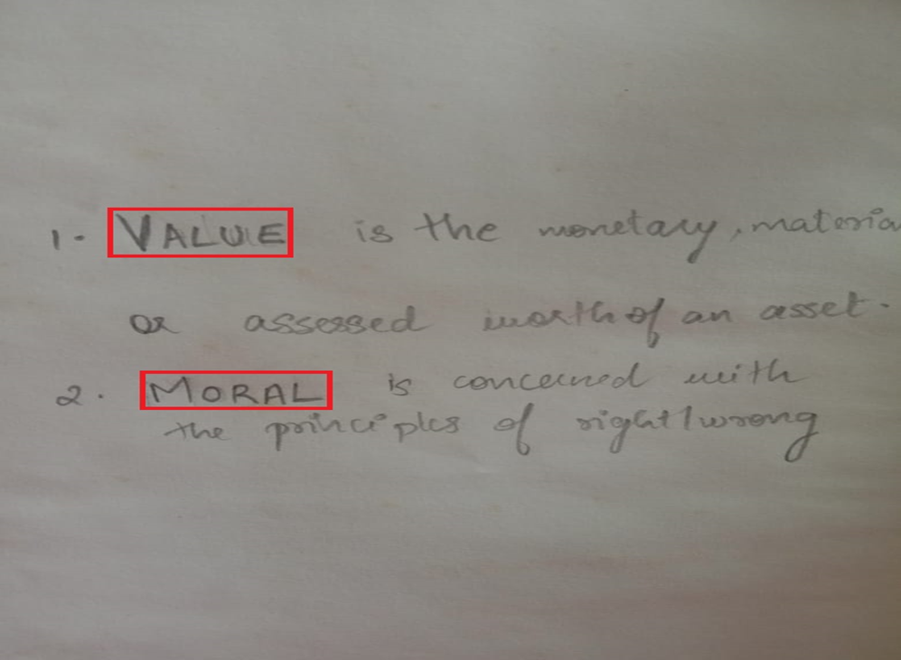

Slide 19
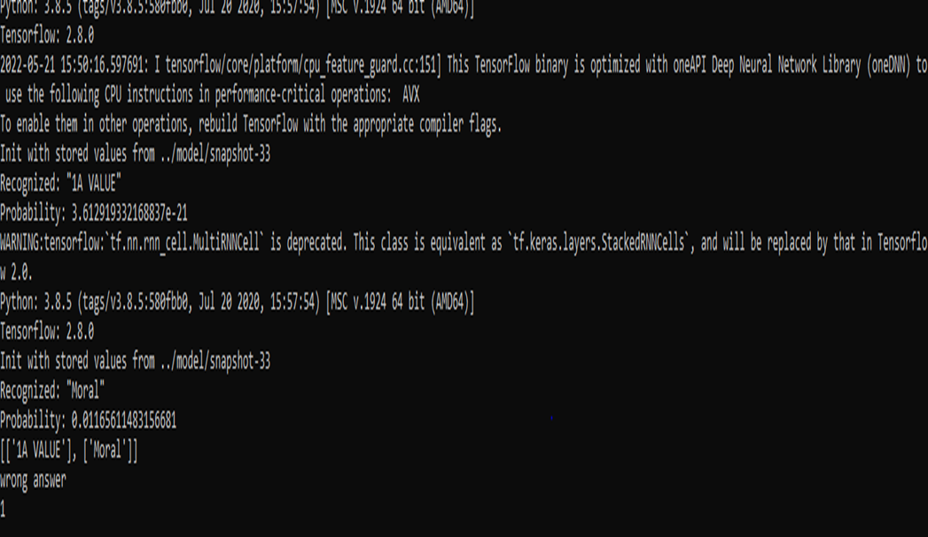

Slide 20
CONCLUSION
We discussed a NN which is in a position to acknowledge text in images. The NN consists of 5 CNN and a couple of RNN layers and outputs a character-probability matrix. This matrix is either used for CTC loss calculation or for CTC decoding. An implementation using TF is provided and a few important parts of the code were presented. Finally, hints to enhance the popularity accuracy got.

Slide 21
REFERENCES
[1]Shilpa Mangesh Pande, Bineet Kumar Jha,Character Recognition System for Devanagari Script Using Machine Learning Approach, Conference on Information and Communication Technology (CICT’18), 2021
[2]Naragudem Sarika, Nageswararao Sirisala, Muni Sekhar Velpuru ,CNN based Optical Character Recognition and Applications, Proceedings of the Sixth International Conference on Inventive Computation Technologies, 2021
[3]Ayan Kumar Bhunia, Shuvozit Ghose, Amandeep Kumar, Pinaki Nath Chowdhury, Aneeshan Sain, Yi-Zhe,Proceedings of the IEEE/CVF Conference on Computer Vision and Pattern Recognition (CVPR), 2021
[5]Daniyar Nurseitov, Kairat Bostanbekov, Maksat Kanatov, Anel Alimova, Abdelrahman Abdallah, Galymzhan Abdimanap, Classification of Handwritten Names of Cities and Handwritten Text Recognition using Various Deep Learning Models, Advances in Science, Technology and Engineering Systems. 5, 934-943 ,2021

