Slide 1
CSE6339 Tutorial Stanford Named Entity Recognizer (NER)
Prepared By
Deepa Warrier
1001097181

Slide 2

Named Entity Recognition
Subtask of information extraction that seeks to locate and classify elements in text into pre-defined categories
NER Systems has been structured as taking an unannotated block of text

Slide 3

Stanford NER
JAVA implementation of a Named Entity Recognizer
It labels sequences of words in a text.
It is also known as CRF Classifier.

Slide 4

Models
3 Class – Location, Person, Organization
4 Class – Location, Person, Organization, Misc
7 Class – Time, Location, Organization, Person, Money, Percent, Date.

Slide 5

Installation
Download Stanford NER from http://nlp.stanford.edu/software/CRF-NER.shtml
Run ner.bat to assign class path for the stanford NER to execute properly.
Run ner-gui.bat to use the tool as a GUI.

Slide 6
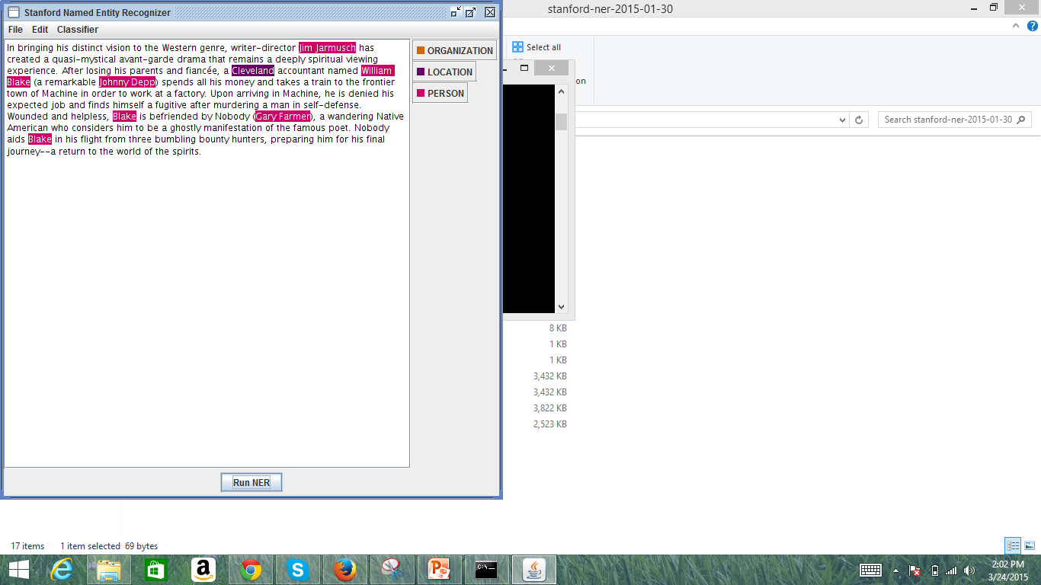
Demo
english.all.3class.distsim.crf.ser

Slide 7
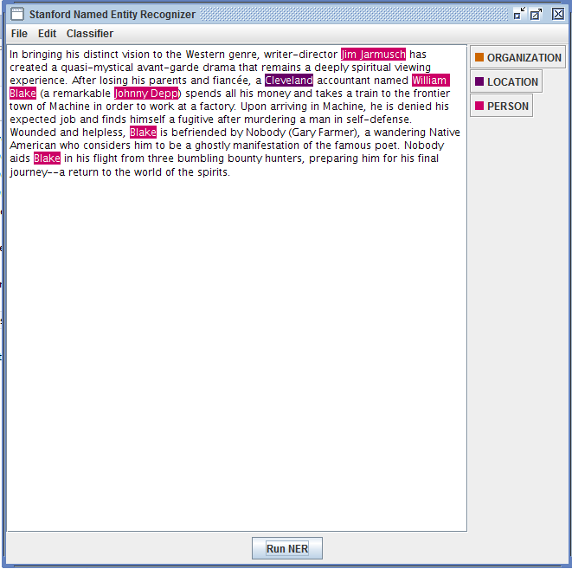
english.nowiki.3class.distsim.crf.ser

Slide 8
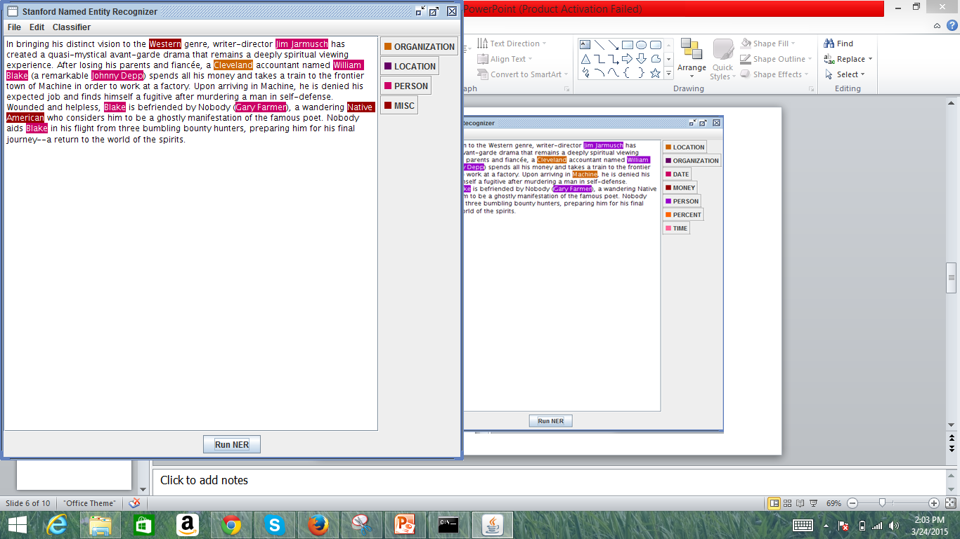
english.conll.4class.distsim.crf.ser

Slide 9
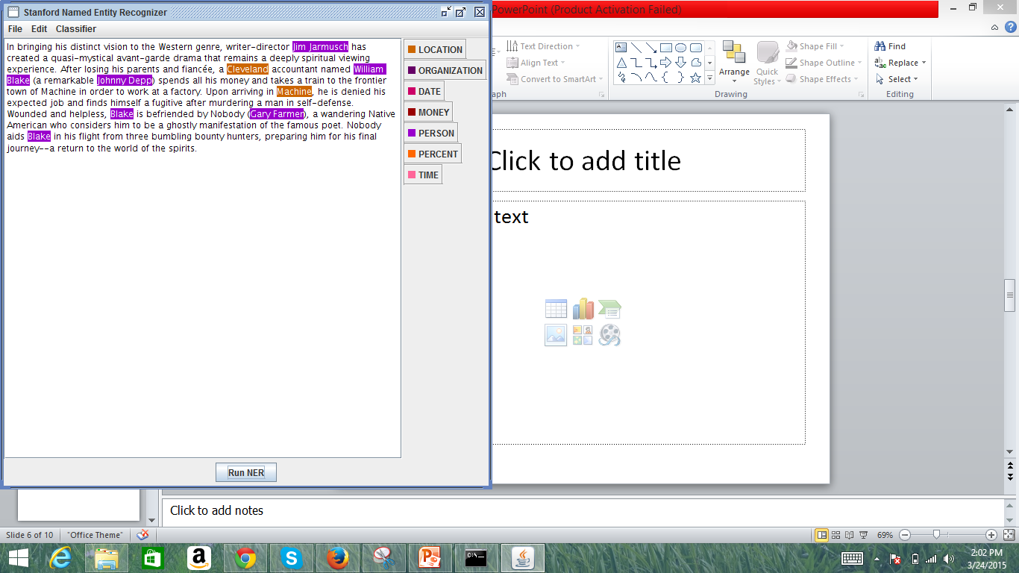
english.all.7class.distsim.crf.ser

Slide 10
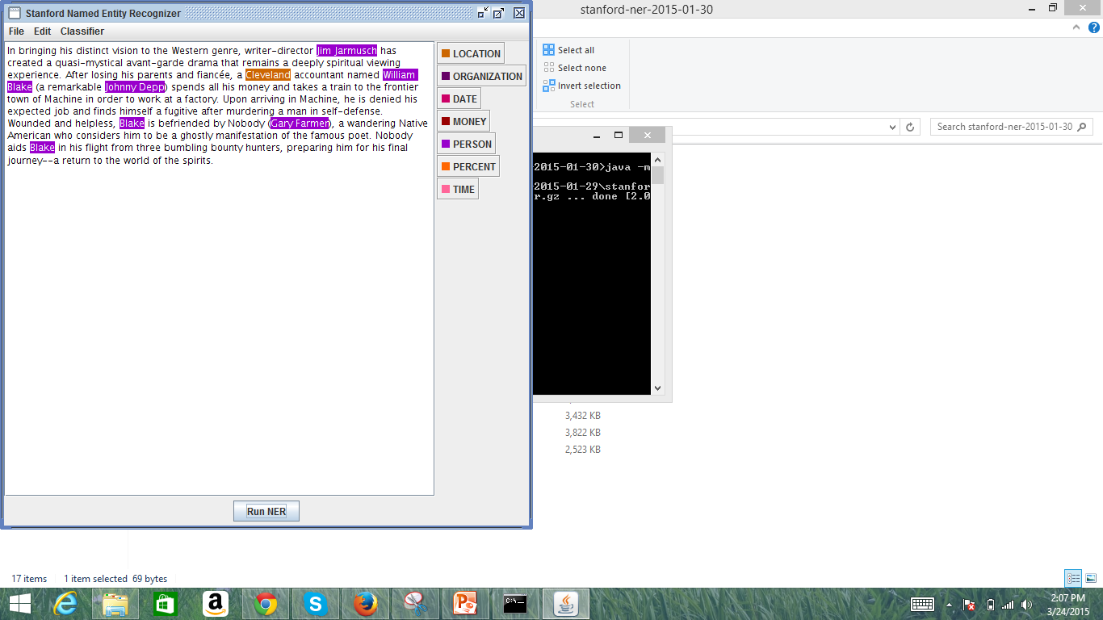
english.muc.7class.distsim.crf.ser

Slide 11

Additional Models
Distsim Features : Models which do not use distributional similarity features
Ignore Capitalization : caseless models
German NER
Spanish CoreNLP models
Chinese NER

Slide 12

Programmatic Use
Import stanford-ner-3.5.1.jar in the program.
Import the desired classifier in the program.

Slide 13
Illinois NET and Wikifier
NET
It tags plain text with named entities.
It uses "classic" 4-label type set (people / organizations / locations / miscellaneous) and with a larger 18-label type set (based on the OntoNotes corpus).
It uses gazetteers extracted from Wikipedia
Wikifier
It identifies the entities with Wikipedia Articles.

Slide 14

References
http://nlp.stanford.edu/software/CRF-NER.shtml
http://en.wikipedia.org/wiki/NER

Slide 15

Q & A

Slide 16


