Slide 1
Credit One
Credit Scoring Analysis

Slide 2
Business Problem
Increase in customer default rates - This is bad for Credit One since they approve the customers for loans in the first place.
If clients lose Revenue and customers it is eventually a loss of clients for Credit One

Slide 3
BADIR Methodology
Business Questions
Analysis Plan
Data Collection
InSights
Recommendations

Slide 4
Business Questions
What is the current method to identify if a loan should be approved
What is the current method to identify the maximum loan amount /pay periods
Is there a list of customers in good vs bad standing outside of the data given
Are there certain loan types that require better credit scores than average
Time Horizon of observations to determine a ‘good’ or a ‘bad; customer

Slide 5
Analysis Plan
Cleaning Up the data for any unknowns or blank data features
Understanding the relationships between the various data features
Identifying the most reliable feature for optimum results
Determining the best predictive models for recommendations

Slide 6
Data Collection
Data provided by Credit One
30302 rows with 25 features
The main features provided are
  Education -14107 University graduates/10672 in Graduate School
  Balance Limit
  Gender – 18217 females/11984 males
  Age – 21 through 79 years
  Marital Status – 13733 married records /16088 unmarried
  Loan Amount and Payment Amount for the past 6 months.
  Current Payment Status (default or not default)

Slide 7
Insights
The data that we have span for 6 months
Are there any linear relationships between the data features?
Are there one or more features that are more reliable than the others?
Based on the data collection and the Analysis plan, more Insights will be added here

Slide 8
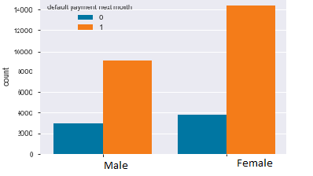
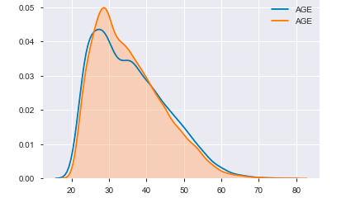
Dependency on Demographic data
GENDER Factor
Based on the analysis, the female population tends
to default less than the male population.
AGE Factor
The population less than the age group of 30 tends to default more based on the data.

Slide 9
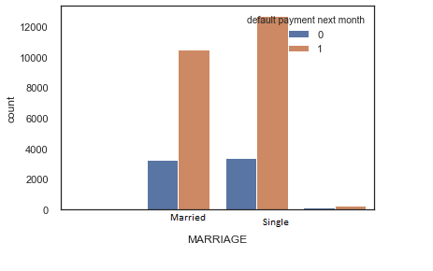
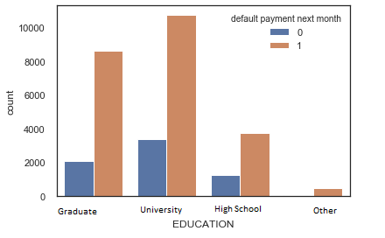
Dependency on Demographic data
MARRIAGE Factor
Married population defaults more than others
EDUCATION Factor
Graduated population seems to default less than the others

Slide 10
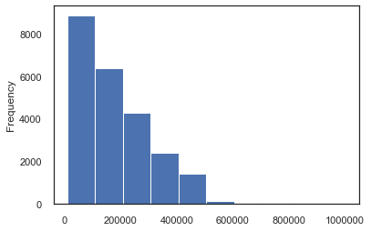
Dependency on Demographic data
LIMIT BALANCE Factor
Anyone with a limit balance
less than 100K tends to default more.

Slide 11
Data Driven Insights
Based on our findings , customers with a
Limit balance less than 100K defaults more
Married Male customers with No graduate degrees tend to default more
Education followed by Age seems to be major determinants in determining the chances of default.
Based on these, we recommend Credit One do more review of male customers with lower limit balances
and Education less than a graduate degree before authorizing a loan.

Slide 12
Recommendations
This is where we will address the issue and have the action plan

