Slide 1

CMR TECHNICAL CAMPUS
mini project on
GEO TRACKING OF WASTE AND Triggering alerts
and
mapping areas with high waste index
under the guidance of : PRESENTED BY:
mr . SVSV PRASAD SANABOINA S.SAI DEEPA REDDY (207R1A0555)
(ASSISTANT PROFESSOR) S.KUSHAL DEEP (207R1A0553)
P.HRUDAY Reddy (207r1a0518)

Slide 2
Contents:
Abstract
Existing System
Disadvantages Of Existing System
Proposed System
Advantages Of Proposed System
System Configuration
Novelty of project
Architecture
Modules
UML Diagrams
Sample Code
Results
Conclusion
Future Scope
Reference
Github Link

Slide 3
Abstract:
Geo-tracking of waste Triggering Alerts and Mapping Areas With High Waste Index is an approach to improve the efficiency of the garbage collection process. The main purpose of this is to use automated machine learning to solve a practical problem of a real-life Smart Waste Management system
In this, we focus on the problem of Prediction of an emptying of a recycling container using sensor measurements. Numerous methods for solving the problem were investigated including the existing manually engineered model.
The use of machine learning algorithms on a set of features based on the filling level at different given periods allowed for improving the classification accuracy of the existing manually engineered model.
Using the above system offers a good solution to waste management and also saves the environment from pollution and various diseases such as cancer, etc.

Slide 4
Existing System:
In, we are developing a smart bin that will improve the waste management system by placing an Ultrasonic sensor on the top of the bin. Interfaced with a microcontroller and a central system displaying the current status of the Dustbin.
When the Dustbin Level crosses the threshold level GSM Modem sends the alerts to the Authority.
Therefore, The HTML page is used to Update the Status of the bin Manually.
However, this system can only recognize the top of the garbage level and cannot recognize the remaining space in the trash can.

Slide 5
Disadvantages Of Existing System:
The problem is accurate detection of a container being emptied
Low Maintenance
Less Accuracy
Low Efficiency
High Cost

Slide 6
Proposed System:
The objective of this system is to ensure proper waste management and provide a detailed analysis of the waste generated in a community.
In, We collect data from the sensor and build a model that is designed to predict the future values of the "FillPercentage" of waste bins based on historical data.
We are building a Machine Learning architecture that makes predictions based on historical waste fill percentage data.
By using the above predictions we can identify the high waste production area and perform the necessary actions to control it.

Slide 7
Advantages Of Proposed System:
Improves the Efficiency of waste management system
Reduce overflow of Dust Bins
High Accuracy
High Maintenance
Reduce Pollution
Low Cost

Slide 8
System Configuration:
HARDWARE REQUIREMENTS:
System : i3 (or) above
RAM : 4GB RAM.
Hard disk : 40GB
SOFTWARE REQUIREMENTS:
Operating system : Windows 10
Coding Language : python

Slide 9
Novelty of project:
This project mainly aims to implement a sustainable model for managing waste.
This provides real-time tracking and future prediction of waste generation.
By efficiently tracking waste we can reduce Pollution further reducing the disease-causing bacteria.
The data collected by this module is used to map the areas with high waste index allowing the staff to take necessary actions.

Slide 10
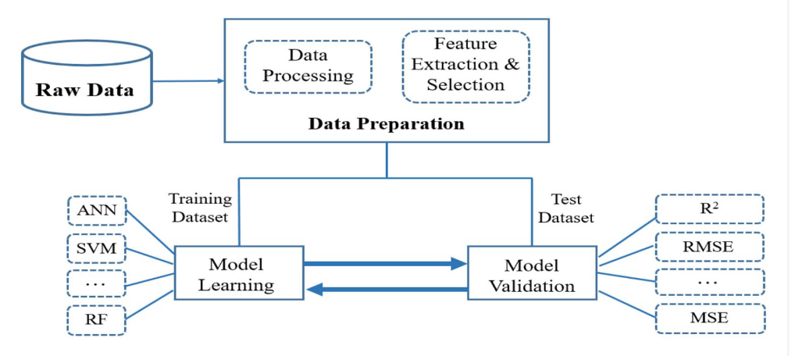
Architecture:

Slide 11
Modules:
Data Collection: Gather data related to waste locations, such as GPS coordinates, waste quantity, and other relevant attributes
Data Preprocessing: Ensure the data is in a suitable format for analysis.
Training and Test Data: Split the preprocessed data into training and test datasets
Waste Index Calculation: Calculate a waste index for each data point, indicating the waste accumulation level in that specific location.
Model Training: Train a model using the training dataset and the corresponding waste index values.
Predictions and Mapping: Apply the trained model to make predictions on new, unseen data points.

Slide 12
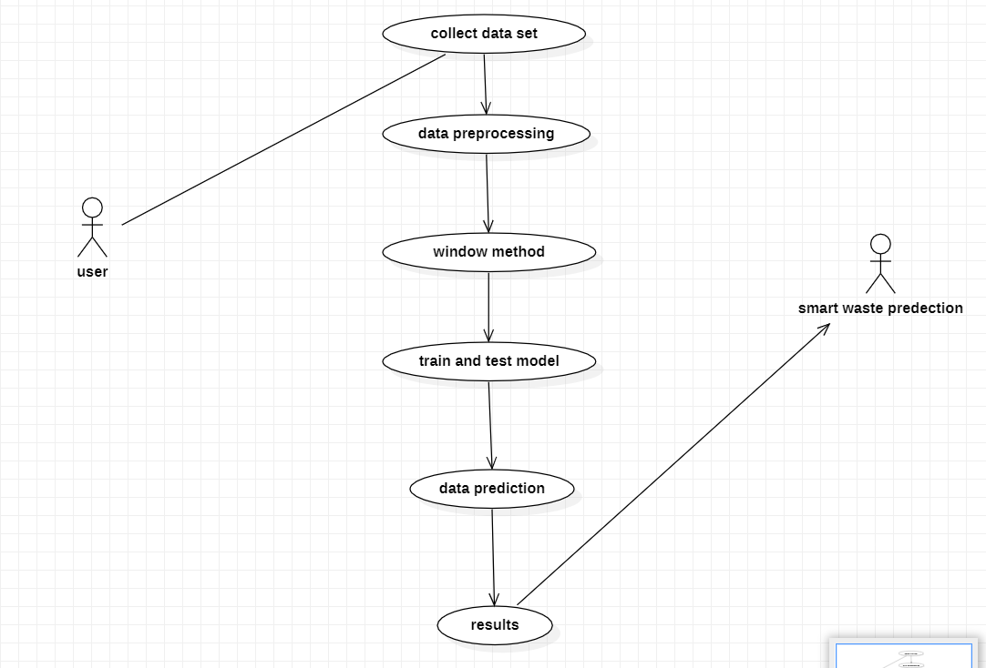
Use Case Diagram:

Slide 13
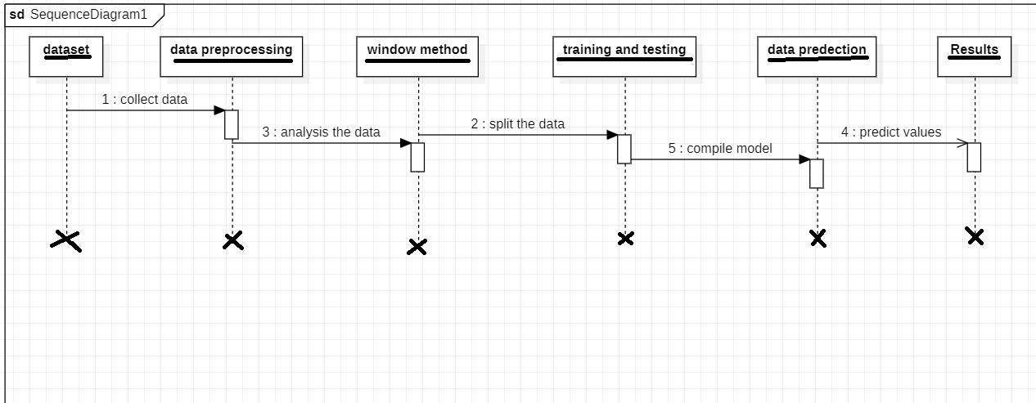
Sequence Diagram:

Slide 14
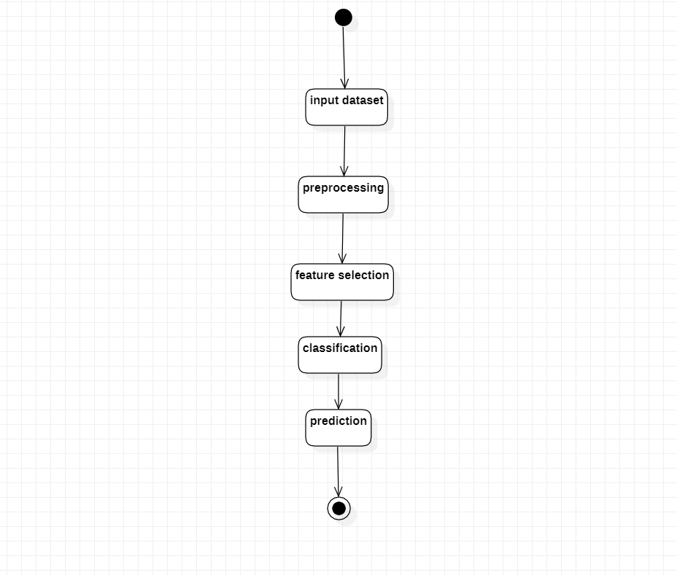
Activity Diagram:

Slide 15
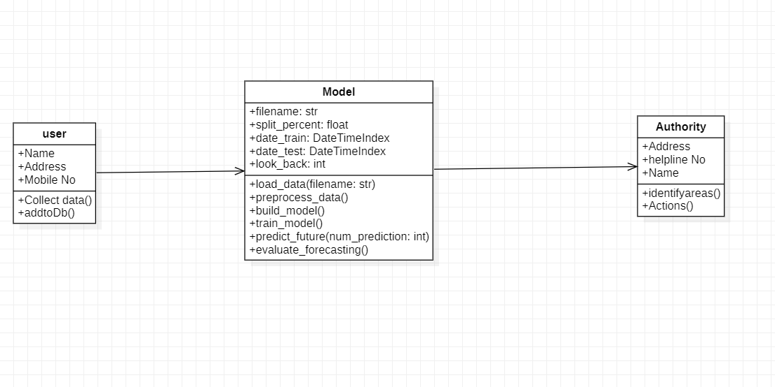
Class Diagram:

Slide 16
Sample Code:
#importing Libraries that are required
import pandas as pd
import numpy as np
import keras
import tensorflow as tf
import matplotlib.pyplot as plt
from keras.preprocessing.sequence import TimeseriesGenerator
filename = r'D:\PROJECT\CODE smartwastage\bin.csv' #load CSV file
df = pd.read_csv(filename)
print(df.info())
df['eventDate'] = pd.to_datetime(df['eventDate']) #convert to datetime(time series'd)
df.set_index(df['eventDate'], inplace=True) #making date as index
df.drop(columns=['id', 'type', 'Battery', 'updateState', 'Distance'], inplace=True) #drop columns not required for our modeling
df

Slide 17
Sample Code:
#Plot FillPercentage Values
plt.figure(figsize=(16,8))
df['FillPercentage'].plot()
plt.xlabel('Date')
plt.ylabel('Fill Percentage')
plt.show()
fill_data = df['FillPercentage'].values
fill_data = fill_data.reshape((-1,1))
split_percent = 0.80 #split data as 80% training set and 20% test set
split = int(split_percent*len(fill_data))
fill_train = fill_data[:split]
fill_test = fill_data[split:]
date_train = df['eventDate'][:split]
date_test = df['eventDate'][split:]
print(len(fill_train))
print(len(fill_test))

Slide 18
Sample Code:
#converting the data from sequence to supervised data to train Model
look_back = 15
train_generator = TimeseriesGenerator(fill_train, fill_train, length=look_back, batch_size=20)
test_generator = TimeseriesGenerator(fill_test, fill_test, length=look_back, batch_size=1)
from keras.layers import Dense,RepeatVector
from keras.layers import Flatten
from keras.layers import TimeDistributed
from tensorflow.keras.layers import Conv1D
from keras.layers import Conv1D
from keras.layers import MaxPooling1D
from keras.layers import Dense
from keras.layers import Dropout
from keras.layers import LSTM
from keras.models import Sequential
model = Sequential()

Slide 19
Sample Code:
model.add(Conv1D(filters=128, kernel_size=2, activation='relu', input_shape=(look_back,1)))
model.add((MaxPooling1D(pool_size=2)))
model.add(TimeDistributed(Flatten()))
model.add(LSTM(50, activation='relu'))
model.add(Dense(1))
model.compile(loss='mse', optimizer='adam') #model compilation
model.summary() #model summary
num_epochs = 500
model.fit_generator(train_generator, epochs=num_epochs, verbose=1)
import plotly.graph_objects as go #library for visualization
prediction = model.predict_generator(test_generator) #forecast/predict for test data
fill_train = fill_train.reshape((-1))
fill_test = fill_test.reshape((-1))
prediction = prediction.reshape((-1))

Slide 20
Sample Code:
#Visualize Actual vs Predicted /Forecasted values
trace1 = go.Scatter(
x = date_train,
y = fill_train,
mode = 'lines',
name = 'Fill Percentage'
)
trace2 = go.Scatter(
x = date_test,
y = prediction,
mode = 'lines',
name = 'Forecasts’)
trace3 = go.Scatter(
x = date_test,
y = fill_test,
mode='lines',
name = 'Ground Truth’)

Slide 21
Sample Code:
layout = go.Layout(
title = "Waste Fill Levels",
xaxis = {'title' : "Date"},
yaxis = {'title' : "Fill Percentage"}
)
fig = go.Figure(data=[trace1, trace2, trace3], layout=layout)
fig.show()
Plt.close()
fill_data = fill_data.reshape((-1))
# Function to predict FillPercentage values for future dates
def predict(num_prediction, model):
prediction_list = fill_data[-look_back:]
for _ in range(num_prediction):
x = prediction_list[-look_back:]
x = x.reshape((1, look_back, 1))
out = model.predict(x)[0][0]
prediction_list = np.append(prediction_list, out)

Slide 22
Sample Code:
prediction_list = prediction_list[look_back-1:]
return prediction_list
# Function to generate future dates
def predict_dates(num_prediction):
last_date = df['eventDate'].values[-1]
prediction_dates = pd.date_range(last_date, periods=num_prediction+1).tolist()
return prediction_dates
num_prediction = 30 #Forecast Future values for next 30 days i.e next one month.
forecast = predict(num_prediction, model)
forecast_dates = predict_dates(num_prediction)
future_forecast = np.append(prediction,forecast)
# Plot values of future forecasted values
trace1 = go.Scatter(
x = date_test,
y = prediction,
mode = 'lines',
name = 'Test Forecast’)

Slide 23
Sample Code:
trace2 = go.Scatter(
x = forecast_dates,
y = forecast,
mode='lines',
name = 'Future Forecast')
layout = go.Layout(
title = "Waste Fill Levels",
xaxis = {'title' : "eventDate"},
yaxis = {'title' : "Fill Percentage"})
fig = go.Figure(data=[trace1, trace2], layout=layout)
fig.show()
plt.close()
# Plot for Actual vs Forecasted Value
plt.figure(figsize = (15,10))
plt.plot(fill_test)
plt.plot(prediction)

Slide 24
Sample Code:
plt.title('Actual vs Prediction plot')
plt.ylabel('waste fill levels')
plt.xlabel('eventDate')
plt.legend(['actual', 'prediction'], loc='upper left')
plt.show()
fig, ax = plt.subplots(1, 2,figsize=(11,4))
ax[0].set_title('predicted one')
ax[0].plot(prediction)
ax[1].set_title('real one')
ax[1].plot(fill_test)
plt.show()
# convert an array of values into a dataset matrix
def create_dataset(dataset, look_back=15):
dataX, dataY = [], []
for i in range(len(dataset)-look_back):

Slide 25
Sample Code:
a = dataset[i:(i+look_back)]
dataX.append(a)
dataY.append(dataset[i + look_back])
return np.array(dataX), np.array(dataY)
testD = create_dataset(fill_test, 15)
# Evaluation metrics
def forecast_accuracy(forecast, actual):
mape = np.mean(np.abs(forecast - actual)/np.abs(actual)) # MAPE
me = np.mean(forecast - actual) # ME
mae = np.mean(np.abs(forecast - actual)) # MAE
mpe = np.mean((forecast - actual)/actual) # MPE
rmse = np.mean((forecast - actual)**2)**.5 # RMSE
corr = np.corrcoef(forecast, actual)[0,1] # corr
mins = np.amin(np.hstack([forecast[:,None],
actual[:,None]]), axis=1)
maxs = np.amax(np.hstack([forecast[:,None], actual[:,None]]), axis=1)

Slide 26
Sample Code:
return({'mape':mape, 'me':me, 'mae': mae,'mpe': mpe, 'rmse':rmse, 'corr':corr})
forecast_accuracy(testD[1], prediction)

Slide 27
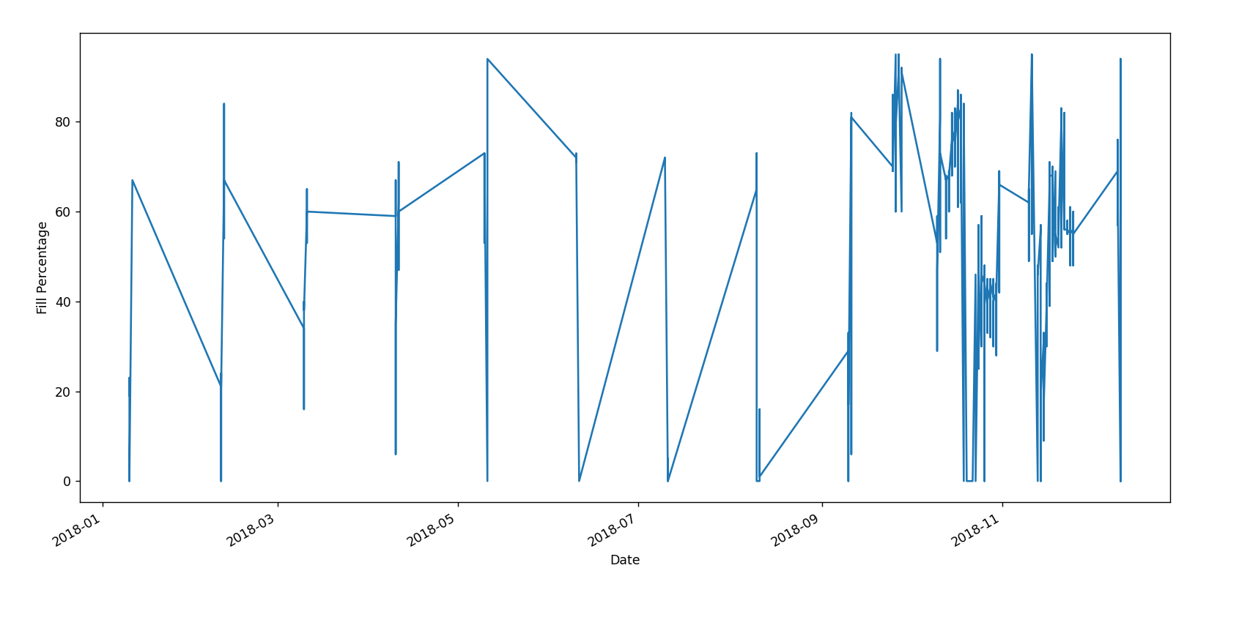
Results:

Slide 28
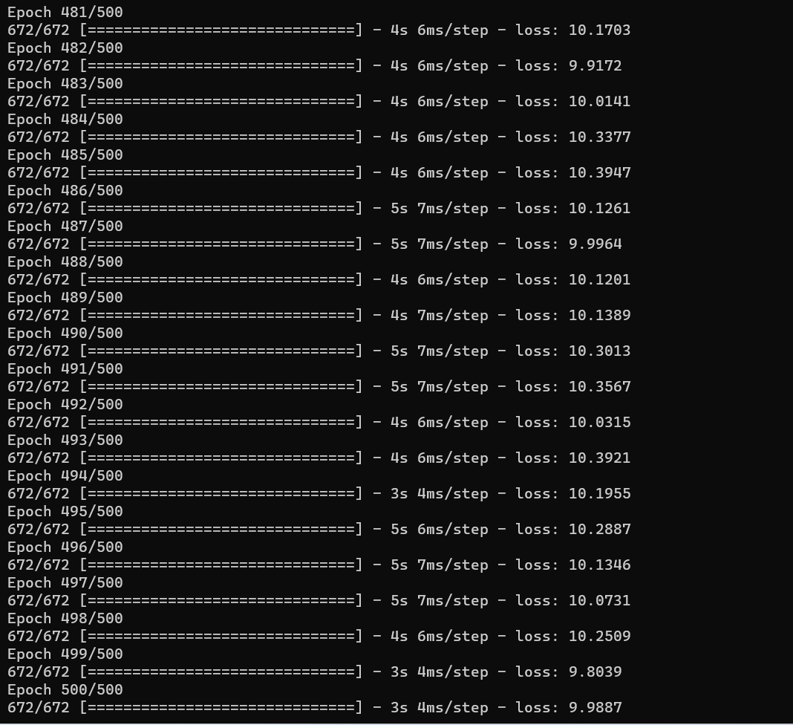
Results:

Slide 29
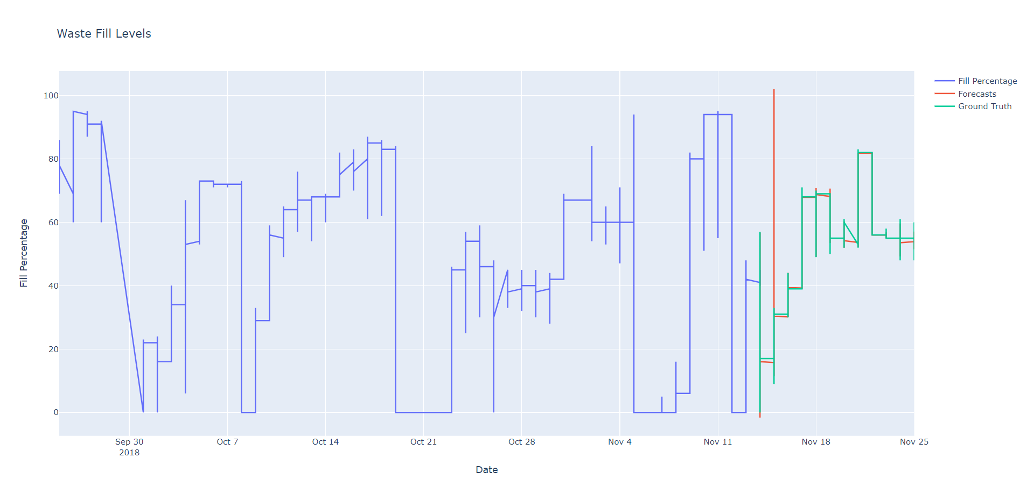
Results

Slide 30
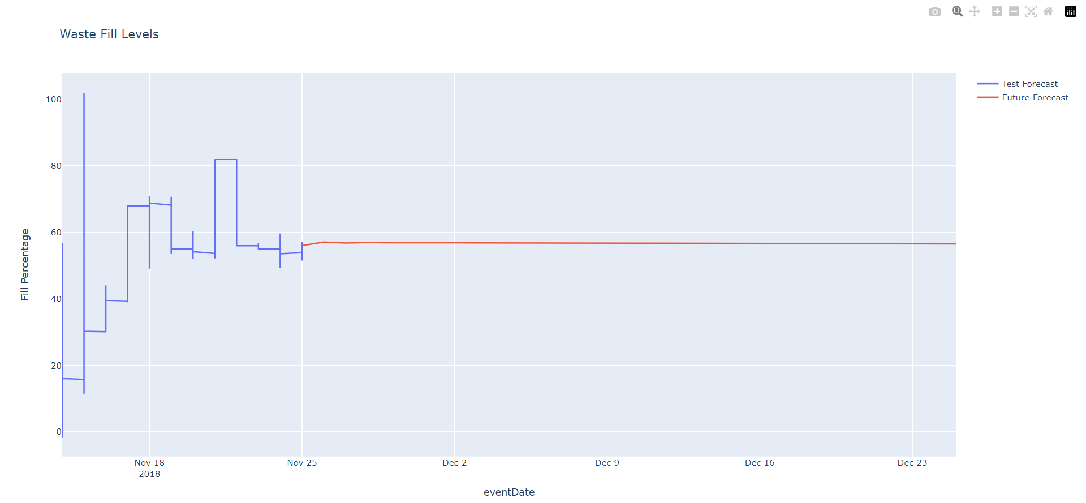
Results:

Slide 31
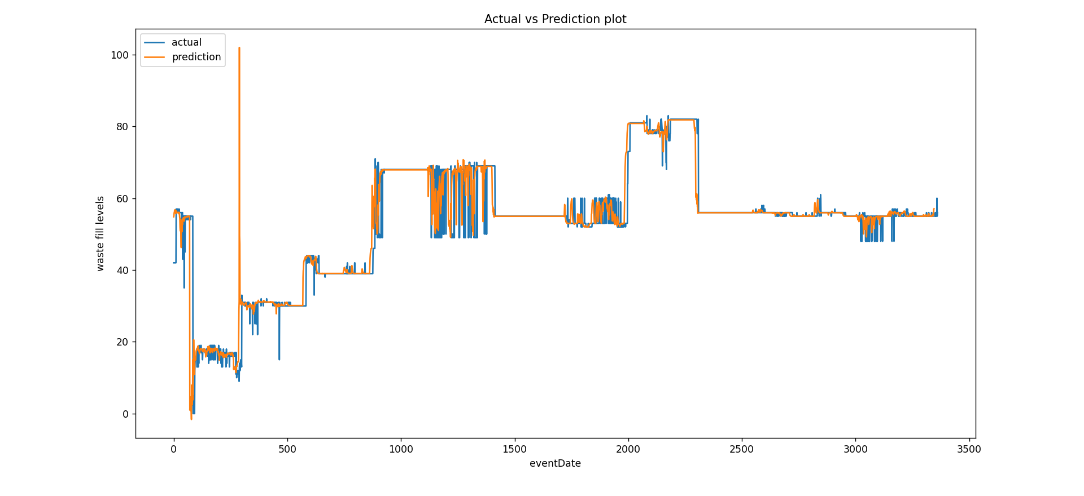
Results:

Slide 32
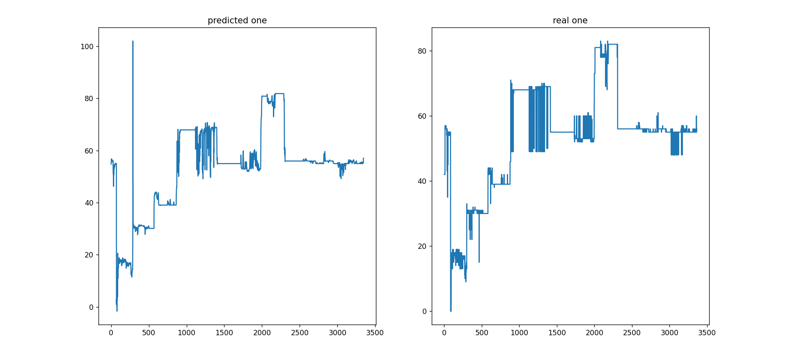
Results:

Slide 33
Conclusion:
Geo-tracking of waste can be an effective tool for managing and reducing waste in a community. By using data from a sensor positioned on top of the Bin, this system demonstrated how an automated machine-learning methodology may be used to predict the dustbin level.
A manual approach was provided in the research, where first an existing solution to the issue was evaluated, then this was optimized, and then machine learning algorithms were proposed to solve the problem.
The data collected by this model is used to map the areas with high waste index allowing the staff to take necessary actions.

Slide 34
Future Scope:
A Smart Waste Management System offers numerous advantages and plays a critical role in addressing contemporary challenges related to waste and environmental sustainability.
Efficient Waste Collection.
Reduction in Overflowing Bins
Enhanced Public Health and Hygiene
Application of Smart City and Home

Slide 35
References:
Krishna Nirde, Prashant Mulay, Chaskar, “IOT based solid waste management system for Smart City”, 2017 International Conference on Intelligent Computing and Control System(ICICCS).
Mahajan, Prof.J.S. Chitode, “Waste Bin MonitoringSystem using Integrated Technologies”,International Journalof Innovative Research in Science, Engineering andTechnology.
“Sensoneo - Smart Waste Management solution,” [Online; accessed 27-May-2018]. [Online]. Available: https://sensoneo.com
“Bigbelly - Smart City Solutions,” http://bigbelly.com/, [Online; accessed 27-May-2018]. [Online]. Available: http://bigbelly.com/
V.N. Bhat, “A model for the optimal allocation of trucks for solid waste management, “Waste Management and Research, Vol. 14, (1), pp.87-96
R. Azim, M. T. Islam, H. Arshad, M. M. Alam, N. Sobahi, and A. I. Khan, ``CPW-fed super-wideband antenna with modified vertical bow-tie-shaped patch for wireless sensor networks,'' IEEE Access, vol. 9, pp. 53435353, 2021.

Slide 36
GitHub Link:
https://github.com/DeepaSrinivas/Project

Slide 37


