Slide 1

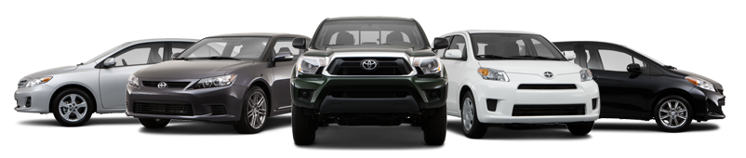
EDA on Car Sales
Term 1– Sept 2018
by Deepa V

Slide 2
Story
This is the sample car sales data set provided by INSAID.
I am doing EDA on this data to understand the car sales patterns, demand and to understand suitable car to buy considering design, engine type and brand.

Slide 3
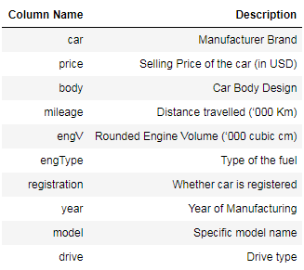
Data Set Details
The dataset comprises of 9576 observations of 10 columns. Below is a table showing names of all the columns and their description.

Slide 4
Problem Statement
To do Exploratory Data Analysis and get insights on the CarSales dataset provided by INSAID.
Data Processing, Identifying anomalies and rectification
Exploring Data to get insights
On sales patterns
Sales trend over years
Inter relation between variables
Recommendations

Slide 5
Data processing
Handling missing values :
Drive, 511 / 5.3% missing values - Missing values are replaced by ‘mode’ of drive
engV, 434 / 4.5% missing values - engV > 5.0 are grouped as ‘Other’
Handling Zeros :
Mileage, 348 / 3.6% zeros -Zero mileage is replaced by mean mileage of matching car, engType, drive categories
price has 267 / 2.8% zeros -Zero Price is replaced with the mean price of car, year, engType, drive
Handling High Cardinality :
car has a high cardinality: 87 distinct values
cars with sales < 200 are grouped as ‘other’
model has a high cardinality: 888 distinct values
Model is not considered in our analysis as it’s cardinality is too high
Duplicate rows Processing 113 rows
Duplicated rows are dropped from the dataset keeping the first entry
Note : ‘Registered’ column is not used in analysis as cars with registered = ‘no’ doesn’t make sense

Slide 6
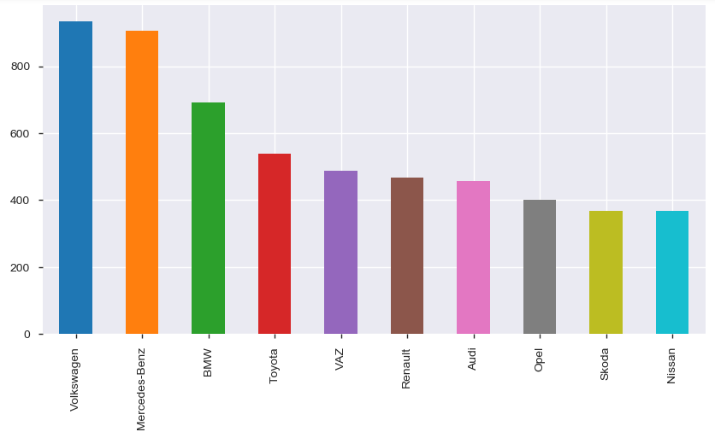
Car sales by Brand
Top 10 car brands by sales
Volkswagen and Mercedes-Benz are the top brands sold and close competitors

Slide 7
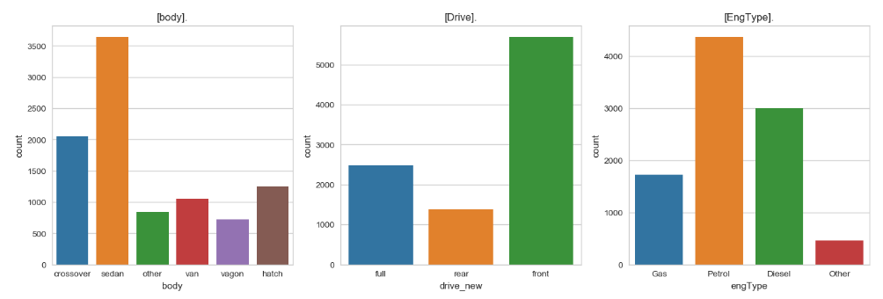
Car sales by body, Drive, Engine type
Sedan cars are sold more over all by car design.
Front drive cars are in high demand by drive type.
Petrol engine is the most sold engine type

Slide 8
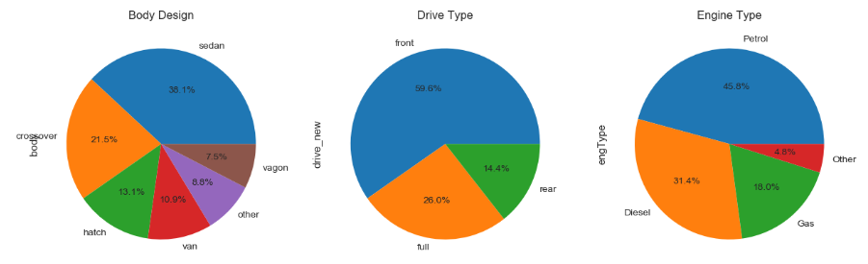
Percentage sales by Body\Drive\Engine Type
36.1 % of cars sold are Sedan
59.6 % of cars sold are ‘Front’ drive type
45.6 % of cars sold are of ‘Petrol’ engine type

Slide 9
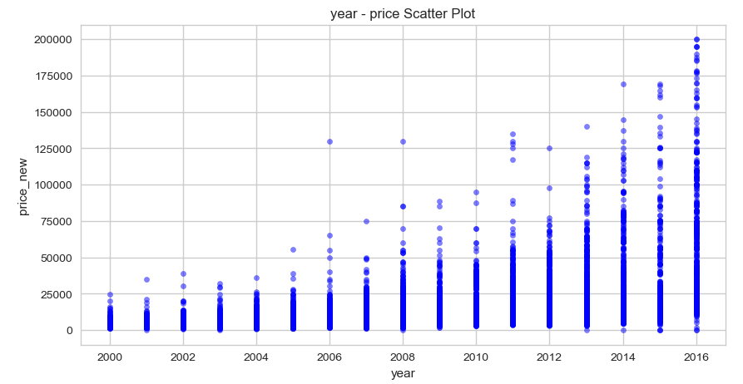
Price over years
Prices are growing linearly over years

Slide 10
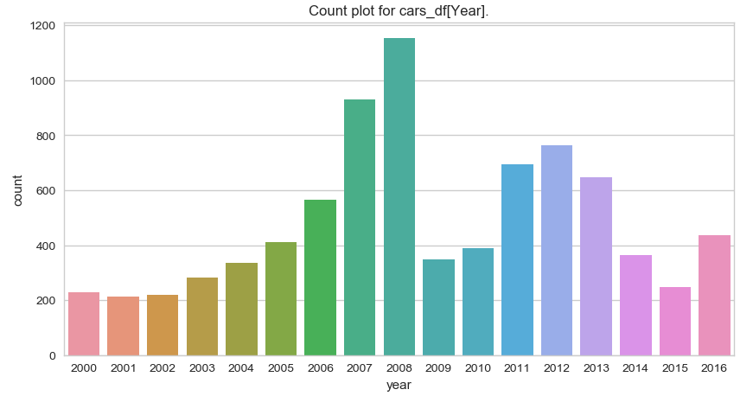
Sales trend
Maximum car sales is observed in the year 2008.

Slide 11
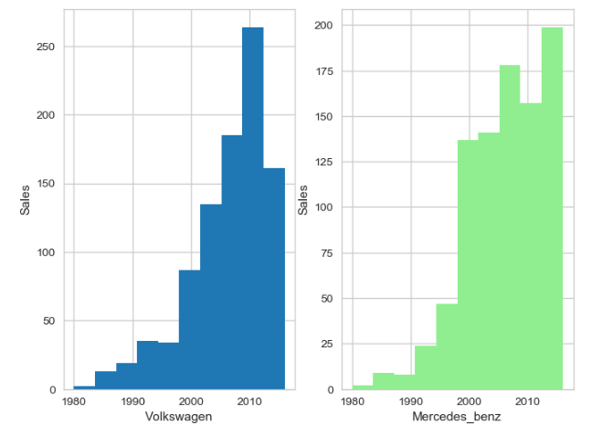
Sales pattern comparison between Top 2 Brands
Both brands saw 2 fold sales in the year 2000, compared to past years.
Volkswagon sales is coming down after year 2010.
Mercedes Benz sales is always growing.

Slide 12
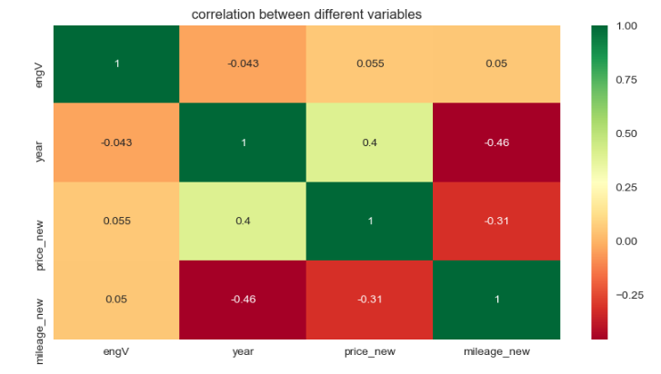
Correlation chart
Price and year are positively co-related

Slide 13
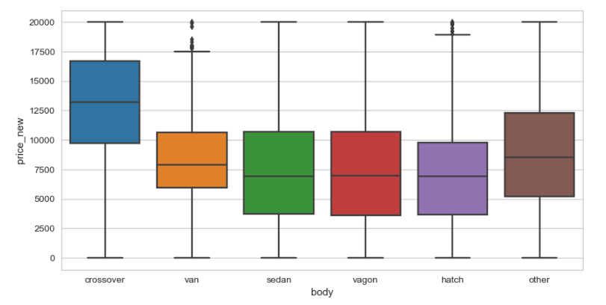
Price range – Body design
Crossover design cars are most expensive.
Sedan and vagon prices are almost similar
Median of sedan, vagon and hatch is almost same

Slide 14
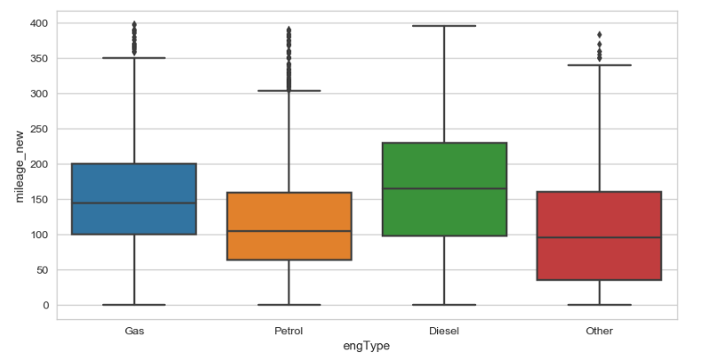
Mileage range - EngType
Diesel cars are driven more and has highest median.

Slide 15

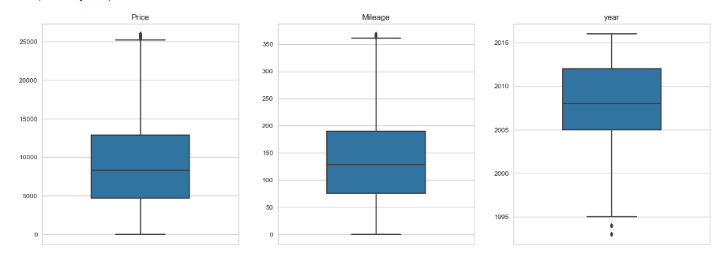
Price\Mileage\Sold year ranges
IQR
Price - 5000 to 13000
Mileage – 75 to 190
Year – 2005 to 2012

Slide 16
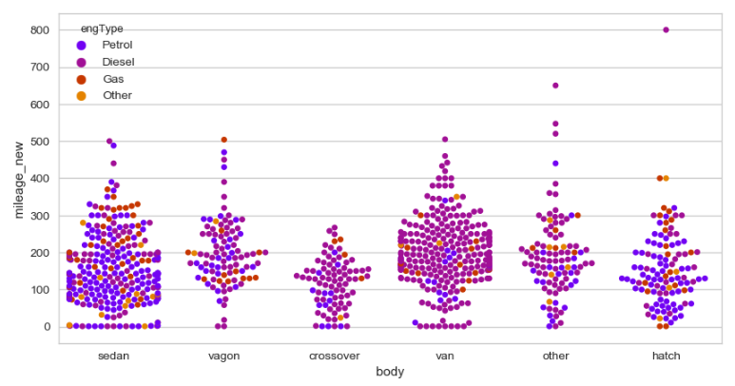
Volkswagen – mileage\design\engtype Distribution
Sales are more in Sedan and Van designs
Sedan has mostly petrol engine type
Vans are mostly of diesel variant

Slide 17
Conclusion
This EDA helped to understand the various sales patterns.
Sedan, Front drive and Petrol engine type are the most in-demand cars.
Year 2008 marked the highest sales.
Car prices are growing exponentially over years.
Volkswagen and Mercedes-Benz are the top 2 car brands sold.
'Cross-over' design is the most expensive car by design.
'Diesel' engines give highest mileage.
Volkswagen has highest sales in van with front drive and diesel engine type

