Slide 1
ECE 571
Introduction to System Verilog
Winter 2024
FINAL PROJECT
TEAM 14
Team Members
Sai Tulasi Prasad Dumpala
Deepak kumar Dupati
Krishna Priya Narra
Vineeth Rao Vala

Slide 2
CONTENTS
MEMORY MODULE BLACK BOX
FSM BLACK BOX
BLACK BOX FOR MODULE
4. STATE MACHINE REALISATION OF MEMORY
5. VERIFICATION PLAN

Slide 3
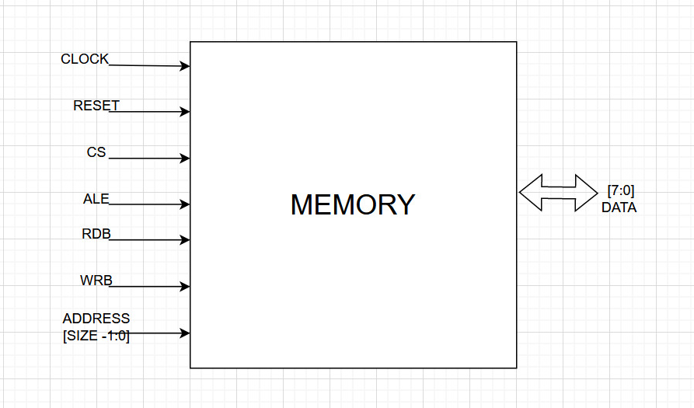
MEMORY MODULE BLACK BOX
Fig1:Memory module

Slide 4
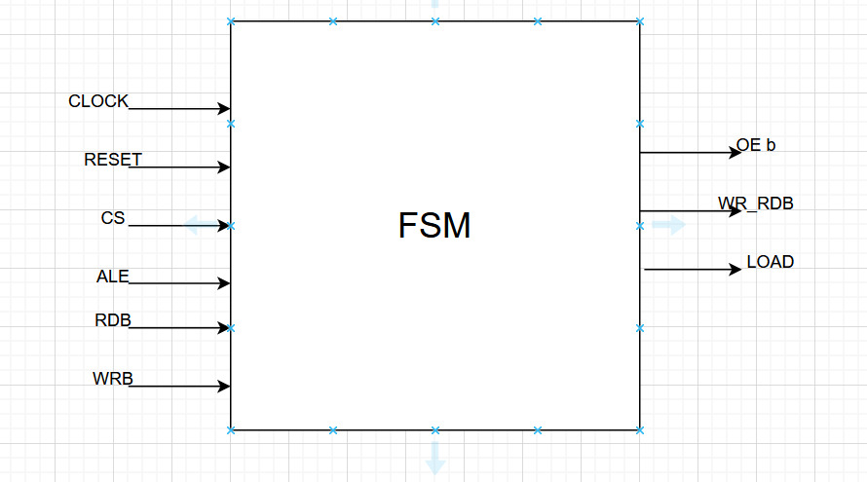
FSM BLACK BOX
Fig 2: FSM Module

Slide 5
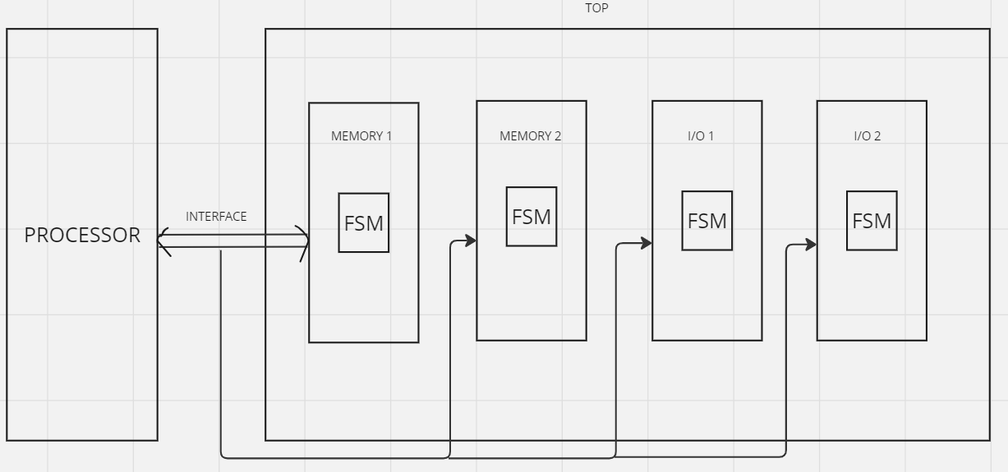
BLACK BOX FOR MODULE

Slide 6
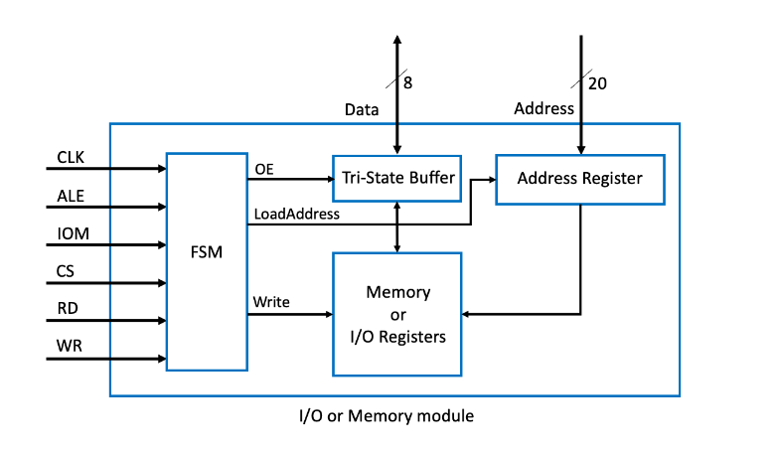

Slide 7
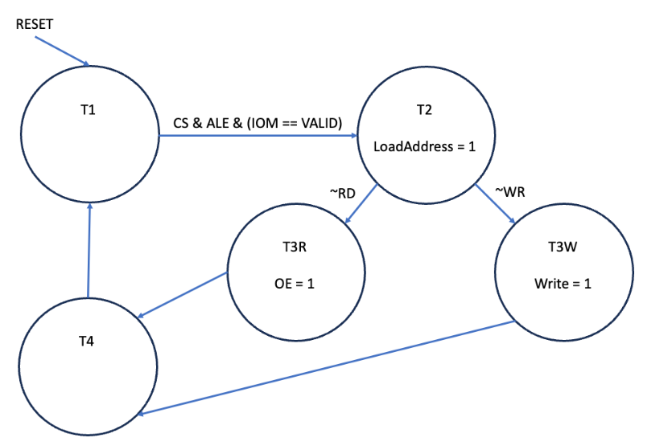
STATE MACHINE REALISATION OF MEMORY
Fig3: Memory FSM

Slide 8
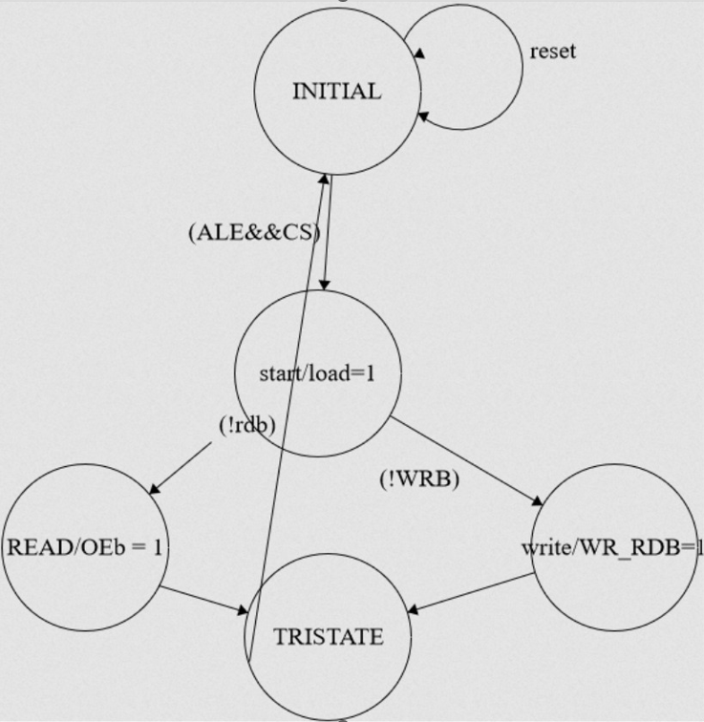

Slide 9
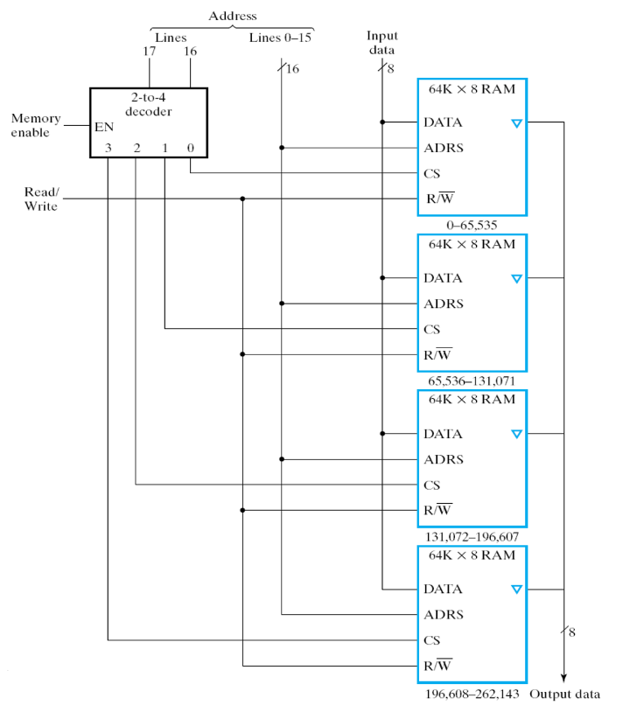

Slide 10
VERIFICATION PLAN
Verification of design with different possible scenarios.
2. Analyzing how our design works when we give corner cases of
read and write.
3. Observing behavior of all the memory modules and I/O devices instantiated.
CASE1: Observing functionality of design we give READ for memory and I/O devices.
CASE2: Observing functionality of design we give WRITE for memory and I/O devices.
CASE3: Asserting consecutive reads and writes in vice versa and observing how our design
responds.

Slide 11
THANK YOU

