Slide 1
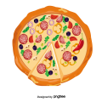
PIZZA SALES REPORT
SQL PROJECT
BY – Deepak Londhe

Slide 2

A pizza shop owner has given us the data of
daily sales and number of pizza orders from his shop
Task - we have to answer all the given questions asked by owner to derive the insights of his business

Slide 3
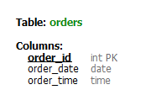
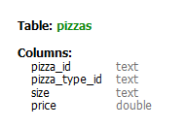
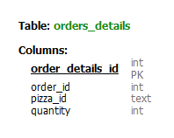
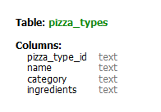

LETS UNDERSTAND HOW THE DATA LOOKS LIKE

Slide 4



1) THE TOTAL NUMBER OF ORDERS PLACED ?
QUERY
OUTPUT

Slide 5
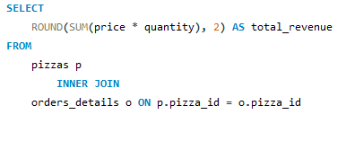

2) THE TOTAL REVENUE GENERATED FROM PIZZA SALES ?
QUERY
OUTPUT

Slide 6


3) IDENTIFY THE HIGHEST PRICED PIZZA ?
QUERY
OUTPUT

Slide 7
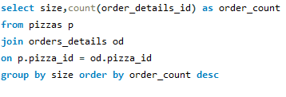
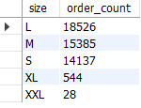
4) THE MOST COMMON PIZZA SIZE ORDERED
QUERY
OUTPUT

Slide 8
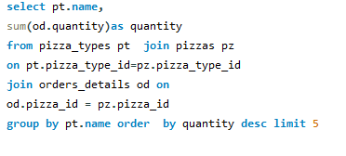
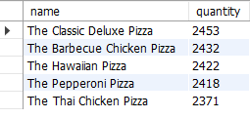
5) THE TOP 5 MOST ORDER PIZZA TYPES WITH QUANTITY ?
QUERY
OUTPUT

Slide 9
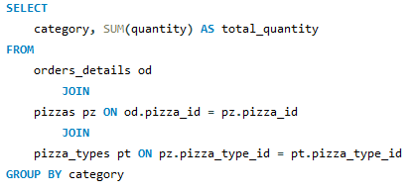

6) JOIN THE TABLE TO FIND TOTAL QUANTITY OF EACH PIZZA CATEGORY ORDERED ?
QUERY
OUTPUT

Slide 10
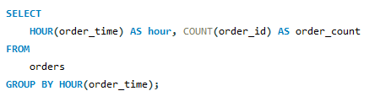
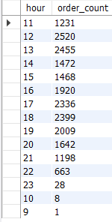
DETERMINE THE DISTRIBUTION OF ORDERS BY HOURS OF DAY ?
QUERY
OUTPUT

Slide 11
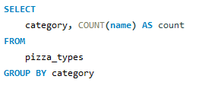
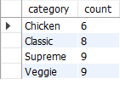
8)JOIN THE TABLE TO FIND THE CATEGORY DISTRIBUTION OF PIZZA ?
QUERY
OUTPUT

Slide 12
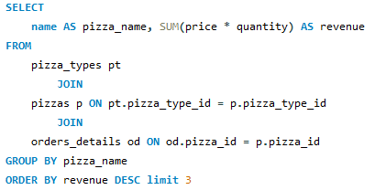

9) TOP 3 MOST ORDERED PIZZA TYPE BASED ON REVENUE ?
QUERY
OUTPUT

Slide 13
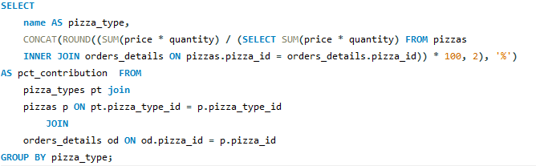
10) THE PERCENTAGE CONTRIBUTION OF EACH PIZZA TYPE TO REVENUE ?
QUERY

Slide 14
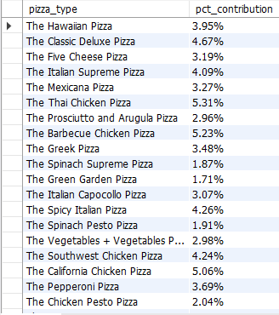
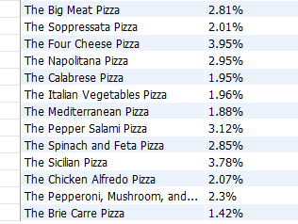
OUTPUT

Slide 15
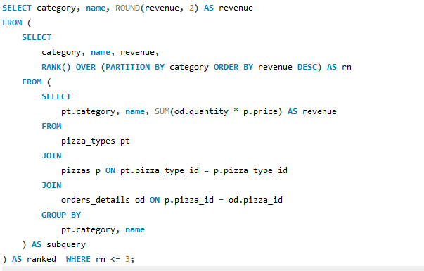
Determine the top 3 most order pizza type based on revenue for each pizza category?
QUERY

Slide 16
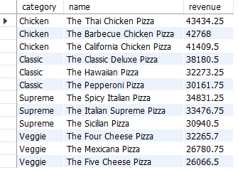
OUTPUT

